Slide 1
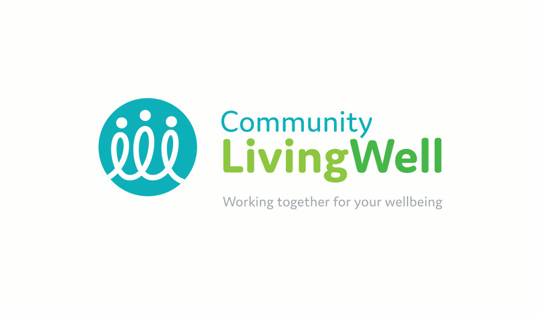


Michelle Poponne
Talking Therapies Community Development Manager

Slide 2




What is Community Living Well?
An integrated mental health and wellbeing service for people with mental health needs. It provides a wraparound service which has individuals at the centre of their care and offers support with social wellbeing, mental and physical health needs.

Slide 3
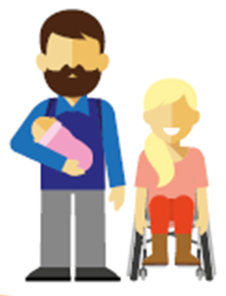
Talking Therapies formally IAPT
Talking Therapies team offers a range of different therapy options, all of which are effective treatments recommended by the National Institute for Clinical Excellence (NICE).
COGNITIVE BEHAVIOURAL THERAPY (CBT)
COUNSELLING
COUPLES AND FAMILY THERAPY
SILVERCLOUD
GUIDED SELF HELP
WORKSHOPS AND COURSES

Slide 4

LTC Long Term Health Conditions Therapies
1-2-1 or group sessions
Long Covid
Diabetes,
Chronic obstructive pulmonary disease (COPD),
HIV,
Heart disease,
Arthritis,
Chronic pain,
Epilepsy, and medically unexplained symptoms

Slide 5
Stepped care Model
IAPT operates in a stepped care model, where levels of intensity of intervention is matched to problem severity and people are stepped up and down as appropriate
Step 3 High Intensity Interventions
Delivered by High Intensity staff
Step 2 Low Intensity Interventions
Delivered by PWP’s
Step 1 Recognition of problem
Assessment, monitoring, education, health promotion

Slide 6

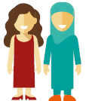
Is Community Living Well delivered by the NHS?
Yes! Central and North West London NHS Foundation Trust (CNWL) IAPT service, in partnership with local organisations delivers Community Living Well
St Mary Abbots Rehabilitation and Training (SMART)
Kensington and Chelsea Mind
Kensington and Chelsea Social Council

Slide 7
Mind Peer Support
Mind Peer Support services provide a range of opportunities for people to come together to reduce isolation, make friends and give and receive support based on the personal experience and a shared understanding of mental distress.

Slide 8
SMART St Mary Abbots Rehabilitation and Training
Navigators- practical support with a range of issues for example:
Benefits
Debt
Housing options,
Access to health and social care services and other rights and entitlements
Employment Support
Find the right kind of work for you
Return to work after a period of sick leave
Stay in work and/or deal with workplace adjustments
Know your employment rights.

Slide 9
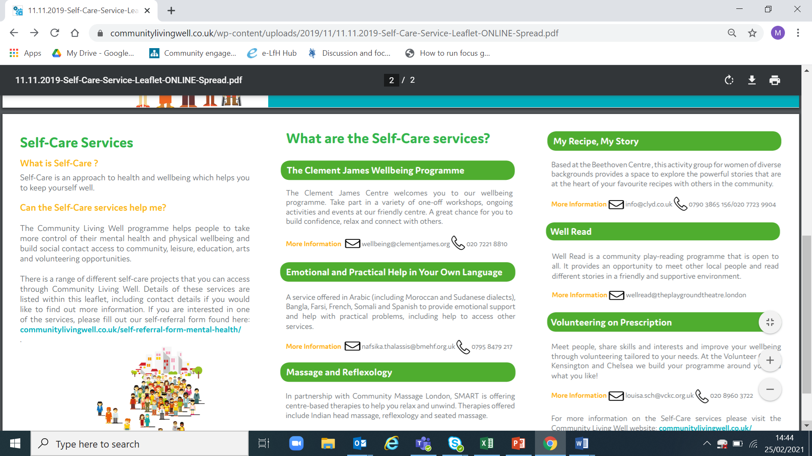
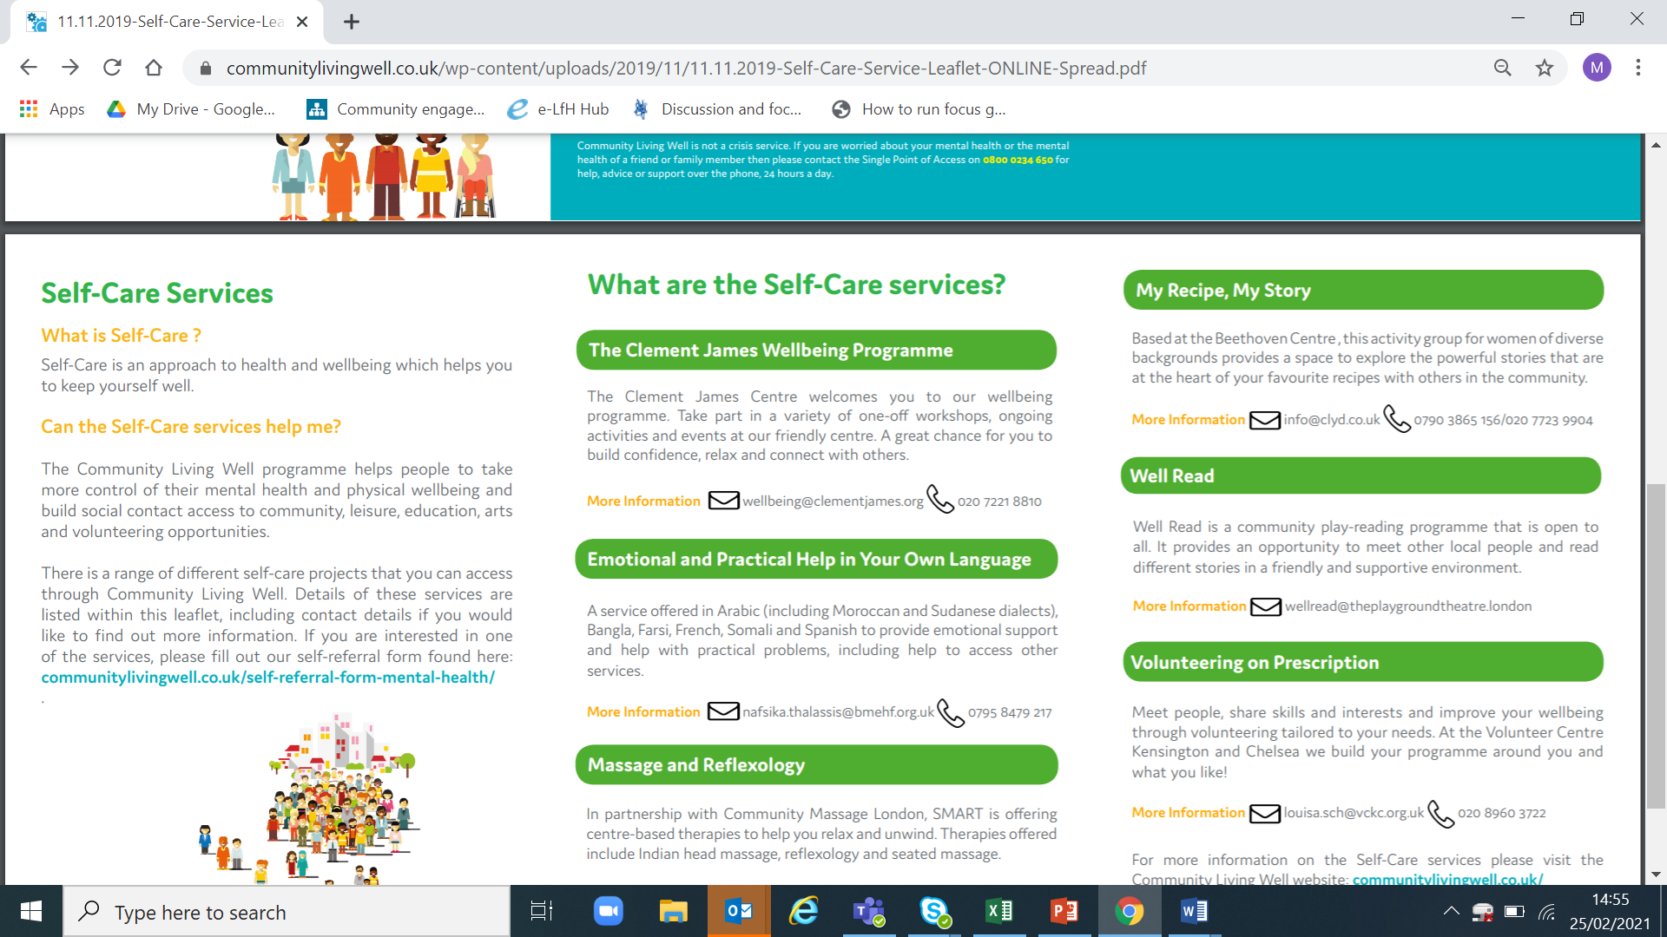
Self Care Managed by KCSC
What is Self Care?
Self-Care is an approach to health and wellbeing which helps you to keep yourself well

Slide 10
Who, Where & How?
Who- Community Living Well is a service for people aged 16 and over who need support with their mental health and wellbeing. It’s for people registered with a GP in the Royal Borough of Kensington and Chelsea, or the Queen’s Park and Paddington areas of Westminster.
Who do we see?
Mild to moderate mental health difficulties
Low mood
Anxiety
Stress
Sleeping difficulties
LTC where mood is impacting this
Perinatal mental health
Who don’t we see?
Excessive drug and alcohol abuse
Severe mental health difficulty e.g. psychosis, bipolar disorder, personality disorders
Under 16
People with high risk
How - communitylivingwell.co.uk Self referral or GP
Where- St Charles Centre for Health and GERTRUDE STREET
https://communitylivingwell.co.uk/
Self referral form https://gateway.mayden.co.uk/referral-v2/d65351bb-6848-4b60-82c3-c2a73683d5fa

Slide 11
Questions?

