Slide 1


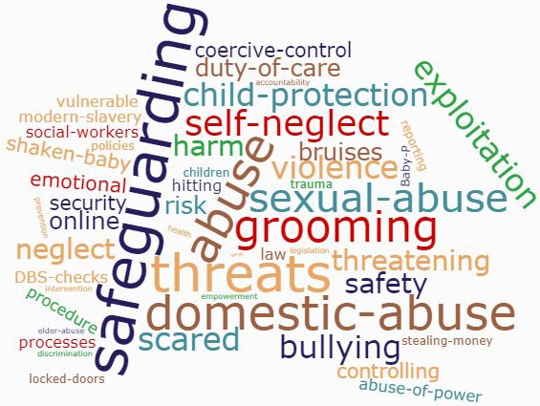
Staying Safe Phase 3
Train the trainer

Slide 2
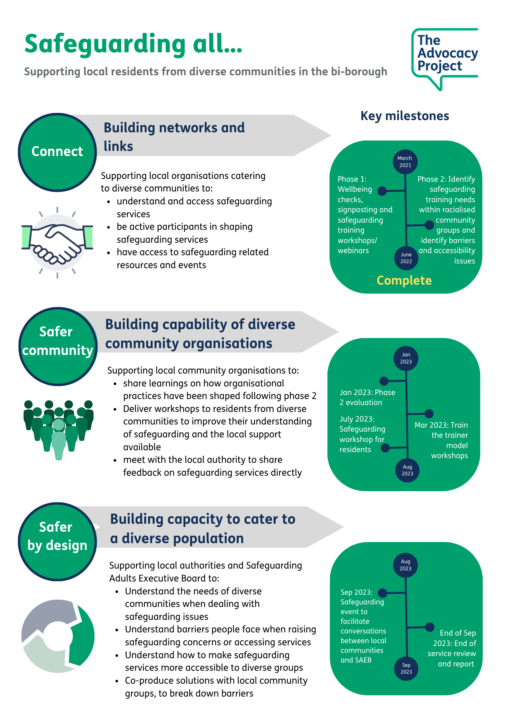
Project Outputs and Outcomes

Slide 3
Delivery
We co-produced the workshop content with the Safeguarding Adults Executive Board and the Advocacy Project.
The training took place on 11th May 2023 with 12 organisations attending including:
    Midaye Somali Development Network
    AL Manaar (The Muslim Cultural Heritage Centre)
    Iranian Association
    Wand UK
    Sudanese Supplementary School
    Fifty Plus Aged Eritrean Welfare Association
    Westminster Bangladeshi Welfare Trust
    Abdul Mageed Educational Trust
    Marylebone Bangladeshi Society
    French African Women's Association
    Migrants Organise
    Sudanese Community and Information Centre
Organisations tailored the workshop content to deliver it to their residents in person or online.
  The content was translated in languages such as Tigrinya, Arabic, Bengali, French, Farsi.

Slide 4
Workshops
Organisations have delivered 12 workshops and have reached 200 people from diverse communities
Attendees were provided with Attendance Certificates confirming participation
Feedback on the workshops have been positive. Participants have said they want to learn more on:
Fire Safety at Home
Female Genital Mutilation
Domestic Violence Support
Victims of Spouse visa who have no recourse to public funds
Racism and Hate Crime
Safety in the Care Homes
Self-Neglect

Slide 5
Demographic Data

Slide 6
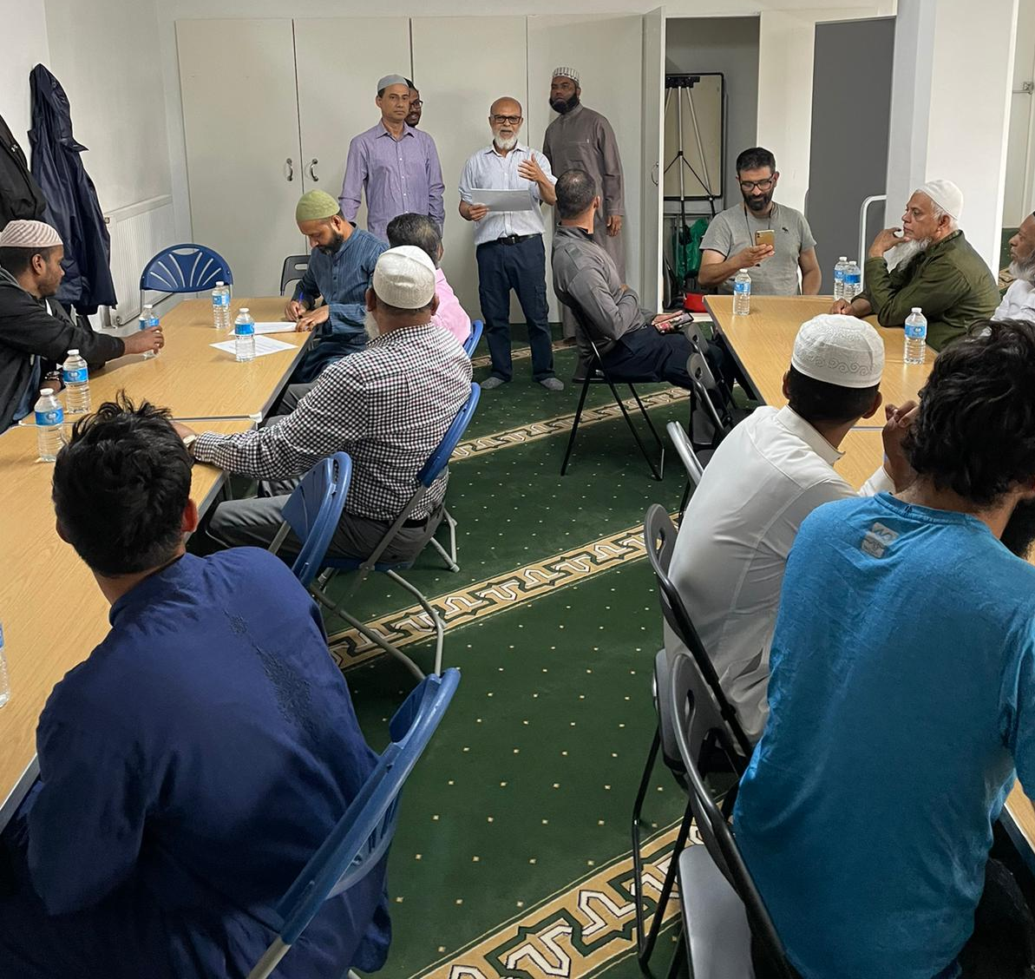
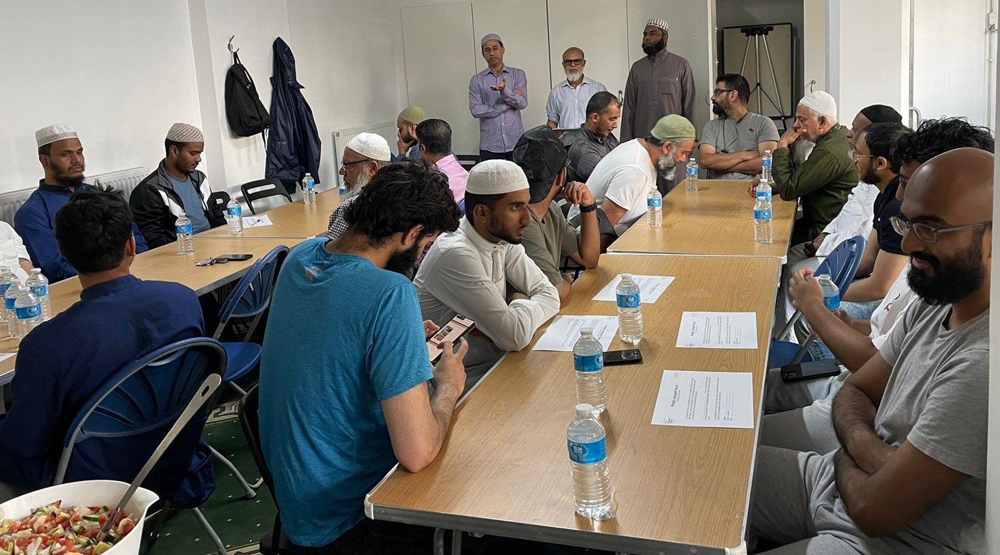
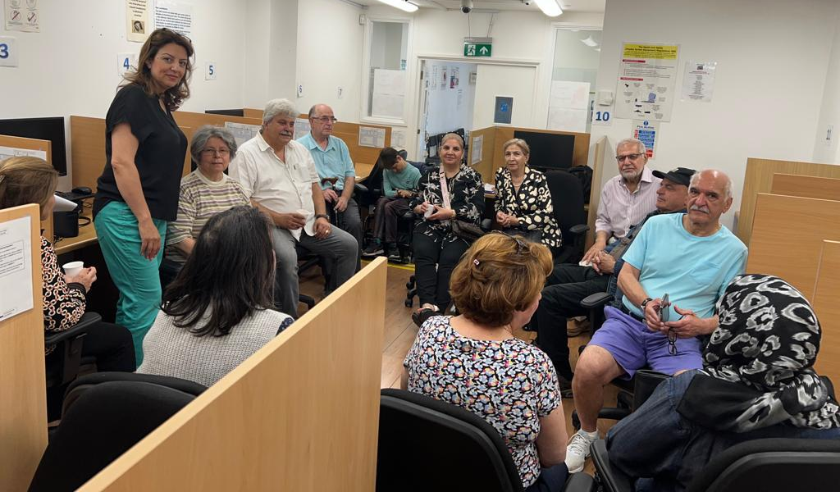
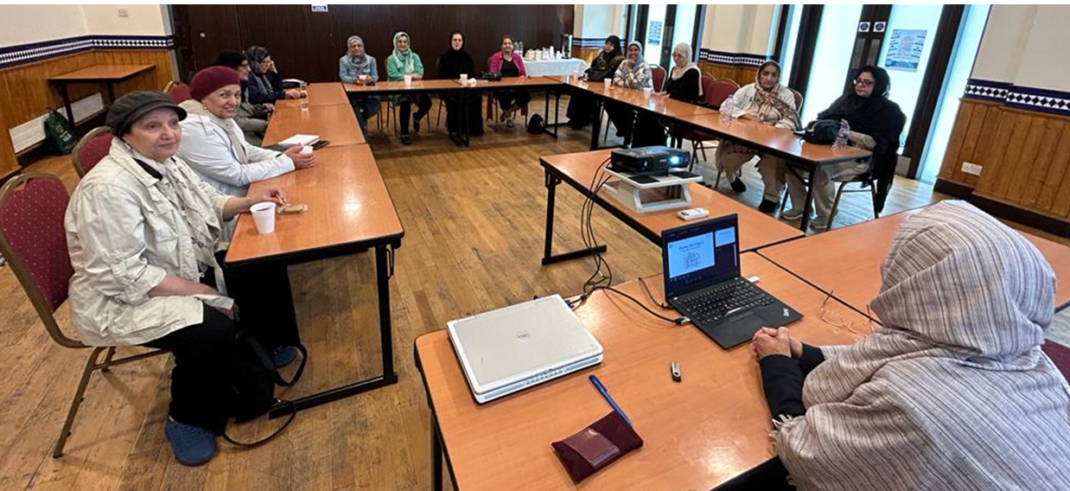
Pictures from the workshops

Slide 7
Services supporting the community organisations

Slide 8
Adult Social Care
Primary Care Services – GPs, Nursing, Mental Health
Domestic Abuse Services
Fire Safety
Carers – Carers Network
MPS - Safer Neighbourhood Team
Community Safety

