Slide 1
Neighbourhood Teams in North West London
Overview for the North West London Residents Forum
Lisa Henschen, Managing Director (Harrow)
December 2024

Slide 2
Purpose of the discussion today
To share our thoughts on why Integrated Neighbourhood teams are so important to improving care for people in North West London
To talk through what Integrated Neighbourhood Teams are and where they are being formed
To talk through how these teams are coming together
To discuss your thoughts on the development of these teams and Borough led involvement of local citizens

Slide 3

We have heard citizens, patients and their carers that they do not always experience care in the way they would expect
Young people are telling us they are concerned their mental health is not being taken seriously
Services are not joined up and can be confusing to navigate
I am concerned about the lack of access to GPs, in particular for face to face appointments
Mental health stigma in some communities remains a challenge
I don’t feel ‘believed’ when speaking to my GP or health professional
This disjointed support from can lead to a sense of disempowerment – the challenge of accessing services and the feeling of having to explain experience time and time again is exhausting so people give up
Disability groups report experiencing behaviours and situations which
exacerbate inequality

Slide 4
And we hear how people want to experience health and care services
Residents tell us
They want a single, recognisable NHS and social care entity that they contact for everything
They want to tell their story once
They want a one stop shop to support their care needs
When something goes wrong, they know a single person to contact – who can make change happen
They are worried about long waits and staff pressures

Slide 5
Integrated Neighbourhood Teams to drive benefits to the public, feel different from what has come before and delivery improved outcomes for patients and the system
Integrated
Across the health and care system.
Neighbourhood
Services geographically planned around communities with a deep understanding of needs.
Teams
Core generalist teams, working as a genuine team – less handoffs of care and a focus on getting the right care for people and their carers.
Through Neighbourhood Teams, people will be able to expect:
  Health and care services that are joined up and provided locally.
  A system that supports and empowers people to stay health and well and maintain independence in the community for longer
  Faster and simplified access to health and care services, so that people receive support, advice or care from the right person at the right time.
  More NHS services delivered in the community, so you only go to hospital if you need to be there
  When you or a loved one, requires support from different services and organisations, a team of health, social care and other professionals that know you best will work together to coordinate care around what matters to you.

Slide 6
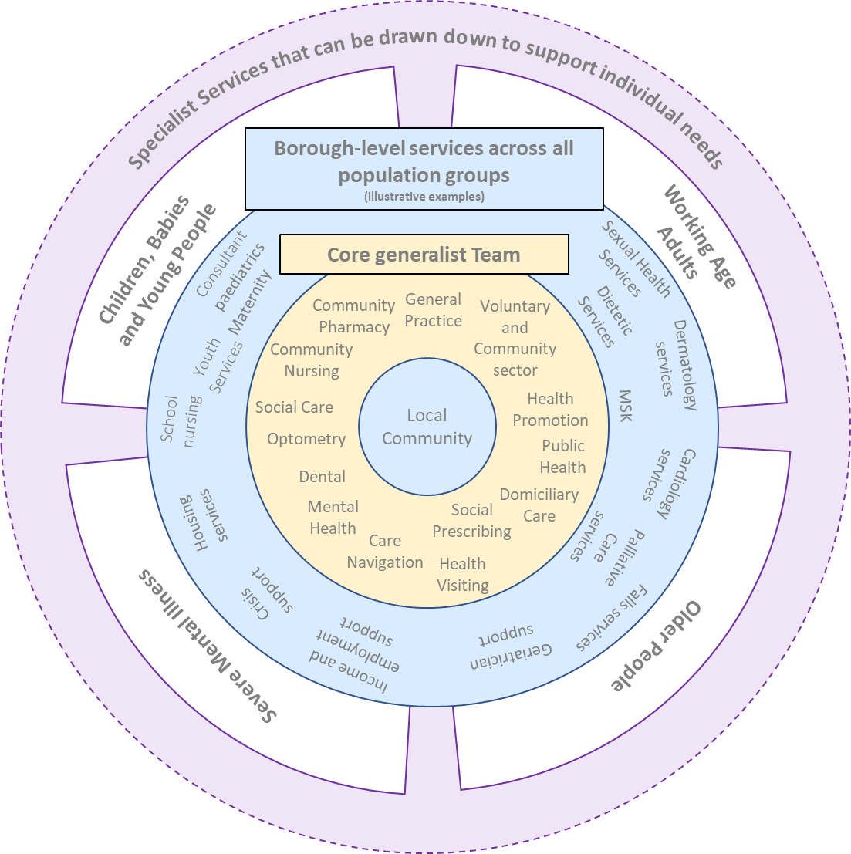
This will be a “team of teams” approach, with the core generalist team operating in the neighbourhood
Integrated Neighbourhood Teams will provide seamless community-based care; and are accountable for their local population and the individual needs within it.
Whilst many aspects of how an Integrated Neighbourhood Team functions will be defined in line with local population need, they will share some common qualities:
They will all be geographically aligned to a population of c.50,000 - 100,000 residents.
They will all contain the core services of General Practice, VCSE, Public Health intelligence, Adult Social Care, Domiciliary Care, Children’s Services (including antenatal and post-natal care), Health Visiting, Social Prescribing, Care Navigation, Community Mental Health, Community Nursing, Community Therapies, Community Pharmacy, Dentistry and Optometry. Within our organisations, staff will take a “no wrong front door” approach for all services, which can be access digitally, by telephony or in person. We will get people to the help and service they need.
They will access connecting services for all population groups, which operate at Borough or wider footprint, in an agile and responsive way.
The core teams will pull down on more specialist, services at scale for specific population groups through their acute trusts and other specialist service provision.

Slide 7
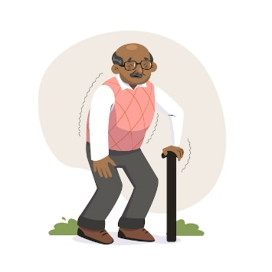


What will all this mean for our residents and patients?
Better coordinated support, in the right place at the right time.
The health and care system is proactive in their response, reducing unnecessary hospital admissions;
There is a clear care coordinator in place. Ease of access to this professional is likely to reduce demand on urgent care services;
Services are recognising the individual and coordinating services that meet both clinical and social needs;
Informal carers are recognised and supported in their role; both practically through reducing the burden of attending appointment and emotionally through a focus on wellbeing.
Muhammad is 86 years old. He has diabetes and hypertension. He recently had a fall which has affected his confidence and now has a care package in place for support at home. His daughter lives nearby and provides informal support.
Muhammad’s care is provided by a single team of health and care professionals in his neighbourhood. He has a single care record developed by lead case worker, with one phone number that he, his family and carers can contact when they need support.
When attending appointments, supported by his daughter, his health and care professionals are all based in the same building. Appointments are coordinated, reducing the need for multiple visits. Social prescribers work closely with local VCS organisations who provide him with strength and balance training and connect him and his daughter with local support groups in his community.

Slide 8



What will all this mean for our residents and patients?
A holistic and person-centred approach.
Aisha has been experiencing heavy menstrual bleeding that is having a negative impact on her wellbeing and confidence and is currently not working as a result.
Community based access to services is available for Aisha, supported by the Acute Trust, but without the need for an outpatient referral and associated waits.
Access to timely support means that Aisha can get well and back to work more quickly.
Aisha’s clinician focus on more than the presenting symptoms, including providing opportunistic screening without the need for her to make a new appointment.
The community-based service means that connections into wider local support can be made.
She attends the Women’s Health services within her local Integrated Neighbourhood Team. Her immediate symptoms are treated by a GP with Special Interest, who is supported in their work by the Gynaecology Consultant from the local acute Trust.
Whilst attending the hub, Aisha’s wider circumstances are considered. Her cervical smear test was overdue, and therefore screening was arranged for her whilst she was at the centre. Her mental wellbeing was discussed, and she was supported to access NHS Talking Therapies and given details of local employment support organisations to approach when her symptoms are controlled.

Slide 9
The minimum timescales for completing phases are set out and the outcomes that should be demonstrated to support the move. We expect some Borough Based Partnerships to move forward faster.
Phase 1: Foundations and integrated practice
Phase 2: Population Health Management (PHM) with supporting infrastructure
Phase 3: Integrated and intelligence led practice
Phase 4: Full delegation for neighbourhood delivery
Functioning INTs in place
PHM fully established, full digital interoperability and estate solutions confirmed
INT jointly plans its workforce to deliver integrated care models
INT delivering demonstrable system benefits and outcomes
Targeting achievement by March 2025
Targeting achievement by March 2026
Targeting achievement by March 2027
Targeting achievement by March 2029
Notes:
Timeframe for the laggards
Don’t stop the trail blazers pushing ahead
Link the phases to the measures that will be associated with it
Everyone by 2030
How do we run a mixed economy? Delegation at Borough level? Move through the stages at a Borough level. Are the inner boroughs too small to go individually? Need to think through the modelling? Financial infrastrucrure to come through the provider collaborative.

