Slide 1
Healthworks update
Westminster HealthWorks is a borough-wide, community-led public health inititative. The service will aim to reduce health inequalities by delivering culturally responsive, preventative health interventions that improve heart, lung, and mental health outcomes for adults aged 16 and over.
Service aims:
  Local communities to lead and deliver public health interventions
  Improve connections between community organisations, public health and primary care services
Competitive tender - £1,47m for 3 years (Commission one lead provider to coordinate and subcontract partner local organisations)
Aug 2025
Cllr Butler-Thalassis PH briefing
Aug – Sept 2025
Procurement and legal support allocated
Gathering data insights
Development of 1st draft spec
Oct 2025
Community, primary care, commissioning engagement
Incorporating feedback in spec
Open tender
December
January 2026
Tender closing
Evaluation
March 2026
Awarding contract
March – Dec 2026
Co-designing service delivery & monitoring

Slide 2

Tackling Loneliness
We found a way to connect in Westminster and Kensington and Chelsea

Slide 3
What is the difference between feeling lonely and being socially isolated?

Slide 4
What is loneliness
Loneliness is:
“A subjective, unwelcome feeling of lack or loss of companionship. It happens when there is a mismatch between the quantity and quality of the social relationships that we have, and those that we want. ”^{[1]}
Social Isolation is
“[The] level and frequency of one’s social interactions”^{[2]}
“having few social relationships or infrequent social contact with others ” ^{[3]}
Loneliness is an experience, not a diagnosis. Anyone can experience short-term and long-term loneliness triggered by life transitions. Loneliness can be adaptive; it can create a change in someone's life.
[1] Department for Digital, Culture, Media & Sport, A connected society: a strategy for tackling loneliness (2018).
[2] Wu, B. ‘Social isolation and loneliness among older adults in the context of COVID-19: a global challenges’, Global Health Research and Policy 5.27 (2020).
[3] Mental Health Foundation. All the lonely people (2022), (p.11).

Slide 5
Loneliness might make anyone feel:
less confident
disconnected from others
tired
isolated and alone
trapped
less focused or lacking purpose
frustrated
and in the most extreme cases, loneliness can cause thoughts of suicide and self-harm.

Slide 6


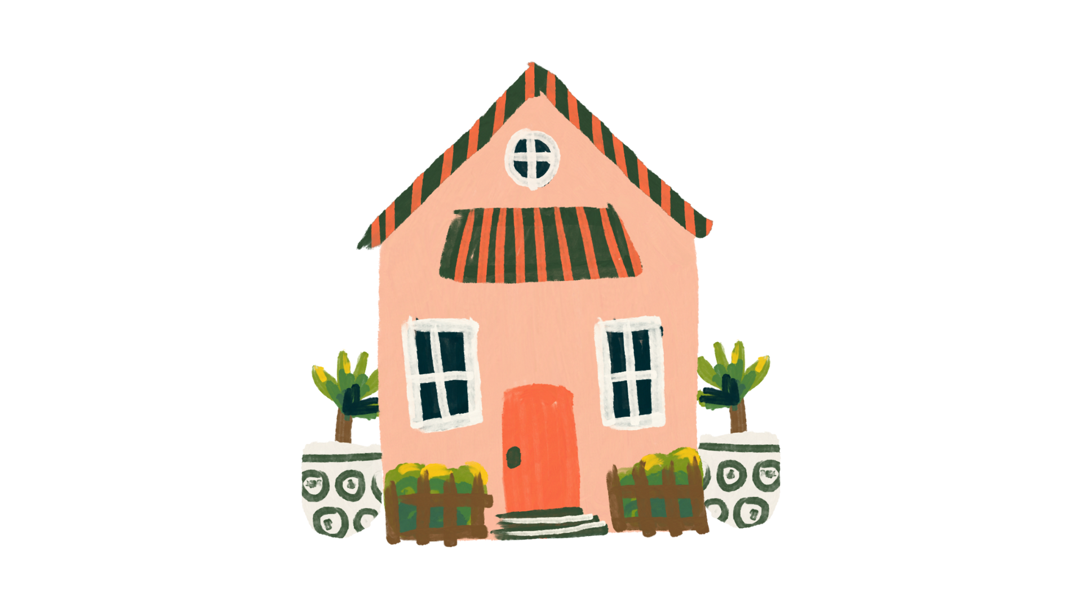
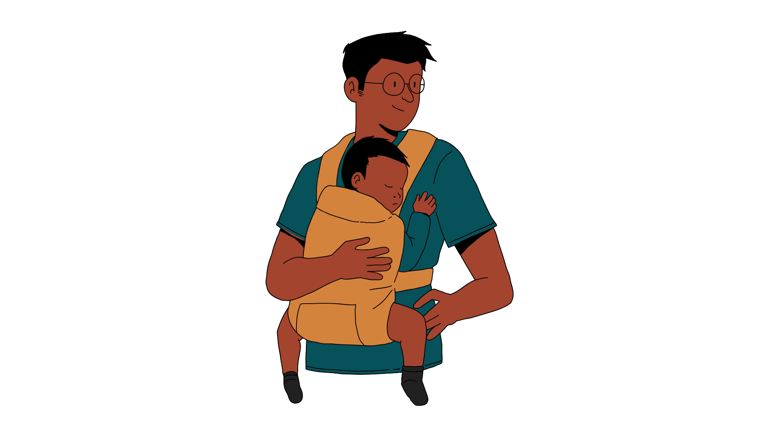

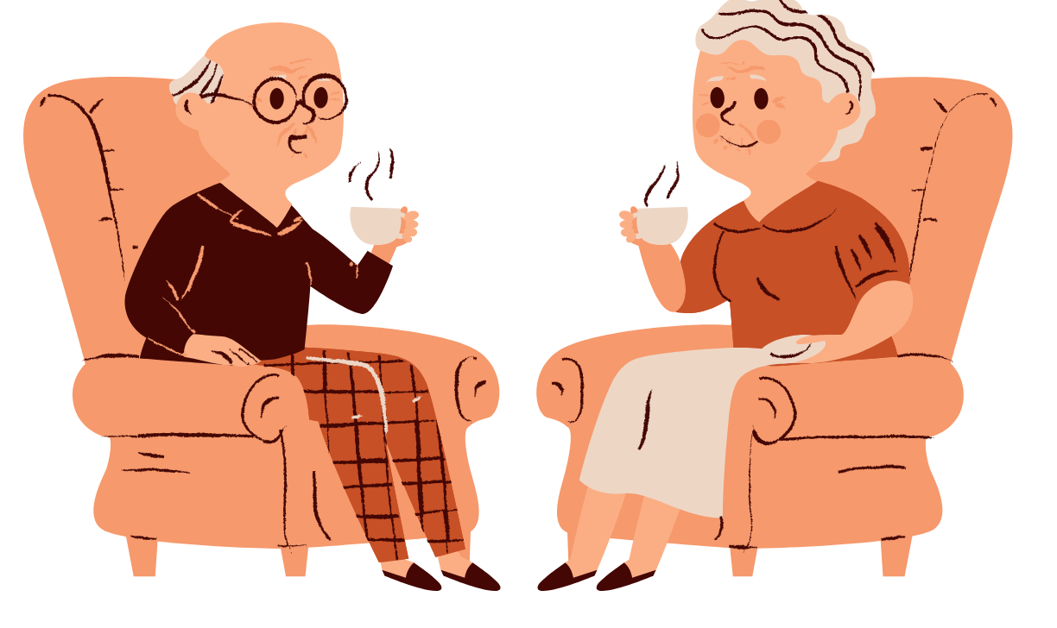
What can lead to severe loneliness
Going to university
Children leaving home
Bereavement
Changing school
Becoming a parent
Retirement
Life transitions can disrupt social connections, psychological stability and reduce availability of a supportive network of friends and family.
Transience (not being in a place for long), transition (changes of circumstance), and low sense of belonging = higher risk of loneliness
Barriers: Language, lack of awareness, financial constraints, traumatic experiences, education and skill recognition, digital literacy

Slide 7
TRUE OR FALSE?
Loneliness is as bad for you as smoking
10 cigarettes a day
15 cigarettes a day

Slide 8
TRUE OR FALSE?
Loneliness is as bad for you as smoking
10 15 cigarettes a day
15 cigarettes a day

Slide 9
Loneliness increases your risk of developing dementia by up to ...
a. 5%
b. 20%
c. 35%
d. 50%

Slide 10
LONELINESS INCREASES YOUR RISK OF DEVELOPING DEMENTIA BY UP TO ...
a. 5%
b. 20%
c. 35%
d. 50%

Slide 11
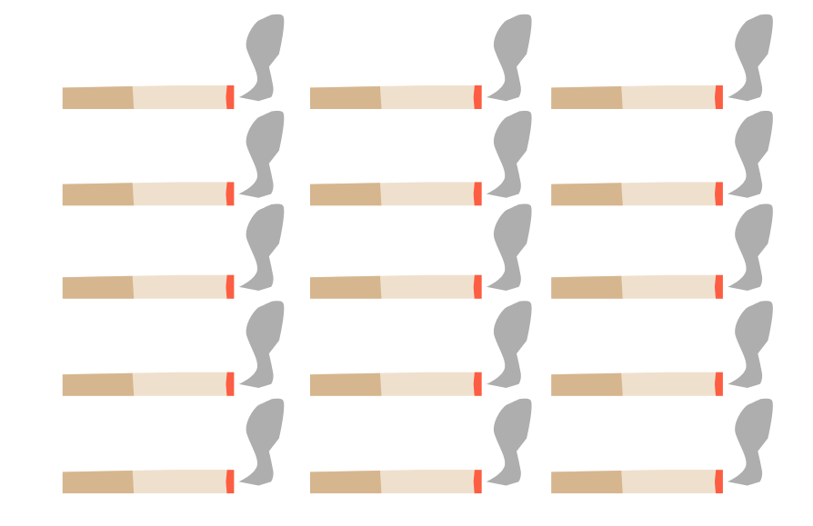

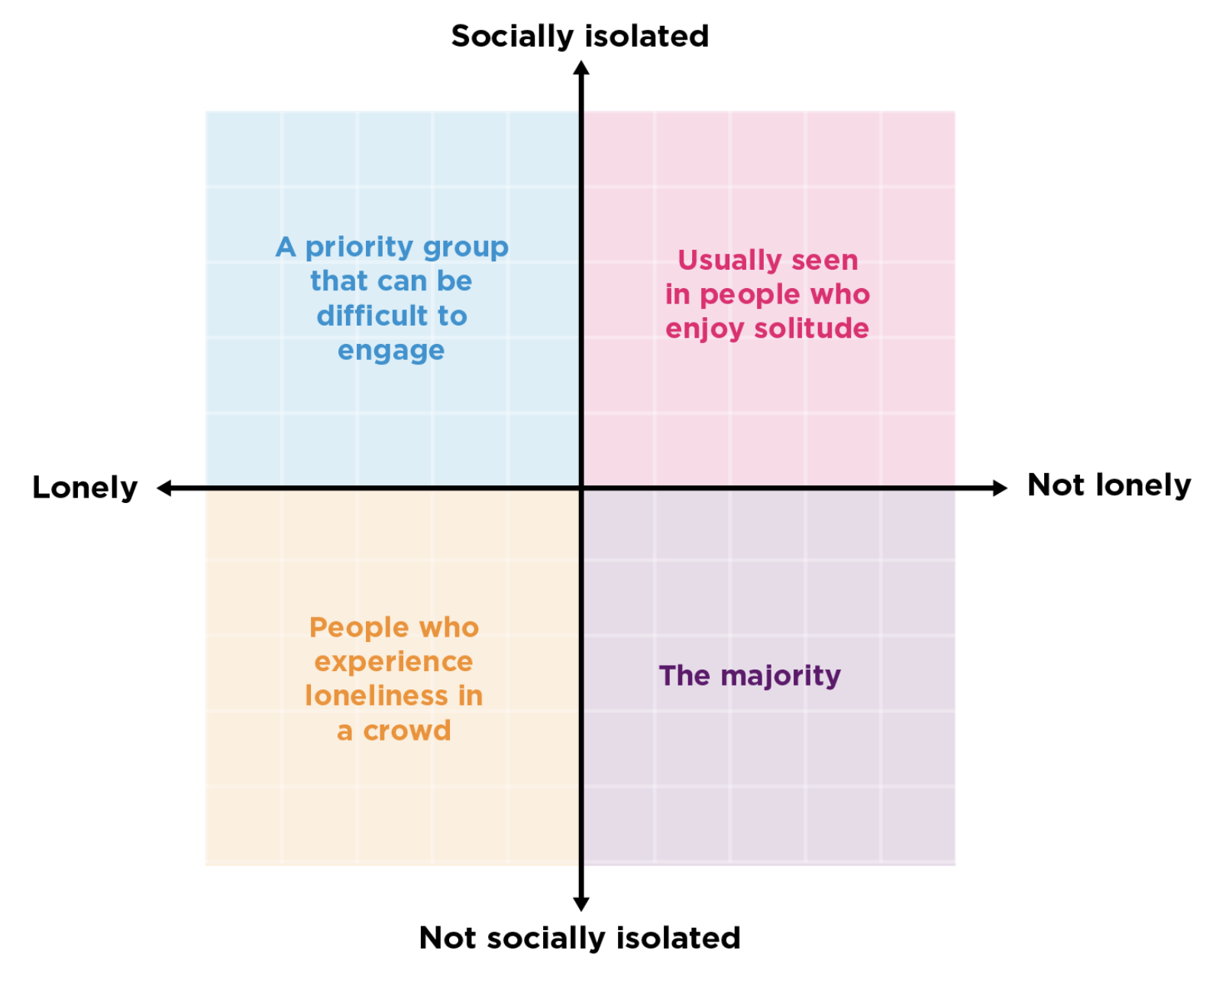
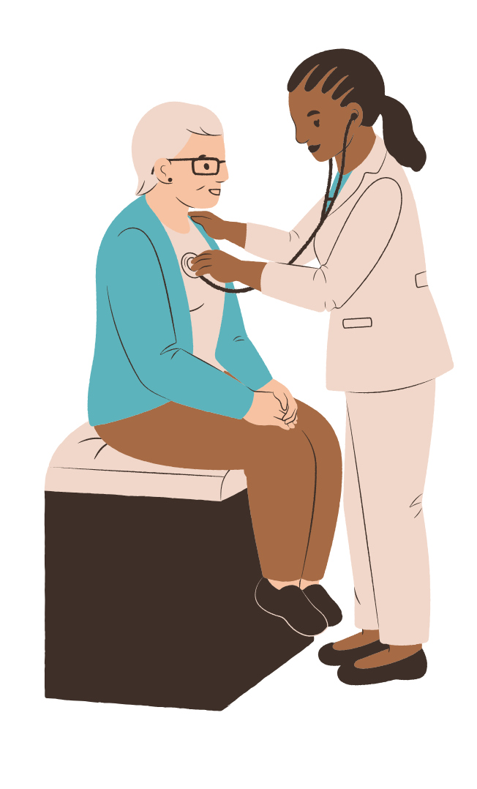

Consequences of Loneliness
Equivalent to smoking
15 cigarettes a day
Up to 50% increase in
risk of developing dementia​
25% increase in risk of early death​​
Up to 30% increase in risk of
stroke and cardiovascular disease​​​
​​

Slide 12
How common is loneliness in London?
Londoners are more at risk of loneliness than the rest of the UK
~700,000 people in London feel lonely 'most' or 'all' of the time
8% of Londoners experience severe loneliness
Loneliness impacts some groups more than others
Young people (16 to 34 years old) have over 5x greater odds of chronic loneliness than those aged 65 or older.
From: Reconceptualising Loneliness in London (May 22), Belonging Forum (2024)
​

Slide 13

Can you think of other things that might increase the risk of chronic loneliness?

Slide 14
Loneliness – Who is at risk in London?
83%
50%
41%
59%
60%
From: Reconceptualising Loneliness in London, May 22.

Slide 15
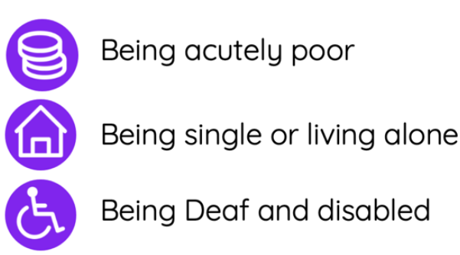
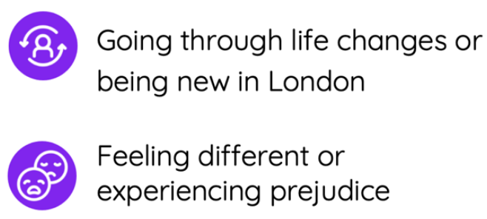
Who is at risk (continued)?
Who is at risk in London?
[1] Reconceptualising Loneliness in London, May 22

Slide 16
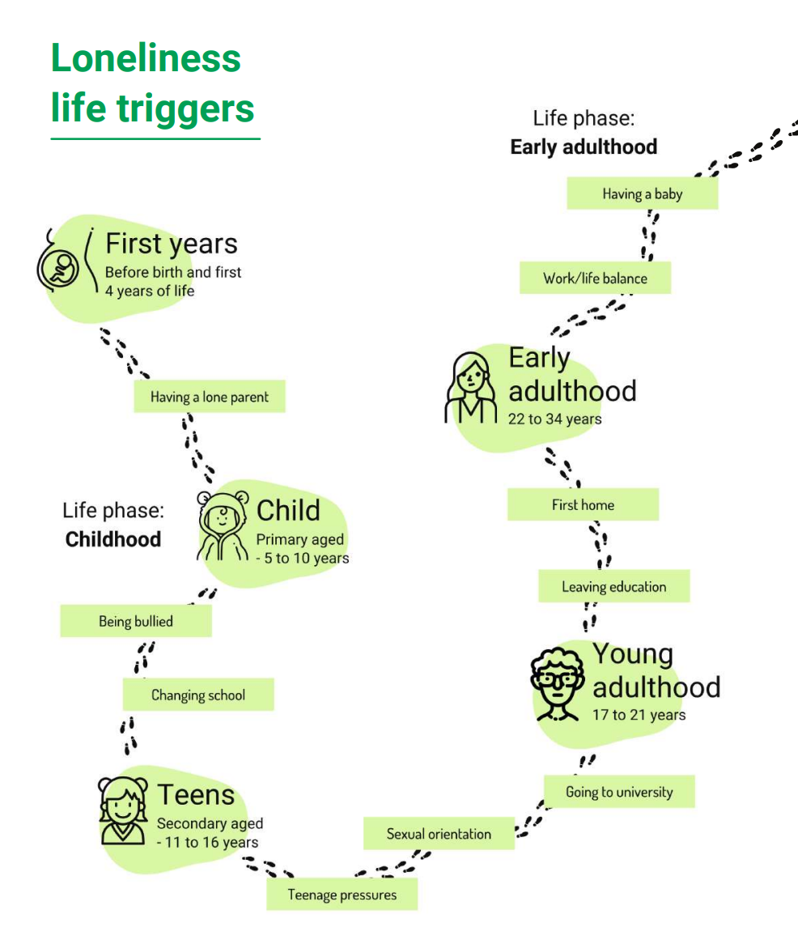
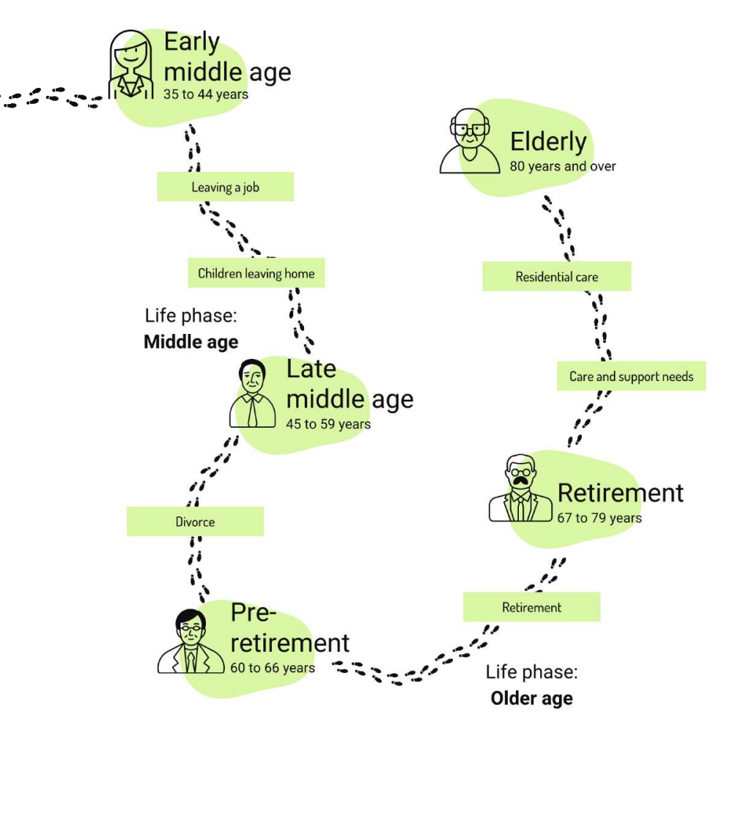
Our life course approach to tackling loneliness
Mental Health Outreach
VCS
Registry
Leisure
Team
Digital Inclusion
Maternity Services
Council Tax
Adult Social Care
Housing Services
Primary Care
Secondary Care
Employers
Employment Services
Education and Child Services
Community Groups
Council
Health
Universities
External
Image Credit: London Borough of Bromley’s Tackling Loneliness Strategy

Slide 17



Tackling Loneliness Action Plan 2025-2026
Objective 2
Connect Sectors
Objective 3
Evidence-Based Action
Objective 1
Build Awareness
Reduce stigma, enable individuals to identify loneliness in themselves and others and to navigate to local help.
Connect existing assets and front-line services to address loneliness across whole life course
Use data-driven insights from academic collaboration to map loneliness and inform targeted interventions

Slide 18
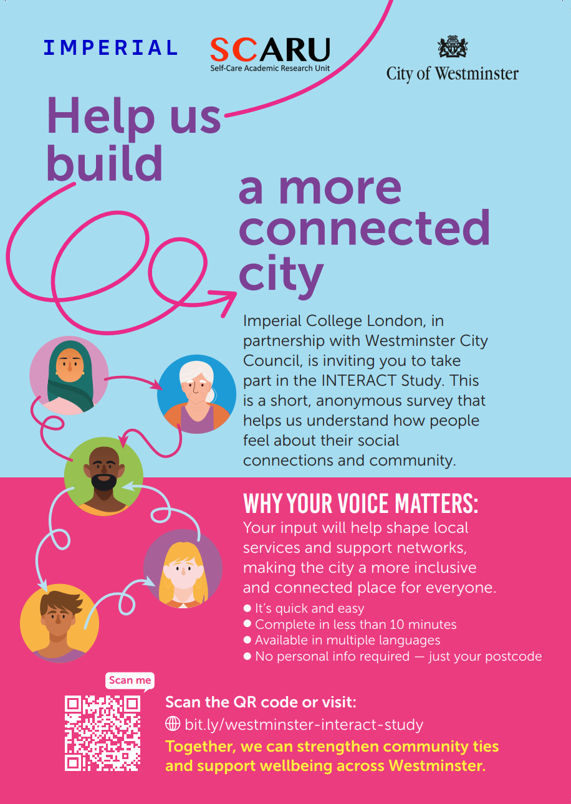
Loneliness Awareness & Support Training
Loneliness Study
About the training
A free 90-minute training session by Mind, offered in Westminster and Kensington & Chelsea, to help build a more connected and supportive community.
Who is it for?
Council staff, Volunteers, Community leaders, Anyone who wants to support people experiencing loneliness
What you’ll learn:
How to spot signs of loneliness
Who is most at risk
Practical ways to offer support
How to signpost to local services
Dates:
Thursday, 12th February 2026, 9:30-11:00
Monday 13th April 2026, 11:30-13:00
Thursday 14th May 2026, 09:00–10:30
Wednesday 10th June 2026, 15:00–16:30
July Tuesday 7th July 2026, 13:00–14:30

Slide 19


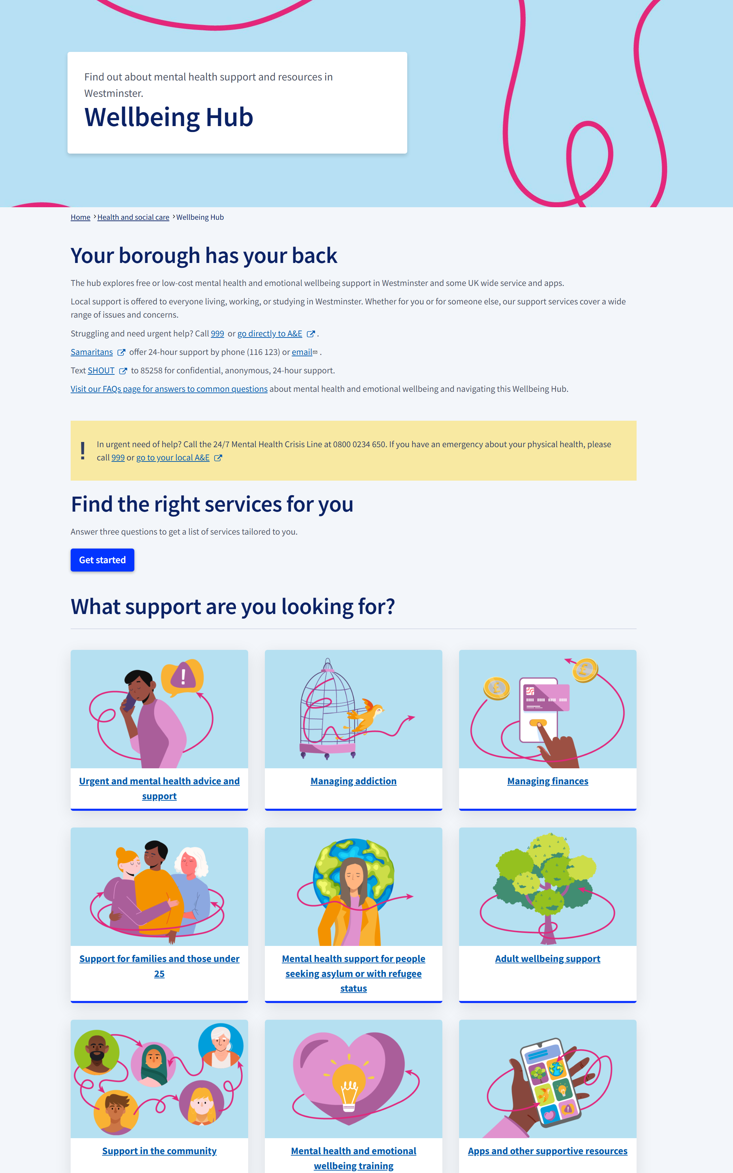
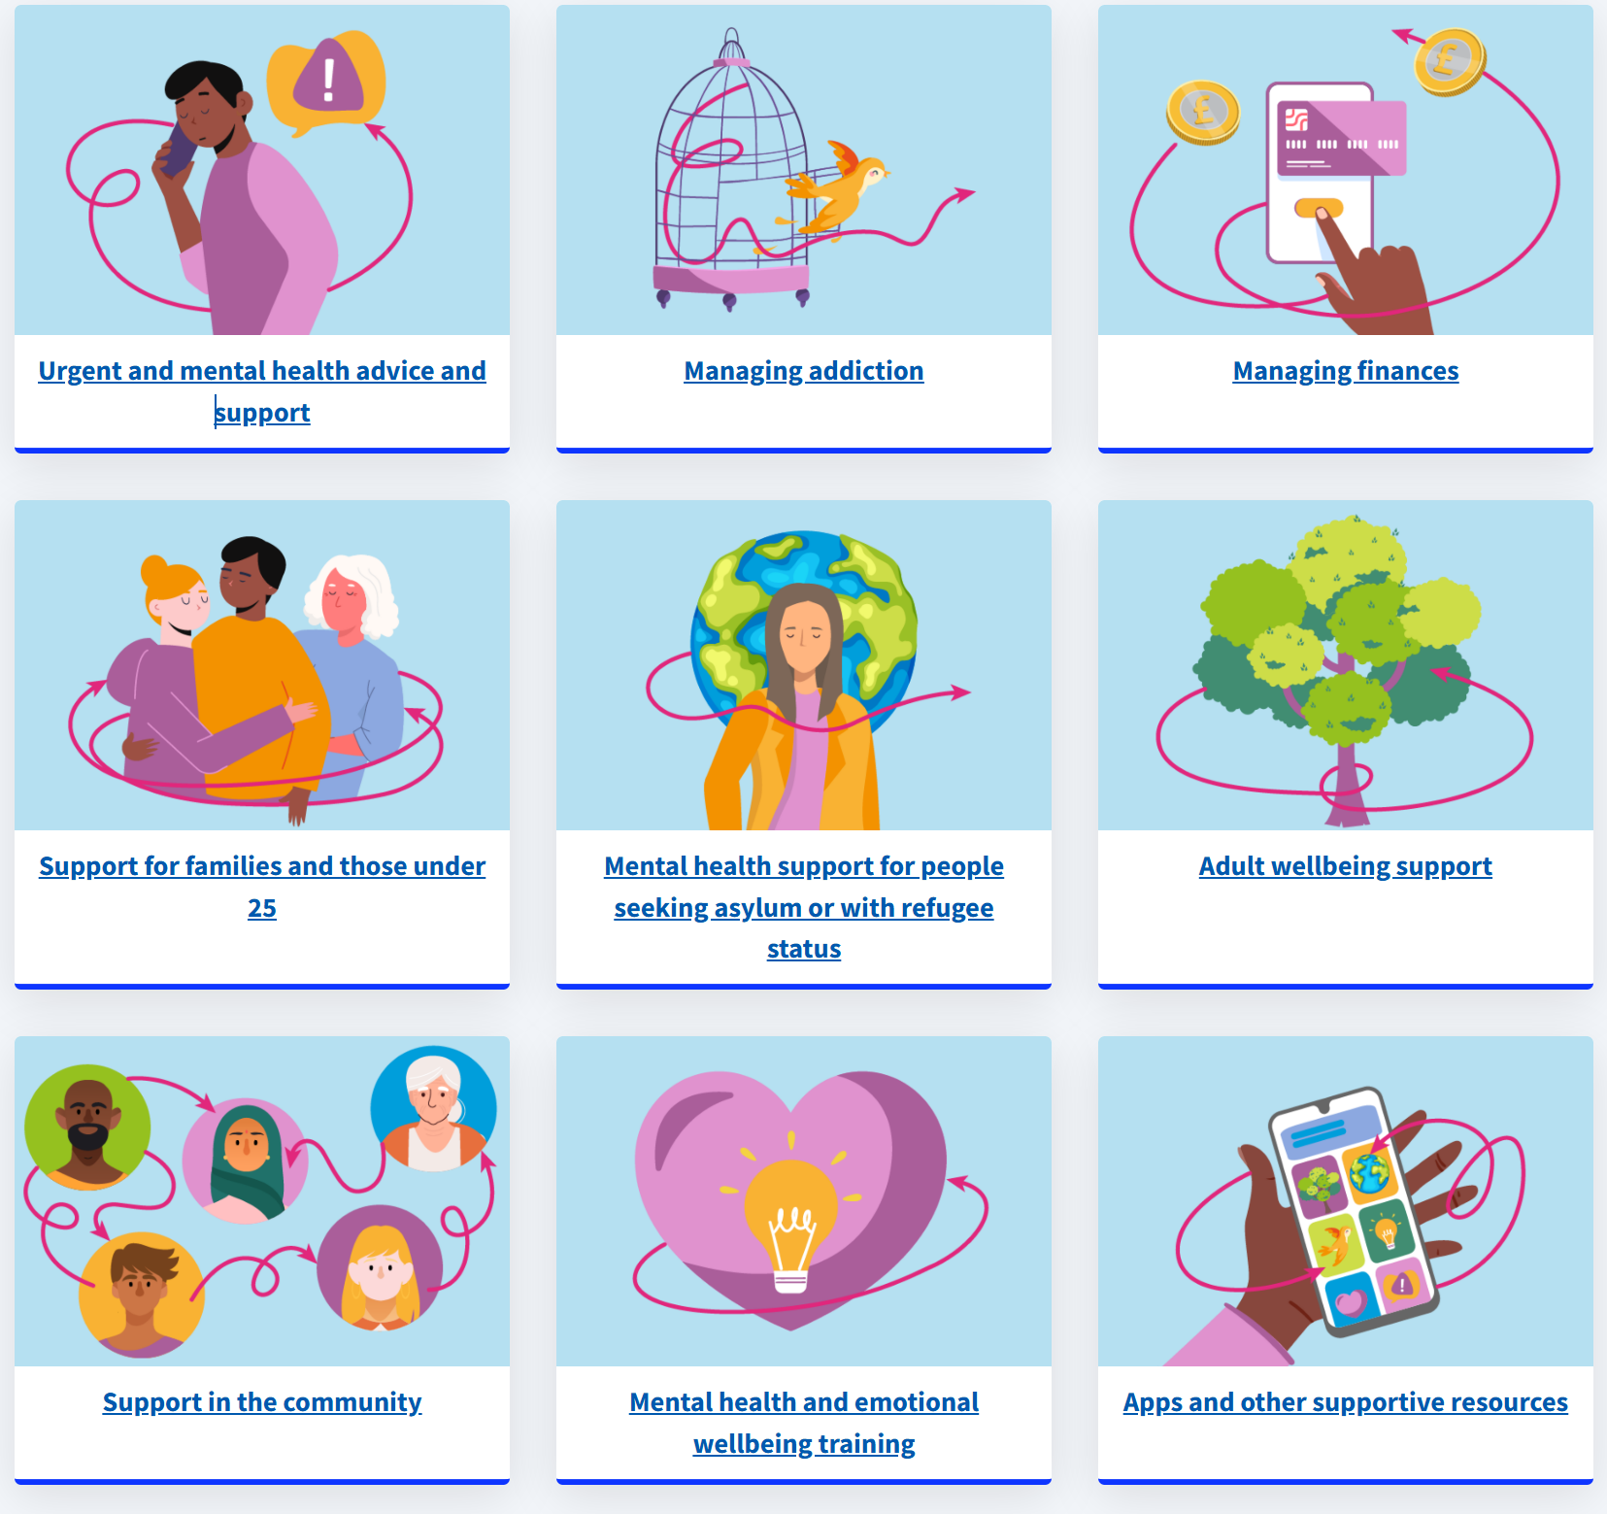
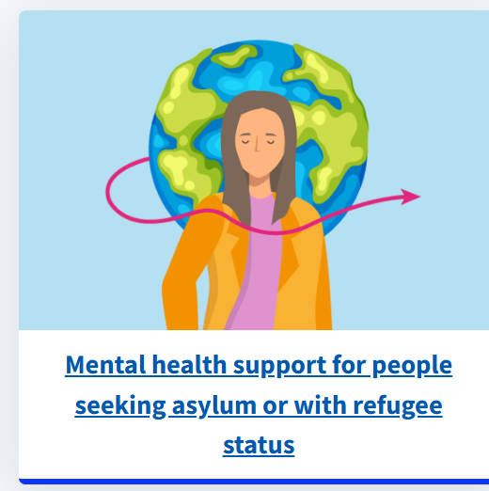
Wellbeing Hub
Scan QR code

