Slide 1



Imperial Patient Experience Research Centre (PERC) - Introduction
Ruchi Wadhwa, Public Involvement Officer, PERC
Maria Piggin, Partnerships & Training Manager, PERC
© 2026 Imperial College London. All rights reserved.

Slide 2
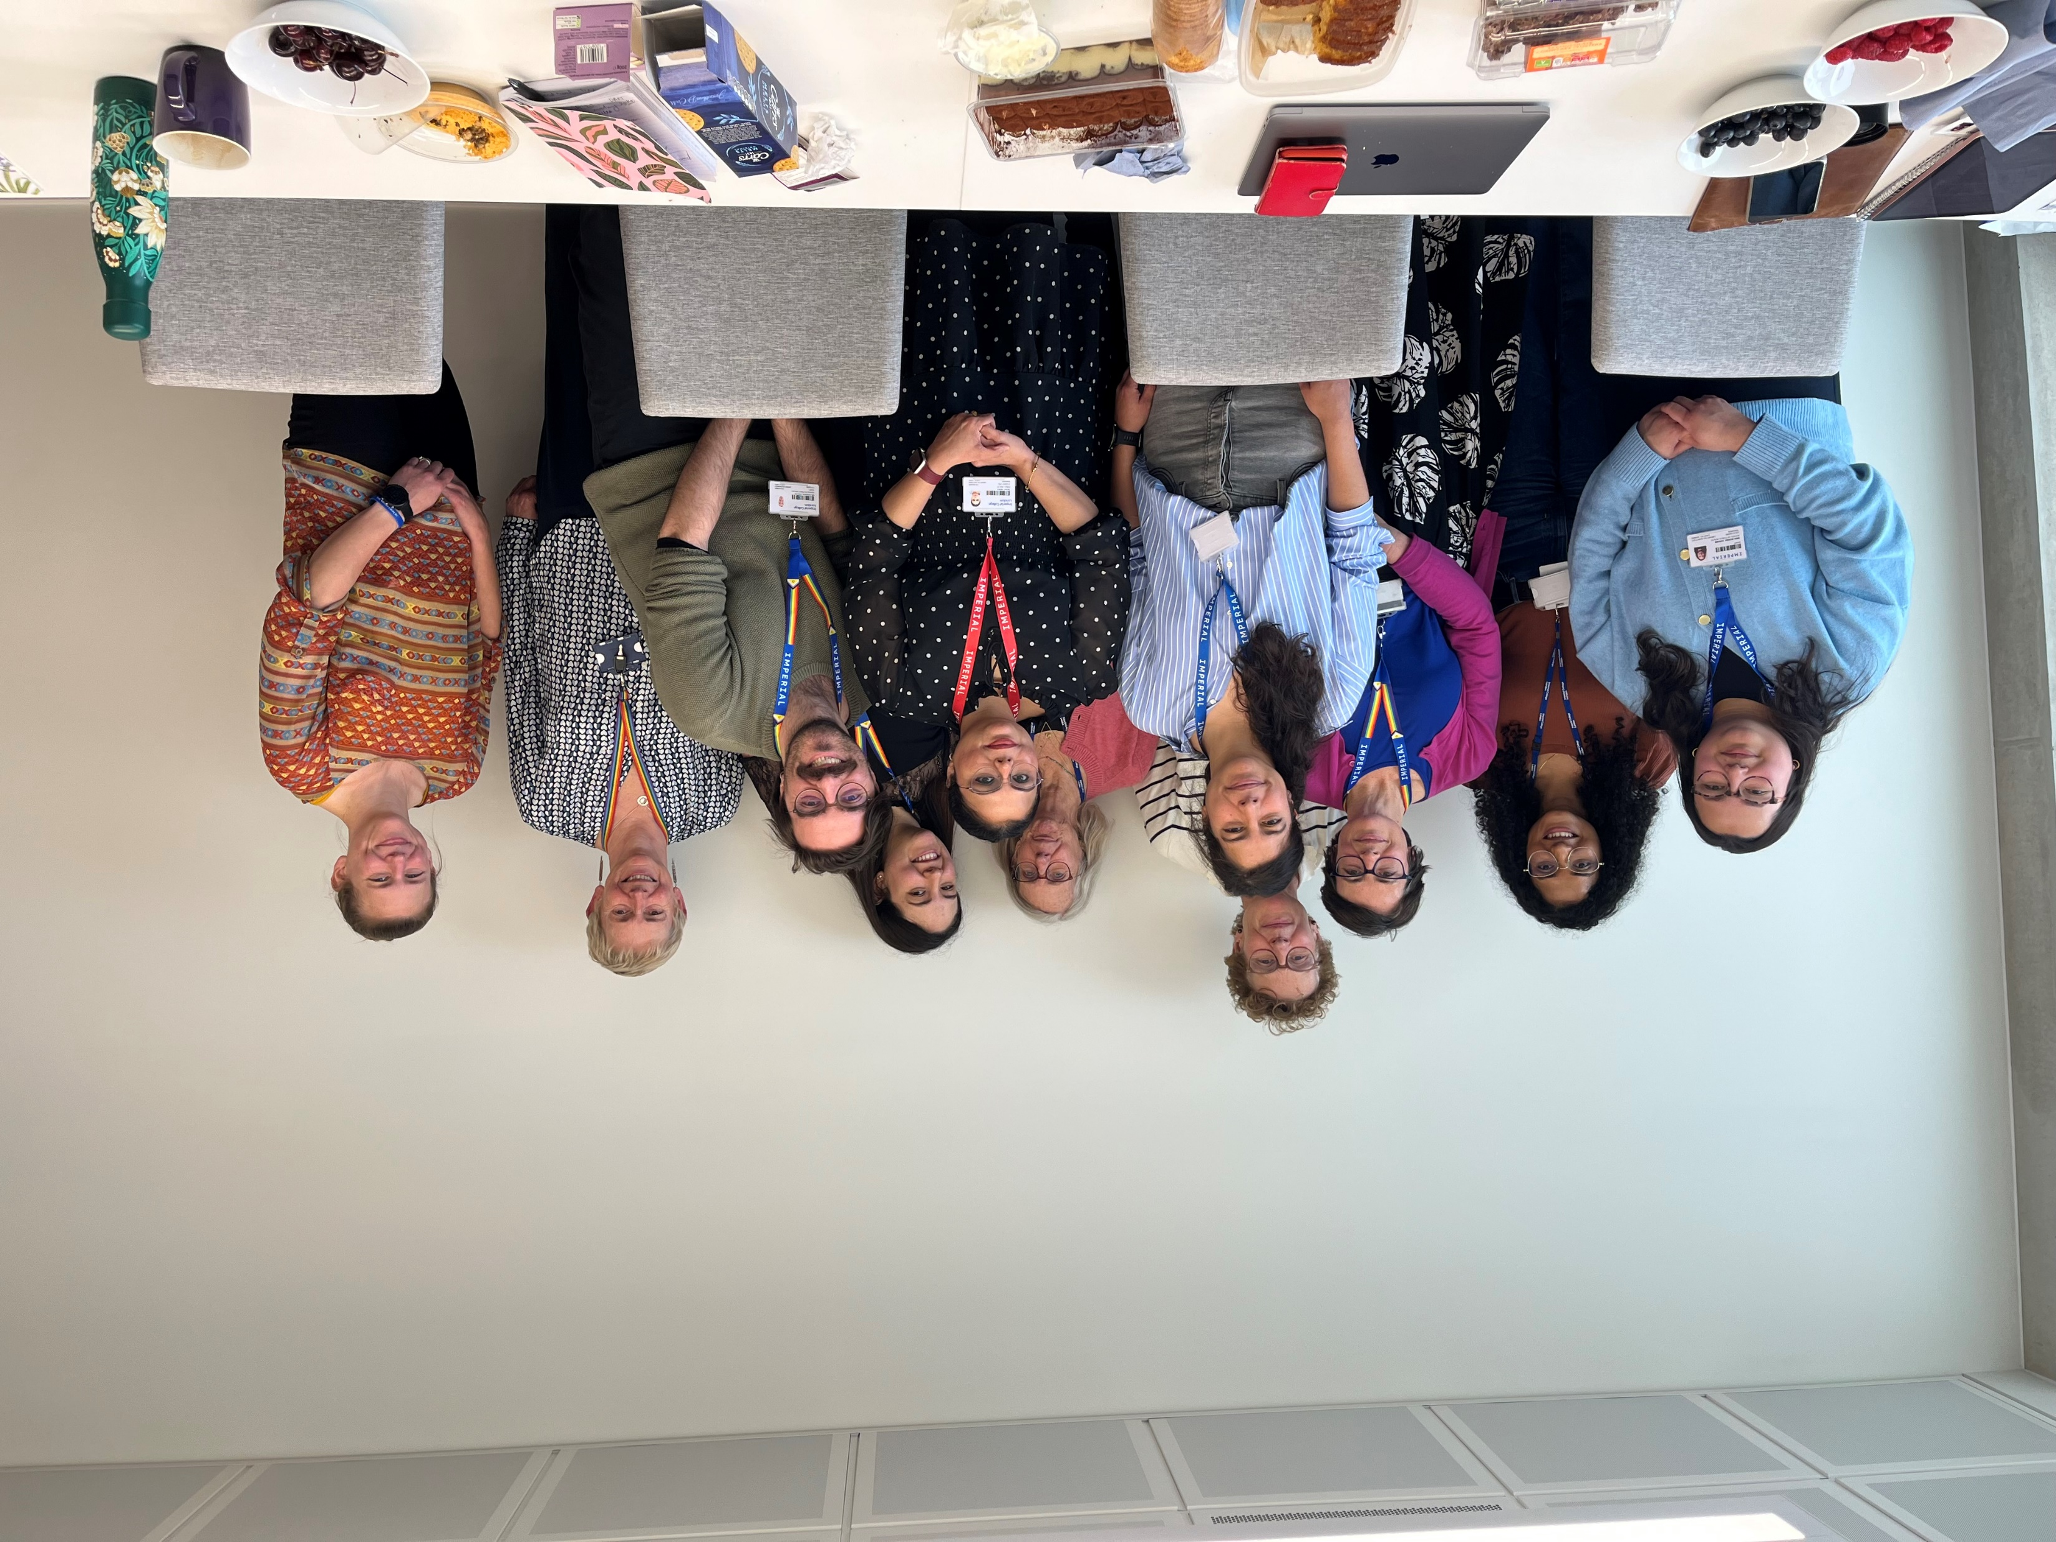

Who we are?
Patient Experience Research Centre (PERC)
A team of researchers, doctors and other staff working to bring communities and professionals together to improve health research
We connect researchers with taxpayers, including charities, community groups, patients, and carers
We help taxpayers have a say in research
We promote opportunities to have a say in research which are paid to recognise people’s time and expertise
We are funded by a government grant called the Imperial Biomedical Research Centre
Notes:
Imperial PERC is a team of health and research experts, including clinicians, social science researchers, and public health specialists. My role in public involvement is to connect researchers with taxpayers — including VCSE organisations, patients, carers, and the communities they represent. We want people to know they have a right to have a say in research, and if they get involved, we pay them for their time.

Slide 3
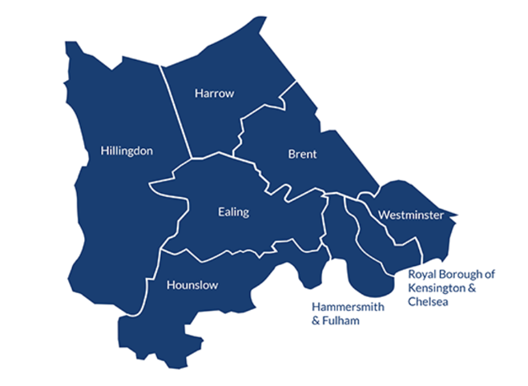
What is the Imperial Biomedical Research Centre (BRC)?
Funded by taxpayer money for 5 years by the National Institute for Health and Care Research (NIHR) (Dec 2022 – March 2028).
A partnership between university (Imperial College) and clinicians/doctors (Imperial College Healthcare NHS Trust)
We are 1 of 20 BRC’s across England. Our BRC covers the below boroughs of North-West London
+
HOSPITAL
Imperial College, London
[University]
Imperial College Healthcare NHS Trust
Queen Charlotte’s & Chelsea Hospital
Hammersmith Hospital
Charing Cross Hospital
St Mary’s Hospital
Western Eye Hospitals

Slide 4
Overall goals of the Imperial Biomedical Research Centre
To research and develop:
  new treatments (e.g., new medications)
  diagnostic tests (e.g., a device to differentiate between viral or bacterial infections in hospitalised children)
  medical technologies (e.g., health monitoring apps, materials to treat wounds/burns)
for the benefit of patients, the public, and the health and care services in North-West London

Slide 5


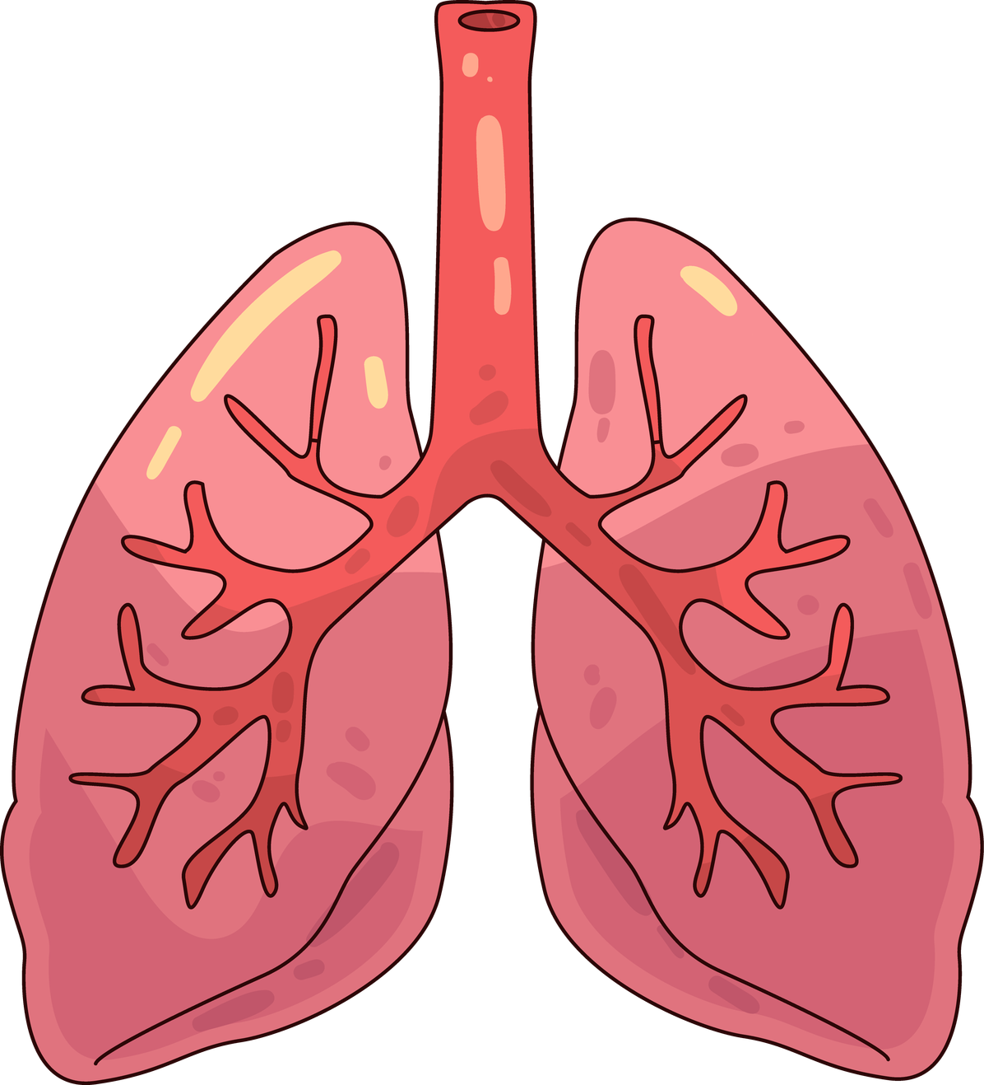

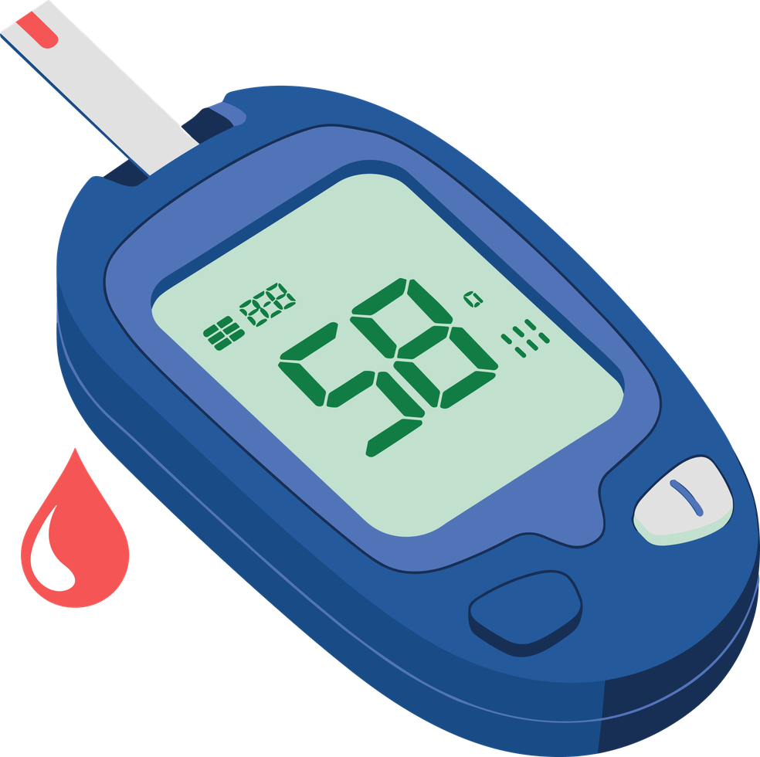

Imperial BRC Research Focus Areas
Biomedical Engineering
Brain
Sciences
Cardiovascular
Digestive
Diseases
Digital
Health
Immunology (kidney & some blood conditions)
Infection and
Anti - Microbial Resistance (AMR)
Metabolic Medicine and Endocrine
(hormones & metabolism including diabetes)
Molecular
Phenomics (understanding health through genes and body chemistry)
Multiple
Long - Term
Conditions
Pregnancy
and Prematurity
Social, Genetic & Environmental Determinants of Health
Respiratory
Surgery and Cancer

Slide 6

Why do we need community voices in health research?
Better design
Ethical reasons
Accountability
Increases impact of research
Transparency
Avoid research waste
The research is funded by public money
Those affected by research can make research more relevant
Notes:
Public money helps fund research
Patients, carers, and the public should be able to influence it
They can shape research questions and how studies are designed
This is different from taking part in research

Slide 7

Why do we need community voices in health research?
Research should include the people most affected by a condition – but this does not always happen
Diabetes Rates
Diabetes Trial Participation in Research Rates
v/s
South Asian and Black ethnic groups have higher diabetes rates than people from White, Mixed, or Other ethnic groups
5 %
12%
15.2 %
8%
Black population
South Asian population
vs
South Asian and Black ethnic groups
White, Mixed, or Other ethnic groups
Community voices can help improve representation from those most affected

Slide 8


How we involve community voices in health research?
Community engagement – building trust, developing reciprocal relationships with North-West London communities
Train and support members of the public to help shape health research
Train and support researchers to meaningfully involve people in health research
Conduct research on working with people and communities e.g., why some groups are underrepresented in health research?
Notes:
Make sure to say Jenny crow speaking next will say more about this shortly – last example

Slide 9
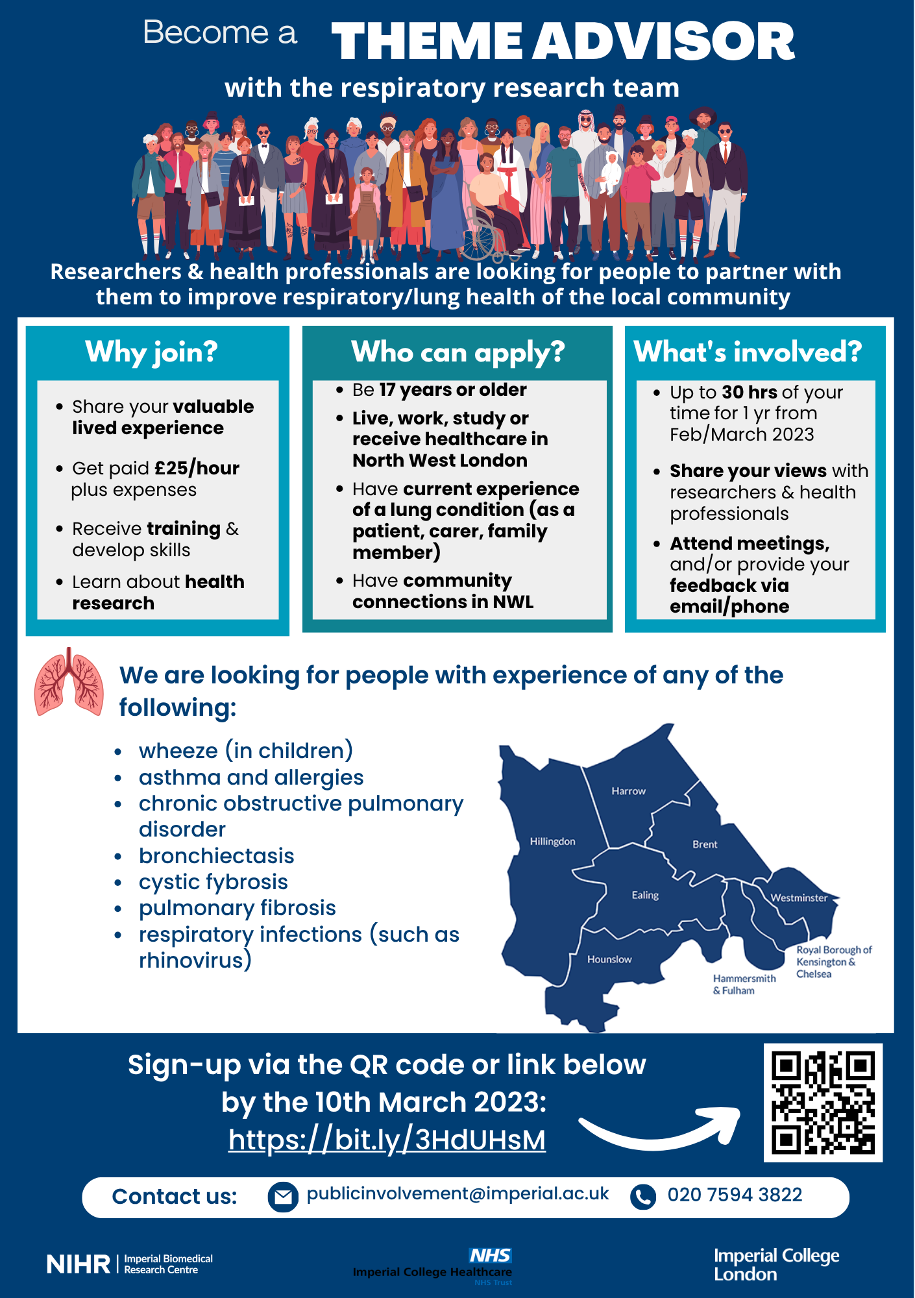
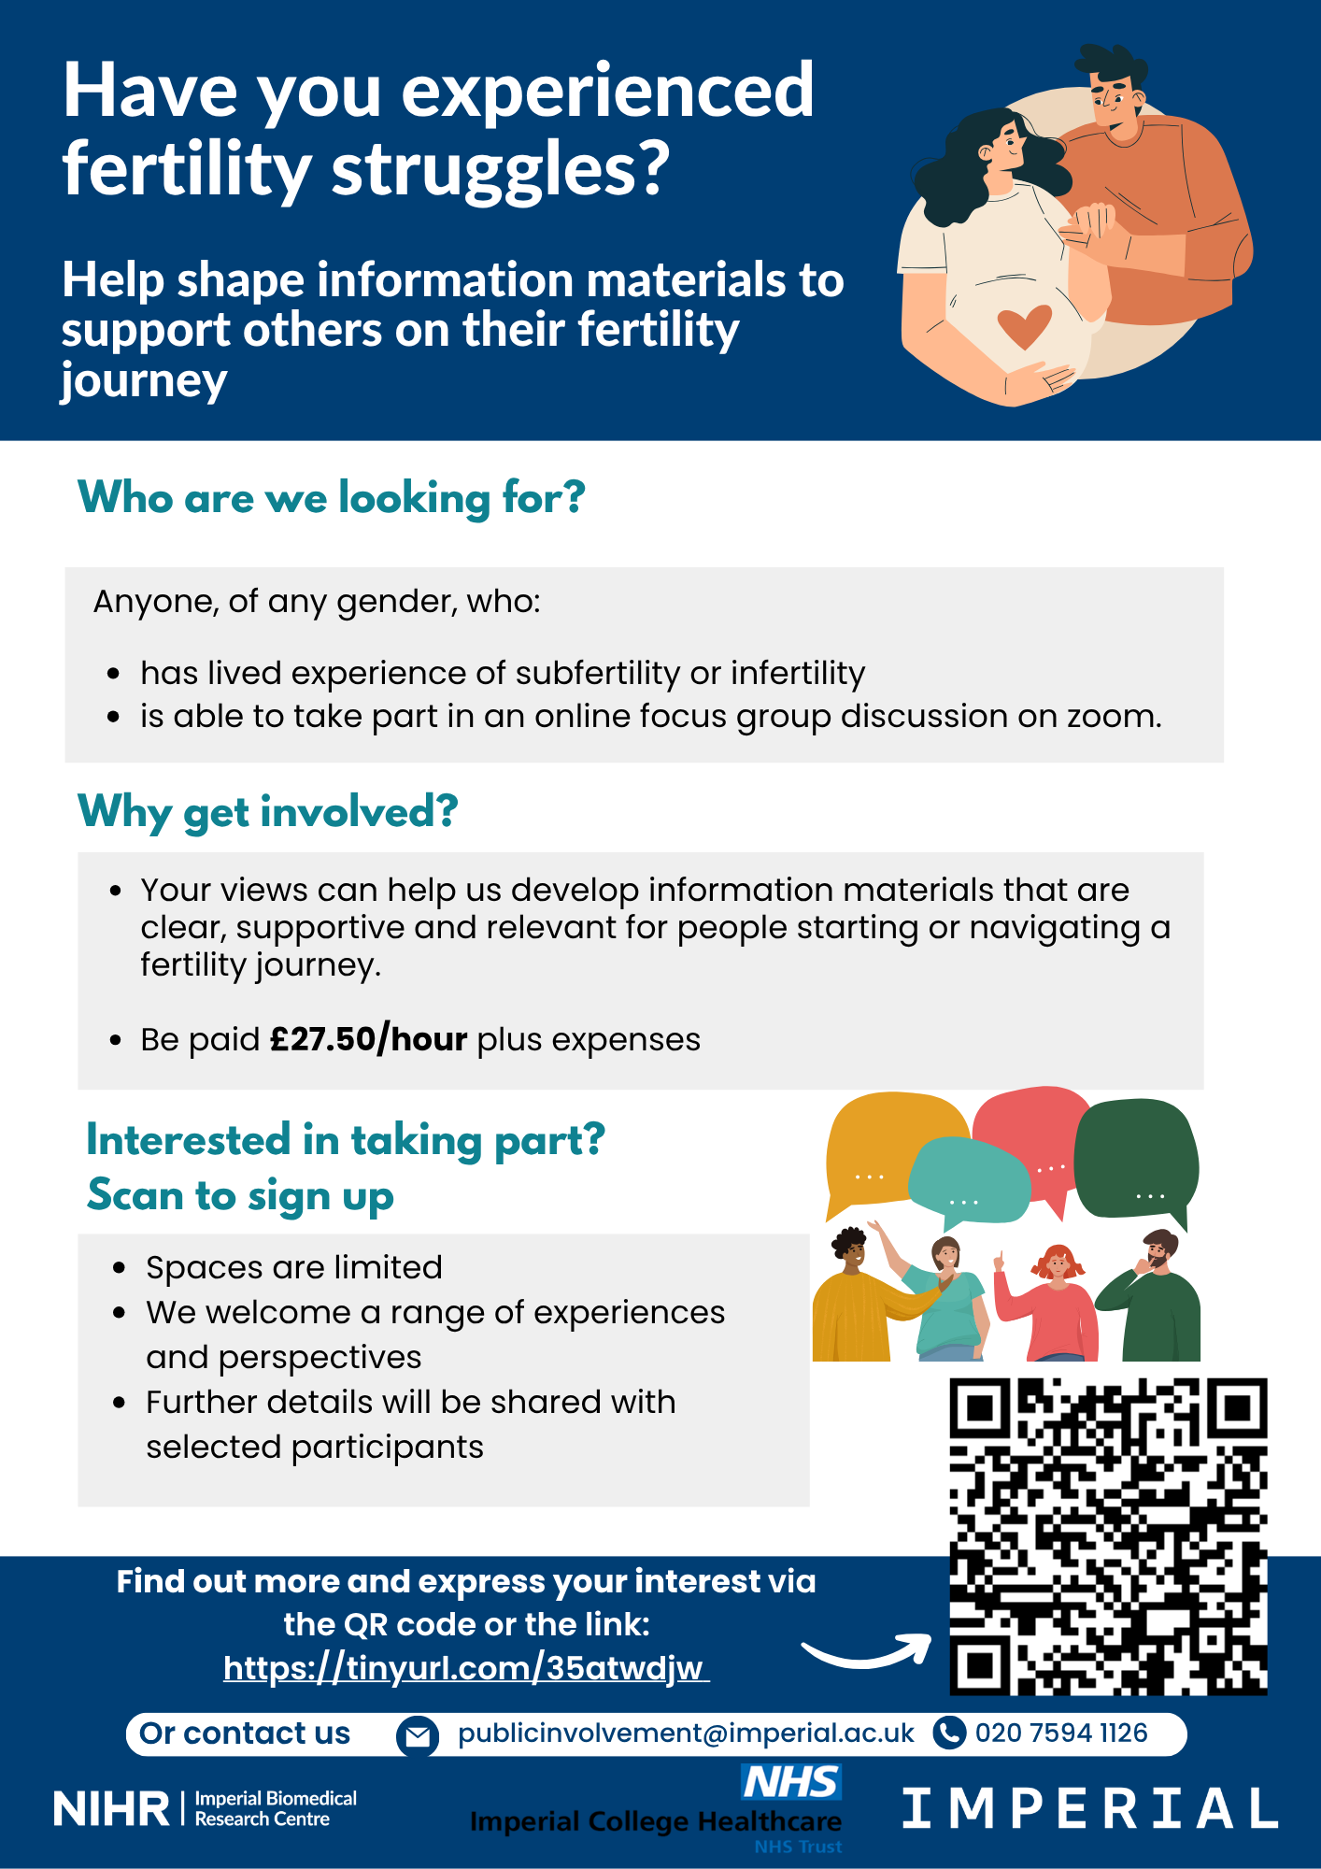
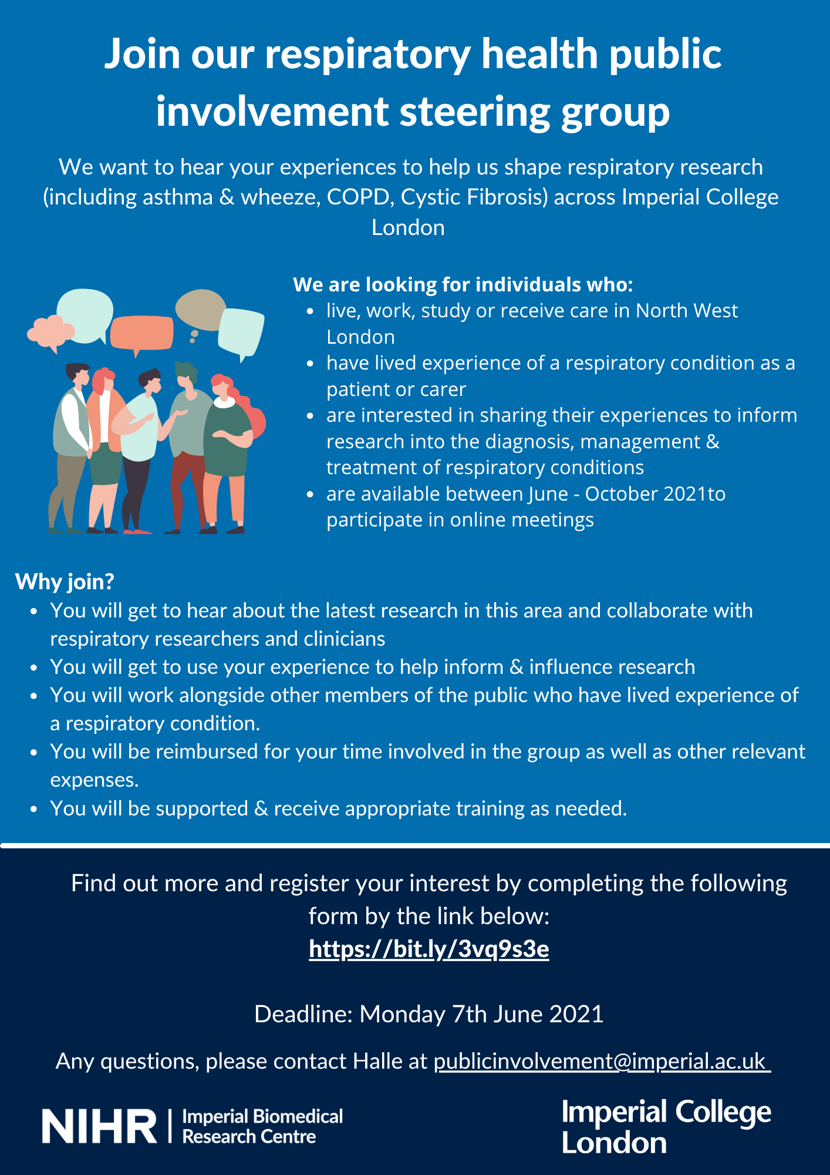
Examples of opportunities to get involved with us
Advisor to a research Theme
Involvement at one point in a research project
Involvement across a research project

Slide 10
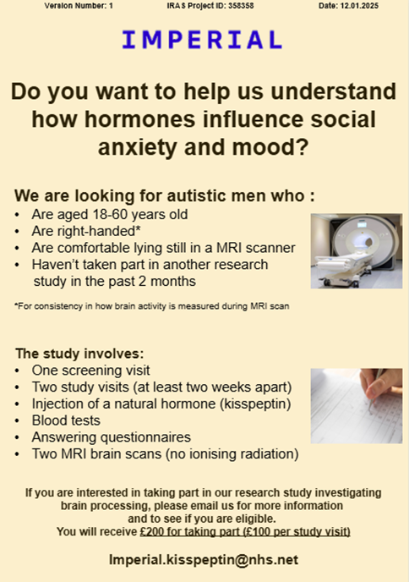

Examples of opportunities to get involved with us
Reviewing patient facing documents
Review research funding applications

Slide 11
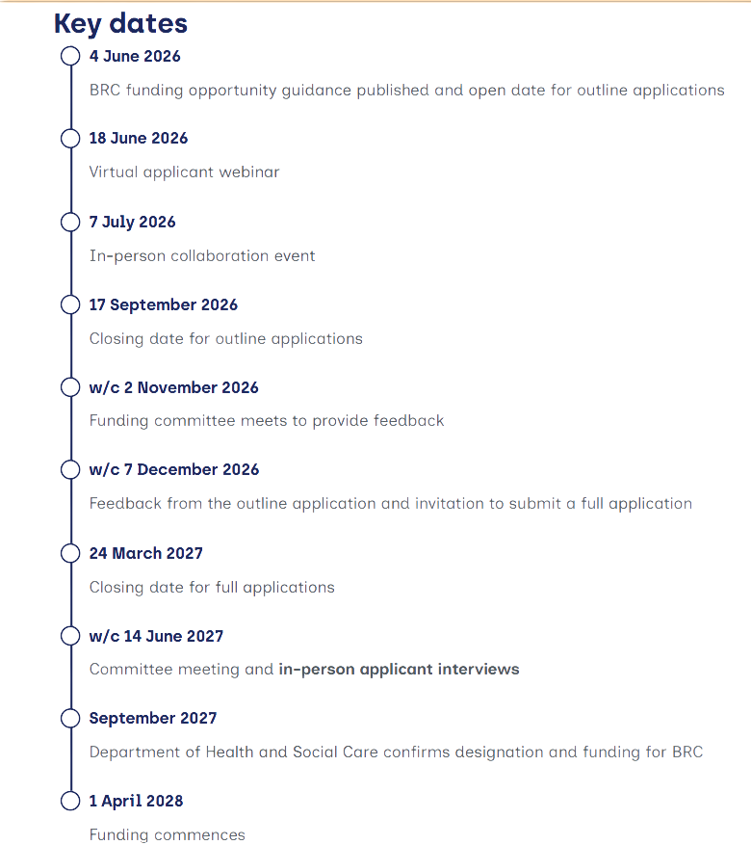
Potential opportunity to shape the next BRC application
Applications are open for the next NIHR BRC funding cycle, 2028–2033
We are currently at Stage 1 (due 17 September 2026)
If we get to Stage 2 (due March 2027), further community comments will be invited to help shape the funding application around local health priorities
These opportunities will be shared through the BME Health Forum

Slide 12
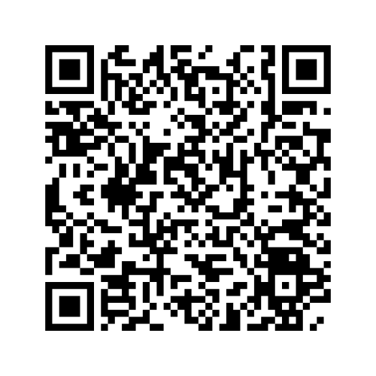
Interested in shaping research at Imperial?
Sign up to our mailing list

