Slide 1


Suicide Prevention Project
Naglaa Sadik Ahmed Mustafa
Abdul Mageed Educational Trust

Slide 2
Aims of the Project
More people will have good mental health
More people with mental health will recover
More people with mental health problems will have good physical health
More people with mental health issues will have good support and care
More people will have a positive experience of care and support
Fewer people will suffer from avoidable harm
Fewer people will experience of stigma and discrimination

Slide 3
Activities/Outputs and Outcomes Delivered
Outputs
Conducted 25 survey with people from different background and ages
Delivered two workshops attended by 39 people in total.
First workshop theme was on tipping the he balance, triggers and consequences, isolation and Lonliness
Second workshops focused on arts therapy, meditation and sound healing
Outcomes
people were able to share their personal stories, share experiences and were giving time to relax, mediate, and heal the wounds
People socialized and made connections and new friends
People have fun and good time together
Increased people awareness about suicide and good mental health

Slide 4
Some of the Survey Findings
25 people from different background mostly Arabic speaking and other Minorites including Eritrean, Pakistani, Bangladeshi etc.
Ages between 24-80
Boroughs- majority from Westminster with some from RBKC, H &F, Brent, Hackney, Harrow and Newham
92% said the mental health is not discussed enough in their communities and 8% said discussed at coffee morning groups and with GPs.
72% said people are not accessing the mental health they need (quotes they do not want to be labelled as unnormal) and 28% said they can access via websites, GPs and community groups
100% said we need to speak more about suicide and promote mental health
92% said there is strong stigma around suicide and mental illness
People seek emotional support from family members, spouses, friends, community groups, NHS and God
To reduce prevalence of suicide we should raise awareness, talk about it , peer support and provide culturally appropriate services etc.

Slide 5
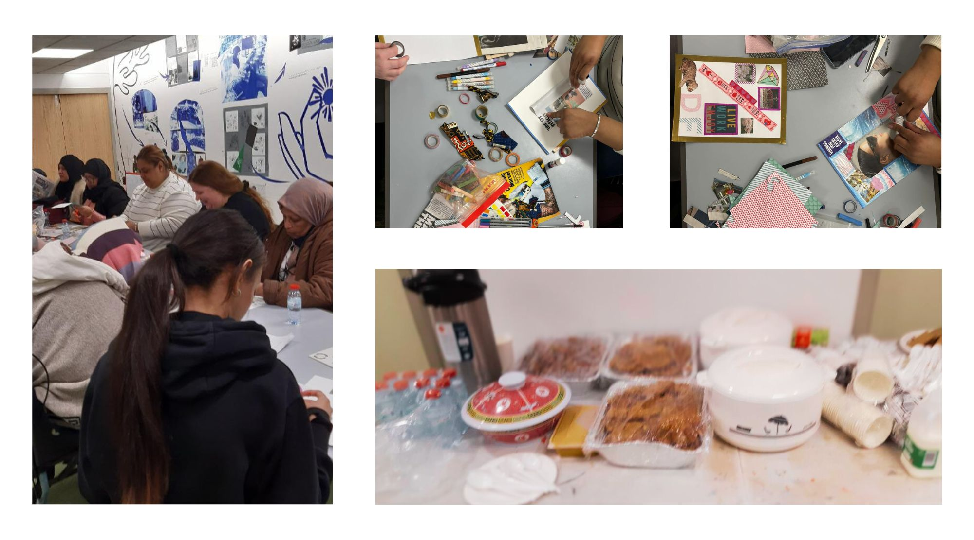
Photos form workshops

Slide 6
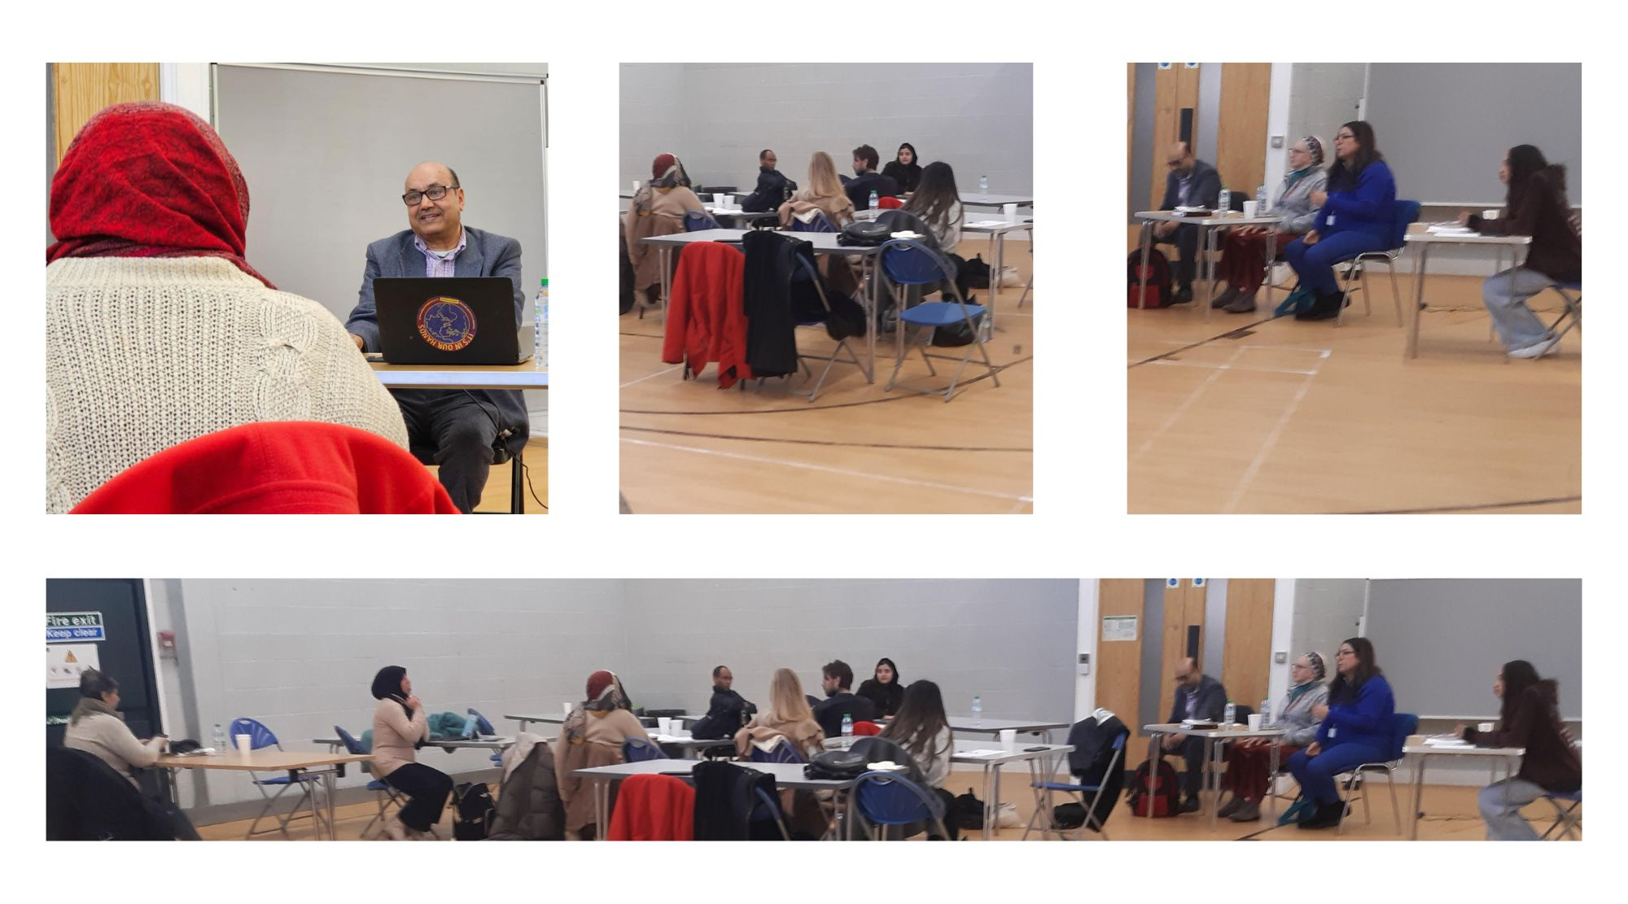
Photos from workshops

Slide 7
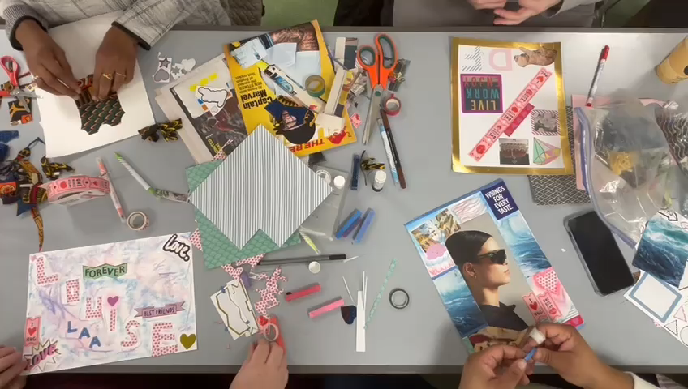
Video

Slide 8
Case Study
Background and needs description : Middle aged woman with mental health difficulties, stress, and low mood. Overwhelmed with life difficulties, poor housing and cost of living crisis. Struggling with suicidal thoughts. She was walking near the canal and thought of jumping in and sinking. Before she takes that action, she thought of her daughter and that pulled her away from suicide. She also mentioned that her religion (Islam) didn’t help her to stop suicidal thoughts/attempt
“People in my community told me that: if you attempt suicide, then you are not Muslim. So, communities do not solve the problem”. She also said that we are brainwashed by many things
How we met the client : Attended the Suicide Prevention and mental health promotion workshop on 15th of January 2024 at the Stowe Centre and spoke about her case.
What support we provided to the client : Sharing, understanding, listening, and caring provided by all participants. Follow up and checking on her on one-to-one basis.
Outcomes achieved: Better mental health and care provided by specialist services.
Networking and links to professionals and prospective friends
Taking it out of her chest, speaking loudly about her ordeal which comforted her.
Engaging with other community events and drop ins.
Follow up - Continuous contact and adding her to our mailing list to receive invitations for all our events and Peer Support groups. contact and added

Slide 9
Conclusion and Recommendations
Mental health training must consider cultural, faith and spiritual beliefs and not only represent the Western perspective of mental health.
The workshops should give information about pathways to access Western care.
Migration routes and their impact on mental health to address
Workshops should touch on mental hygiene, how to keep your mind well, and what to do to improve mental well-being.
To recruit and train mental health champions, ambassadors, and advocates to tackle suicide prevention in the community, and train to them on how to identify suicide signs and how to talk to victims or families and signpost them for further support.
Spiritual and religious leaders should participate in the workshops to help believers embrace mental well-being hygiene.
Understanding the stigma and taboo associated with mental health awareness, especially in black and ethnic minority communities.
Identifying people at risk of suicidal thoughts, particularly young mums who struggle with post-natal depression, victims of domestic violence, mums of disabled children, asylum seekers and refugees, and young people who need the right support.
We need to embark on joint research on mental health and suicidal thoughts in our communities.
Interpreting in Arabic and Amharic is crucial to the success of the workshops.

