Slide 1

Cancer Screen, Detect and Protect Project & Cancer Awareness Communications and Engagement Project Brief Reports
Dr. Eiman Khidir
Community Engagement Coordinator
Abdul Mageed Educational Trust

Slide 2
Cancer Screen, Detect and Protect Project Overview
Three workshops about bowel, breast, and cervical cancer last June and July.
Delivered by presenters from Imperial College Healthcare NHS Trust
Venues: Church Street Library, London, NW8 8EU and Ground Floor Hall, Rebel, London, W9 3RU
Attendees: 34 participants

Slide 3
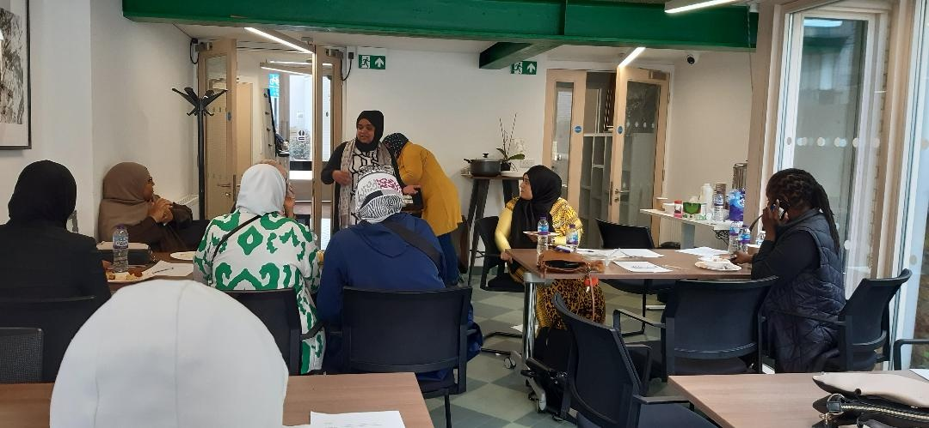
Photos

Slide 4
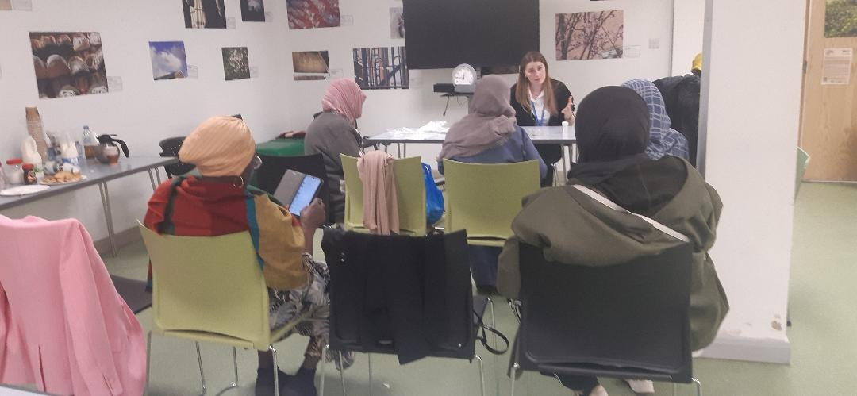
Photos

Slide 5
Main Outcomes
The participants became aware of various types of cancer and the importance of screening for early detection.
More knowledge about symptoms of breast cancer and when women can seek help from the GP. Also, the participants became aware of the mammogram method and how to weigh its benefits over the pain and discomfort that could be associated with the procedure.

Slide 6
Main Outcomes Cont.
More information about symptoms of cervical cancer, its causes, and at which age the women should be invited for the screening test. Also, there was more elaboration about the screening technique and the given options for women to choose the suitable size of the test device.
Detailed information about the symptoms of bowel cancer, the screening method, and at which age they could be invited for the test. However, they should seek immediate help from the GP if they have any concerns about changes in their bowel habits or noticing blood in the stool.

Slide 7
Feedback
Most of the participants mentioned they have a greater awareness of the symptoms, the importance of early detection of bowel, breast, and cervical cancer and the screening process as a result of attending the workshops.
Most of them will attend cancer screening when they receive an invitation.
All participants will encourage family members, relatives, and neighbours to attend cancer screening.
One participant mentioned she had bowel cancer in 1995.

Slide 8
Case Study One
Female patient, age 51, Black African, with cervical cancer undergoing chemotherapy.
She has the courage and determination to talk about her experience to the public and hopes to recover and become well.
Knowing the importance of cancer screening, she will be keen to attend her smear tests regularly and inform and advise others to do the same.

Slide 9
Case Study Two
Female, bowel cancer survivour, Age 85, Indian Background.
She attended a bowel cancer workshop and spoke publicly about her experience.
She gained confidence, energy and a strong will to overcome cancer and three major operations. She is willing to talk to anybody who needs to know her survival story.

Slide 10
Cancer Ambassador One
Name: Fatima Taha
Organisation: Abdul Mageed Educational Trust
She wanted to be a cancer ambassador after attending these workshops to raise awareness about the importance of cancer screening for early detection, diagnosis, and treatment.
She spoke about cervical cancer and bowel cancer screening with 25 attendees.
The outcomes: the participants were encouraged to attend screening and smear tests for cervical cancer and were informed about which equipment size and gel they could decide to choose.
There is a stigma about cancer.

Slide 11
Cancer Ambassador Two
Name: Dr. Eiman Abd Almonim Khidir
Organisation: Abdul Mageed Educational Trust
What made me want to become a cancer ambassador is I suffer from a benign tumour, which I am screening every few months. I am passionate about educating and raising awareness about cancer screening and general health issues.
I learned a lot from attending the cancer screening workshops about different cancer screening methods offered by the NHS. Hence, I was keen to pass the knowledge to others to enlighten them about cancer, its different symptoms and the screening procedures.

Slide 12
Cancer Awareness Communications and Engagement Project Overview
Two workshops about NHS cervical cancer and bowel cancer screening.
Delivered by GP from Brunswick Park Medical Centre and presenter from Imperial College Healthcare NHS Trust last May.
Venues: Ground Floor Hall, Rebel, London, W9 3RU and Stowe Centre, London W2 5ES
Interpreter: Naglaa Sadik Ahmed Mustafa
Attendees: 27
Ethnicity: Black Africans, Asians, Middle Eastern and White Africans.

Slide 13
Main Outcomes
The GP spoke about three types of NHS cancer screening including, cervical, breast and bowel screening. She then spoke thoroughly about cervical cancer. There was a long discussion, and the feedback was rich.
The other presenter showed a presentation and a video explaining the importance of early detection of cancer by screening.

Slide 14
Feedback
Most of the participants have a greater awareness of symptoms, the importance of early detection of cancer and the cancer screening process as a result of attending the workshops
All participants will attend cancer screening when they receive invitation in the future.
Most of them will encourage family members, relatives, and neighbours to attend cancer screening.

Slide 15
Concluding Remarks
Invitation to speak about different treatment options offered by the NHS.
Working through the reduction of cancer screening stigma, especially among ethnic minorities.

