Slide 1
Better Care, When You Need It Most
Transforming Urgent and Emergency Care
in North West London
11th December 2024
Presented by:
Melissa Mellett
Associate Director of Urgent and Emergency Care
North West London Integrated Care Board

Slide 2


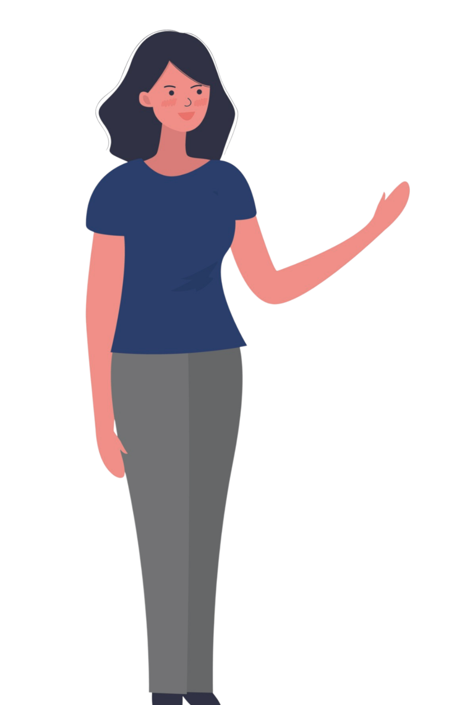

Introduction: Why this matters to you
Why are we transforming Urgent and Emergency Care Services
Why are we here today?
Patient experience: We are seeing many people visiting emergency departments due to being unable to access emergency care within other healthcare settings. We recognise the system is not working as well as it could be.
Your experience matters: Share your thoughts and help shape the future of healthcare in your community.
What’s changing: See how new plans will make it easier for you to get the right care at the right time.
There are various engagement events covering urgent care. This event will be included in the feedback on experience of services. Tell us what’s working and what needs improvement.
Why are we doing this?
We understand that some of you may find it difficult to identify the right care at the right time, whether it's for an emergency, managing long-term conditions, or recovering after a hospital stay. Our goal is to improve how urgent and emergency care is delivered, focusing on better access, less waiting, and care closer to home.

Slide 3

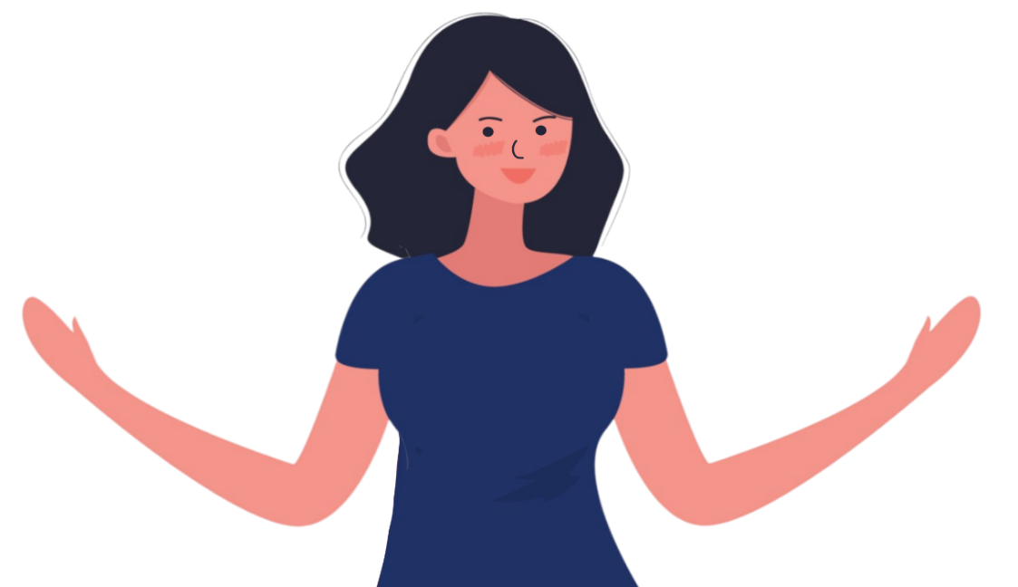
What is Urgent and Emergency Care?
What is Emergency care?
Emergency care involves life-threatening illnesses or accidents which require immediate treatment from the ambulance service (via 999) and an emergency department (A&E).
What is Urgent care?
Urgent care involves any non-life-threatening illness or injury needing urgent attention which might be dealt with by phone consultation through the NHS 111, pharmacy advice, out-of-hours GP appointments, and/or referral to an Urgent Treatment Centre (UTC).
If you’re unsure if you need urgent medical help then NHS 111 can help.
Urgent and Emergency care services are changing to ensure that patients get the right care, by the right person, in the right place, whenever they need it, and as quickly as possible – to keep you healthy.

Slide 4

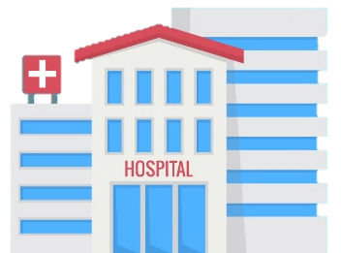
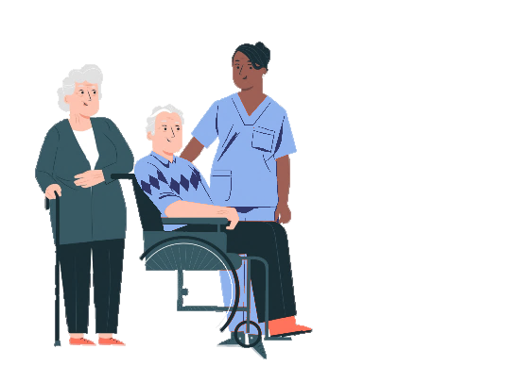

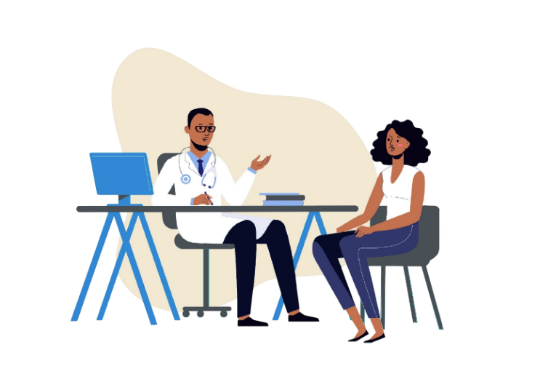

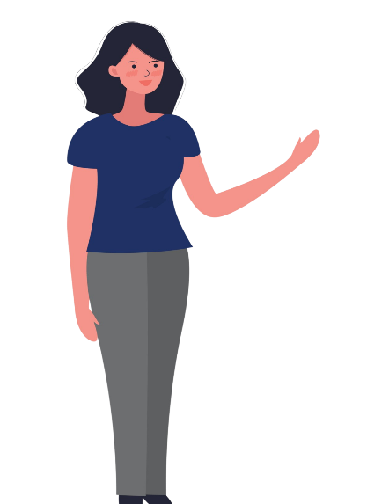
Our Strategy: Why are we doing this?
We are focusing on four key areas to improve the care you receive:
A. Helping you stay healthy
Personalised healthcare support close to home especially for those with complex needs.
B. Improved Access to Primary Care
Easier access to primary care, when you need It.
D
C. Efficient Hospital Care in an emergency
Responsive diagnosis and treatment in an emergency – Efficient, effective care for urgent health needs.
C
D. Helping you recover Ensuring a smooth, supported transition back home or to the community after a hospital stay.
B
A

Slide 5

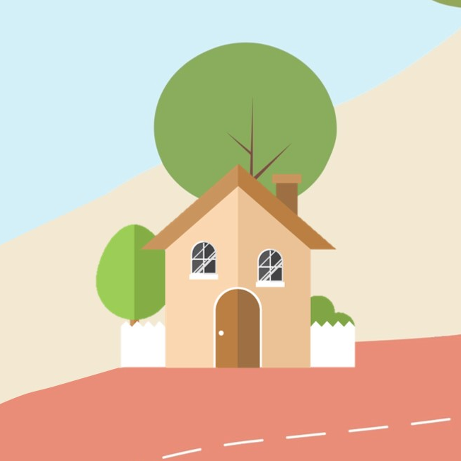
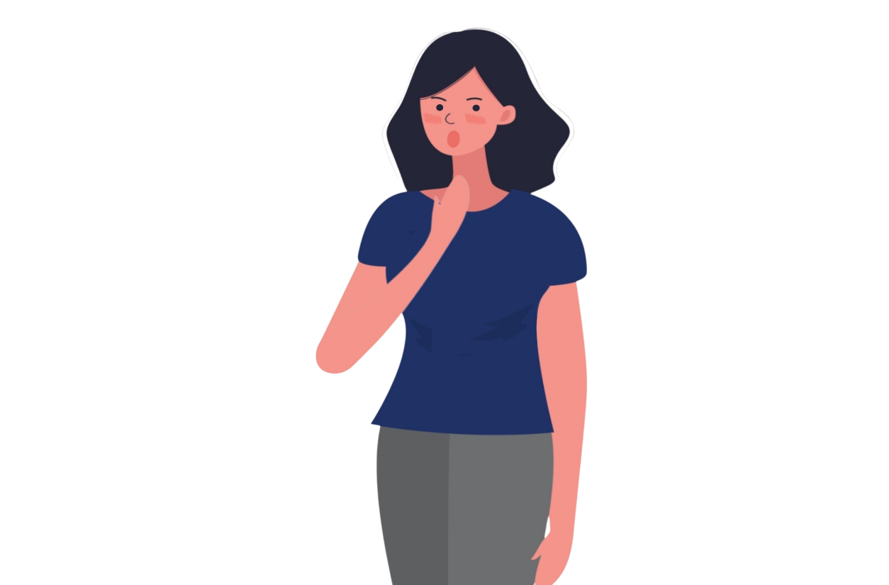
Helping you stay healthy
A
What does this mean for you?
We are supporting people with long-term conditions (like diabetes, heart disease, frailty) get better care in the community to help prevent a health crisis needing emergency care.
You will have more access to services before things become urgent – such as regular contact with a healthcare professional, health monitoring through virtual wards (which offer easy access to specialist acute support and use technology to provide safe and effective care at home for patients without needing to stay in the hospital), and personalised care plans – meaning more support at home and less need for hospital visits.
Key benefit
Avoid hospital stays and get more support for managing your condition at home.
Is this important to your care?
Have we missed anything?

Slide 6
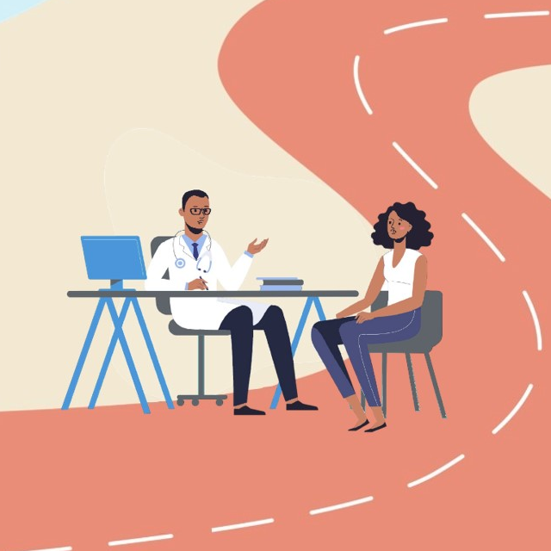
Pillar B:
Improved Access to Primary Care
B
What does this mean for you?
Primary care services in your local area are working to make sure that when you need help quickly it is available closer to home. You can easily contact services online or by phone, to help you find the right care.
For example, by calling 111, where your call will be answered within 30 seconds, a trained call handler can direct you to the right service and book an appointment if you need one. This might be a face-to-face appointment with a GP or a local dentist, or support from a practice nurse or care coordinator. Some GPs are also setting up specialist hubs to provide urgent care quickly in your local area.
Your local pharmacy can also provide urgent care for some conditions, so this may be quickest and simplest way to get you the care you need.
Key benefit
You can get access closer to home, and don’t have to go to A&E to get the support you need.
Is this important to your care?
Have we missed anything?

Slide 7
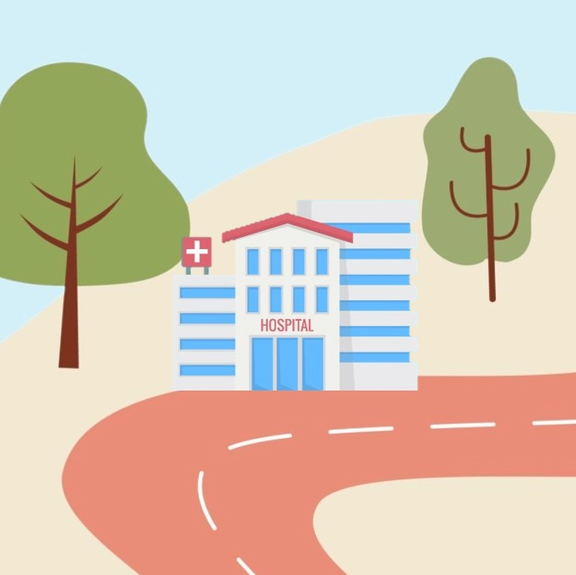
Pillar C:
Efficient Hospital Care in an emergency
What does this mean for you?
C
When you need urgent care, you will be seen faster. A&Es will be redesigned to ensure efficient and quicker care. We’re expanding Same Day Emergency Care (SDEC) capacity to treat more patients without the need for hospitalisation. Medical SDEC is available in all of our hospital sites. Surgical and Frailty SDEC are not available in all sites and will be introduced across all sites over the next 2 years. These services will improve their experience and overall patient journey.
Key benefit
Direct access to diagnostics, more expertise in urgent care hubs so you don’t need to go to A&E, more done online if easier for you
Is this important to your care?
Have we missed anything?

Slide 8
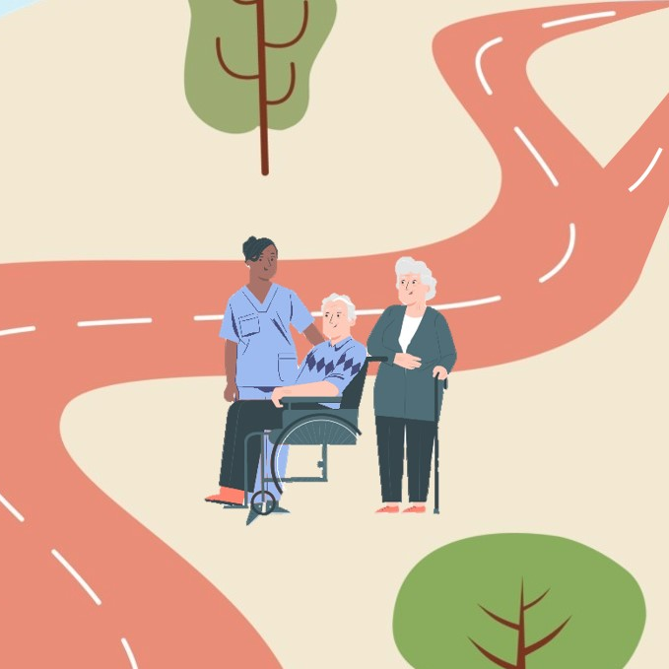
Pillar D:
Helping you recover
What does this mean for you?
D
After a hospital stay, we will make sure that you leave hospital with a plan for ongoing care at home or in the community. We will ensure you have follow-up care helping you manage your health at home, including input from social care and virtual ward options. Virtual wards offer easy access to specialist acute support and use technology to provide safe and effective care at home for patients without needing to stay in the hospital.
Virtual Wards specialities include respiratory diseases, and heart failure. Services are being expanded to include acute medicine. We are also looking at community provision
Key benefit
Better support once you leave the hospital with less chance of being readmitted.
Is this important to your care?
Have we missed anything?

Slide 9
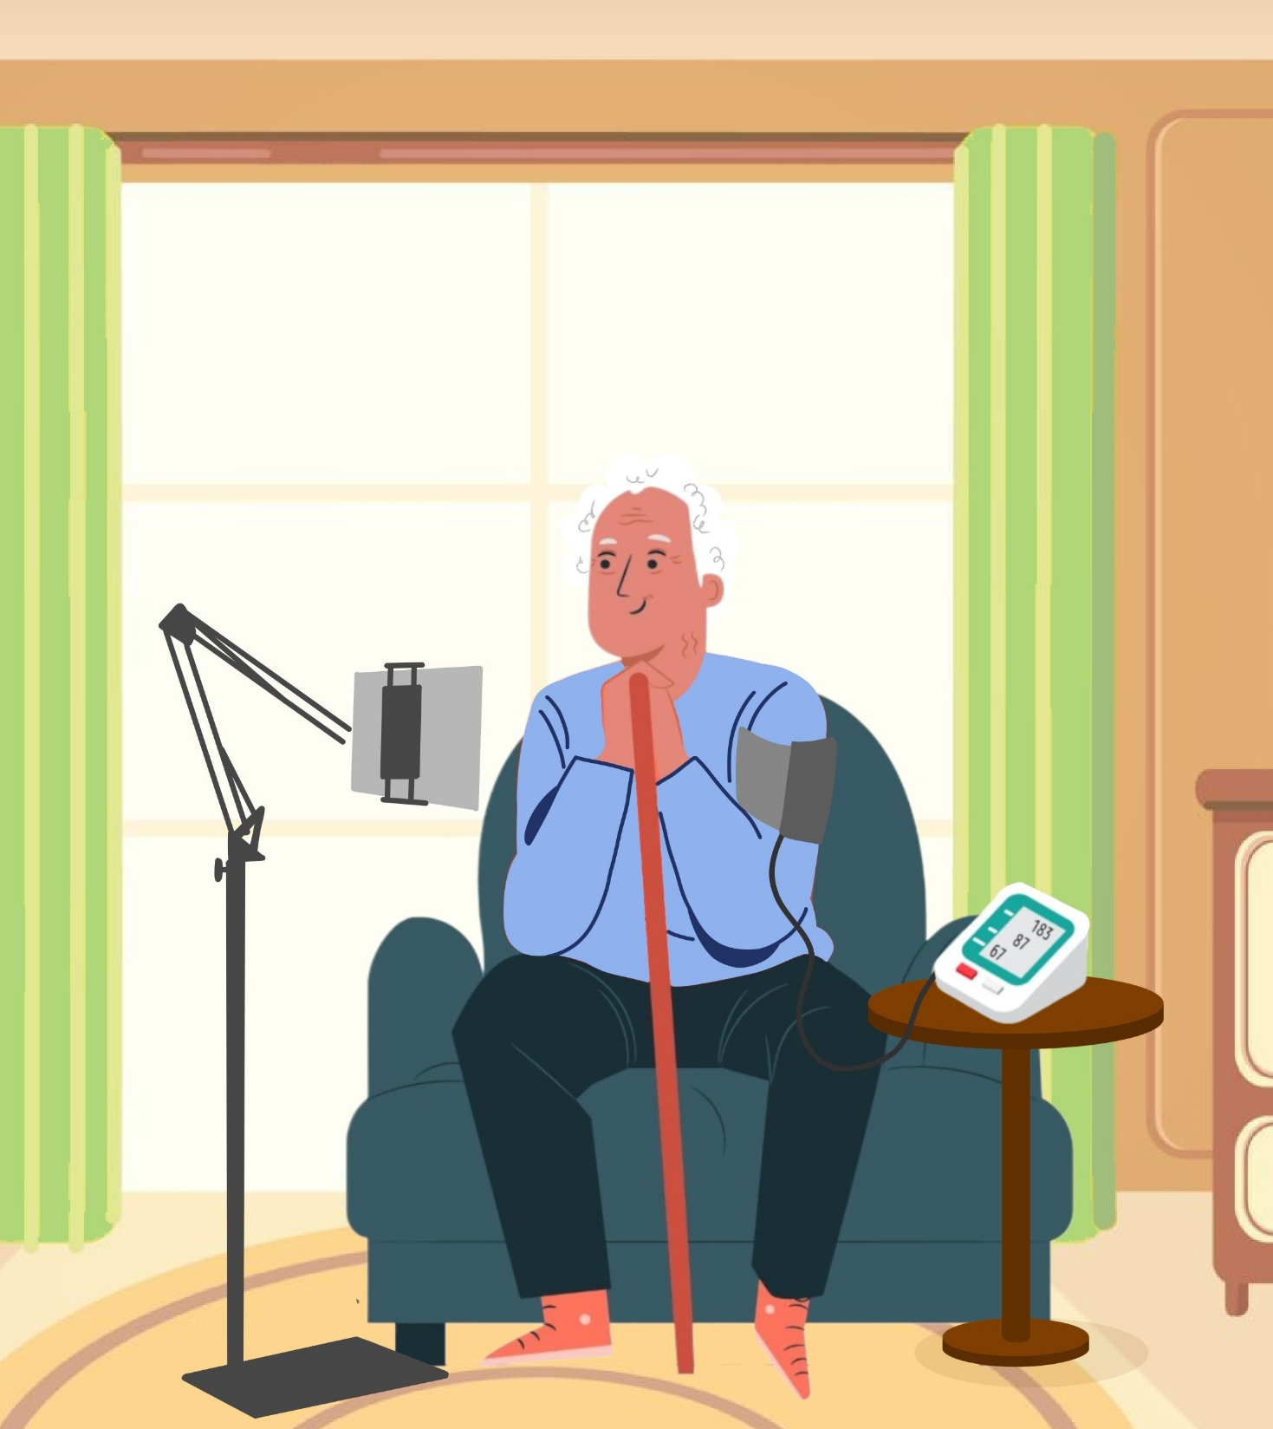

Story A: James’ journey
Staying healthy at home
A
James, a North West London resident, has benefited from our integrated care approach.
Problem: Before, James struggled with frequent hospital trips and long waits for care.
Solution: With more community support, James now gets: Regular contact from healthcare professionals. 24/7 virtual monitoring to track his health. Personalised care plan tailored to his needs.
Impact: Fewer hospital visits, more time with family. James says: “I no longer live in fear of emergencies. I feel confident and supported.”
At 81, James suffered from heart disease and often found himself in and out of the hospital as a result of his condition. He remembers feeling frustrated and scared, not knowing the next time he will need to go to hospital and how long he would have to wait for treatment; the constant trips to the hospital took a toll on his physical and emotional well-being.
With our new proactive care model, James now receives regular contacts from community health professionals and has access to a virtual ward that monitors his health remotely. This means James can manage his condition more effectively at home, reducing the need for emergency visits to hospital and allowing him to feel more in control of his health.
James shared he no longer lives in fear of the next emergency and can enjoy more time with his family, feeling confident in the care he receives.
.

Slide 10
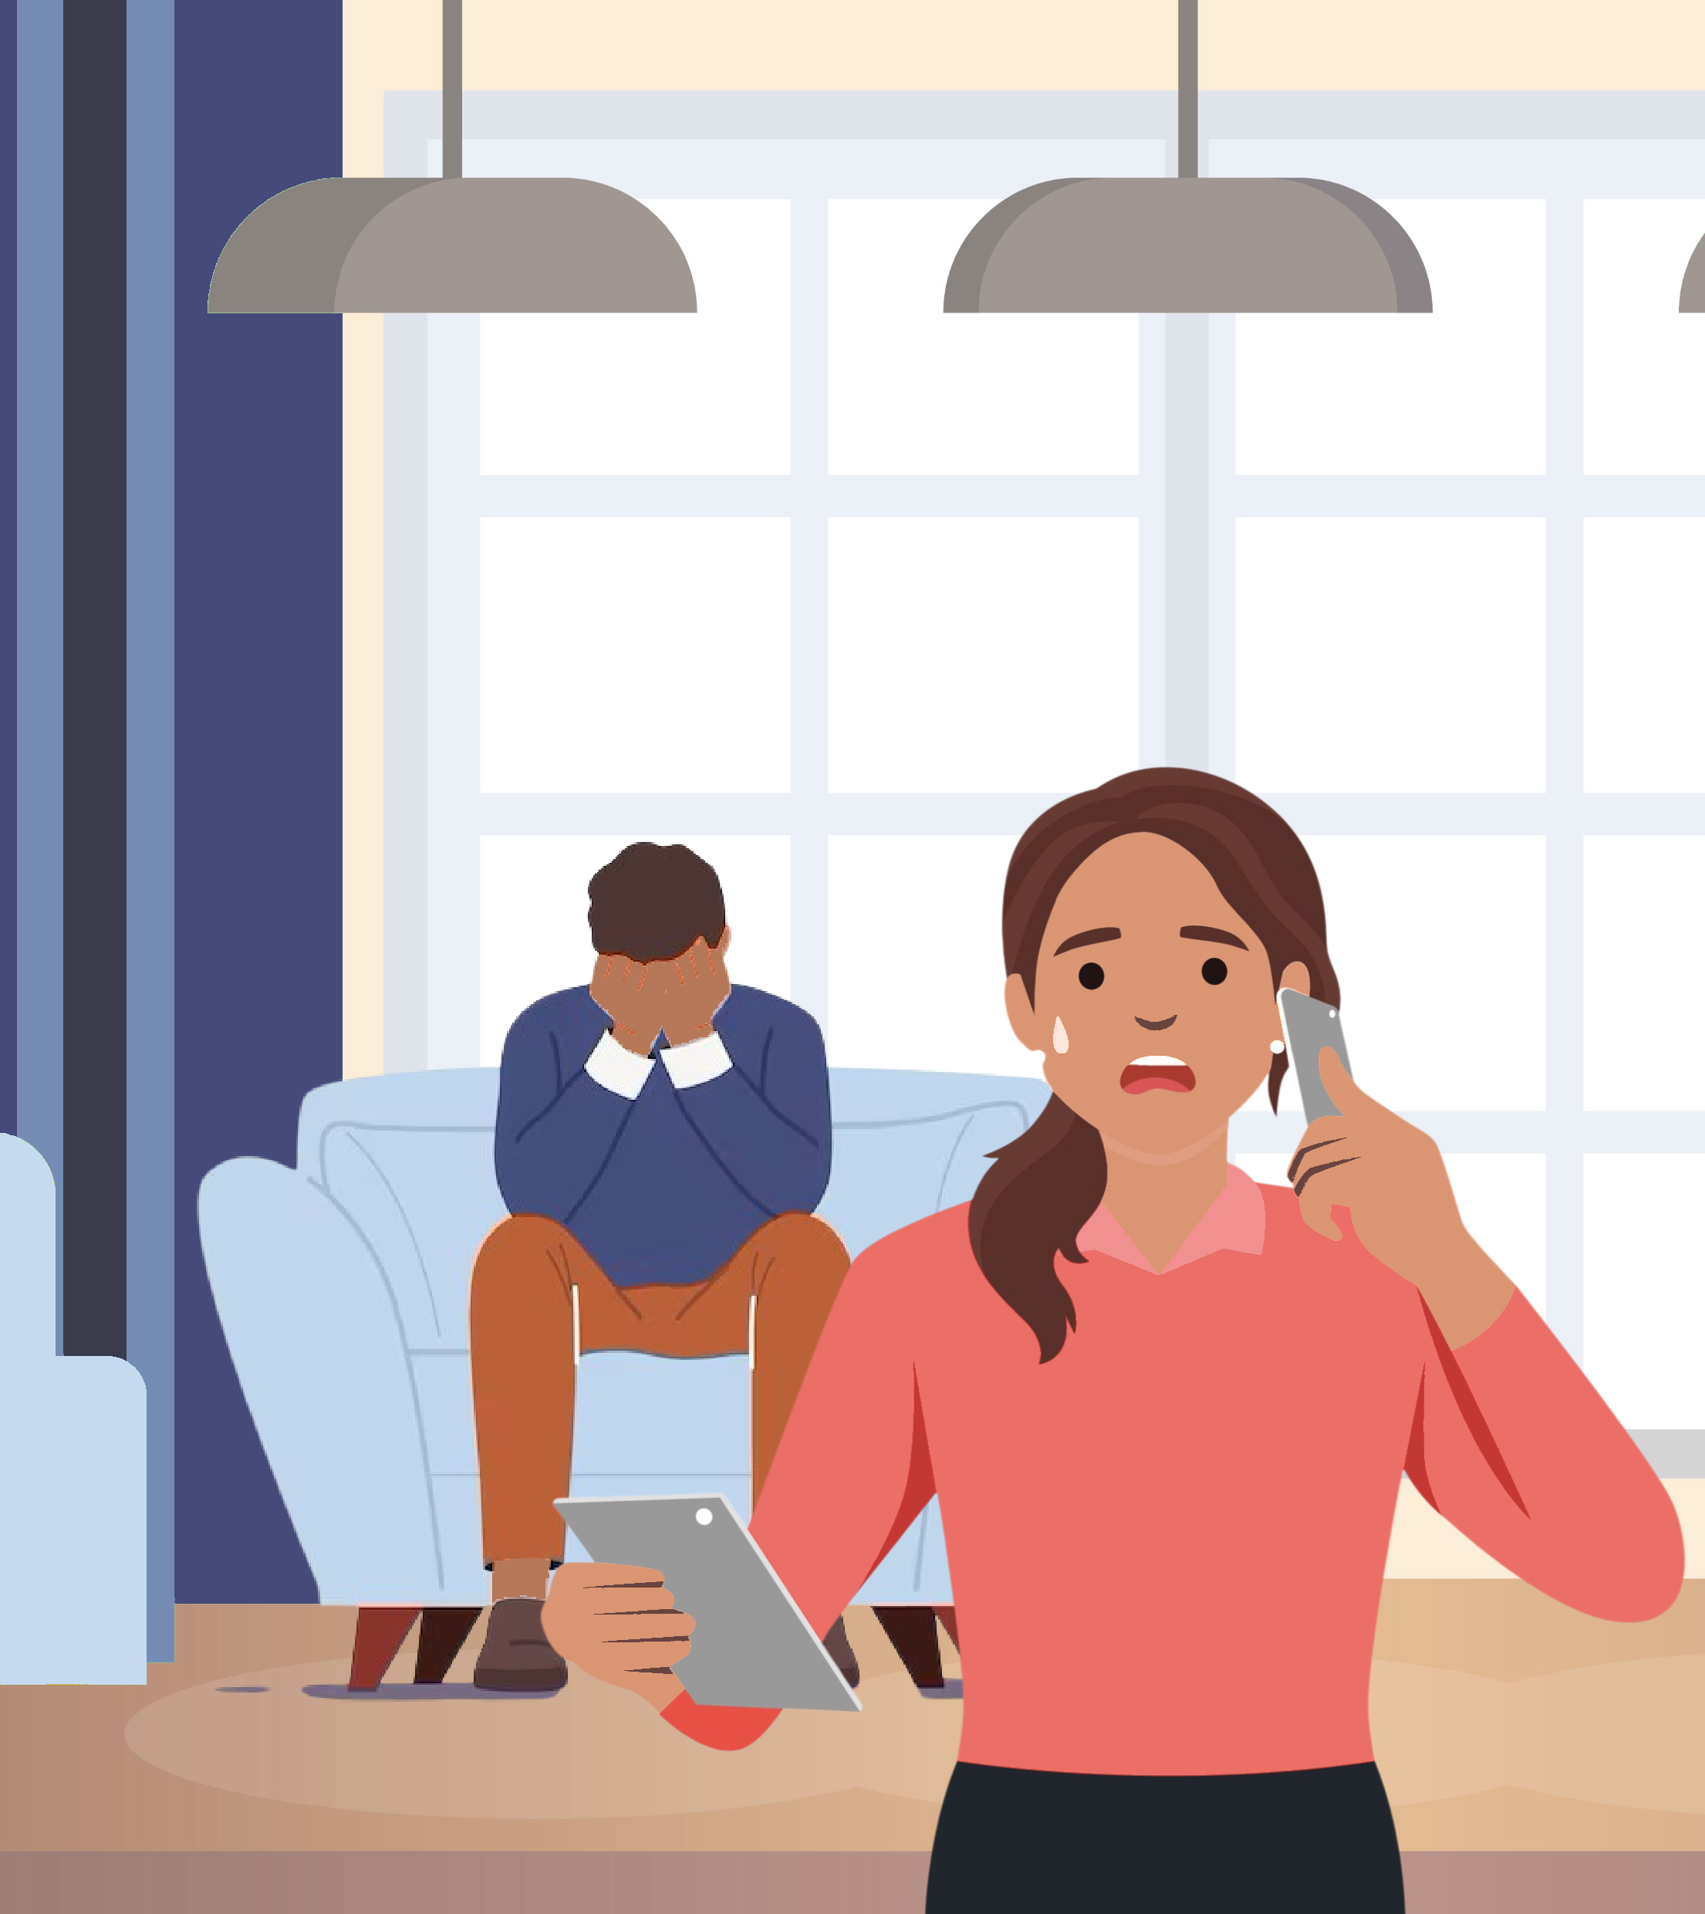

Story B: Dev and Alisha’s journey
Easier access to the right care
B
Problem: Dev is 52 and he said he didn’t want to live anymore. He was overwhelmed with anxiety and depression after his marriage ended. He lived with his 19-year-old daughter, Alisha, her 14-month-old child, and her three younger siblings.
Worried about her dad and the safety of her family, Alisha called 111, unsure of where else to turn. In urgency, she missed the *2 option on her phone for mental health support. When connected, the Health Advisor encouraged Dev to speak with a 111 Clinician, who assessed the situation.
Solution: The clinician confirmed no immediate danger but quickly connected Dev with the local Mental Health hub for his anxiety and depression. They also arranged for a follow-up appointment with Dev’s GP to consider medication and any further referrals he might need.
The clinician also referred the family to children’s social care in their neighbourhood who worked with Alisha and Dev to identify the children’s needs and provide tailored support for the whole family.
Impact: Thanks to the responsive and joined-up care Dev now has access to mental health care and the family is receiving the support they need to move forward together.

Slide 11
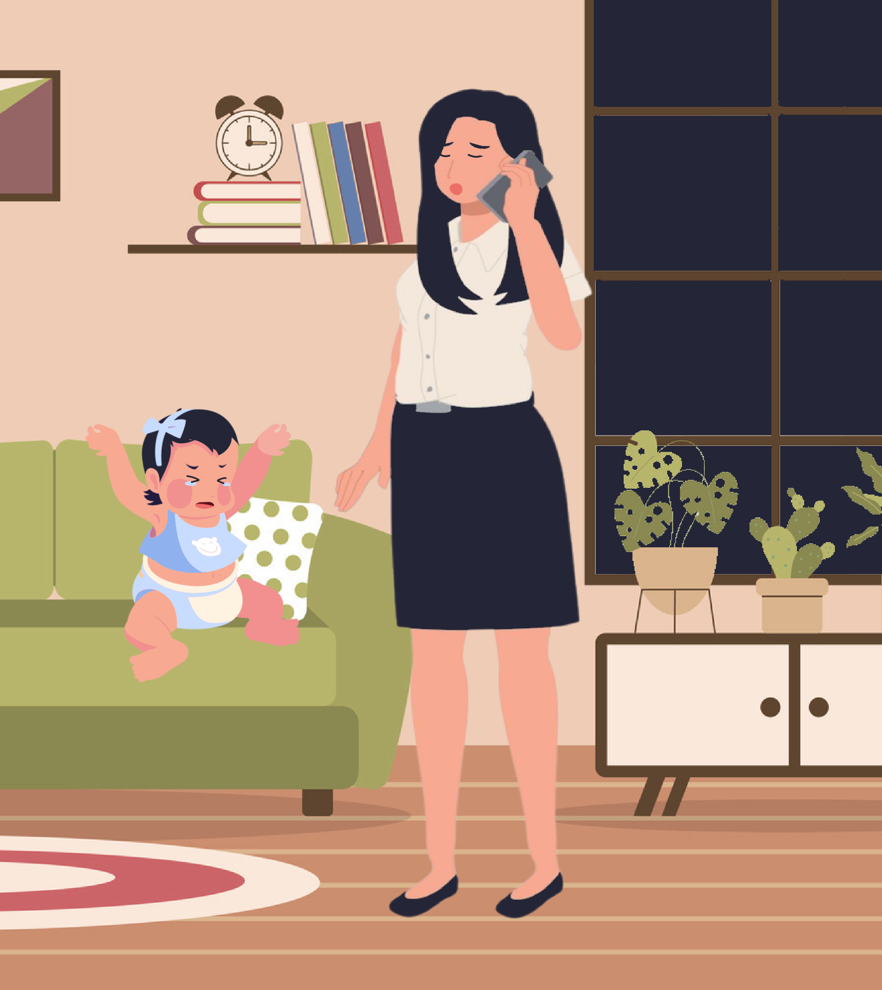
Story B: Amanda’s journey
Easier access to the right care
B
Problem: Amanda is a busy working mum. One evening after her work shift, her 2-year-old daughter developed a persistent high fever of 38.8°C for the second day. Unsure of what to do at 10pm, Amanda decided to call 111. She trusted the service because, in the past, when she experienced postpartum depression, 111 connected her with a Mental Health Practitioner who provided advice and support.
Solution: This time, after calling 111, Amanda spoke to a Health Advisor who went through a list of her child’s symptoms, including a rash and a loss of appetite. She was then connected to a clinician who assessed the situation, determined it was not an emergency, and booked a GP appointment. Amanda and her daughter visited the GP, who provided treatment and prescribed medication. The GP also recommended a Family Hub in the neighbourhood that connected Amanda and her child to additional community support, which they found very helpful.
Impact: Amanda appreciated how quickly and efficiently the service guided her to the care her daughter needed, giving her peace of mind in a stressful situation.

Slide 12
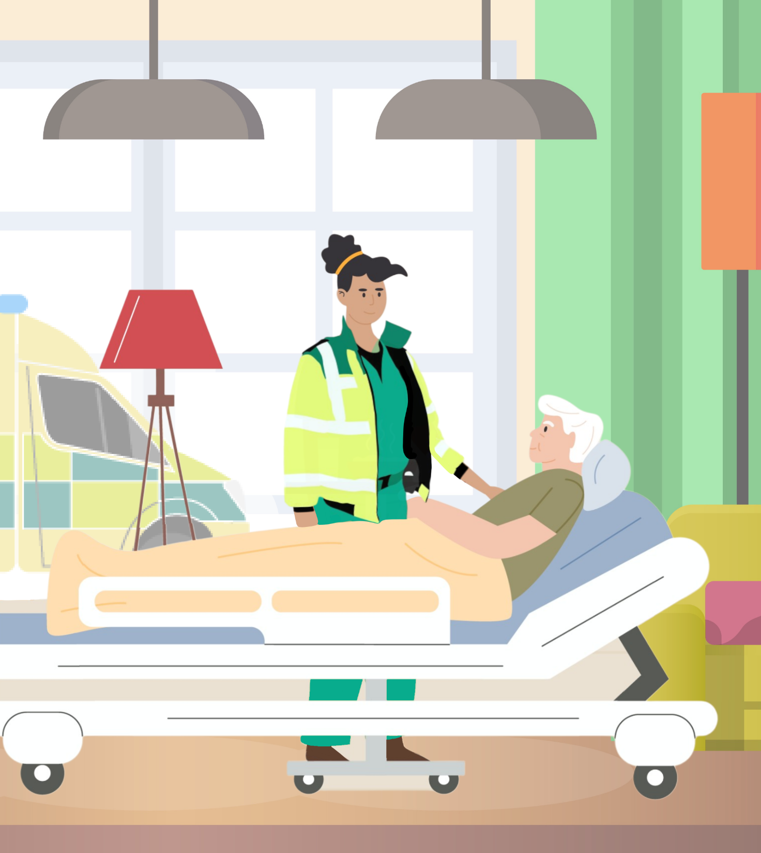
Story C: Bartek’s journey
Responsive treatment in emergencies
C
Problem: Bartek is a 75 year old man who lives alone. He has been feeling unwell for the last few hours and is starting to feel confused.
Solution: He calls his GP practice and is put through to a GP for an assessment over the phone. His GP identifies that he needs some immediate attention from an emergency service and calls the ambulance service via a healthcare practitioner line that takes him straight through to an ambulance crew member.
An ambulance is sent to Bartek’s home where he is assessed. The ambulance crew identifies that he requires support within a hospital setting and contacts the team most able to provide for his needs. Bartek arrives at hospital and is directed into the frailty team who can manage his condition.
Impact: Thanks to coordinated care across healthcare services, Bartek receives a fast response that is able to provide assessment within his home and identify the most appropriate service to provide management for his urgent care condition.
.

Slide 13
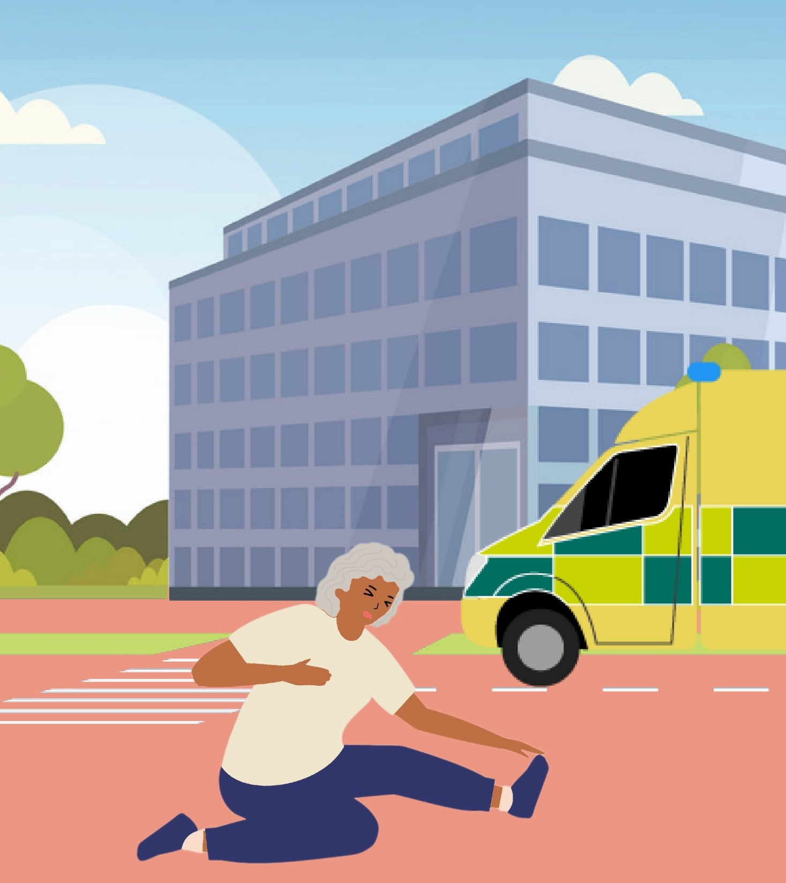
Story C: Rashida’s Journey
Responsive treatment in emergencies
C
Let’s hear from Rashida, a resident who has benefited from our efficient care services.
Problem: Rashida has just turned 70, has a history of heart disease but stays active by exercising at least twice a week. One day, on her way to a swimming class, she suddenly felt breathless, experienced burning chest pain, dizziness, and discomfort. The sports centre called 999, and an ambulance quickly arrived to take her to the nearest hospital.
Solution: During the ambulance ride, the paramedics helped keep Rashida calm, and assessed her symptoms and needs. When she arrived at the hospital, she was referred directly to the Same Day Emergency Care (SDEC) department. There, a heart specialist (Cardiologist) assessed her condition, provided treatment, prescribed medication, and gave her clear aftercare instructions. Rashida was able to return home on the same day without needing to stay overnight in the hospital.
Impact: Rapid assessment of symptoms and onward referral to an appropriate service that can manage her needs utilising the Same Day Emergency Care (SDEC) department.
Rashida felt relieved and grateful for the efficient and effective care she received. She was happy to avoid going to A&E or waiting weeks for a specialist appointment, which made her experience much less stressful.

Slide 14
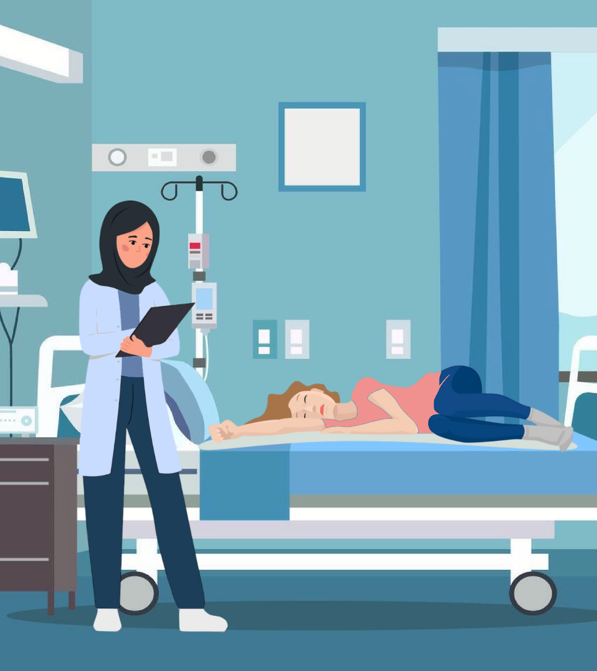
Story D: Claire’s journey
Recovery and plan for the future
D
Let’s hear from Claire, a resident who has benefited from our integrated care approach.
Problem: Claire is 36 with a long history of drug use and diabetes. One day, Claire was admitted via the Emergency Department with a deep infection of her hand.
Solution: Because she lived in a homeless hostel, she was referred quickly to the hospital Inclusion Health Team. They helped ensure Claire didn’t lose her hostel space due to her absence and supported her in registering with a GP. They also connected her with a specialist drug service to get the help she needed.
Following discharge, the team arranged for a peer advocate to bring her to follow-up appointments which were required to maintain her treatment at her GP and drug service.
Impact: Without the Inclusion Health Team’s intervention, Claire might have lost her place at the hostel and been forced to return to sleeping rough on the streets. Without the connections to her GP, drug services, and other support, her situations could have recurred.
Claire now has the support she needs to stay on the path to recovery.

Slide 15

How will we know we’re succeeding?
Care Plans
Increasing number of patients with personalised care plans
Urgent Care
Ensuring patients can access alternatives to A&E for urgent care conditions
A&E
Reducing waiting times in A&E.
Same Day Emergency Care
Increasing the proportion of patients seen and discharged from emergency care on the same day. Goal: +15,000 treated.
Effective triage
Ensuring patients are directed to the right care setting.
Primary Care Access
Ensuring patients can easily access their GP practice or other appropriate primary care services.
Online support
Easier and better online support via 111 Online and NHS App.
Reducing your time in hospital
Goal: Reduction of length of stay (LoS) by 10% and only 4% of patient not meeting the criteria to reside (CTR).
Hospital discharge
Making sure patients are discharged with a care plan swiftly when they are medically fit

Slide 16

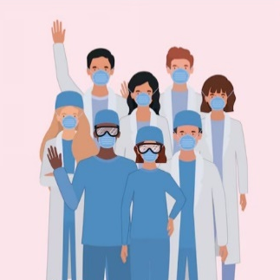

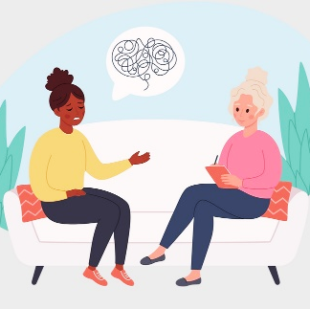
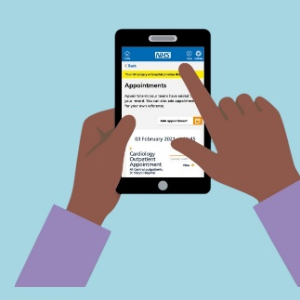
What we need to make this work?
Care closer to home
Community care, better facilities for home monitoring and virtual care. Imagine your neighbourhood pharmacy offering more services to avoid hospital visits.
Data & Digital: Better tools
Digital health tools to help you manage your care at home. Secure systems that share your health information between GPs, hospitals, and specialists safely and quickly.
Enablers
Workforce: People who care
Training and expansion of new clinical roles in the community.
Communications: Clear information
Simple and reliable advice about where to go for help. Raising awareness of new and improved services. Working with different community groups to support being conveyed in an understandable way

Slide 17

How will this be delivered?
1. Working together
We will ensure that all health services are working together and communicating to support smooth care transitions for patients.
2. Strong leadership and oversight
A dedicated team will make sure these changes are implemented. Regular checks will be made to ensure care improves, and your feedback matters.
3. Collaborative partnerships
Hospitals, GPs, mental health community and social care providers will work hand-in-hand to deliver joined-up care. You’ll get the right care, in the right place, at the right time.

Slide 18


What have we achieved so far?
NHS 111 offers quicker access to services like Mental Health and Dental care by choosing the star (*) option on your phone.
98% of NW London pharmacists participate in Pharmacy First, to assess and prescribe medicines to treat 7 common health conditions
Virtual Wards in NWL use technology to provide care at home for patients without needing to stay in the hospital, helping approx. 500 patients per month
Support for High Intensity Users of A&E by Case Workers and Care Coordinators.
Child Health Hubs to provide specialised care to young patients in their neighbourhood.
NHS 111 are directly booking appointments into GP practices.
Ambulances take patients directly to an Urgent Treatment Centre or Same Day Emergency Care rather than A&E.
SDEC: Specialists care and discharge patients within the same day to reduce patient waiting time in ED and the need for a hospital stay.
NHS App provides a direct link to NHS 111.
Universal Care Plans make it easy for patients to share their care preferences with healthcare professionals.
Urgent Community Response teams provide urgent care at home.
Redesigned A&E services at every NWL A&E site that aligns the Emergency Department and Urgent Treatment Centre services

Slide 19





Facts and Figures in 2023-24
669,000 NHS 111 calls answered
423,000 999 calls answered
175,500 ambulances conveyed
601,000 attendances in A&E
Of those, 415,000 were UTC attendances
74.7% A&E attendances seen within 4 hours
218,000 patients were admitted into the hospital
Average length of stay for emergency admissions in the hospital was 7.2 days
Approximately 7,000 Virtual Wards admissions within 2023/24

Slide 20
What happens next with your input
Why this matters?
Inputs into service change: We are taking inputs from a wide group of residents and service users and looking to improve services for everyone
Better outcomes: Proactive, joined-up care means fewer emergencies, less stress, and more time living your life.
Stronger communities: Together, we’re building a system that cares for everyone – today and tomorrow.
What this means for you?
Peace of mind: Whether it’s urgent help or long-term care, you’ll know where to turn.
A personalised journey: Services tailored to your unique needs and circumstances.
Our strategy is focused on coordinating every step of your care – Together, We Can Make It Happen.
Your voice matters: Thank you for sharing your insights and helping us shape better care.
Our commitment: We’ll continue working with you to create a system that works for everyone.
Next steps: Stay involved – your feedback guides us every step of the way.

Slide 21
Thank You
T

