Slide 1
Cost of living update
Ealing Advice Forum
November 2025
Louisa McDonald

Slide 2

Winter Holiday Activity and Food scheme
The Ealing Winter HAF Programme is now open for bookings.
The programme of free, fun activities and food is available to all children in school years reception to year 11 that are in receipt of benefits related free school meals; families on our FSM eligibility list have been sent an email with the booking details.
We have a small proportion of our budget to support children in households that are not in receipt of benefits related FSM to enjoy HAF activities. If you work with families and you have not referred them before, please do so here: online referral application form. Families that have been referred for our summer programme will have their eligibility renewed for the Winter Programme; no referral needed.
Please support families that you are working with to book an activity, particularly those that have been referred or may struggle with digital access.
The booking link to share with the families is www.eequ.org/ealinghaf

Slide 3
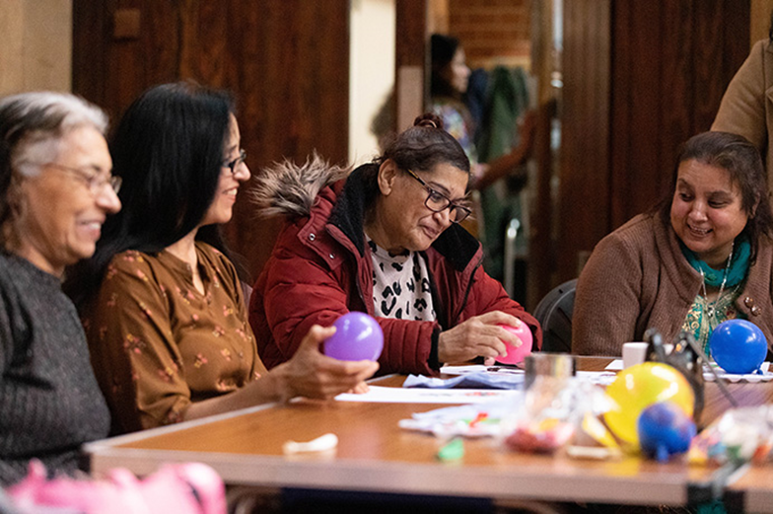
Warm Spaces
The brough’s Warm and Welcome Spaces programme will run again this Winter. (End of October to end of March) all participating groups and buildings will be listed on The Community Support Directory.
If you are running a Warm and Welcome Space and you have not listed it on the Community Support Directory, please do.

Slide 4
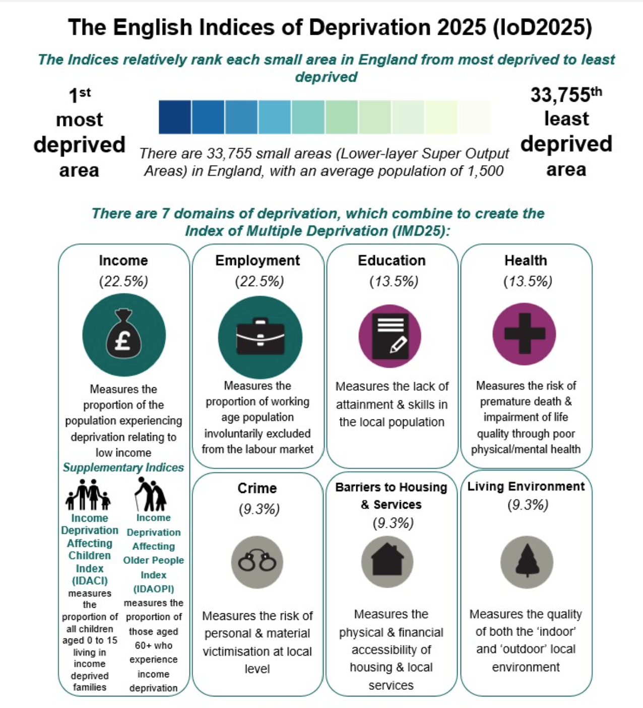
Indices of Multiple Deprivation 2025
Ealing’s position
In terms of the average rank of deprivation, Ealing is now placed as the 45th most deprived local authority districts (out of 296) in 2025, a decline from being the 88th most deprived in 2019 (out of 317).
A key reason for the change is due to a different methodology being used. For example relative deprivation has grown in Ealing and many other parts of London due to income deprivation now being calculated after housing costs rather than before, like it was in 2019.
Ealing's Research and Insight team has developed a detailed analysis of the data.

Slide 5
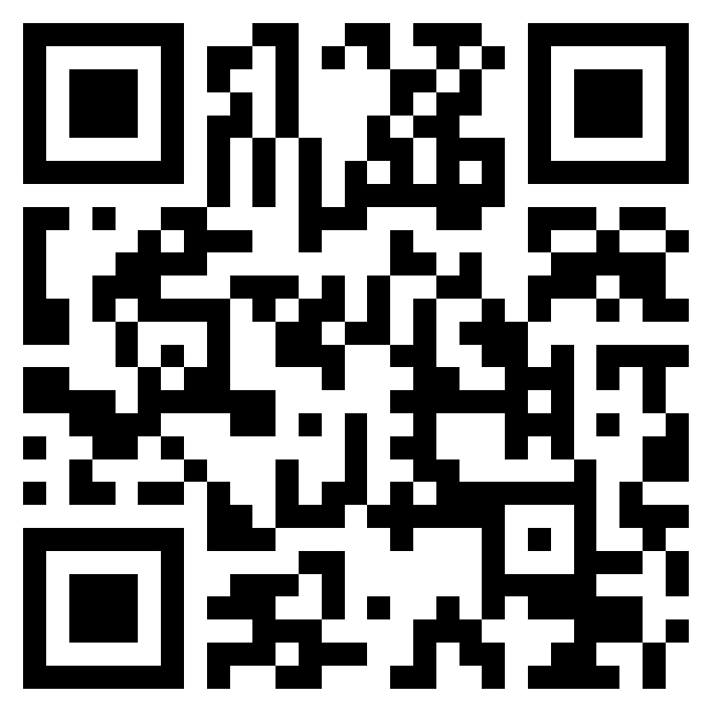
The Borough Frontline
Next topic - digital inclusion
The next online session will be on Friday 23 January 2026 @ 11:00am.
We want to involve a variety of organisations that offer support to those that are digitally excluded.
If you would like to contribute, please email Sam Booth – booths@ealing.gov.uk
To join The Borough Frontline, scan the QR code and complete the form to get on the invite list for future meetings and receive relevant information.

Slide 6
The Ticket Bank – Offer to all low income families
Ealing Council has partnered with The Ticket Bank to provide low income families across the borough free and heavily discounted tickets to concerts, theatre, comedy nights, sports matches, family attractions, and cultural events across London and the UK.
The Ticket Bank collaborates with venues and event partners to ensure that empty seats are allocated to those who will benefit most.
We will be writing to low income families to tell them about the scheme and providing them with a unique code to register.
What's on offer:
• Tickets from £1-£5.95, with no hidden fees and no sign up costs.
• Access to events nationwide
• Instant booking - tickets delivered straight to recipient's email
For more information go to www.ticketsforgood.org/the-ticket-bank

