Slide 1


SERVICES AT
JOHN HUNTER CLINIC
Krystle Jarrett - Health Advisor
Eduardo Peres - Speciality Doctor

Slide 2


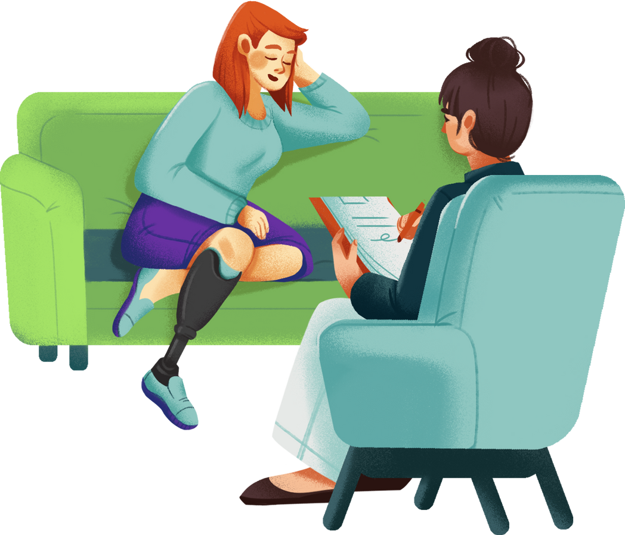
John
Hunter
Clinic
AGENDA
  Introduction - defintion
  To understand what services the John Hunter Clinic provide
  To learn some basics of SRH
  To consider the SRH needs of different communities
  To hopefully link our services more closely

Slide 3

Definition
• Sexual health is fundamental to overall health and quality of life
• Requires a positive and respectful approach to sexuality and relationships
• Involves the right to safe, pleasurable experiences free from coercion and discrimination
What is Needed
• Access to clear, accurate information about sex and sexuality
• Knowledge of potential risks and vulnerabilities
• Availability of high-quality sexual health services
• Living in an environment that promotes and affirms sexual health
Key Issues
• HIV, STIs
• Unintended pregnancy
• Sexual function and wellbeing
• Sexual violence
• Harmful practices (e.g. FGM, chemsex)
John
Hunter
Clinic
REFERENCE: WORLD HEALTH ORGANIZATION – SEXUAL HEALTH:
https://www.who.int/health-topics/sexual-health#tab=tab_1

Slide 4










We are a team of doctors, nurses, health advisors, health care assistants and admin staff all passionate about improving sexual and reproductive care
SERVICES JHC PROVIDES?
John
Hunter
Clinic
Specialist clinics include:
  Club Drug Clinic
  Complex contraception
  SWISH - sex workers service
  Recurrent problems clinic
  Referrals to psychosexual service
  Outreach
  Young People
  Safeguarding
Notes:
Short and long acting reversible contraception methods
Emergency contraception – morning after pills and emergency coils
Sexual health screens inc BBV screening
Symptomatic testing and diagnosis
Pre and Post exposure prophylaxis
Microscopy
Treatments
Vaccinations
Post SA care
Health advisors provide tailored support and signposting to other support services
Club drug clinic, SASH for patients working in sex industry, gender affirmation service, specialist clinics for recurrent issues/prostatitis and referrals to psychosexual counselling
Kobler clinic provides HIV care

Slide 5
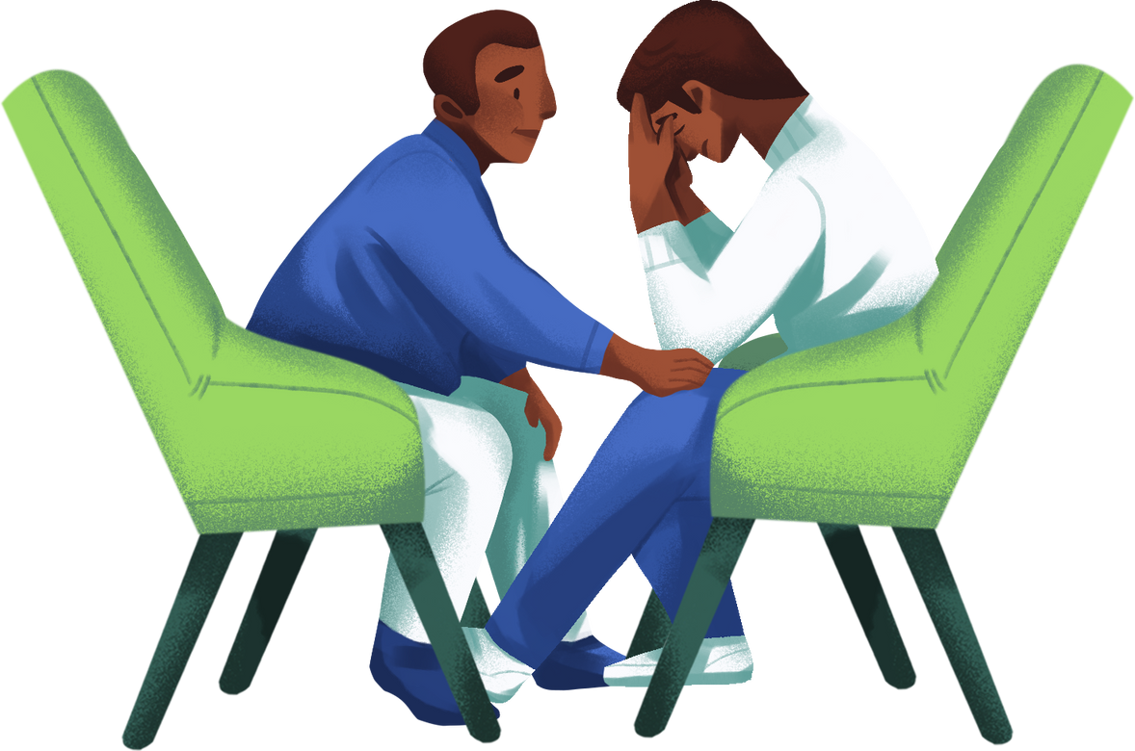
ROLE OF THE HEALTH ADVISORS AT JHC
Involved in sexual health for many years, working to support both patients and clinic staff.
Role includes:
•PARTNER NOFTIFICATION
•SAFER SEX ADVICE & SCHOOLS WORK
•SEXUAL HEALTH ADVICE AND INFORMATION
•GUIDANCE ON ONLINE SAFETY
•SUPPORT AROUND A DIAGNOSIS LIKE HERPES
•SUPPORT WITH HIV DIAGNOSIS AND ON GOING SUPPORT
•COUNSELLING SUPPORT
•SAFEGUARDING
•WORKING WITH OTHER COMMUNITY SERVICES
•MENTAL HEALTH ASSESSMENTS AND REFERRAL

Slide 6

Patients complaining of these symptoms may need to be reviewed and screened for STI’s
SYMPTOMS OF STI’S
  Vaginal, urethral, rectal discharge
  Dysuria
  Abdominal, rectal or testicular pain
  Lumps, bumps, ulcers
  Rashes
  Itch
  Pain during or after sex
  Bleeding in between periods or afters sex
  Feeling ‘run down’
  Not exhaustive list as many will be asymptomatic

Slide 7


EMERGENCY PRESENTATIONS
Patients can access our service as emergencies for the following reasons:
  Sexual assault
  Potentially exposed to HIV
  Requiring emergency contraception
  Under 18's
  Painful symptoms e.g. ulcers, LAP
Notes:
Haven's - sexual assault referral centres in London - provide forensics, police, counselling, see adults and children - DNA evidence can be taken within 7 days but will support those SA in past 12m
Post exposure prophylaxis - tenofovir disoproxil/emtricitabine

Slide 8


IMMUNISATIONS
Patients can access our service for immunisation against several different conditions:
  HEPATITIS A
  HEPATITIS B
  MPOX
  HPV (for GBMSM until 45yo)
  MENB (Gonorrhoea vaccine)
Notes:
Haven's - sexual assault referral centres in London - provide forensics, police, counselling, see adults and children - DNA evidence can be taken within 7 days but will support those SA in past 12m
Post exposure prophylaxis - tenofovir disoproxil/emtricitabine

Slide 9




CONTRACEPTION
Patients can access our service for oral and long-acting reversible contraception (LARC):
  Combined pills (CHC)
  Progesterone-only pills (POP)
  Barrier methods
  Progesterone injection
  Subdermal implants
  Hormonal coils
  Non-hormonal coils
Notes:
Haven's - sexual assault referral centres in London - provide forensics, police, counselling, see adults and children - DNA evidence can be taken within 7 days but will support those SA in past 12m
Post exposure prophylaxis - tenofovir disoproxil/emtricitabine

Slide 10
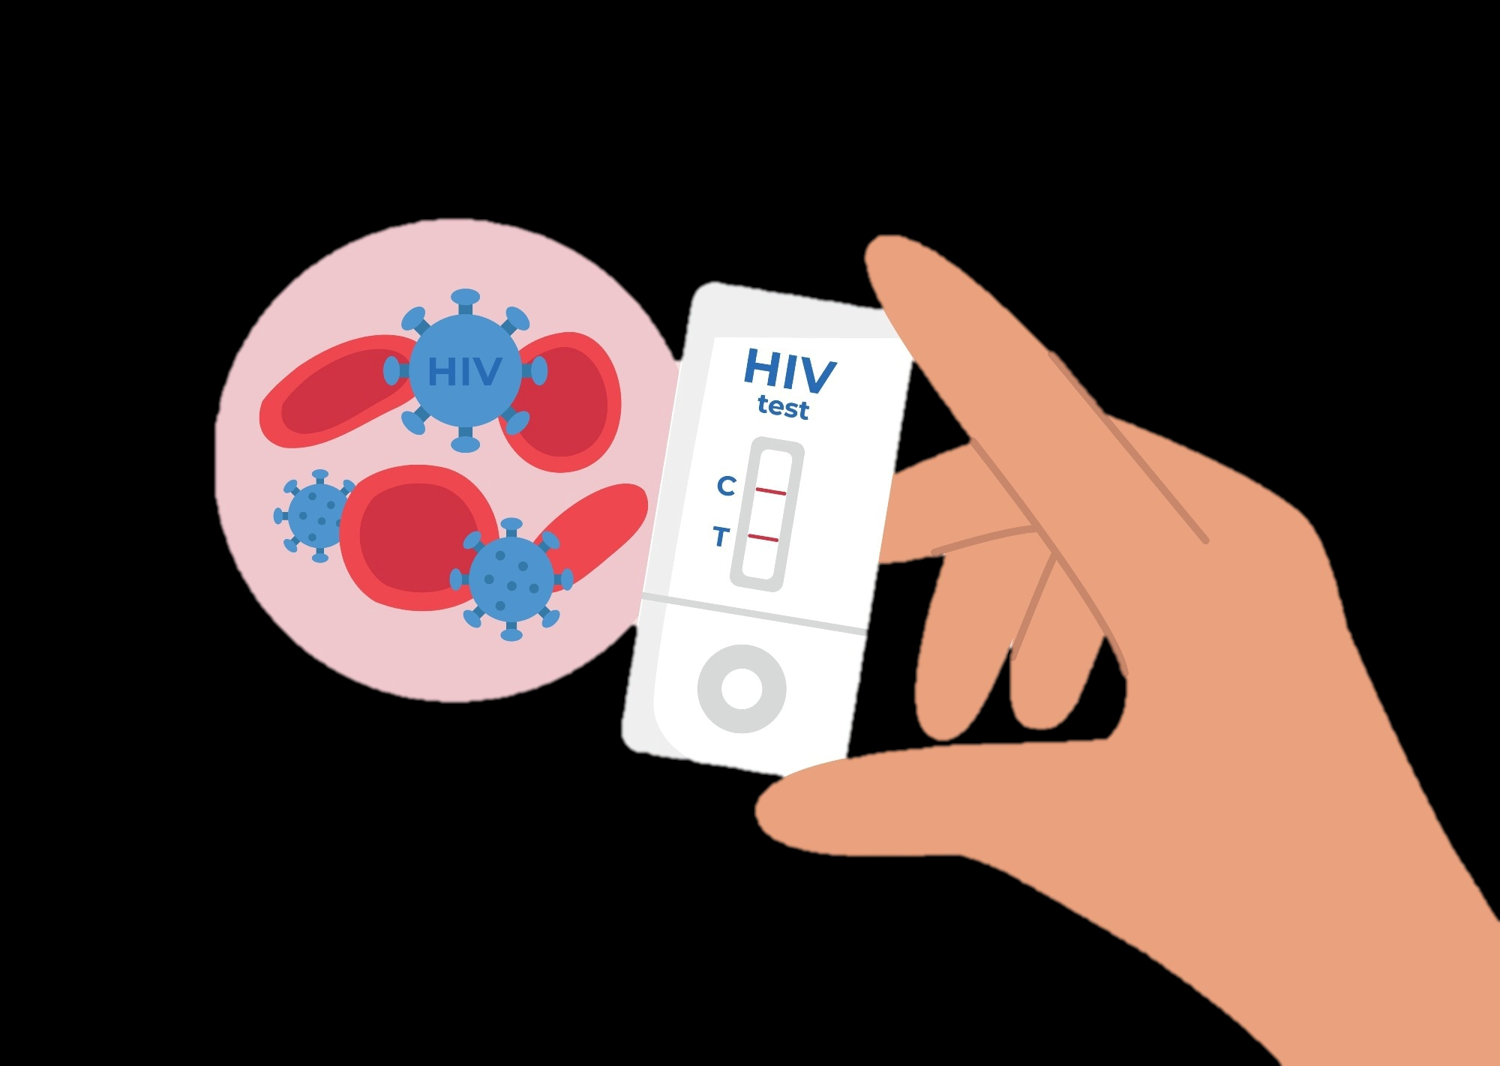
HIV MEDICINE
PREVENTION AND TREATMENT

Slide 11

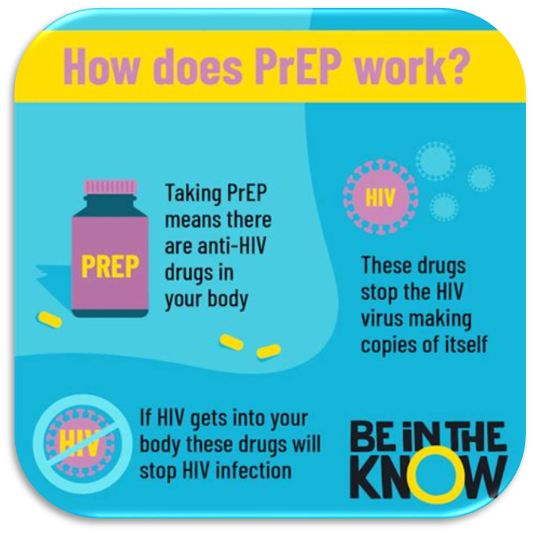


👉 PrEP is taken before sex (pre-exposure), and also afterwards.
👉 ‘Prophylaxis’ means prevention of infection. ••
PrEP is available to everyone who could benefit – not only those at high risk
•Quick-start option: 2 pills first dose, works within 2 hours
•Flexible dosing 4+ doses per week = very high protection
•Event-based dosing 2:1:1 or 2:7 available for all
•Free at UK sexual health clinic (also available online)
References:
. What is PrEP – i-Base: https://i-base.info/guides/prep/what-is-prep
• PrEP for Women – i-Base: https://i-base.info/guides/prep/prep-for-women

Slide 12
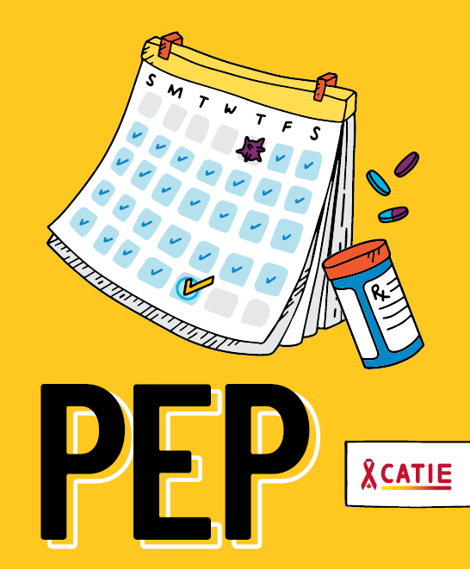
👉 PEP is taken after sex (post-exposure), started up until 72h after risk exposure.
👉 ‘Prophylaxis’ means prevention of infection.
PEP is available to everyone who might have had a risk exposure to HIV.
It can be obtained at any emergency department or sexual health services.
It must be started within 3 days (72h) of risk-exposure.

Slide 13

👉 People living with HIV on adequate treatment have healthy, long lives.
👉 PLWH who are undetectable cannot pass the virus onwards
HIV Medicine has developed considerably, and the infection is no longer a death sentence as it used to be. With adequate treatment, PLWH have long, health lives and cannot pass it on.

Slide 14
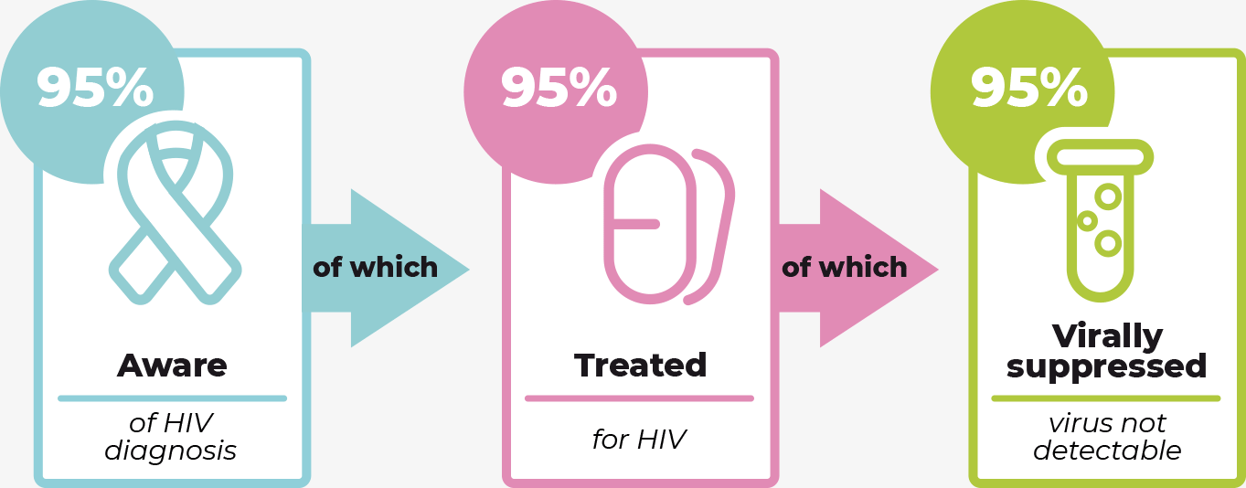


Slide 15
TAILORING CARE TO TARGET POPULATIONS
Confidentiality (unless concerns)
YP: Fraser & Gillick Competencies
Home life
Consent
Screening for CSA/CSE
Safeguarding Assessment and Support
Online safety
Holistic care
Mental health
Drugs and alcohol misuse
STIs testing and treatment
Education on safe sex
Condoms
Contraception
Emergency contraception

Slide 16
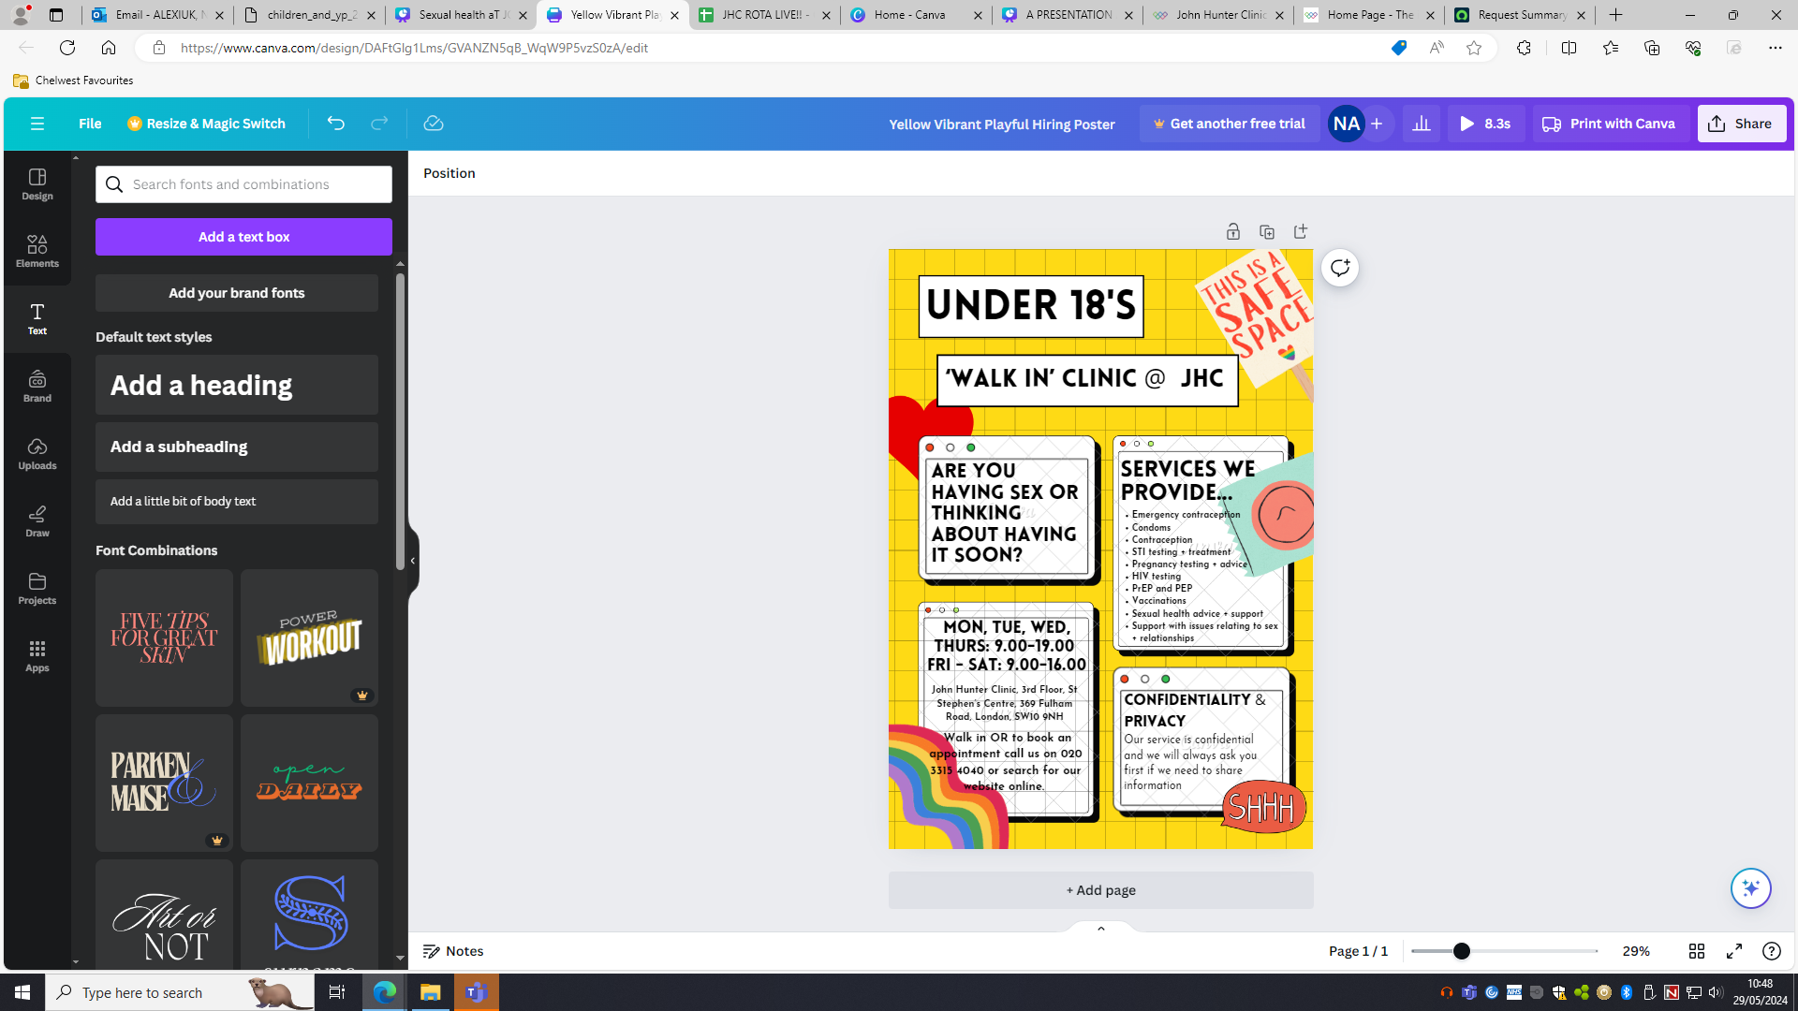
John
Hunter
Clinic

Slide 17

SWISH CLINIC
CLINIC DEDICATED TO FACILITATE ACCESS TO SEXUAL AND REPRODUCTIVE HEALTHCARE TO SEX WORKERS :
  BUSINESS WHATSAPP TO LINK WITH PATIENTS
  MAIN DEMOGRAPHICS: IMMIGRANTS, CIS AND TRANSGENDER WOMEN;
  ACCESS TO HIV PREVENTION (PREP/PEP), STI TESTING, CONDOMS, VACCINATION AND CONTRACEPTION;
  COUNSELLING AND ADDITIONAL SUPPORT.

Slide 18




TAILORED BY-AND-FOR PROJECTS
Workshops with stakeholders from by-and-for orgs;
Community Events;
Ad-hoc events;
Link with by-and-for organisations for signposting and facilitating access.
John
Hunter
Clinic
CULTURAL
DIVERSITY
EQUITY IN
COMPETENCY
AND INCLUSION
PREVENTION

Slide 19
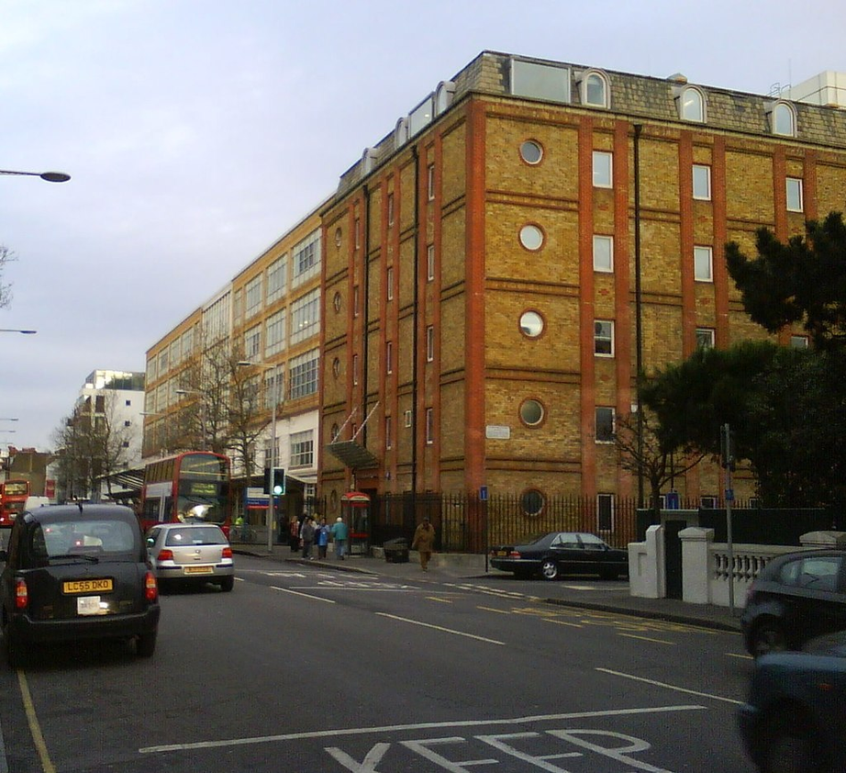
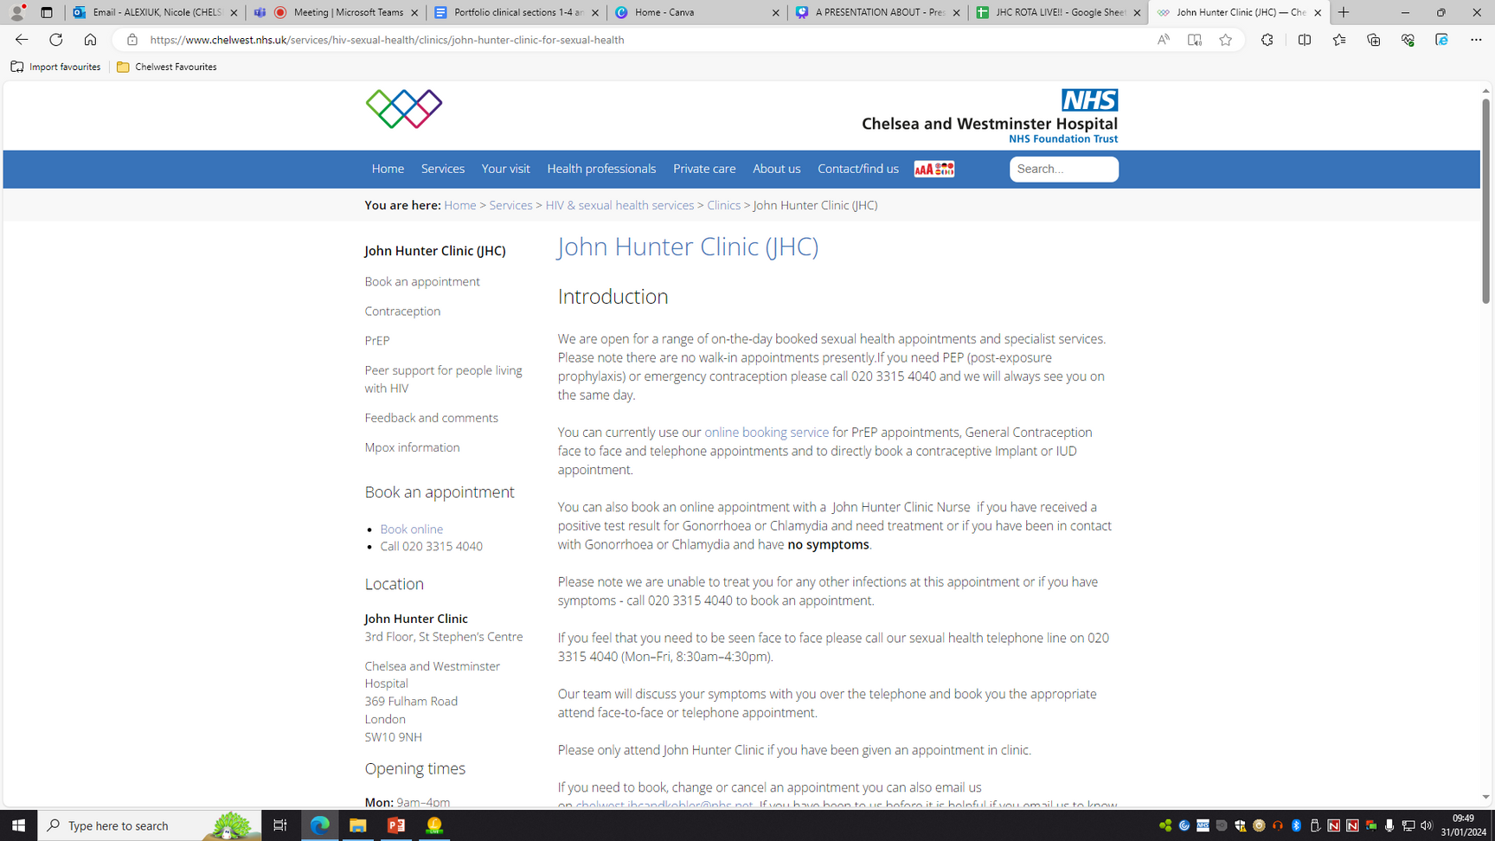
HOW TO FIND US
John
Hunter
Clinic

Slide 20

ACCESS TO OUR SERVICE
All under 18's and sex workers can walk in to our service without an appointment
Appointments can be booked by calling 020 3315 4040
OR by going online (QR CODE)
If school nurses would like to refer a YP into our team, request outreach care or ask for advice you can email one of the team
JHC.outreach@nhs.net
If by-and-for organisations would like to refer individuals from target groups to our team, request outreach care as well.
John
Hunter
Clinic

