Slide 1

Trish O’Hara &
Jane Hough
RDS Cascader

Slide 2

Rare Dementia
Estimated 7.5% or 70,800 of estimated 944,000 people living with dementia in UK are living with young onset dementia where symptoms occurred under 65
30% first receive incorrect psychiatric diagnosis
Rare dementia brings unique & complex challenges

Slide 3
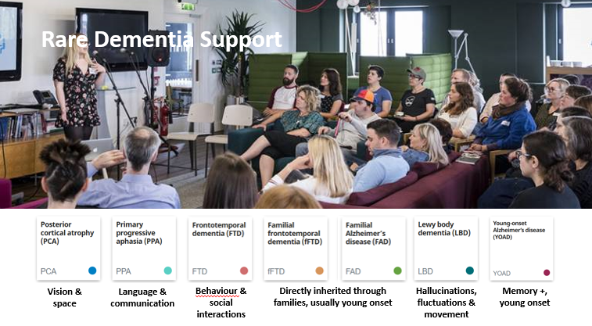

Slide 4

Frontotemporal Dementia FTD
Usually start to affect people in the 50’s and 60’s
Behaviour bvFTD
Communication PPA
Movement MND CDB SNP
fFTD
Roughly 20-40% inherited
FTD

Slide 5

Primary Progressive Aphasia
Semantic Dementia SD
Progressive Non-fluent Aphasia PNFA
Logopenic Dementia LPA
PPA much less likely to be familial
PPA

Slide 6
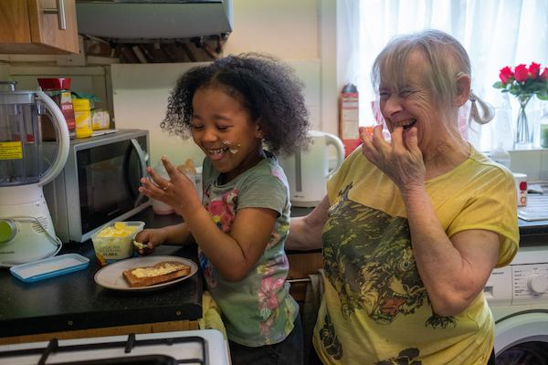
Posterior Cortical Atrophy PCA
Progressive Visual and spatial Impairment in absence of eye changes
Usually occurs in people 50’s or 60’s
Problems with seeing things and knowing where things are
PCA

Slide 7

Lewy Body Dementia
10-15% (app 100,000 UK)
May have problems staying alert & sleep
Hallucinations & delusions
May have fluctuating problems with thinking and memory
May have problems with movements and falls
Changes from one moment to another

Slide 8
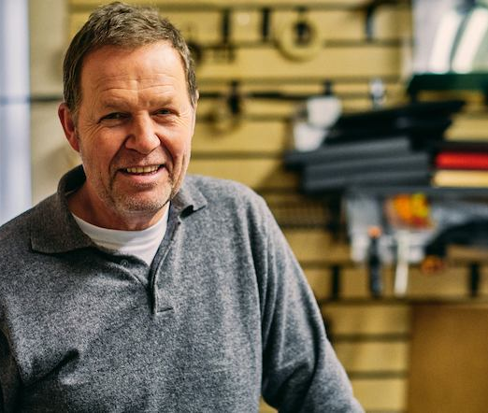
Young Onset Alzheimer’s Disease YOAD
Around 5% of people with Alzheimer’s Disease are under 65
Usually 40s, 50s & early 60s
Often still working, physically fit & may have dependent children or parents at home
Likely to have major financial commitments

Slide 9

Familial Alzheimer’s Disease FAD
Accounts for less than 1% of all cases of AD
Usually strong family history
Each child is at 50% risk of inheriting gene – near certainty that if you inherit faulty gene, you will develop

Slide 10
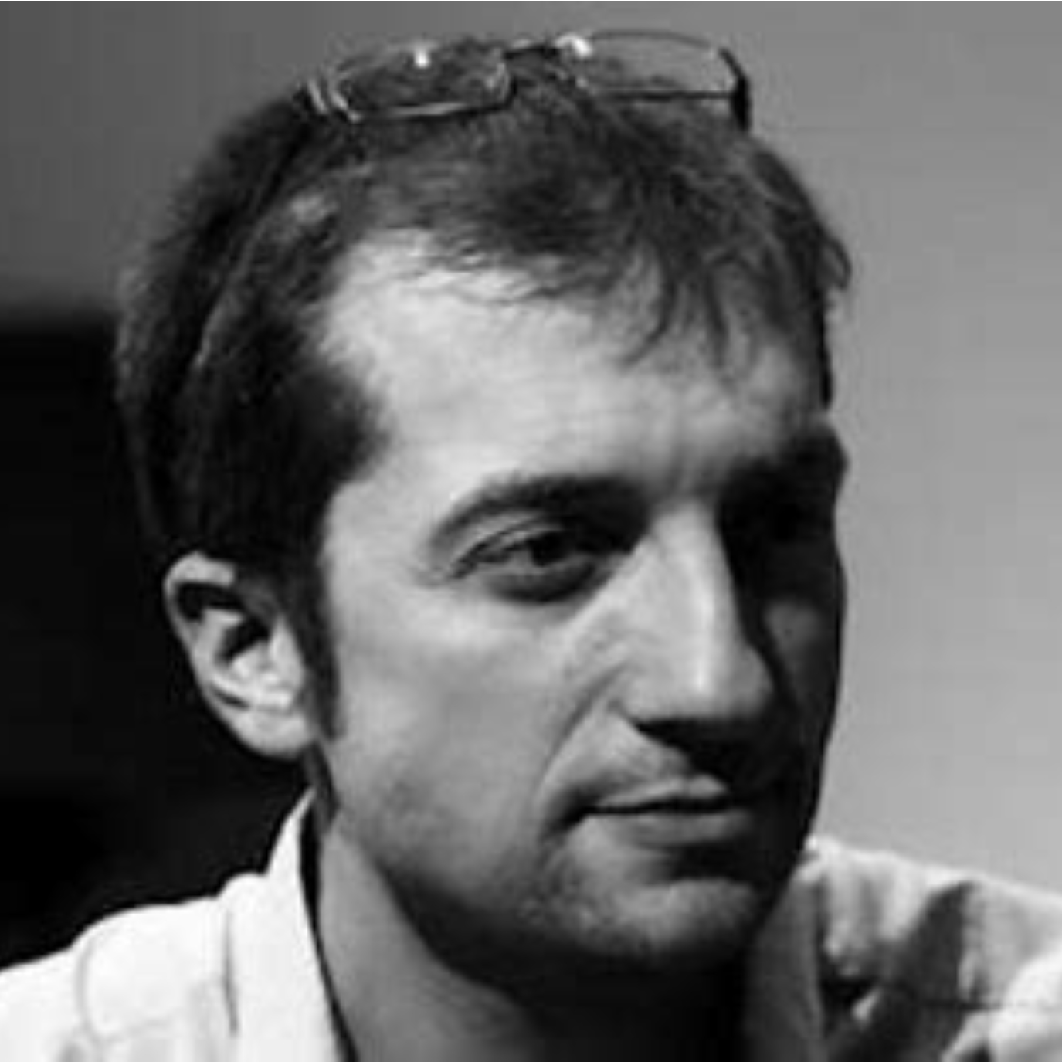

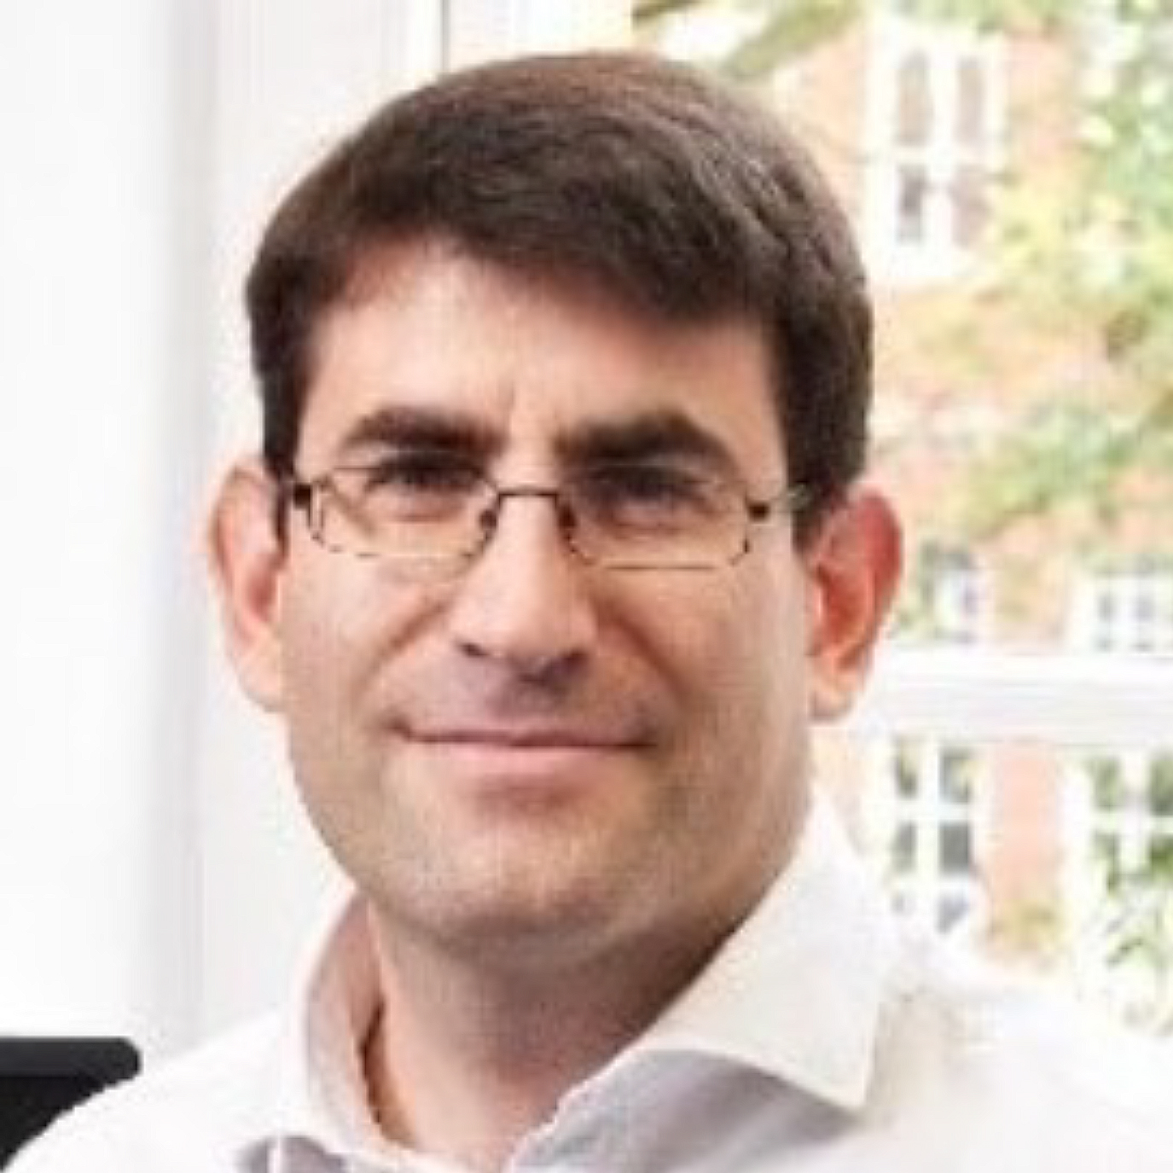
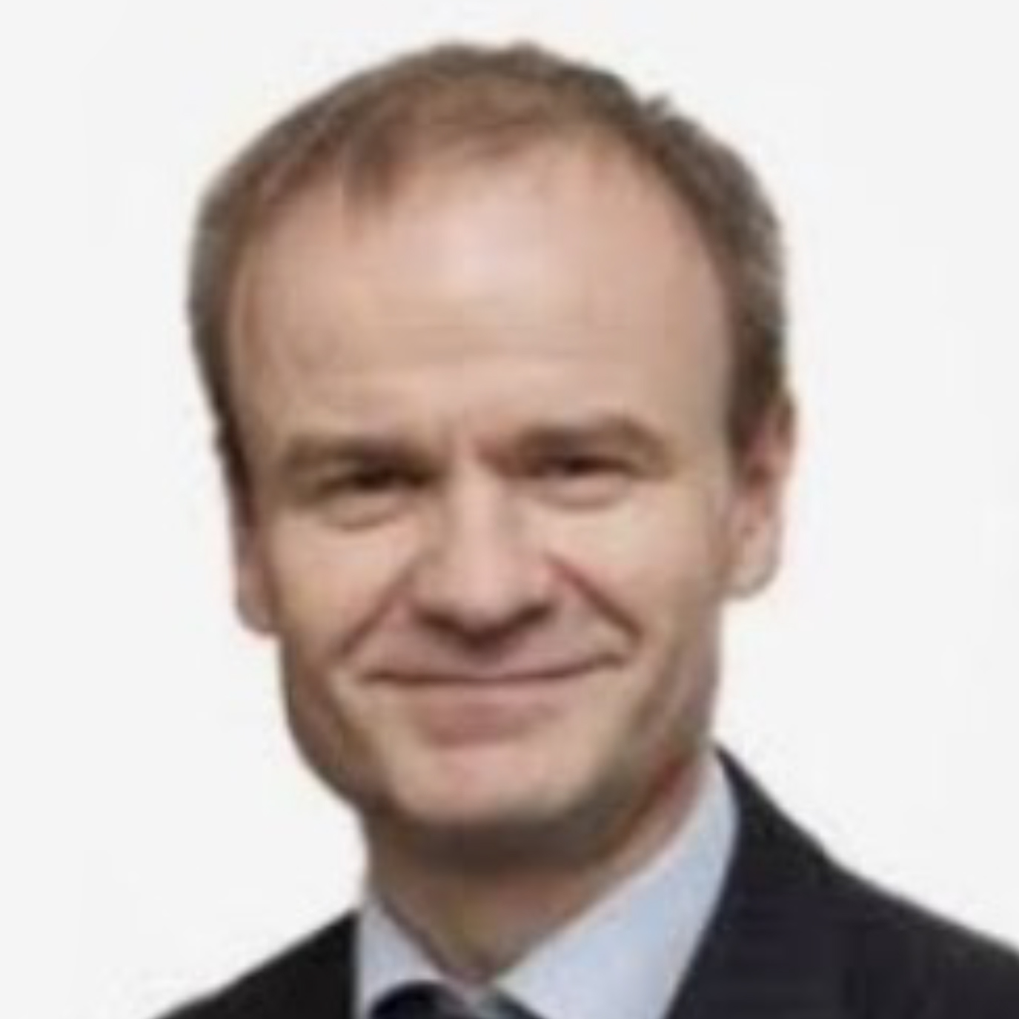
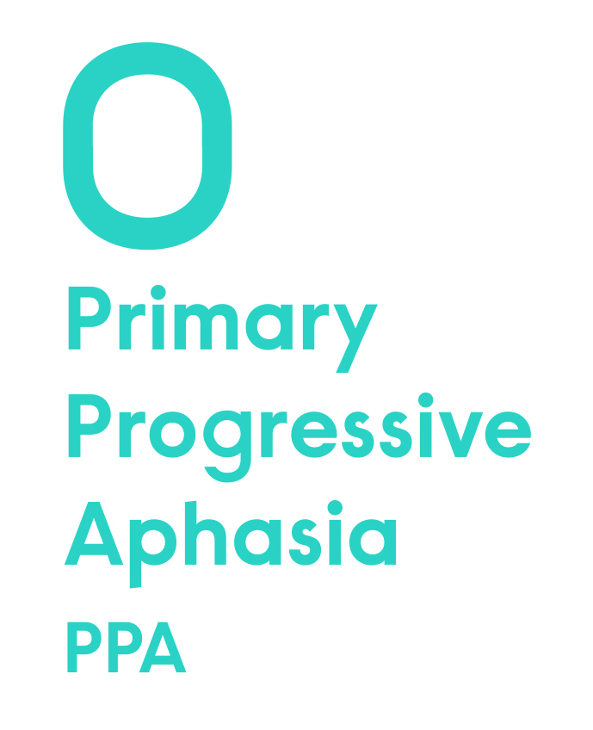
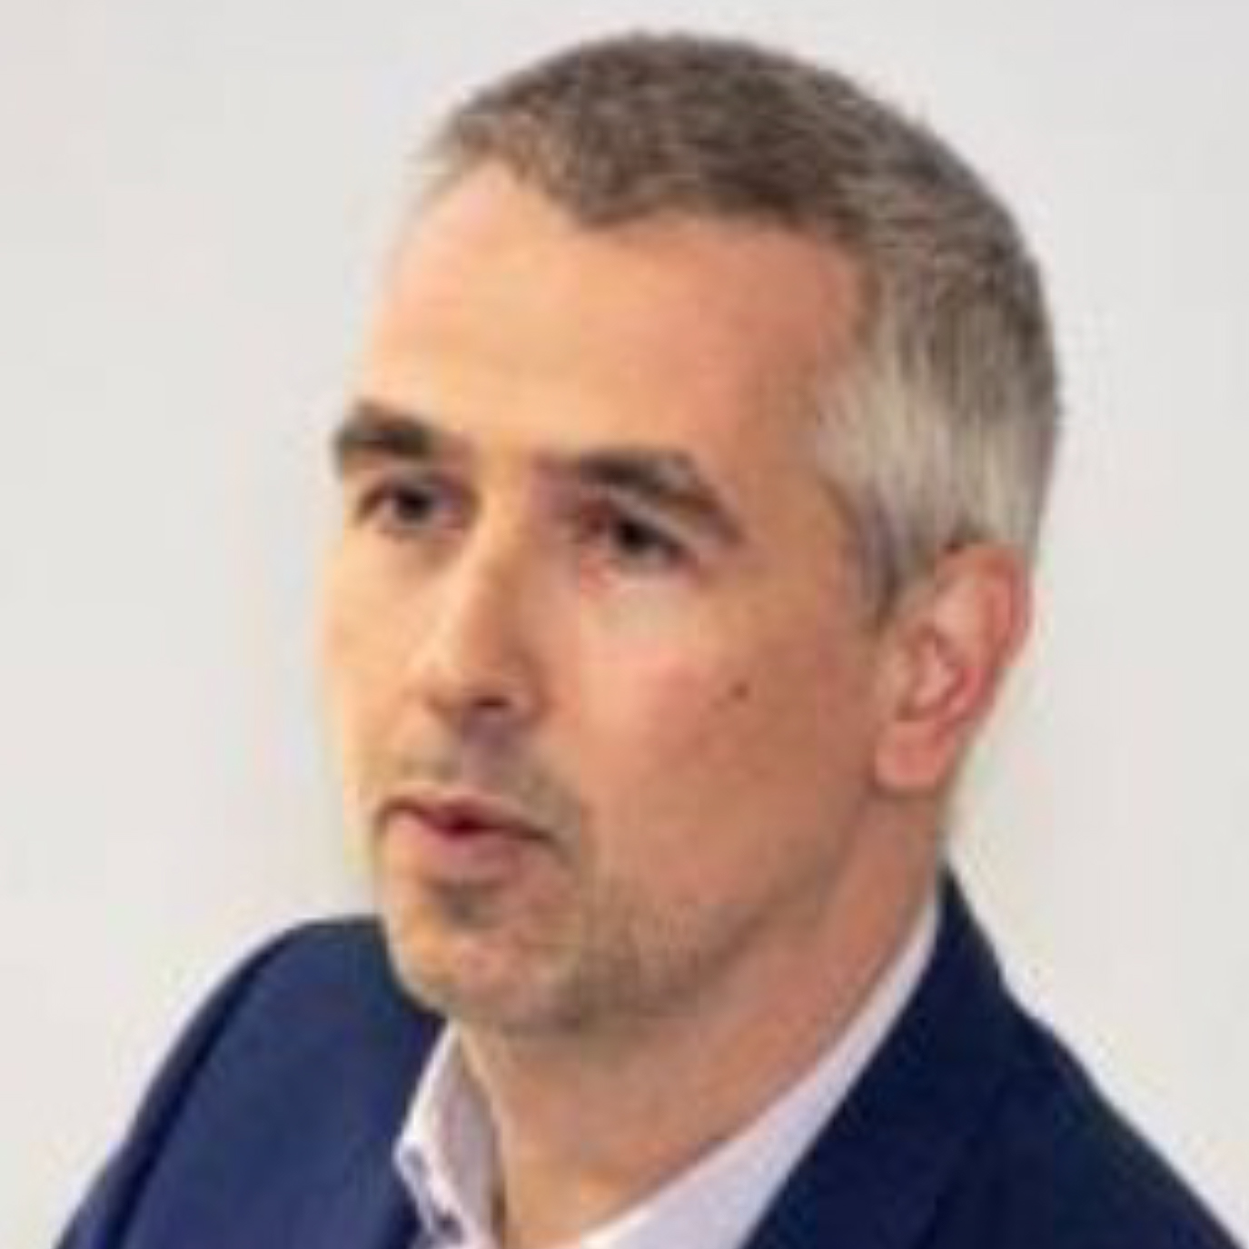


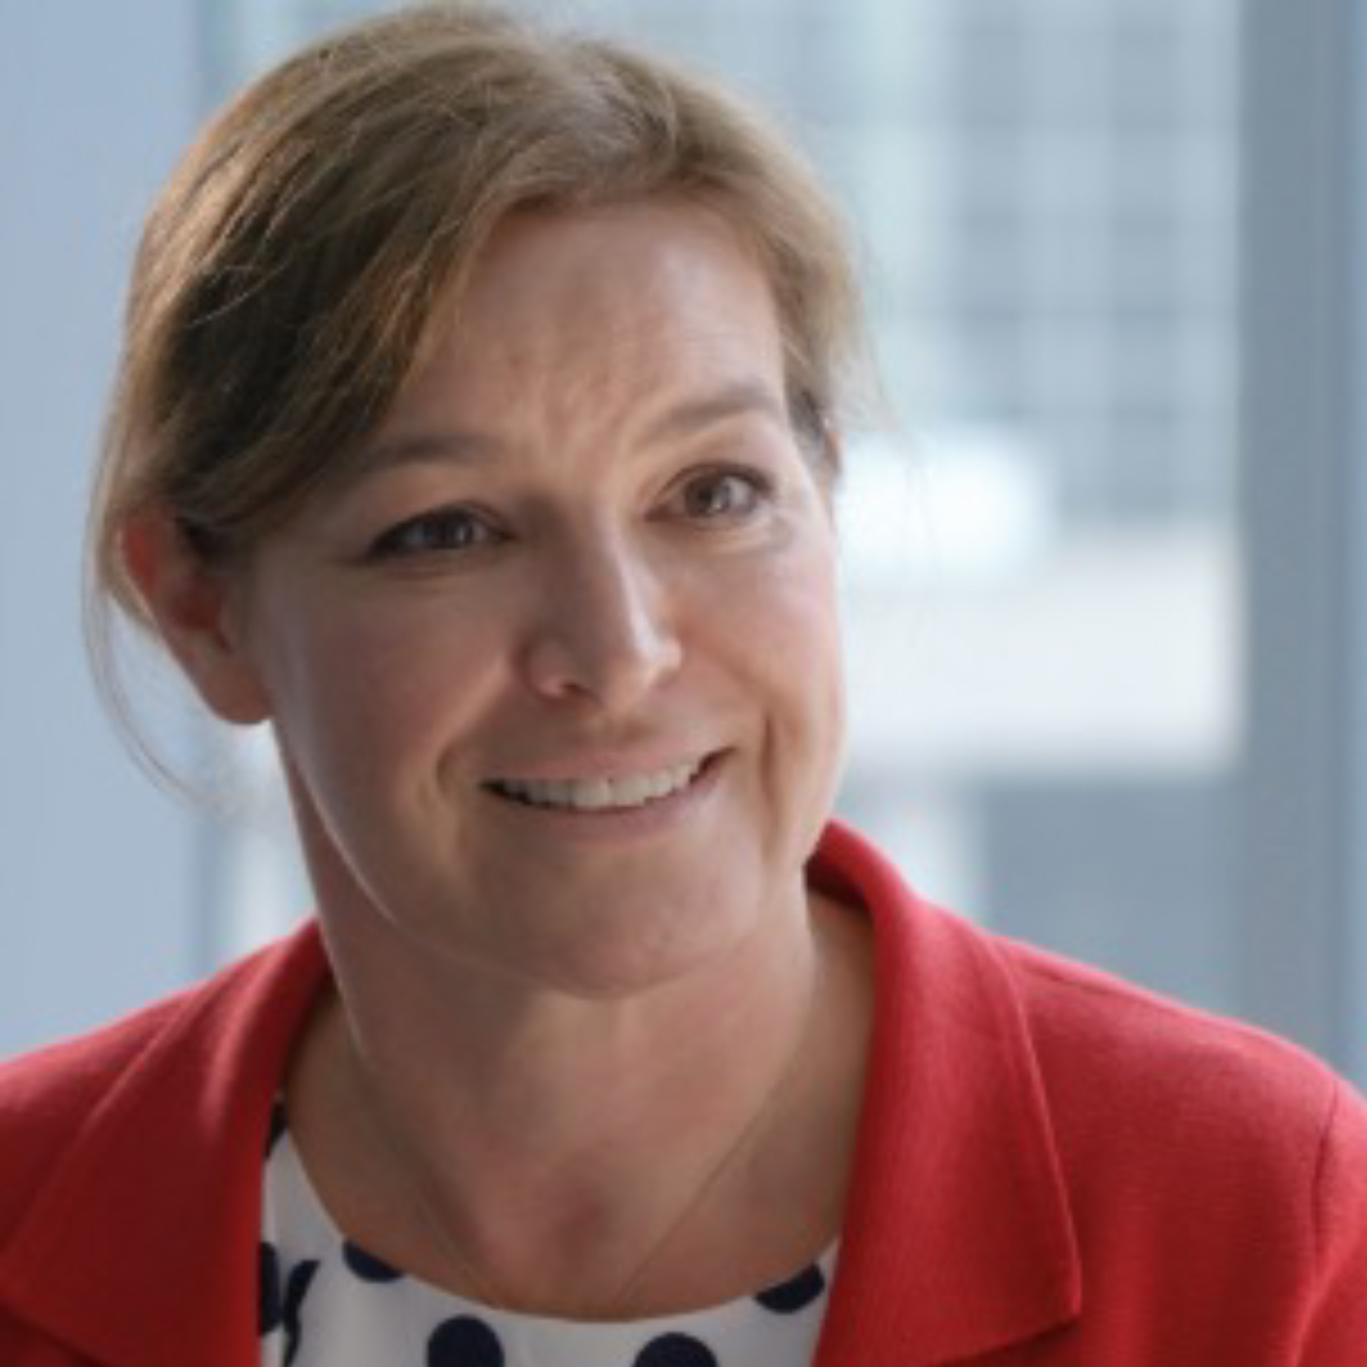






RDS Support Group Clinical Leads
Professor Seb Crutch
      Professor Jonathan Schott
      Professor Jason Warren
      Professor Jonathan Rohrer
  Dr Catherine Mummery
      Dr Natalie Ryan
      Professor Nick Fox
  Dr Rimona Weil

Slide 11
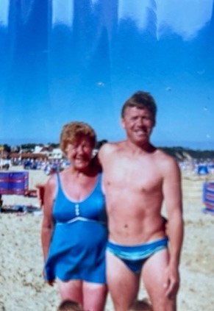
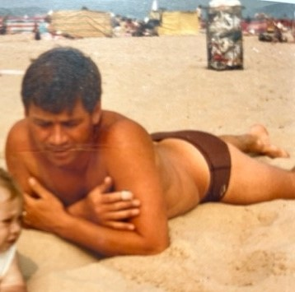
My brother Tony as a young man

Slide 12
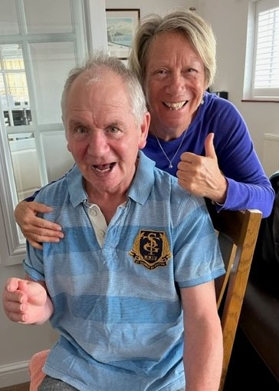
THANK YOU
for hearing my lived experience with Tony

Slide 13
THANK YOU

Slide 14

Here is where to find resources you might find helpful
www.raredementiasupport.org

Slide 15
Advert: https://www.youtube.com/watch?v=rG_h0N7XGYo&t=7s
FTD video (unlisted) - https://youtu.be/DvPRDEllHFA
PPA video (unlisted) - https://youtu.be/XG0Max7zfuQ
PCA video (unlisted) - https://youtu.be/Dvmhj5tkLd4
LBD video (unlisted) - https://youtu.be/SdU0ZYF6lgc
FAD video (unlisted) - https://youtu.be/CLIkeyfo0Xs
YOAD video (unlisted) - https://youtu.be/tzEt4sV_DDk

