Slide 1
Community Engagement
Dipannita Betal - Senior Stakeholder Engagement Manager
Grace Harman - Clinical Advisor to the Clinical Directorate

Slide 2
Content
North West London 111 Patient Advisory Group
Signposting public on using 999 and NHS 111 services
London Lifesavers
Reducing health inequalities

Slide 3
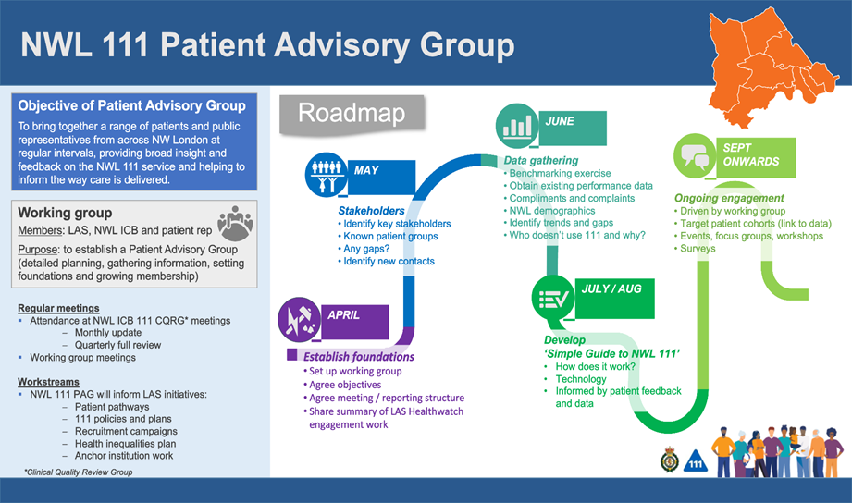
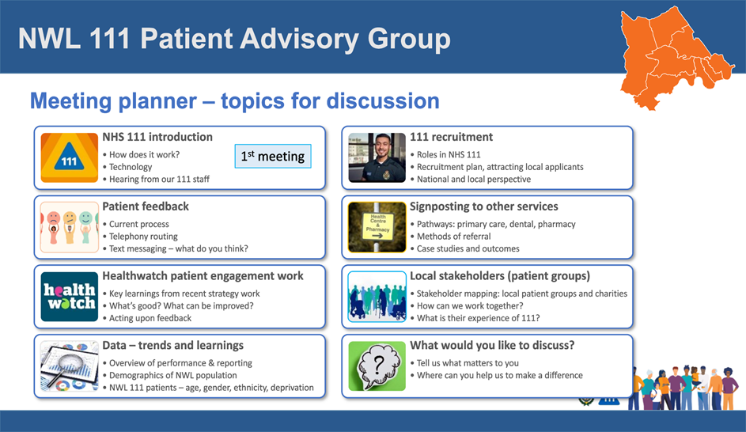
North West London 111 Patient Advisory Group
As the only pan-London NHS service, LAS has been working with its diverse communities in North West London to continue to improve our expanding NHS 111 contracts and provision. By taking a patient-informed approach, we hope to further understand the barriers to accessing NHS 111 and ways to engage communities in culturally responsive ways.
Notes:
Membership: Sixteen members who have used NHS 111
Geographically: Representatives for Brent, Ealing, Harrow, Hammersmith & Fulham, Hillingdon, Hounslow, Westminster, and the Royal Borough of Kensington and Chelsea
Now elected a patient co-chair
Meets every quarter virtually for an hour long session
1st Meeting: NHS 111 Introduction
2nd Meeting: NHS 111 Patient Feedback Survey/Patient Stories
3rd Meeting: Signposting public on using 999 and NHS 111 services

Slide 4
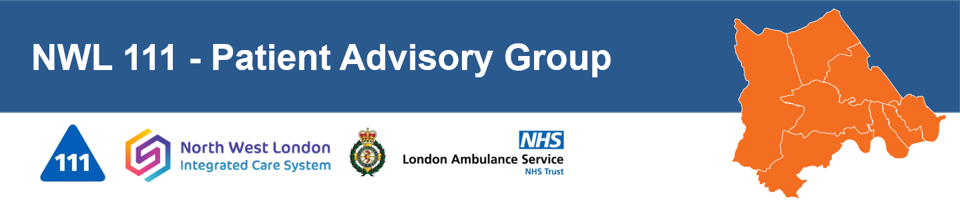


Welcome
Looking for North West London residents, aged 35 years or under who would you like to help improve NHS 111 services in NWL?
We are looking for creative, perceptive people with a passion for health and wellbeing who would like to help shape the NHS 111 service in North West London.
Requirements - we ask for commitment of an hour-long meeting via MS Teams every 3 months (quarter).
To submit an expression of interest, please scan the QR code or for further details email londamb.las.ppc@nhs.net

Slide 5

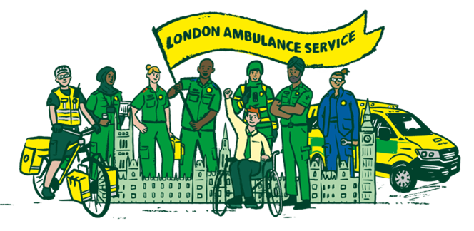
Signposting public on using 999 and NHS 111 services
Reviewing our communications to the public on using 999 and NHS 111 services and devising a new campaign
  Undertake a public education programme to both primary and secondary schools
Widening engagement with specific adult groups:
  Working with community leaders and faith leaders
  Older persons community groups
  Refugee groups and asylum seekers
  Learning disability community groups
Notes:
Promoting understanding of each service which is easily understood.
What to expect when you contact each service
Promote accessibility to these services e.g. language line, visual or hearing impairment (BSL or Text relay)

Slide 6
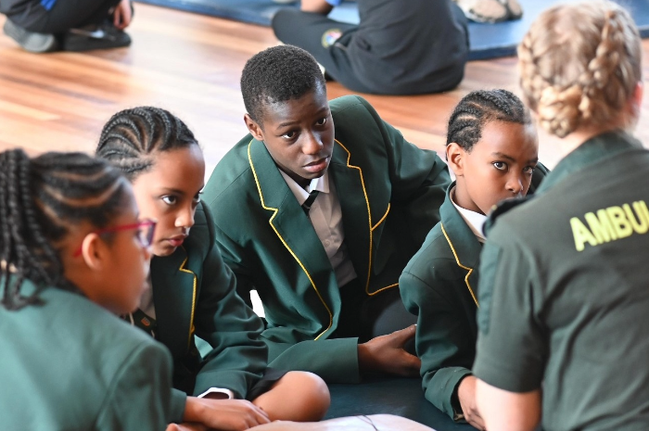
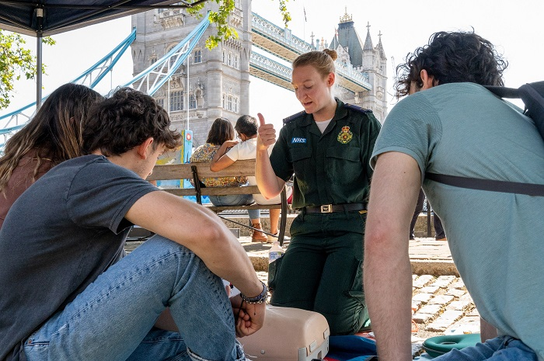
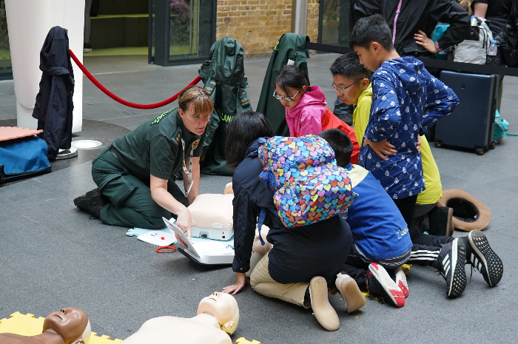
London Lifesavers Programme
London Ambulance Service’s dedicated programme to improving out of hospital cardiac arrest survival rates across the Capital, to make London a safer place to live, work and enjoy.
We want to address health inequalities in the incidence of cardiac arrest, bystander CPR and distribution of public access defibrillators. We will inspire a generation of school children to learn lifesaving skills, improve outcomes for patients, promote health education and choose a career in the London Ambulance Service.

Slide 7

London Lifesavers Programme
  To make London a city of lifesavers, through organising life-saving CPR and defibrillator training for communities, organisations and schools
  Improving cardiac arrest survival rates
  To train and register every Londoner who lives, works or volunteers in London
  Train every child in London between the ages of 12-13 in schools (approx. 55,000 pupils)
  Addressing health inequalities by focusing on neighbourhoods with high poverty rates
Notes:
The project is supported by the Mayor of London’s office
We have partnered with TFL and GLA to produce an instructional video which will be available via a QR code

Slide 8




LAS Health inequalities
LAS are taking a collaborative approach between the clinical and strategy department
Patient engagement projects to ensure the patients voice is heard​
Sickle cell society ​
Croydon Sickle Cell & Thalassemia Support group
Completion of the AACE maturity matrix
Development of a 5 year action plan ​
Developing an LAS CORE20PLUS5 approach​
CQUIN​
Notes:
Tacking health inequalities ​
- LAS Strategy - Mission 3 – using our unique pan London position to improve the health of the capital ​
​
LAS are taking a collaborative approach between the clinical and strategy department ​
Employment of a consultant paramedic with a health inequalities focus ​
Collaborative work between strategy and clinical ​
​
AACE maturity matric ​
Association of Ambulance Chief Executives provides ambulance services with a central organisation that supports, coordinates and implements nationally agreed policy ​
A tool for ambulance service to self-evaluate themselves and identify areas for improvement ​
​
​
CORE20PLUS5​
Based on the analysis of CQUIN work to date, HI workshop outputs, ICS Core20PLUS5 priorities for five ICS in London, early data analysis a long list of proposed LAS health inequalities priorities for consideration has been collated. ​
Mental health (adults) ​
Pre-hospital maternity care (with focus on Global Majority ethnicity) ​
Sickle Cell Disorder ​
Hypertension ​
Diabetes ​
Vulnerable patient cohorts (inclusion groups)​
​
Patients experiencing Homelessness ​
Patients in detention (including custody and prison) ​
Patients with Autism, learning disabilities and/or neurodiversity ​
Bariatric patients ​
Children and young people (incl mental health) ​
High Intensity Users ​
Patients with major neurocognitive disorder (associated interference with independence in everyday activities, eg dementia) ​
​
​
All feeds in to the development of the 5 year action plan

Slide 9
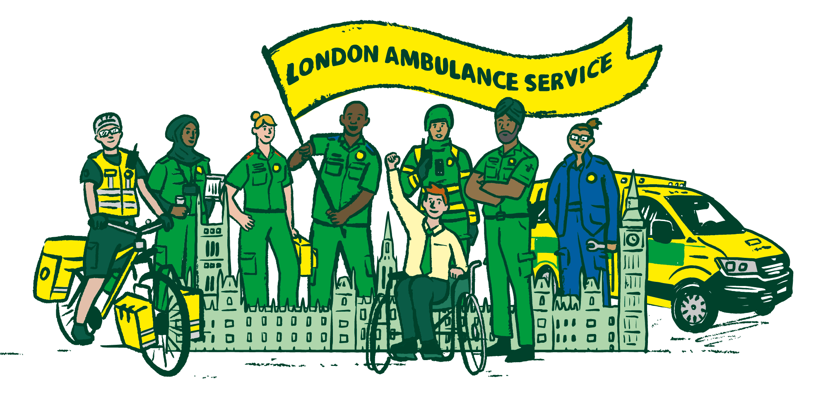
We are the capital’s emergency and urgent care responders.
We aim to deliver outstanding emergency and urgent care whenever and wherever needed for everyone in London, 24/7, 365 days a year.
Together, we put the values of caring, respect and teamwork at the heart of all we do for Londoners.

Slide 10
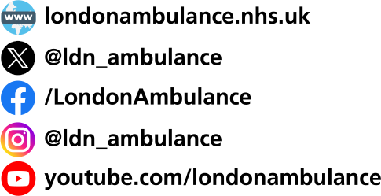
Contact details
Dipannita Betal: dipannita.betal@nhs.net
Grace Harman: grace.harman1@nhs.net
For more information visit
londonambulance.nhs.uk
London Ambulance Service NHS Trust
Headquarters
220 Waterloo Road
London. SE1 8SD

