Slide 1
BME Health Forum
slide 15.
Health Equity Priorities NWL ICB – A New Approach
June Farquharson Assistant Director Population Health and Inequalities Programme

Slide 2

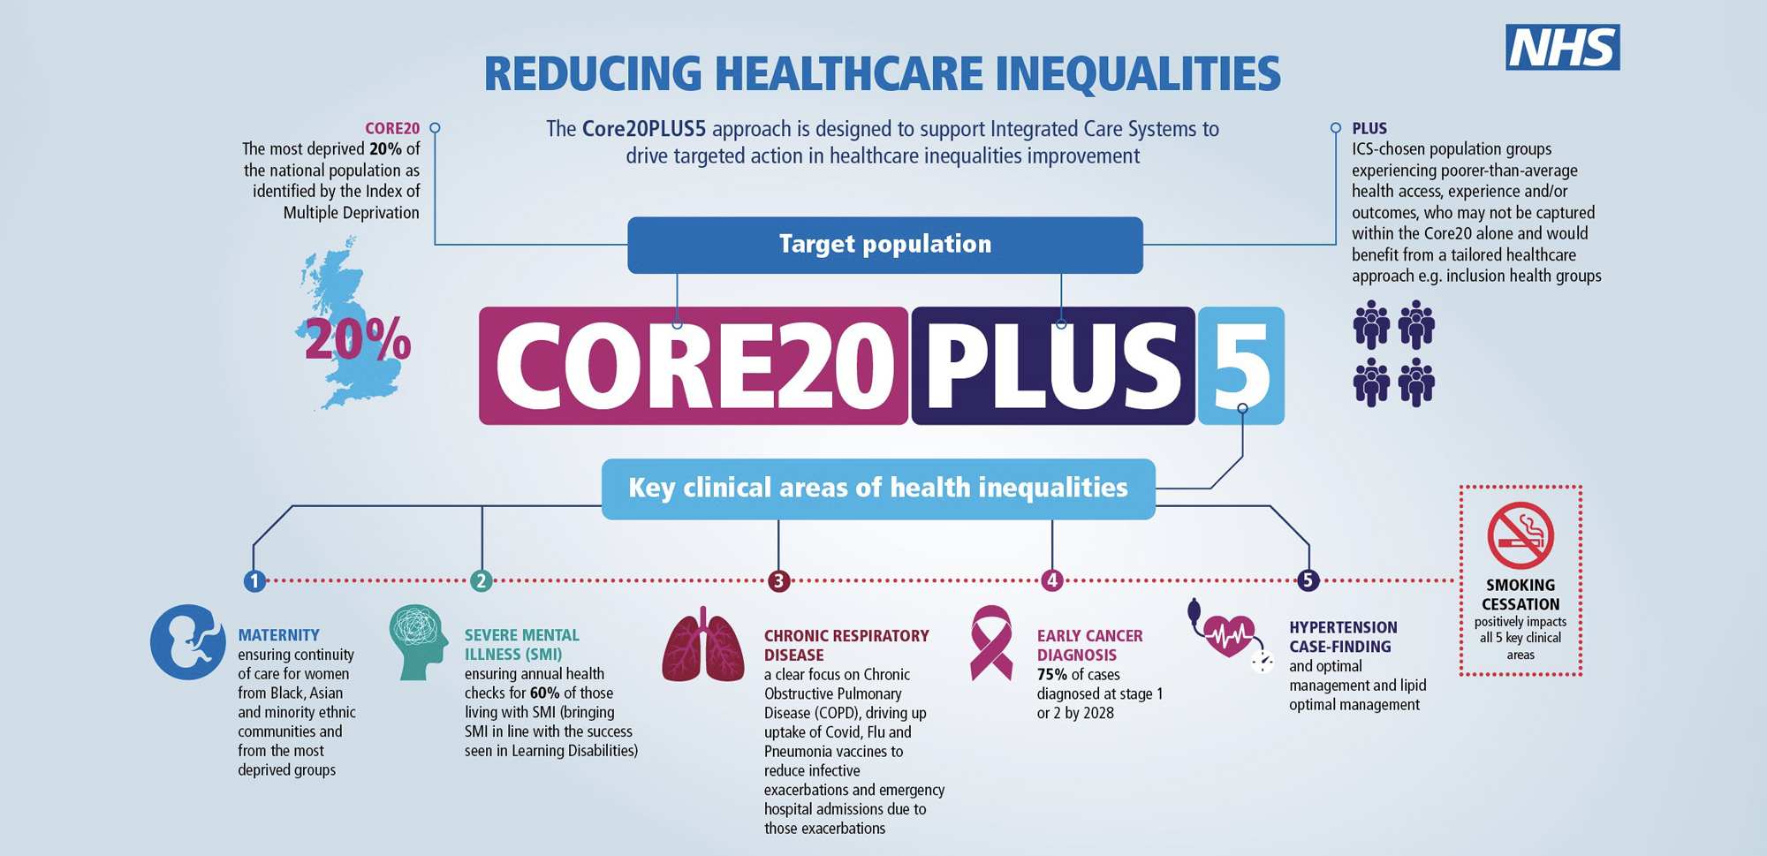
The Core20Plus5 Framework is used to focus on the key priority inequalities areas and as an engagement tool with communities on the Plus element

Slide 3

Plus the children and young people’s Core20Plus5 Framework has recently been launched, which will help focus on the key priority inequalities areas

Slide 4

Key barrier themes have already been identified that can be used to plan and build the next phase of co-production
Booking appointments – people are struggling with a lack of flexibility in booking, with fewer face to face appointments and telephone access reported as challenging
Wider determinants of health – people have more pressing concerns than being able to manage their health, for example due to the Cost of Living
Digital issues – digital methods aren’t accessible to all people e.g. those with visual impairments, learning, neuro diverse conditions or problems with dexterity
Language and length of appointment – failure to consider the needs of people for whom English isn’t their first language or of people with learning disabilities and autism
Patient Experience – people experience poor treatment when engaging with services and are less likely to engage with services in future
Patient Empowerment – Lack of information provided on decisions and next steps
Challenges registering with a GP – particularly for populations such as homeless people, asylum seekers
Different expectations of healthcare – residents do not understand how NHS services are structured, and some communities default to hospitals over GPs
Health anxiety – people may be anxious about attending appointments and engaging with their health, e.g. they feel they may be stigmatised due to their weight, they have perceptions of interventions having adverse impacts
People don’t understand their rights – many people don’t know that they have a right to go to an appointment during working hours, particularly exacerbated if people in temporary work or 0 hour contracts.
Caring commitments – people can’t take time off due to caring commitments
“I’m not able to travel to services now they have moved further away, due to the cost”
“Due to the cost of living, I don’t have time to monitor my own health. I can’t miss my shift so sometimes I skip my appointments”
“I don’t trust prescriptions / advice given over the phone”
“I am worried about heating my home and keeping warm”

Slide 5







Our delivery areas have been developed to focus on where we believe there is most opportunity to support our Integrated Care System (ICS) partners achieve maximal impact in addressing inequalities.
Healthy living
Population health management
Addressing structural racism
Anchor development
Digital inclusion
Volunteering and VCS development
Reducing inequalities
Supporting residents to maintain a healthy lifestyle and ensuring focus on key long term plan commitments e.g. obesity, smoking, vaccination
Developing a culture that promotes and supports a population health management approach to improving health outcomes across North West London (NWL)
Providing oversight and direction to the system in the important area of improving health outcomes through the lens of racial equality
Delivering the system’s anchor programme recognising our role as key organisations and employers within NWL focussing on employment, procurement and sustainability
Developing a strategic approach to improving digital inclusion across NWL, aligned to the wider Integrated Care Board (ICB) Digital Inclusion Strategy
Promoting volunteering as a key part of the workforce and supporting the Voluntary and Community Sector (VCS) through development of NWL infrastructure to enable the VCS to be an effective partner within the ICS
Delivering projects through an equalities lens, providing support in developing metrics, training and academic expertise.
Support the identification of barriers to health outcomes using approaches such as Core20plus5.
Notes:
Presenter: June

Slide 6






We have developed with ICHP the FOCUS-ON framework to provide a methodology to deliver Population Health Management and reduce inequalities
FIND areas of inequalities using quantitative data. At a minimum, exploring disparities in constitutional standards based on deprivation, sex, age & ethnicity. If possible, expanding to other aspects.
OPEN conversations with those communities & cohorts who are experiencing those inequalities. This qualitative data enhances our knowledge about the problem(s) & its causes.
CO-CREATE ideas about potential solutions to specific problems identified. This idea generation should be done in collaboration with a mix of stakeholders, both citizens & professionals.
UNITE your co-design group around a small subset of ideas that we will prototype. We do not have unlimited resources and therefore we need to select 1-3 ideas that we will robustly test.
STUDY the impact
of your tested ideas.
This requires both quantitative & qualitative methods. This should
be proportionate to the test and should help decide whether to continue or not.
ONGOING MEASUREMENT
As a learning health care system, we need continuous monitoring of our interventions and inequalities metrics. This helps create accountability for
us as a system, ensuring that our efforts are continuing to make impact
and that we can continue to identify new or exacerbating inequalities.

Slide 7
We have already developed an initial co-production approach for practical implementation and this has now been tested during a recent launch co-creation workshop. This focussed on three areas, DNA, Prostate Screening and Primary Care Access.
Ensure groups are representative and inclusive, using community groups and aligning with the NWL principles of co-production
Identify priority areas for intervention and co-design the next stages, including further engagement and/or task and finish group
Build in an agreement to “what good looks like” and how this will be measured / evaluated
Bring in insight data, qualitative and quantitative, and invite reflections on the problem based on lived experience
Bring in evidence about best practice and co-create solutions to address the identified issues
Frame the issue for discussion in a way that invites open conversation about ‘what matters to me’ and does not close down the potential solutions

Slide 8
The Race Steering Group was established in July 2022, to ensure that we understand and action inequalities through the lens of Race.
Lead and ambassador a social movement for change with addressing and reducing structural racism as a barrier to effective health outcomes
Ensure that the ICS Board is actively promoting and accountable for a zero tolerance on structural racism within its services both in terms of staff and citizens through statement and actions.
Using community research models understand the experience and other evidence sources highlight where ethnic differences are evident in relation to service provision, access, experience and outcomes from neonatal care to end of life care.
Invest in and implement co-production of solutions to remove barriers and increase trust and confidence in NWL through an establishment of a reference group.

Slide 9
Race Steering Group Focus
Cancer Disparities – Move from plan to delivery to improve screening uptake in the population groups that the data reflects have the lowest uptake to cancer screening associated with 5 agreed tumour sites.
Workforce barriers to leadership – Complete the procurement process to appoint a provider to engage with clinical and non clinical staff to identify key barriers to black staff being appointed to senior leadership roles, to report on these findings and make recommendations that shape and change the culture of the organisation and its internal processes.
Black Community Health and Wellbeing event – To engage with stakeholders across NWL to draw attention and address the disparities in the health and wellbeing sphere for the Black population in NWL through organising a Black community Health and Wellbeing event.
3rd sector, Ethnicity and Marginalised communities – Through the presentation by The Chief Executive of CVS Brent, get agreement around the commitment to enact meaningful and transformational change through Brent’s Voluntary, community and social enterprise sector. This includes the development of a Black Strategic Health Forum.

Slide 10
Questions

