Slide 1
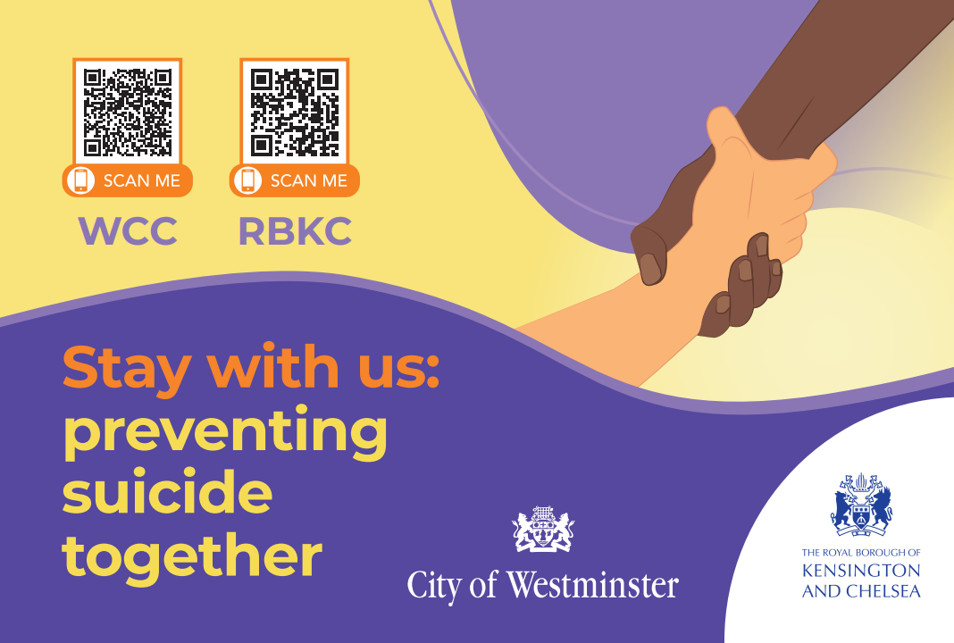

Slide 2
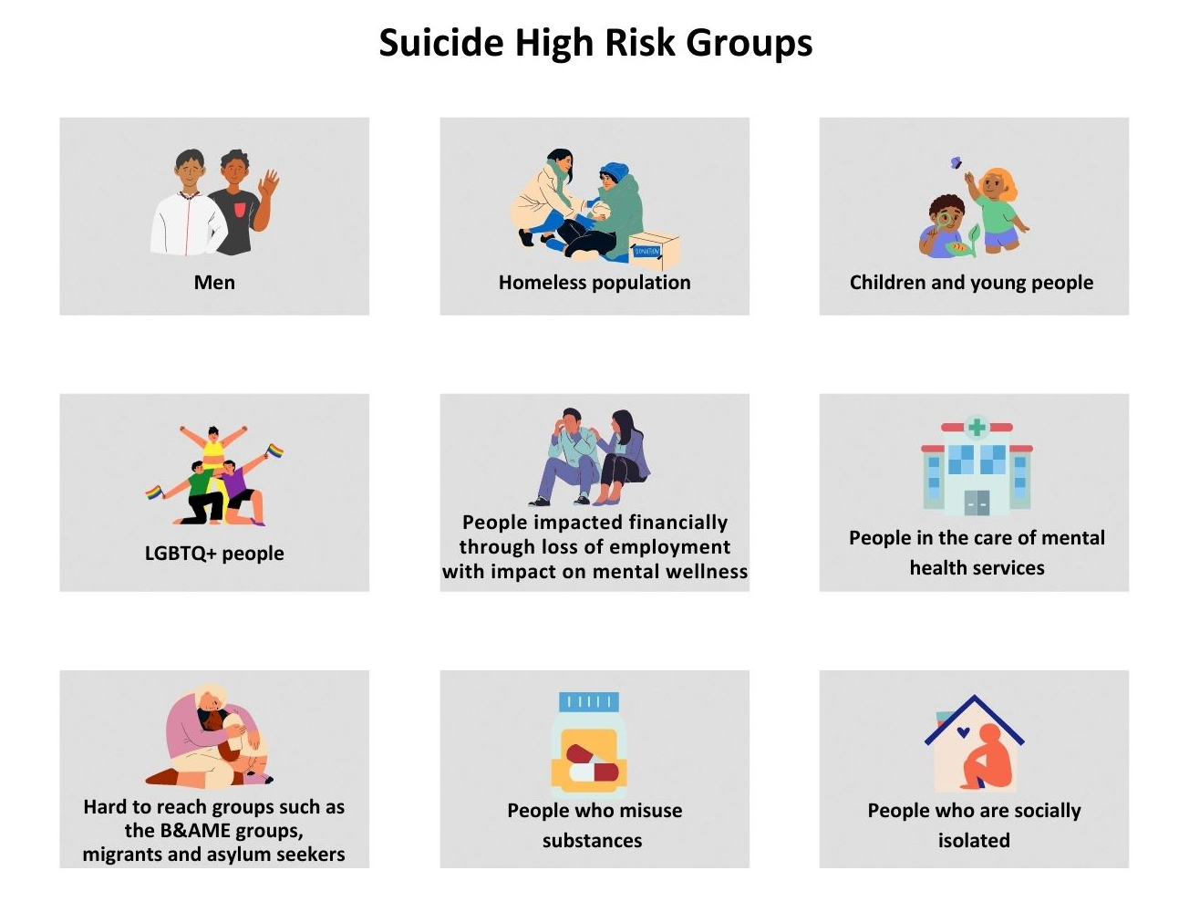
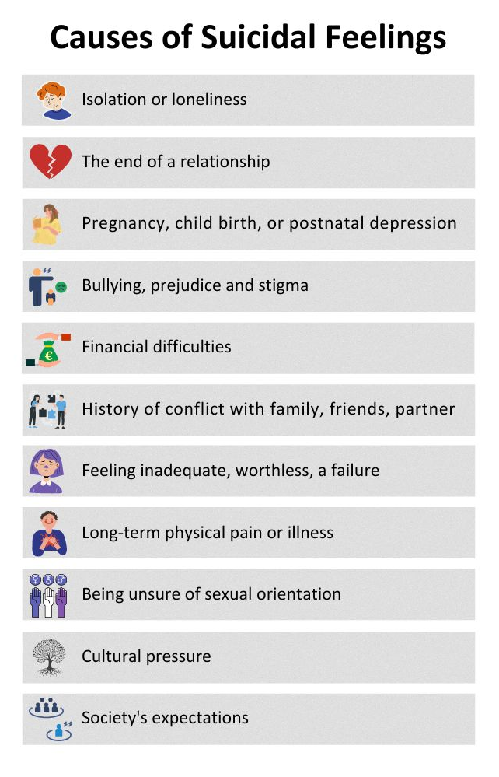
What do we know…

Slide 3
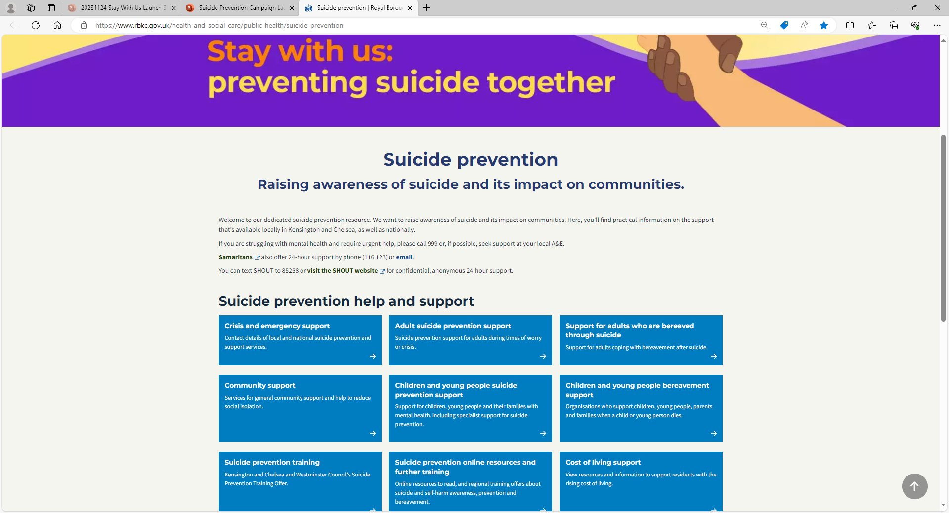
Suicide Prevention Web Resource
Suicide prevention | Royal Borough of Kensington and Chelsea (rbkc.gov.uk)

Slide 4
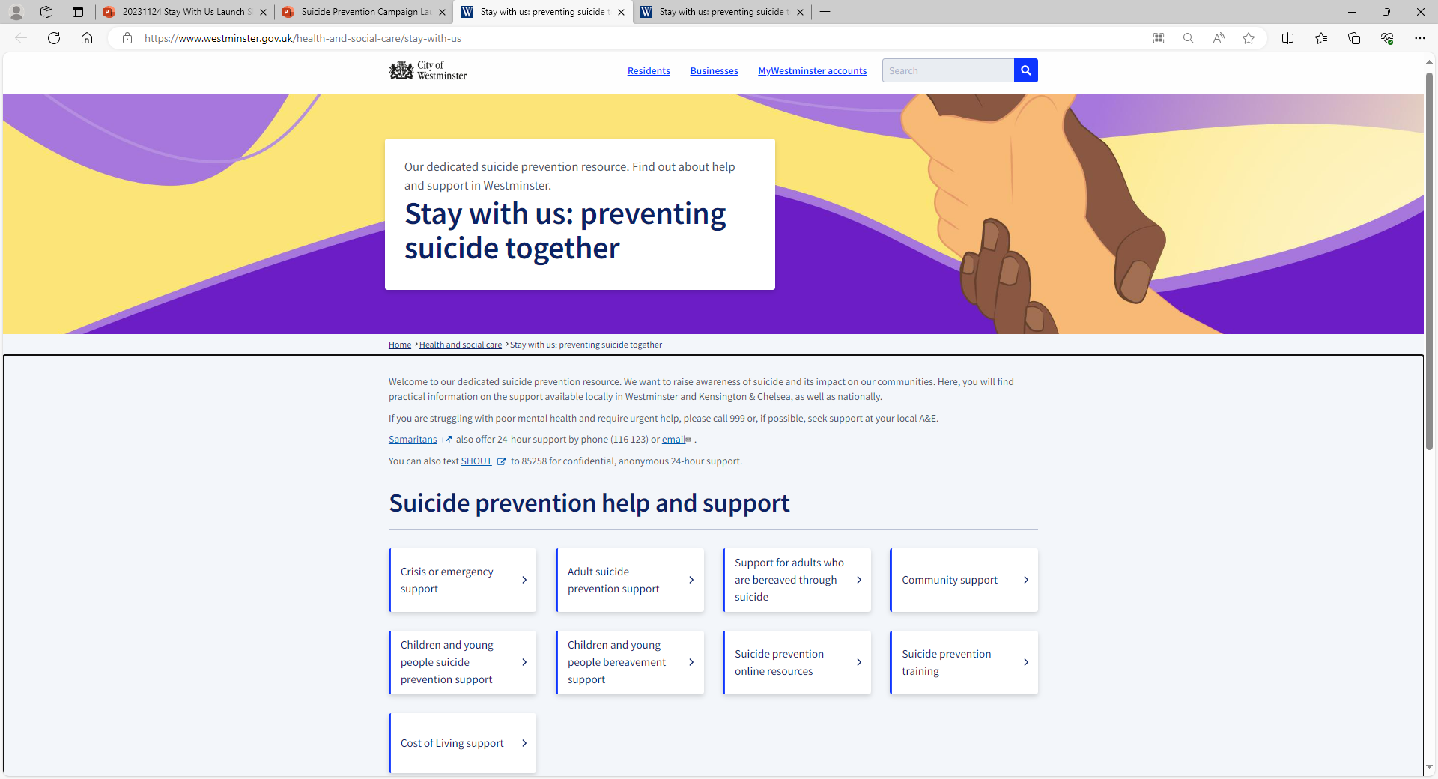
Suicide Prevention Web Resource
Stay with us: preventing suicide together | Westminster City Council

Slide 5
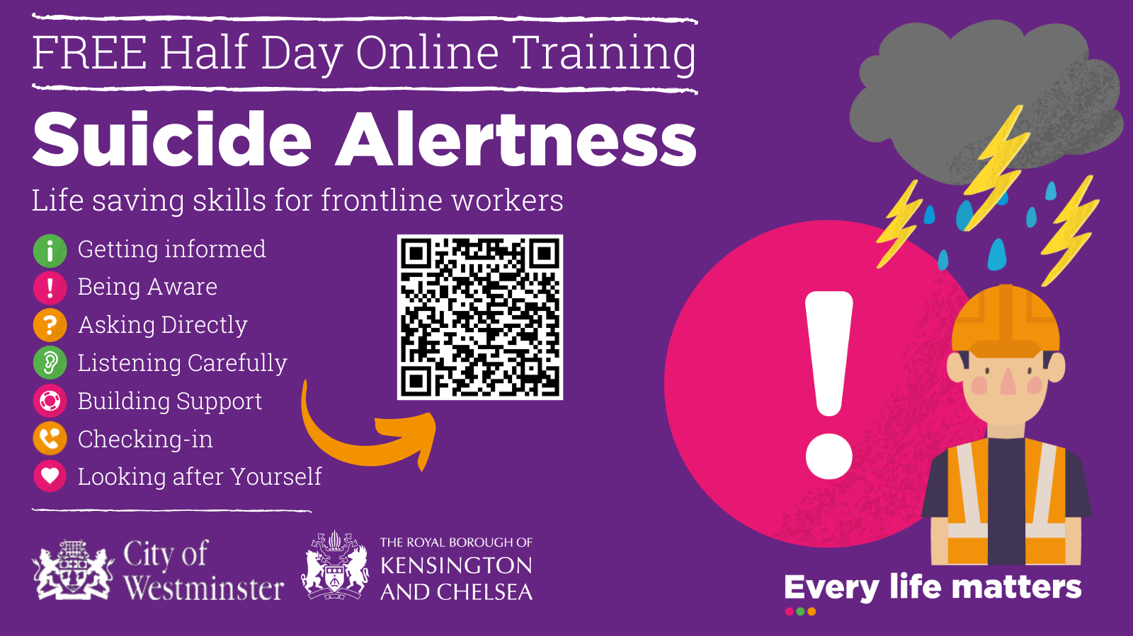
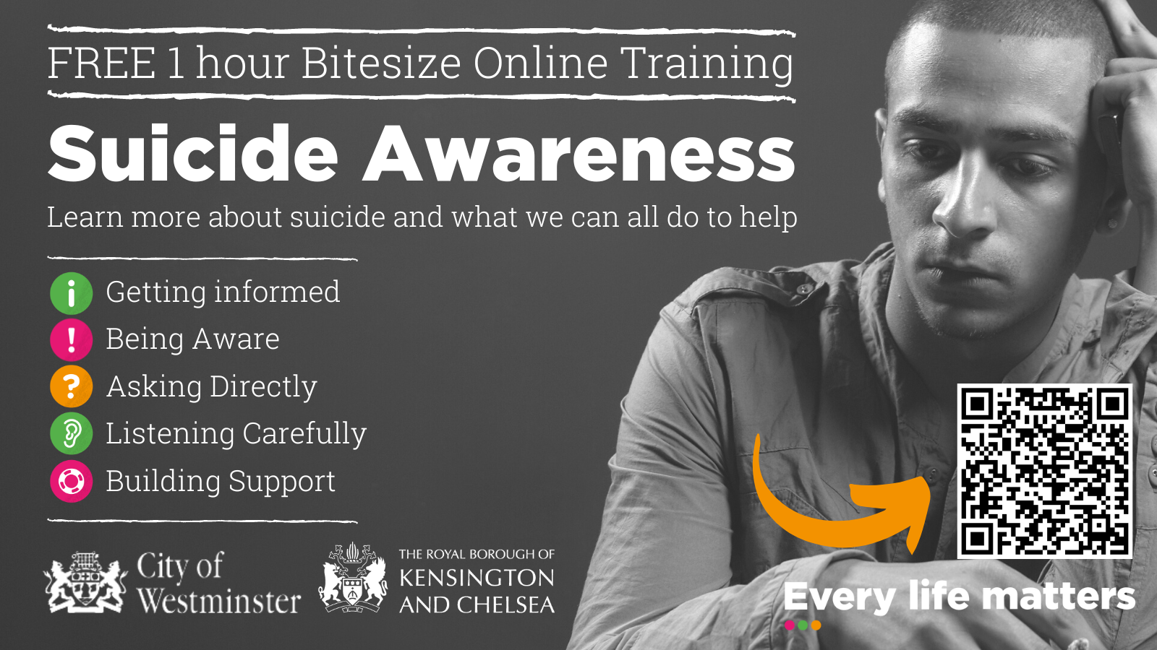
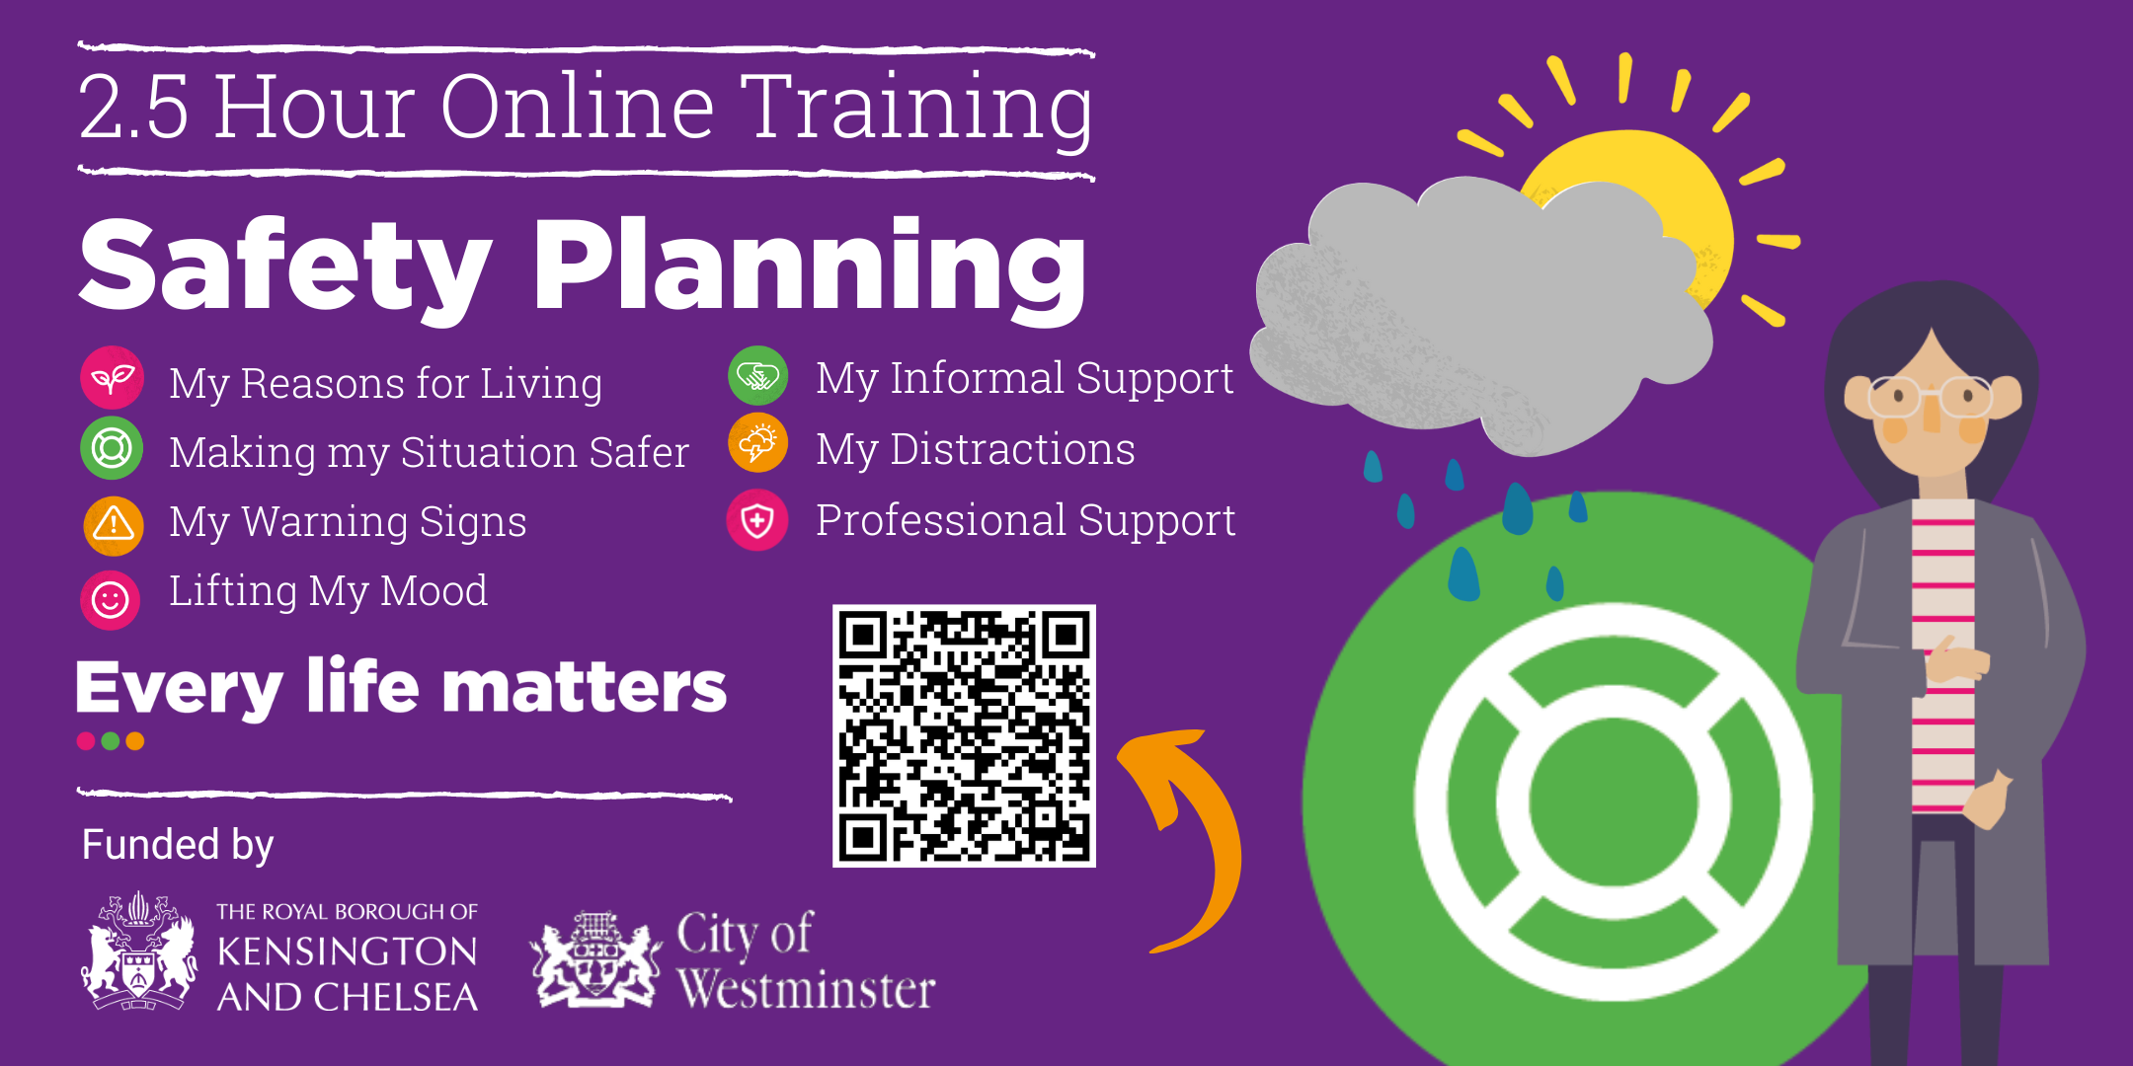
Suicide Prevention Training

Slide 6
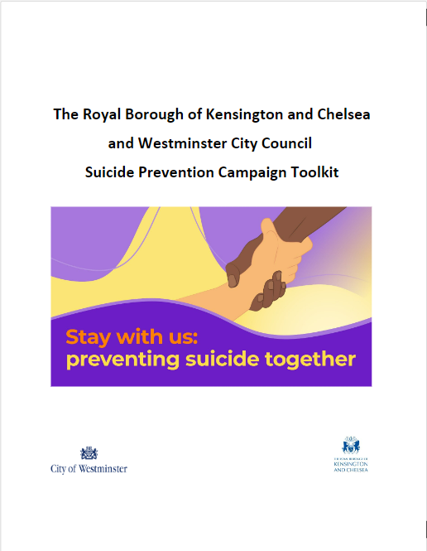
Suicide Prevention Campaign Toolkit

Slide 7
Mental Health Digital Platform
What is it?
It is a website that will be available via the Westminster and Kensington and Chelsea council websites to help residents with their health and wellbeing and could include:
      Information about Mental Health conditions
      Information about the types of service available
      Videos describing common conditions
      Videos explaining the different types of support available
      Help to access appropriate local support services

Slide 8
Mental Health Digital Platform
We need your help to make sure the tool is appropriate

Slide 9
Mental Health Digital Platform
Which of the following ways of finding the most appropriate Mental Health support do you prefer?

Slide 10
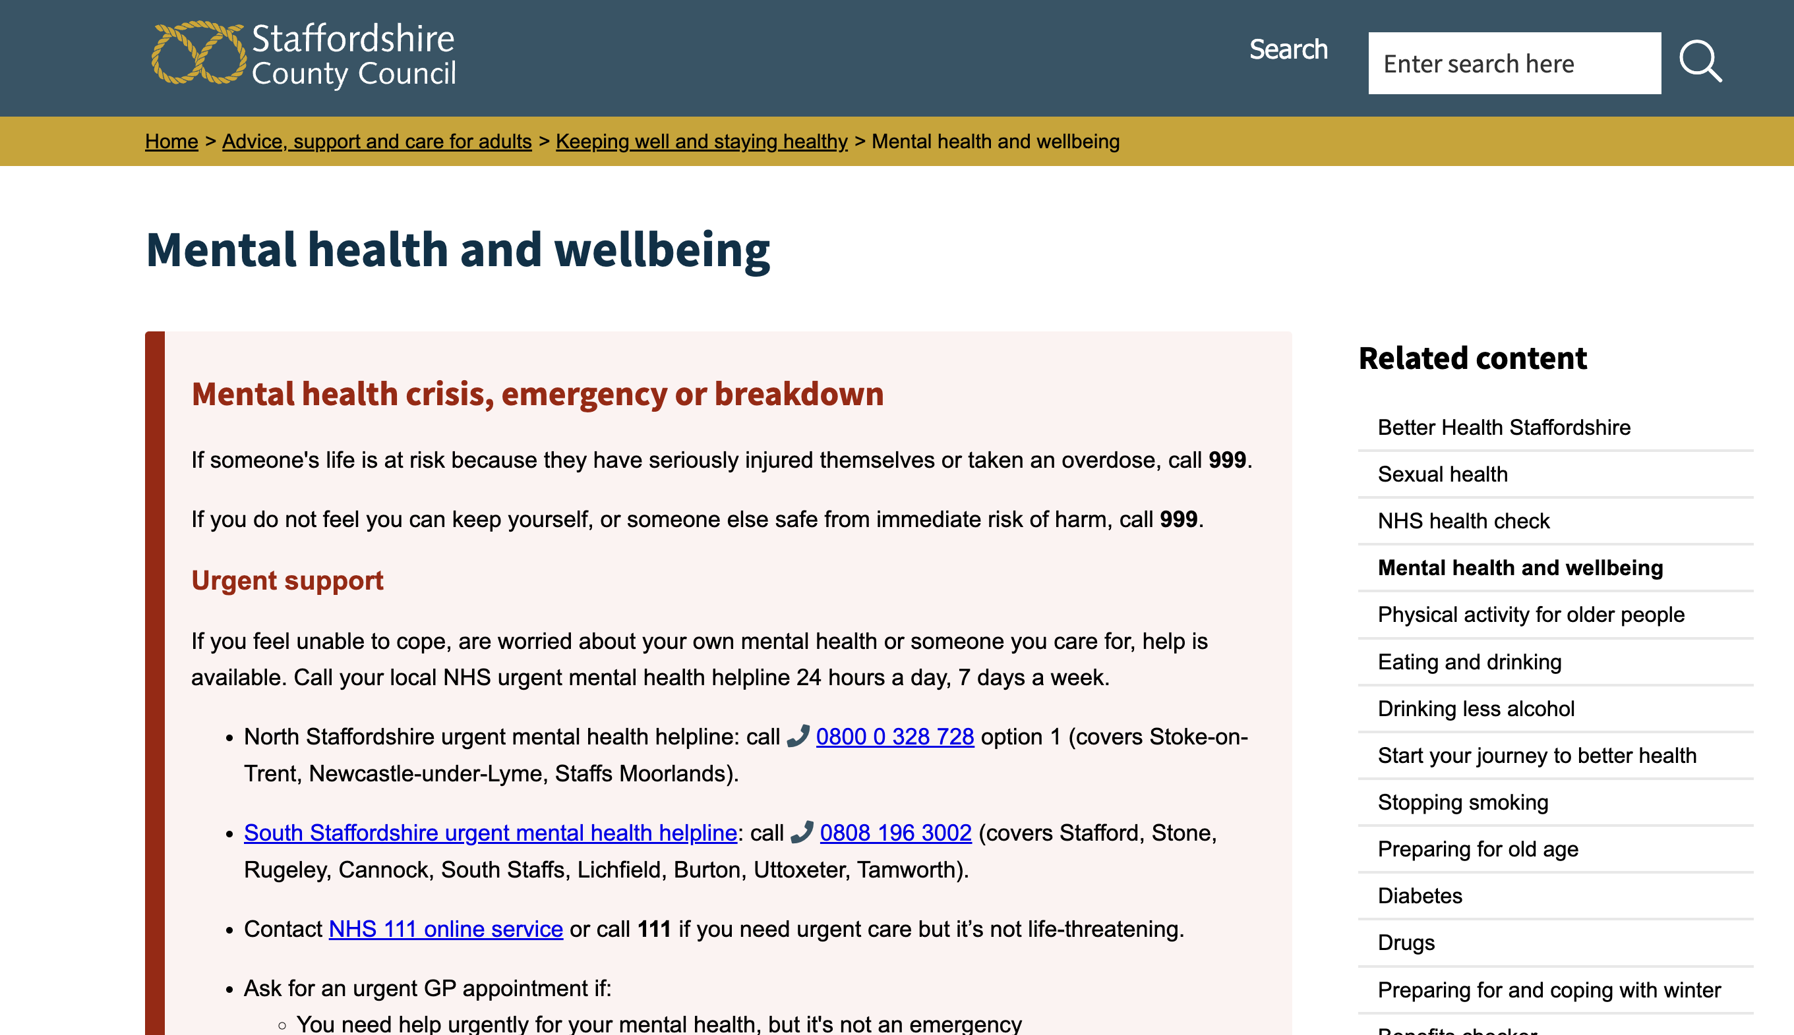
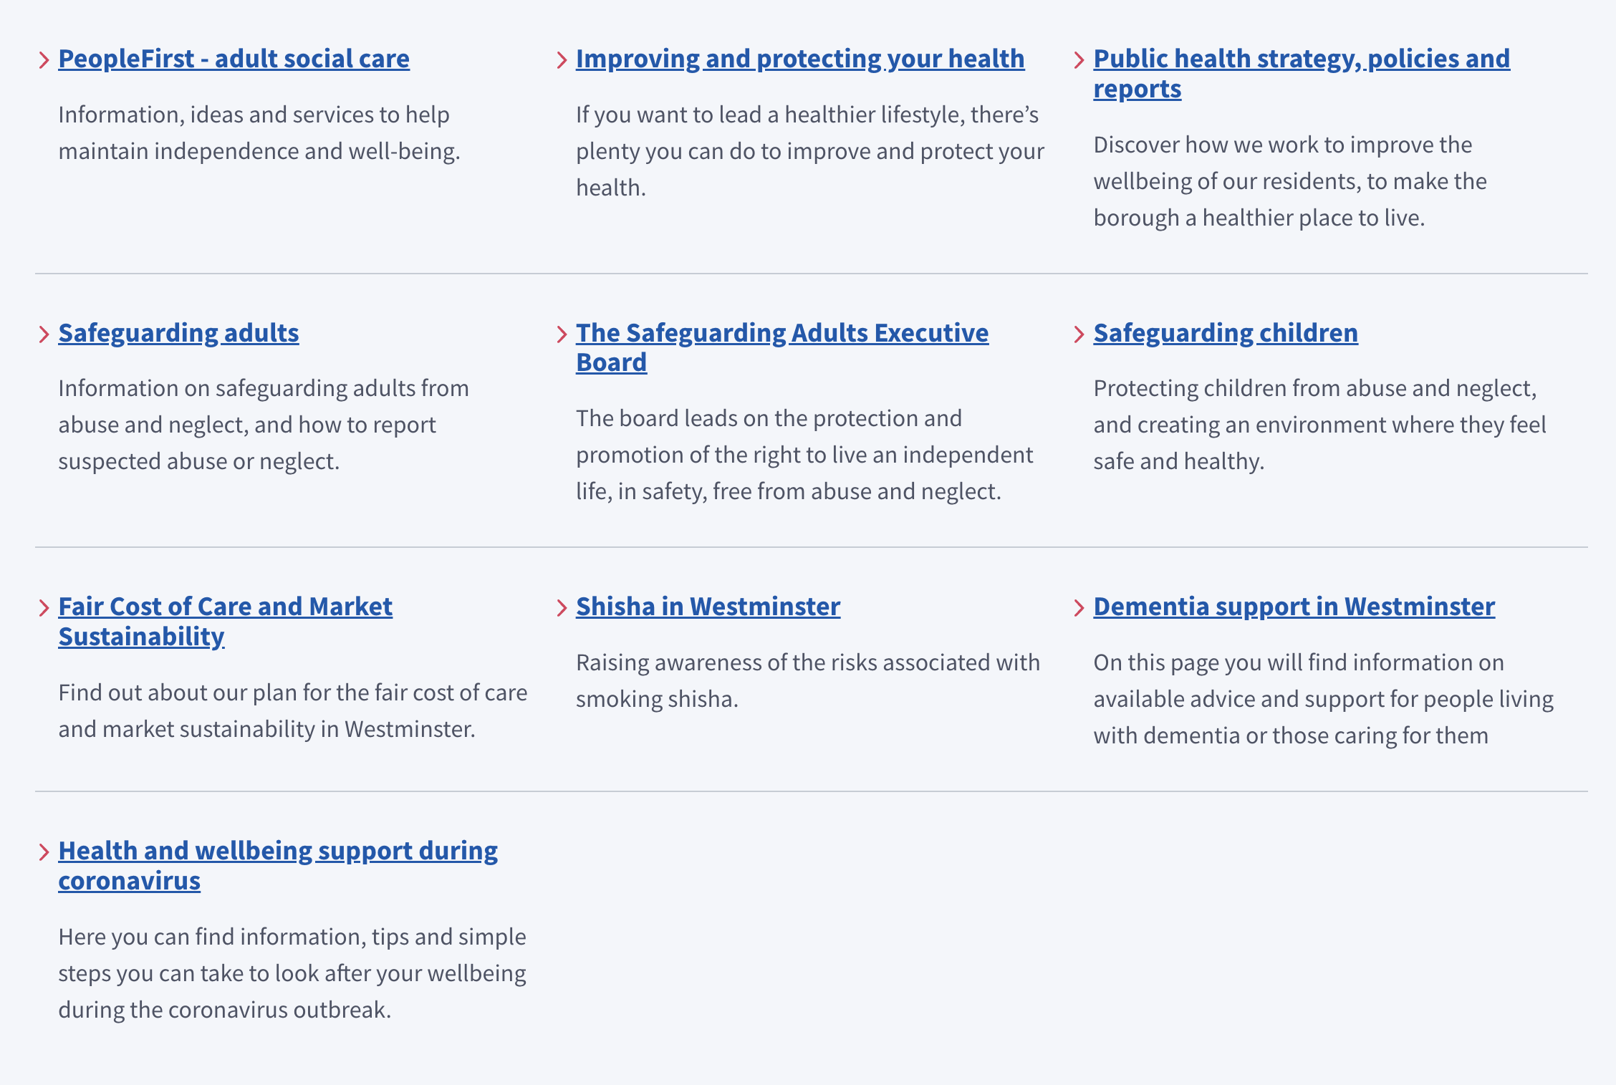
Word-based

Slide 11
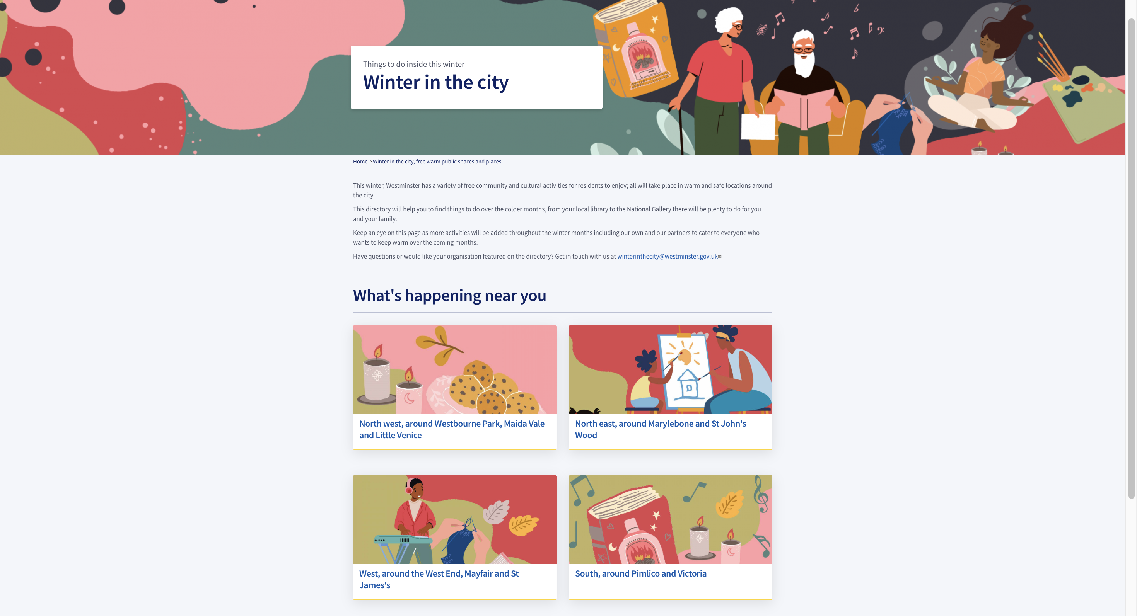
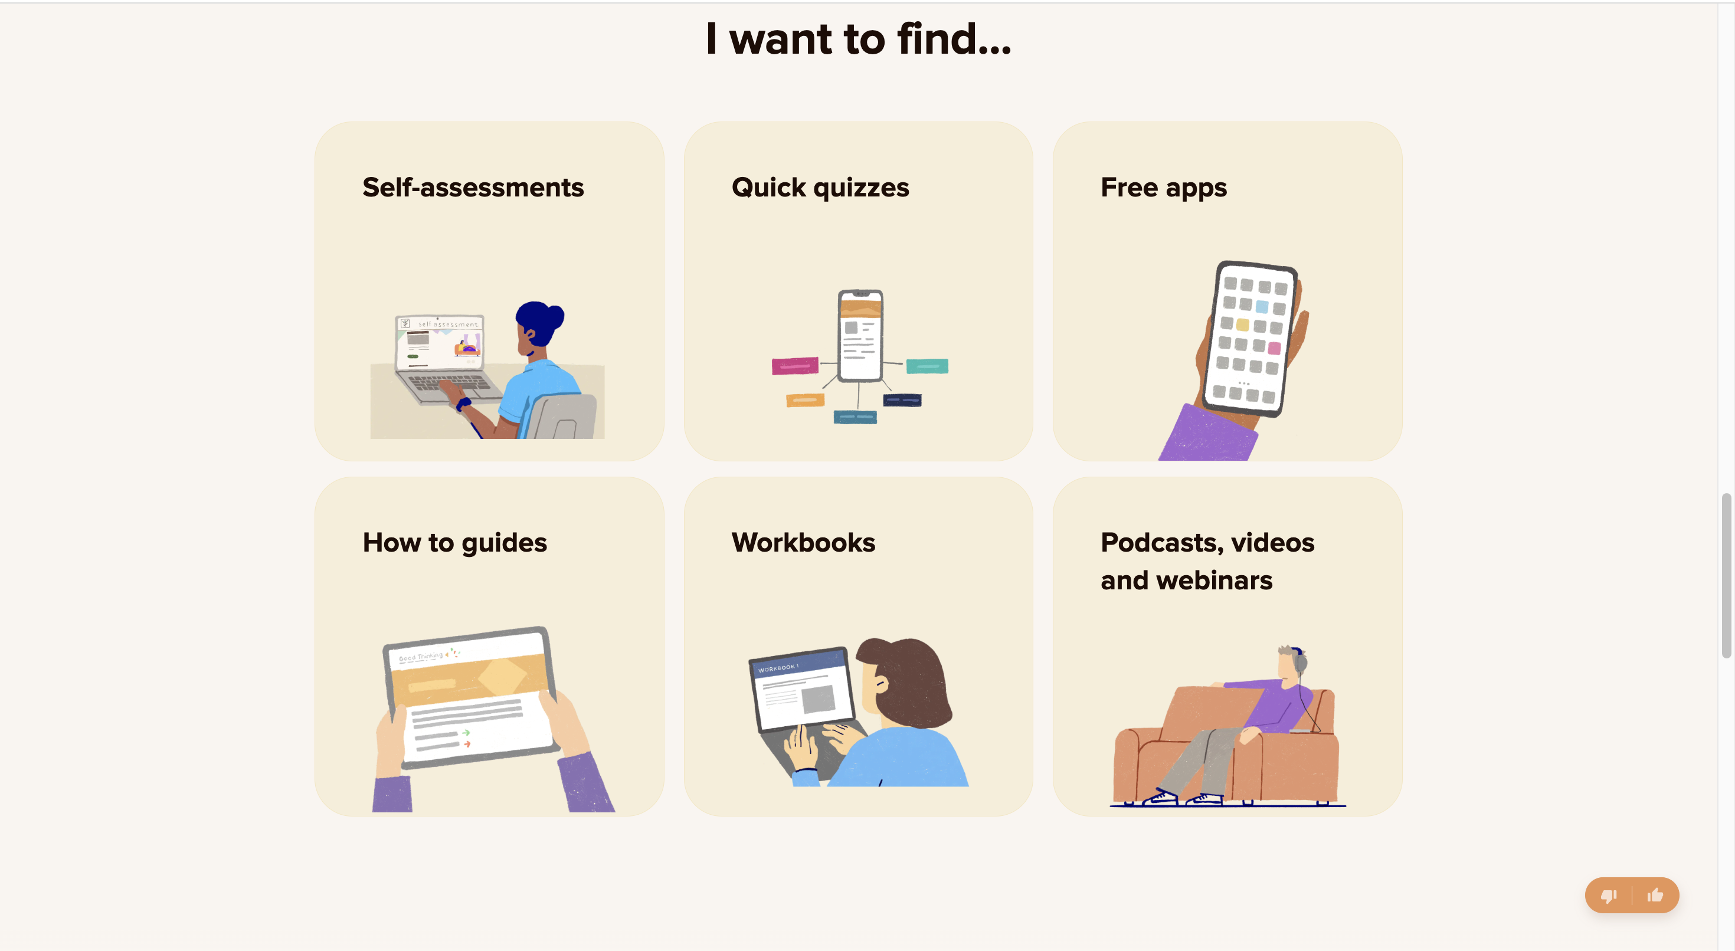
Image-based

Slide 12
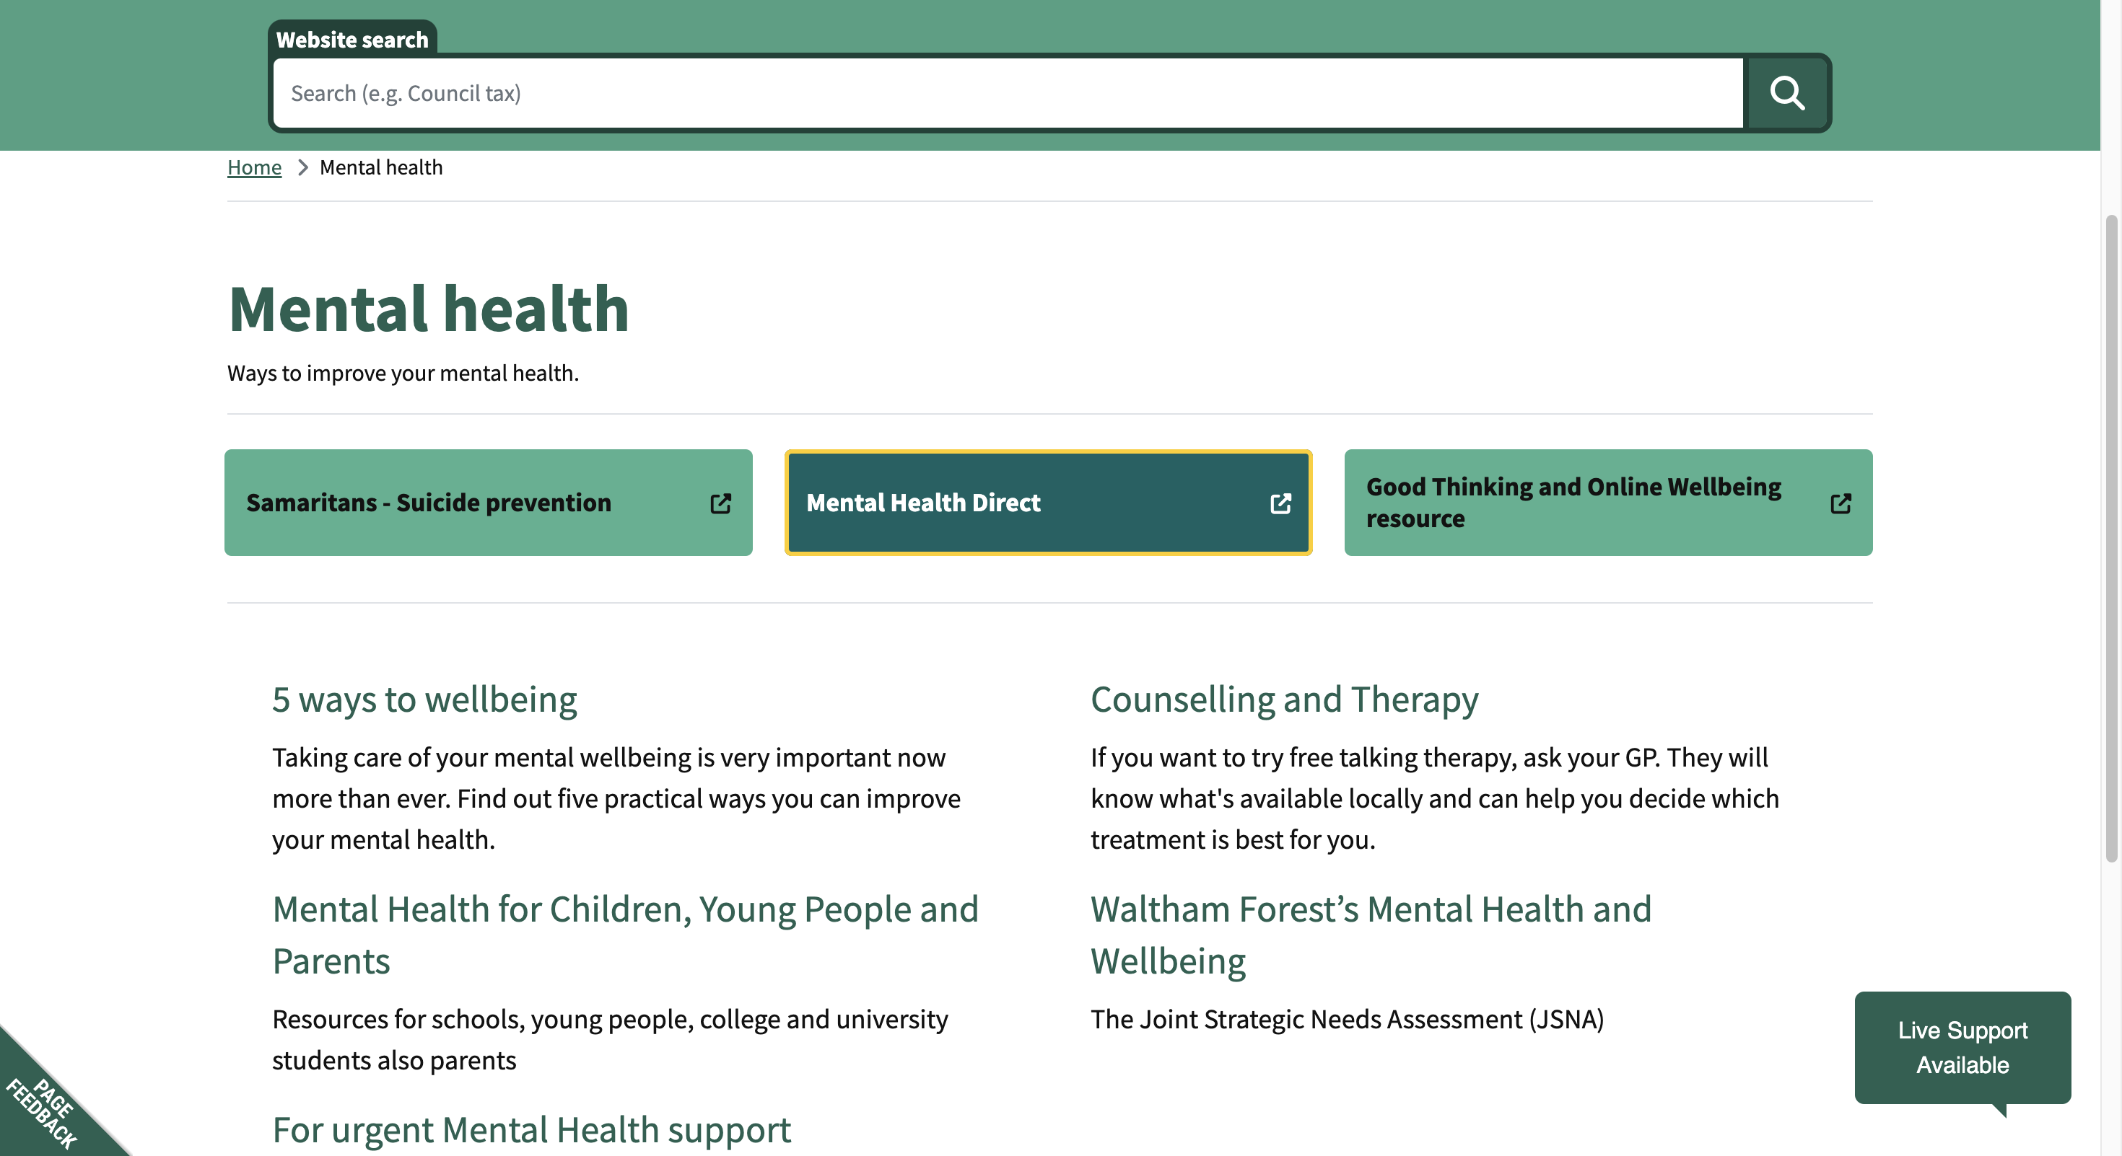
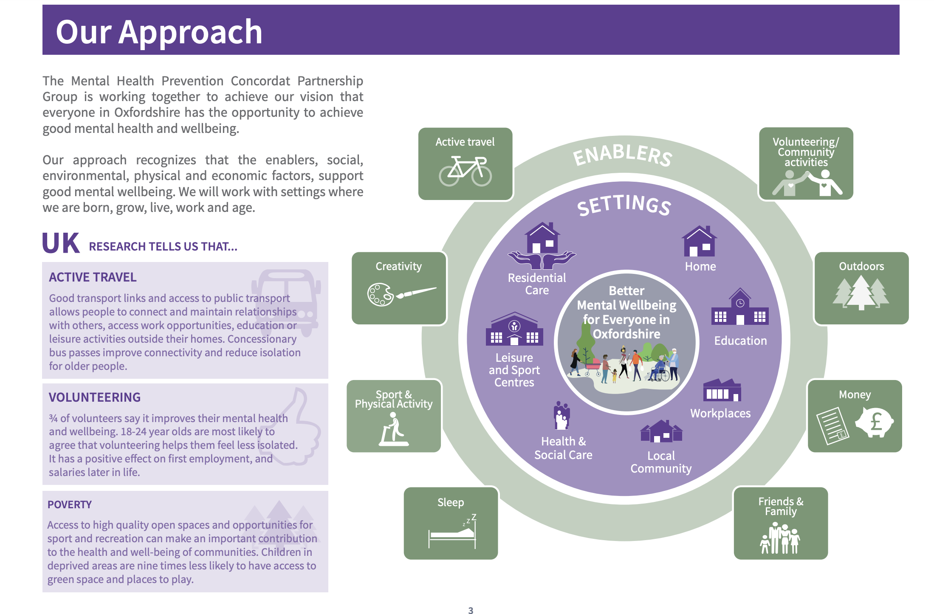
Text with colour and icons

Slide 13
Mental Health Digital Platform
Which of the following ways of finding services do you prefer?

Slide 14
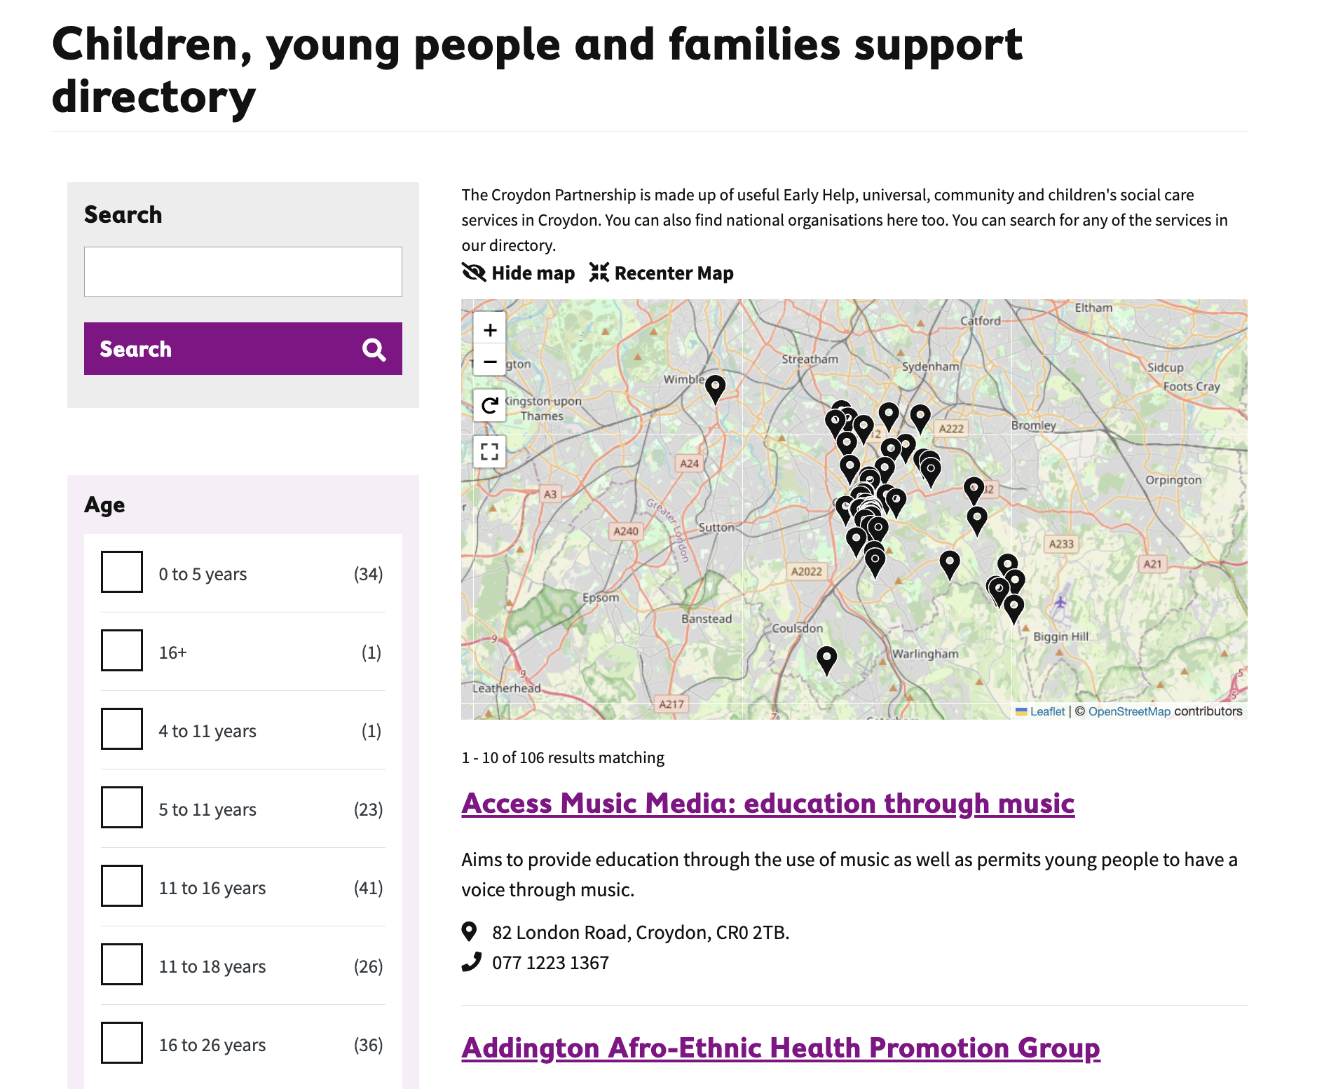
Interactive map

Slide 15
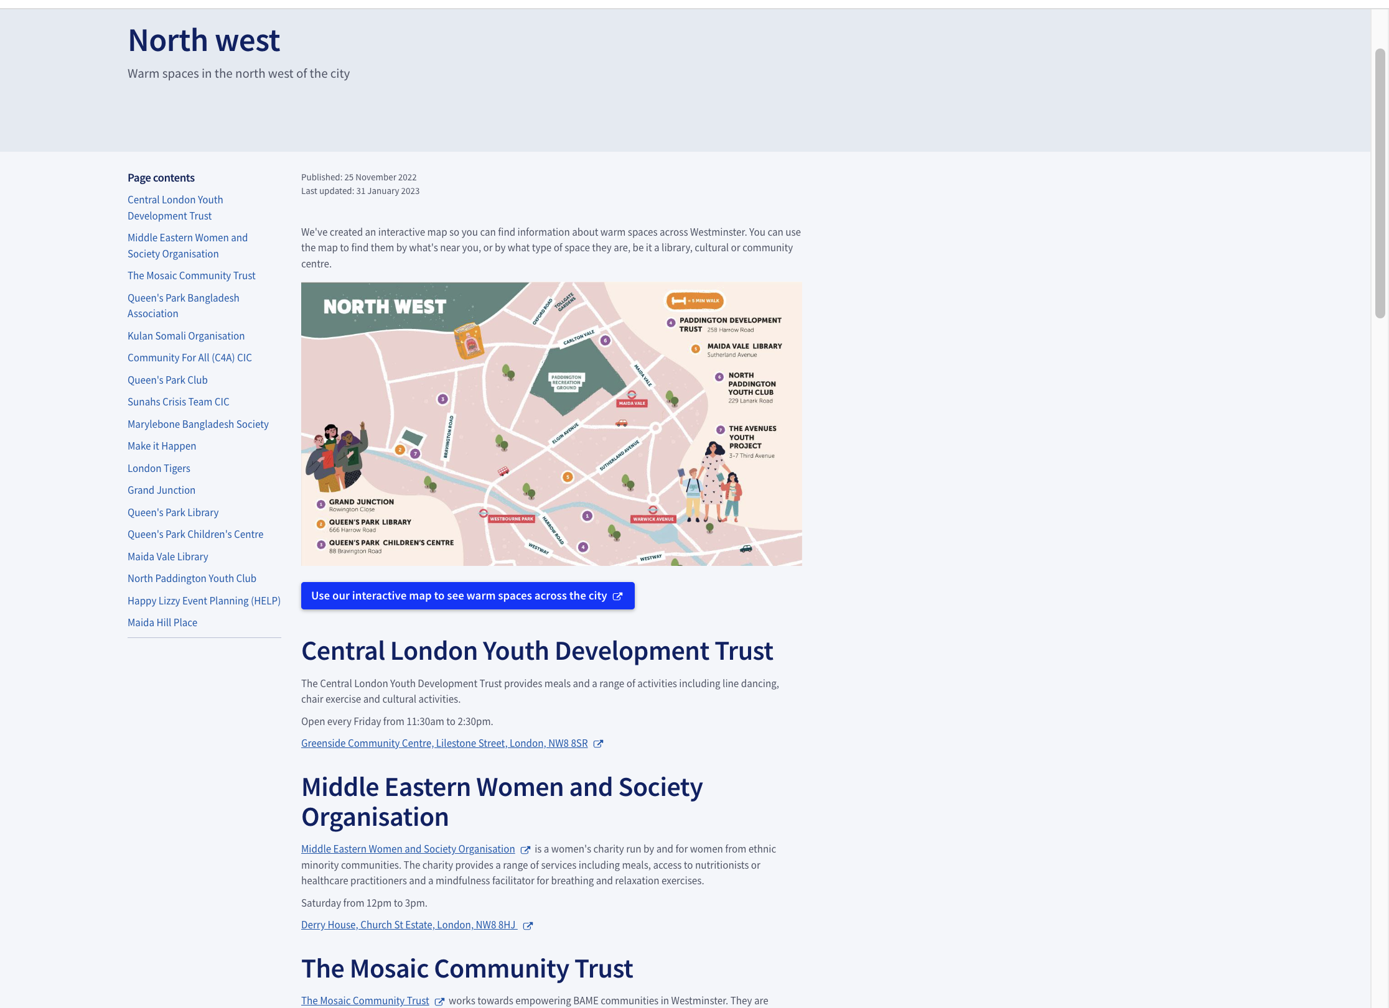
Animated map

Slide 16
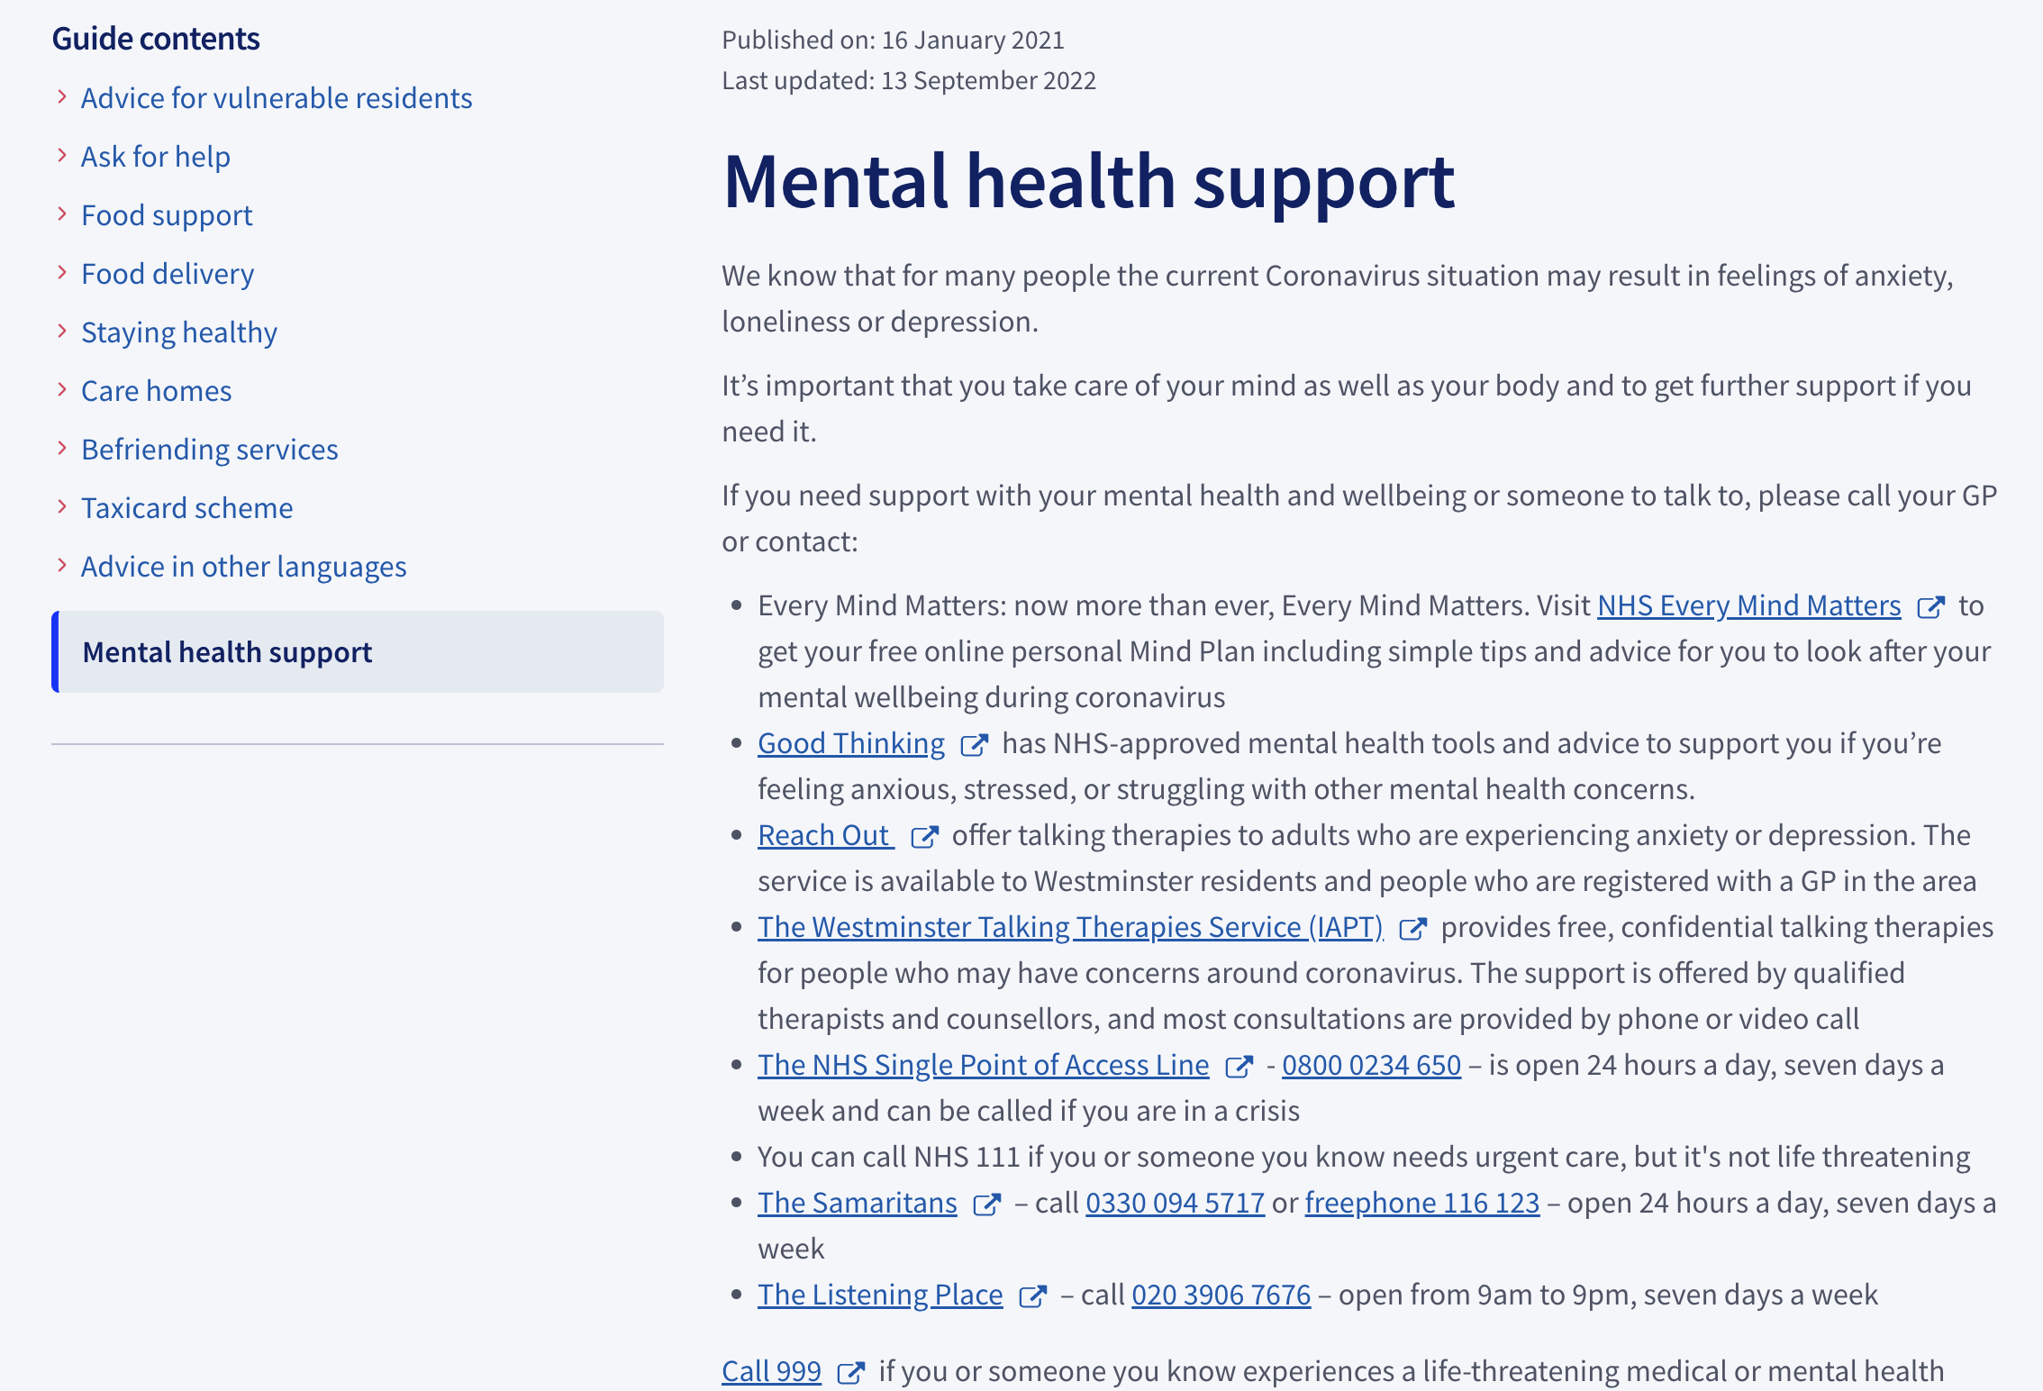
List of services

Slide 17
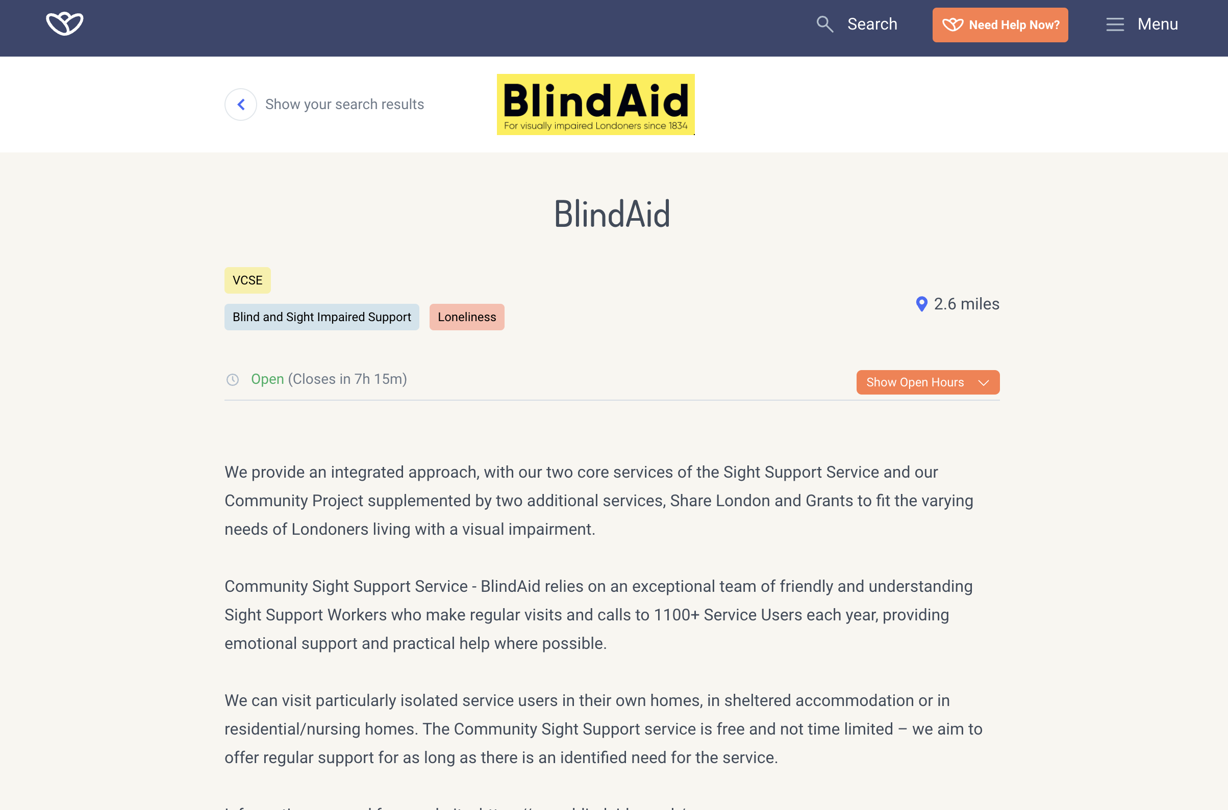
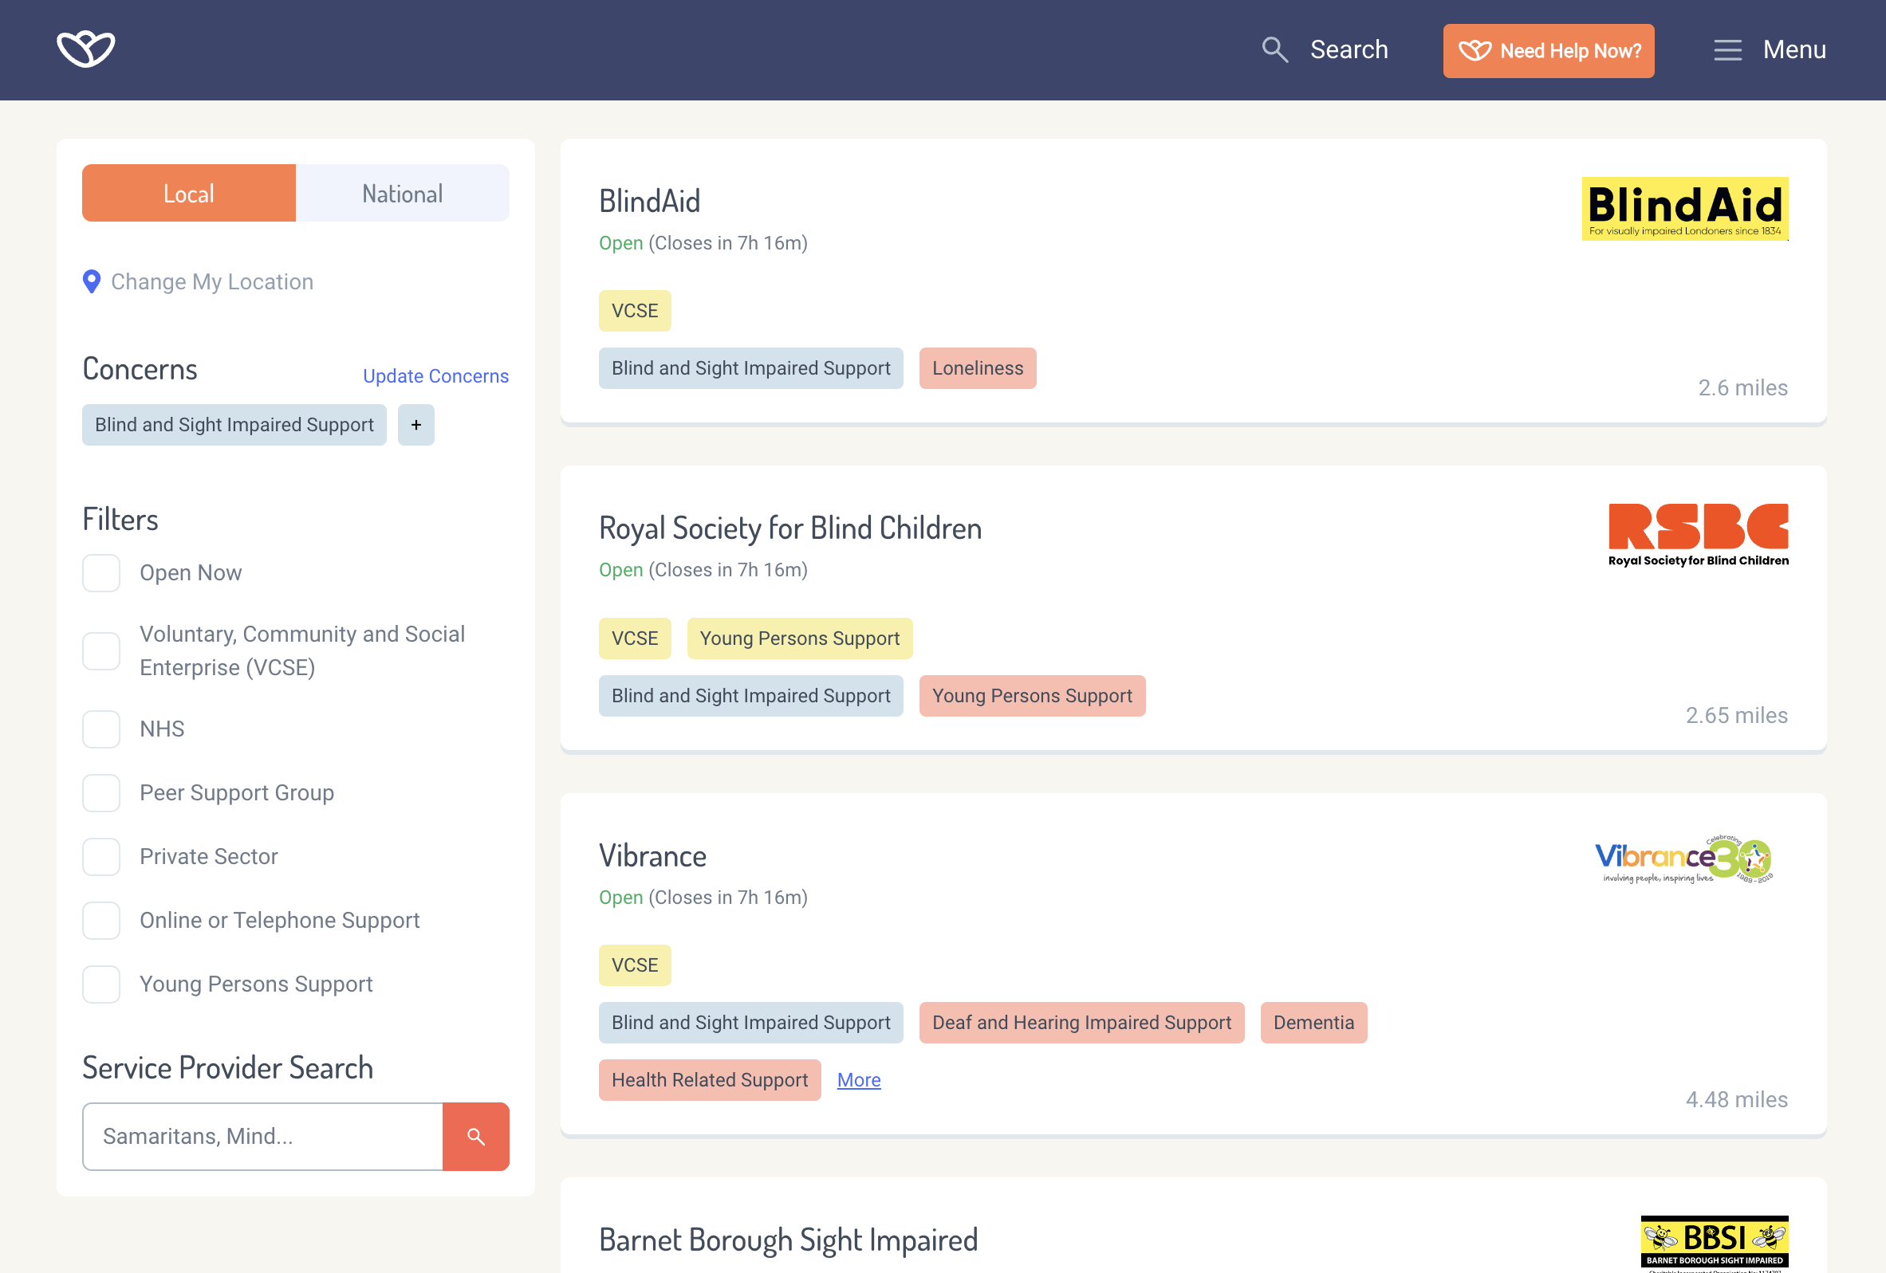
List of services with focus issues highlighted
Notes:
Ask for a show of hands on which format people prefer

Slide 18
Mental Health Digital Platform
A campaign to promote the Mental Health Digital project is going to be launched. Which of the following 3 campaign types do you think is most suitable

Slide 19
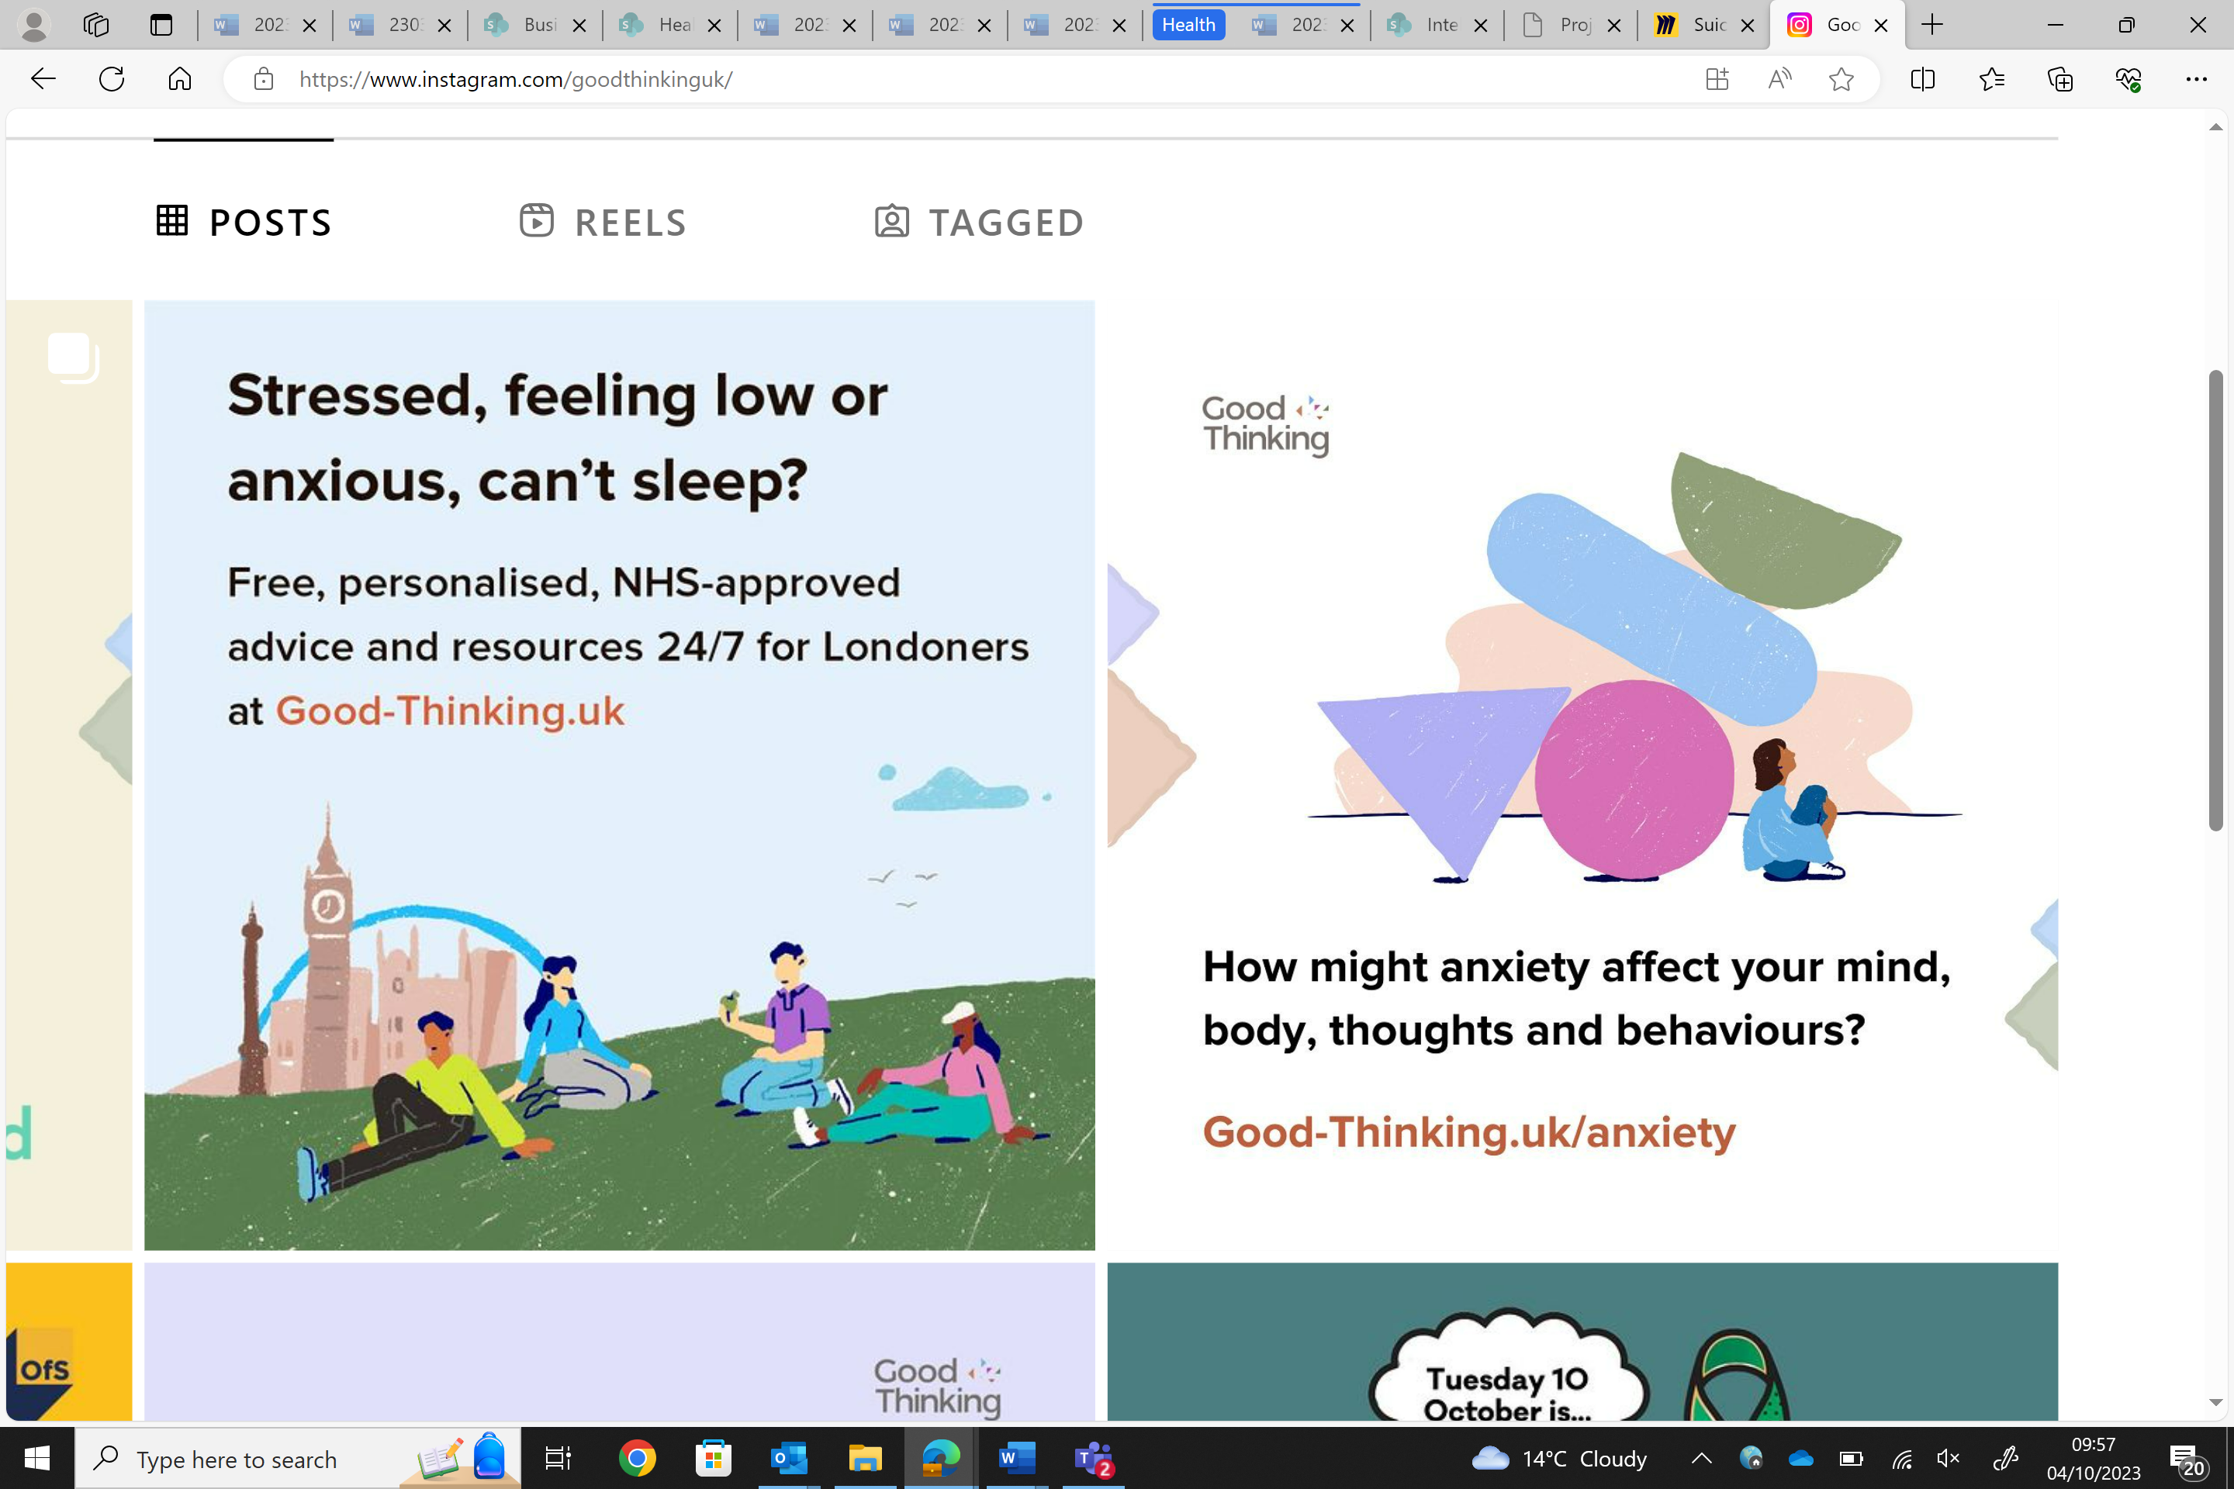
Cartoon

Slide 20
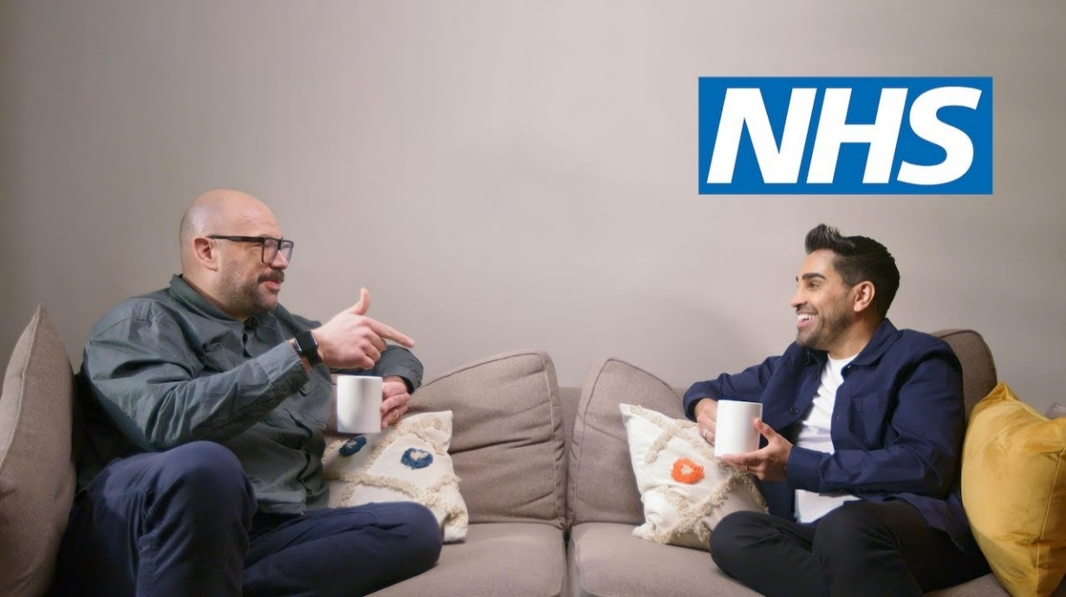

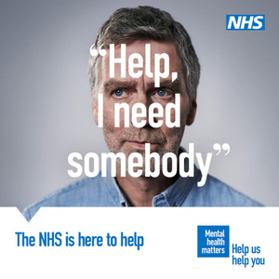
Photographic

Slide 21
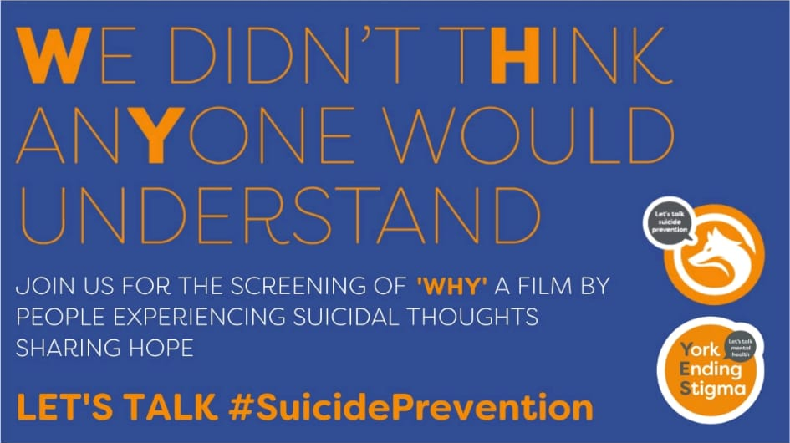
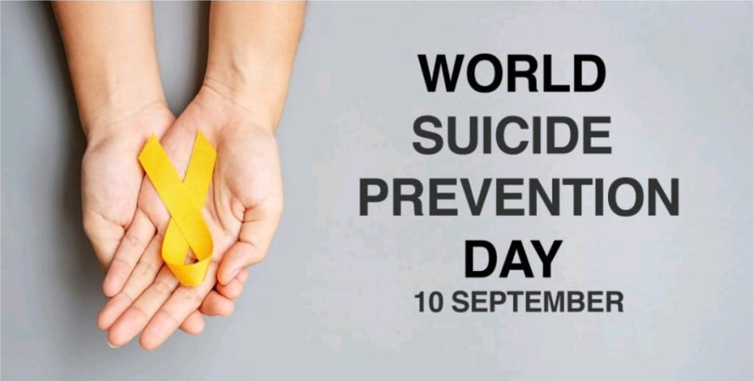
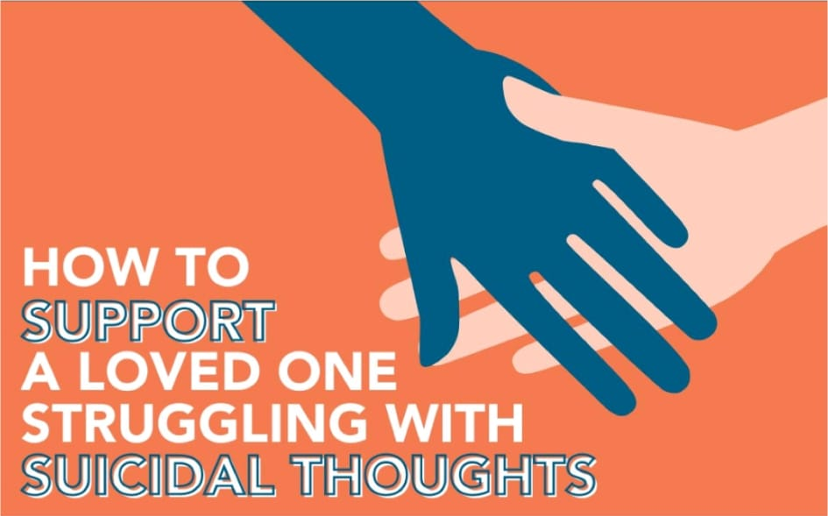
Images/words
Notes:
Show of hands for preference

Slide 22
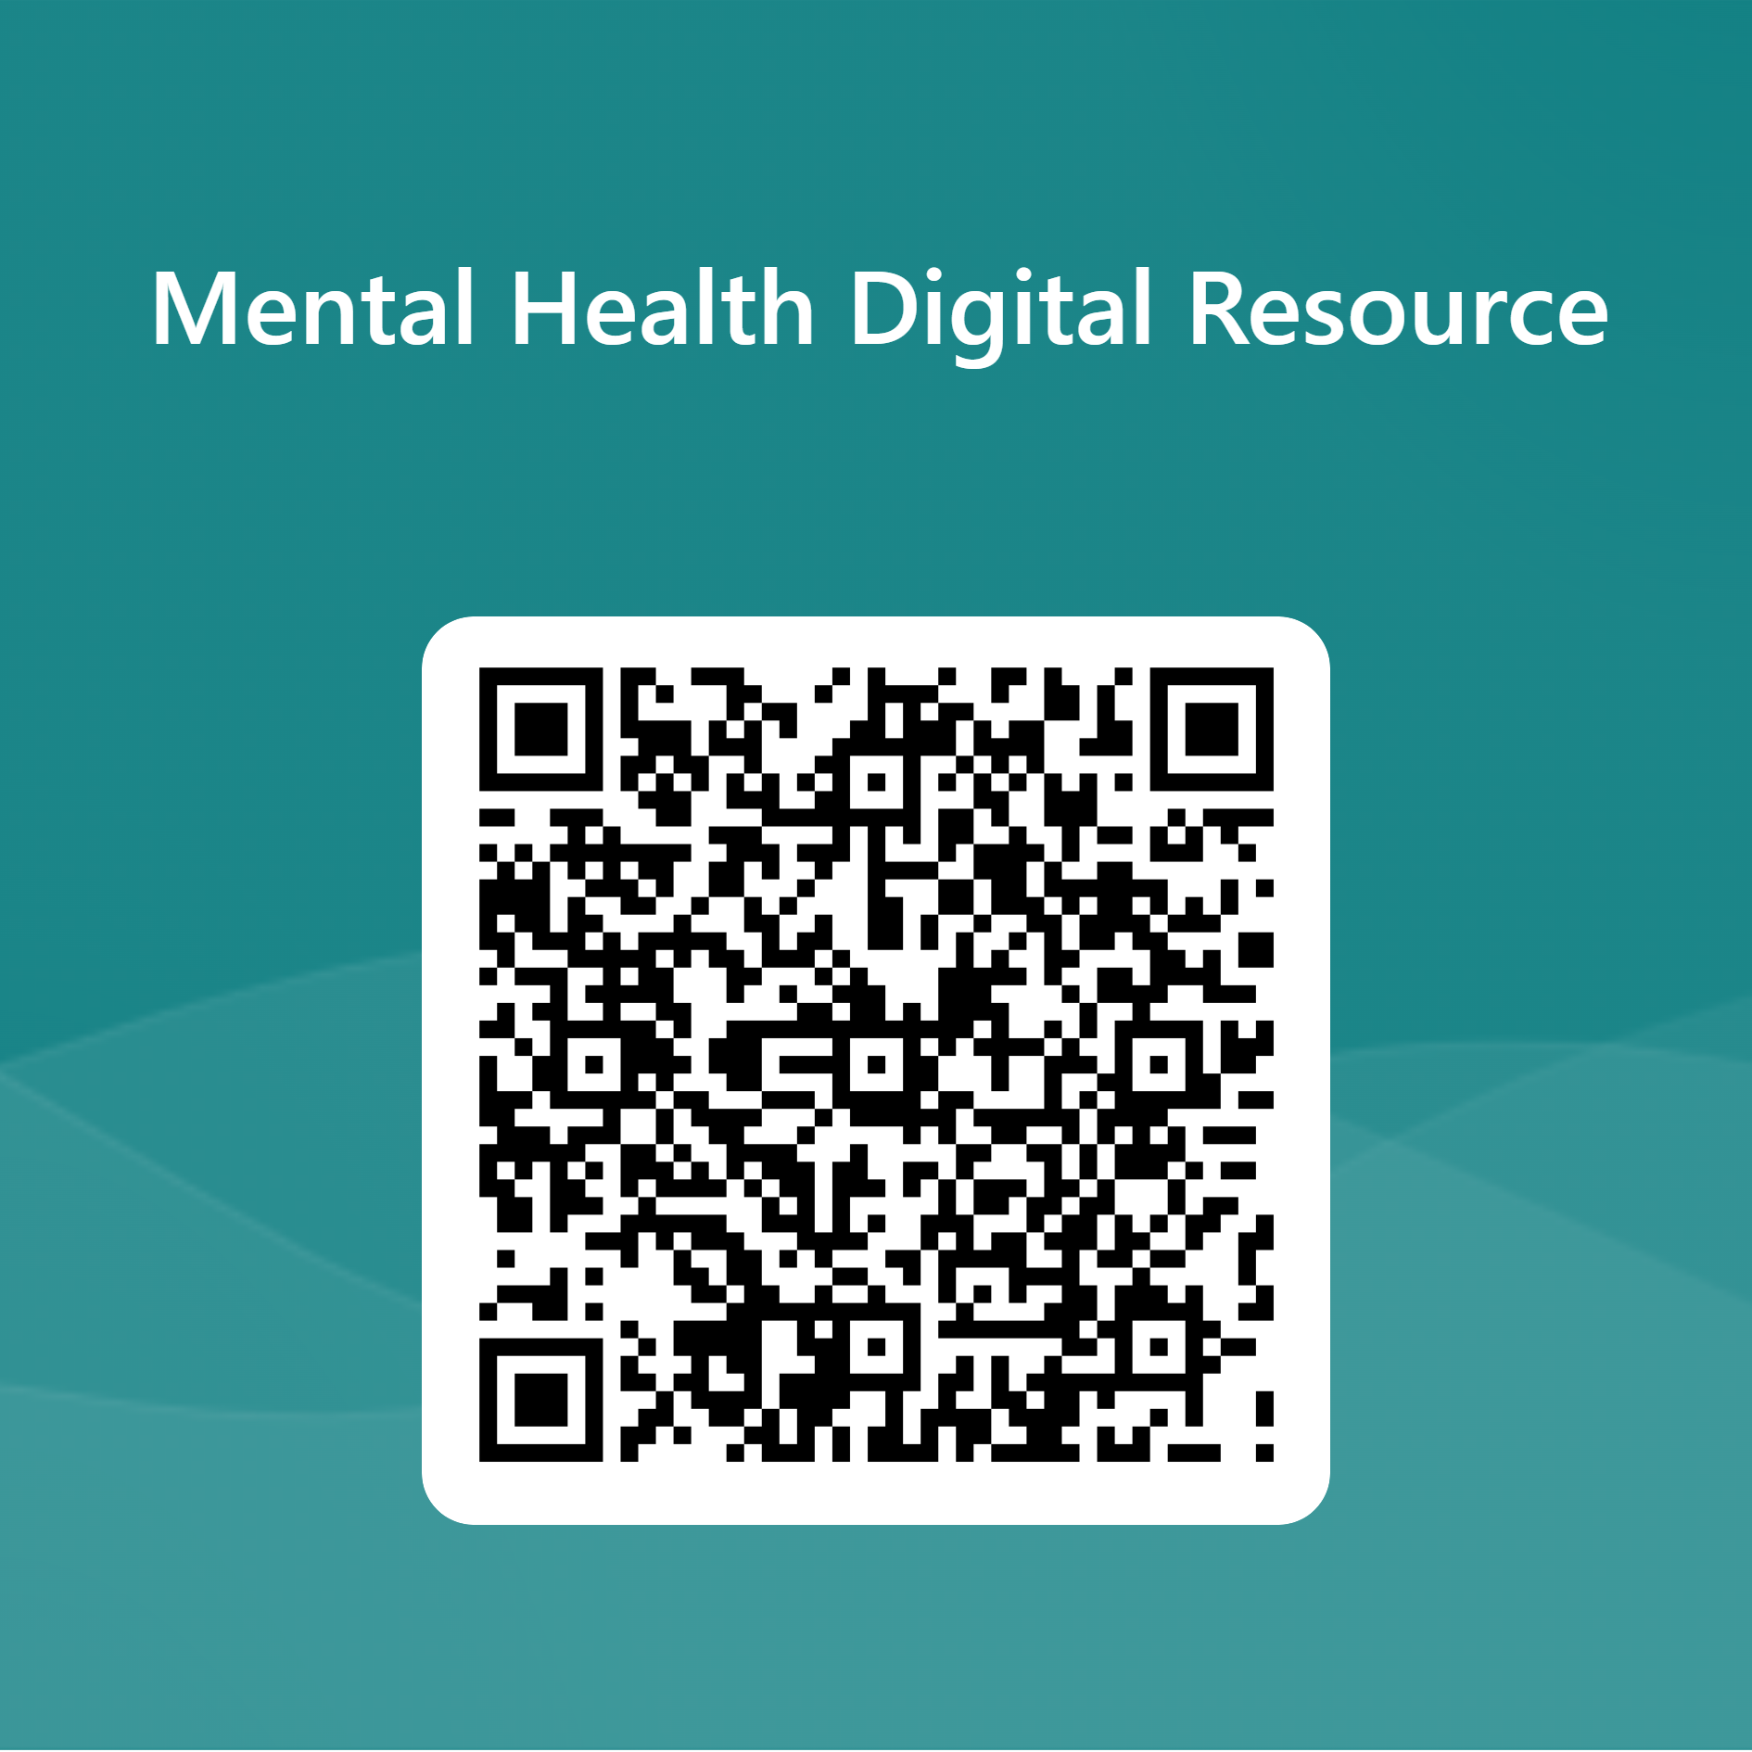
Mental Health Digital Platform
QR code

