Slide 1


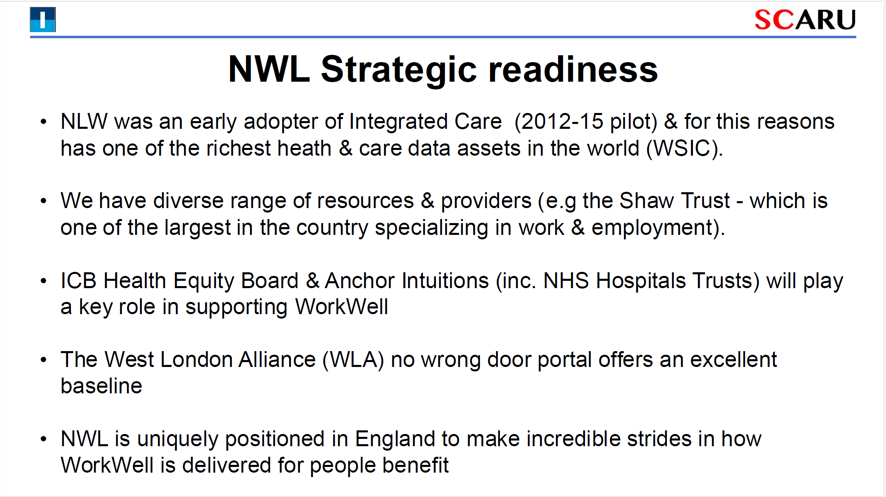
WorkWell – NWL
What is WorkWell?

Slide 2
North West London ICB: Addressing Health Inequalities through WorkWell
North West London ICB is one of 15 WorkWell Vanguards funded by the Department for Work and Pensions to support residents back into work. This initiative directly addresses the widening life expectancy gap between communities in NW London, largely driven by wider determinants of health such as poor housing, poverty, and lack of employment opportunities.
Key Points:
WorkWell aligns with the ICS's fourth objective, focusing on social and economic development in our most deprived communities.
WorkWell serves as the primary vehicle to deliver on this objective, creating a strategic and streamlined front-end to various health and work initiatives.
It builds on existing strong partnerships and the national Core20Plus5 framework, maximising our roles as Anchor Institutions
Reduces employers’ absence costs and improves productivity through early help & preventive interventions.
The Government has proposed measures to overhaul the health and benefits system to support employment (outlined in the ‘Get Britain Working’ white paper).
We are working together in these ways to address these issues, maximising the opportunity this ICB brings to local people:
NW London ICB collaborated with West London Alliance to secure this investment.
West London Alliance has been commissioned to deliver WorkWell across all eight NW London boroughs.
The programme was launched in July 2024, marking the first phase of a medium-term strategy to develop a whole-system integrated offer for work and health.
The WorkWell delivery model outlines participants' journey through the programme, offering a range of services tailored to individual needs. Feedback from the launch event has been incorporated to strengthen the approach.
By addressing these social determinants of health, WorkWell aims to reduce health inequalities, improve employment rates, and ultimately enhance the overall well-being of NW London communities.
WorkWell is well positioned to create a more strategic and streamlined front-end to the range of health and work initiatives and support services for NW London.

Slide 3
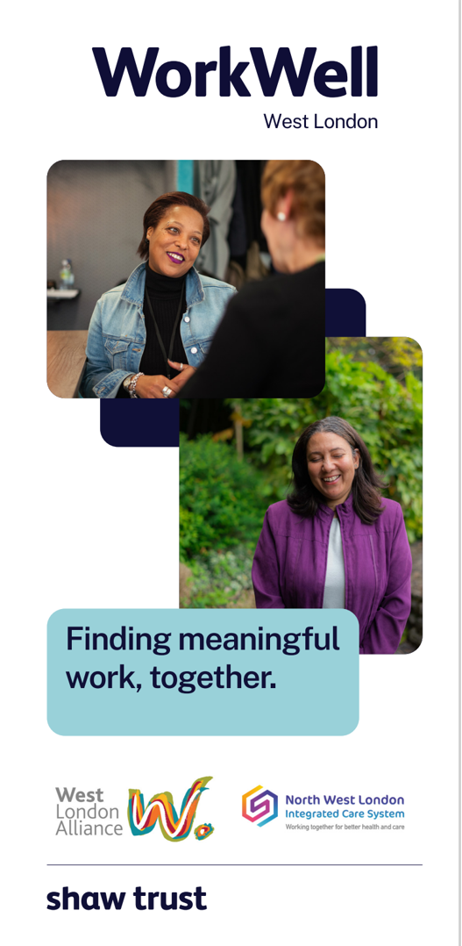
WorkWell is a…
Digital Front Door and Triage Point: to a wider range of employment support
Catalyst for strategic systems change: through an Integrated Work and Health Strategy
Notes:
North West London ICB is one of 15 WorkWell Vanguards funded by the Department for Work and Pensions to support residents back into work. This initiative directly addresses the widening life expectancy gap between communities in NW London, largely driven by wider determinants of health such as poor housing, poverty, and lack of employment opportunities.
Key Points:
WorkWell aligns with the ICS's fourth objective, focusing on social and economic development in our most deprived communities.
WorkWell serves as the primary vehicle to deliver on this objective, creating a strategic and streamlined front-end to various health and work initiatives.
It builds on existing strong partnerships and the national Core20Plus5 framework, maximising our roles as Anchor Institutions
Reduces employers absence costs and improves productivity through early help & preventive interventions.
The Government has proposed measures to overhaul the health and benefits system to support employment (outlined in the ‘Get Britain Working’ white paper).
We are working together in these ways to address these issues, maximising the opportunity this ICB brings to local people:
NW London ICB collaborated with West London Alliance to secure this investment.
West London Alliance has been commissioned to deliver WorkWell across all eight NW London boroughs.
The programme was launched in July 2024, marking the first phase of a medium-term strategy to develop a whole-system integrated offer for work and health.
The WorkWell delivery model outlines participants' journey through the programme, offering a range of services tailored to individual needs. Feedback from the launch event has been incorporated to strengthen the approach.
By addressing these social determinants of health, WorkWell aims to reduce health inequalities, improve employment rates, and ultimately enhance the overall well-being of NW London communities.
WorkWell is well positioned to create a more strategic and streamlined front-end to the range of health and work initiatives and support services for NW London.

Slide 4
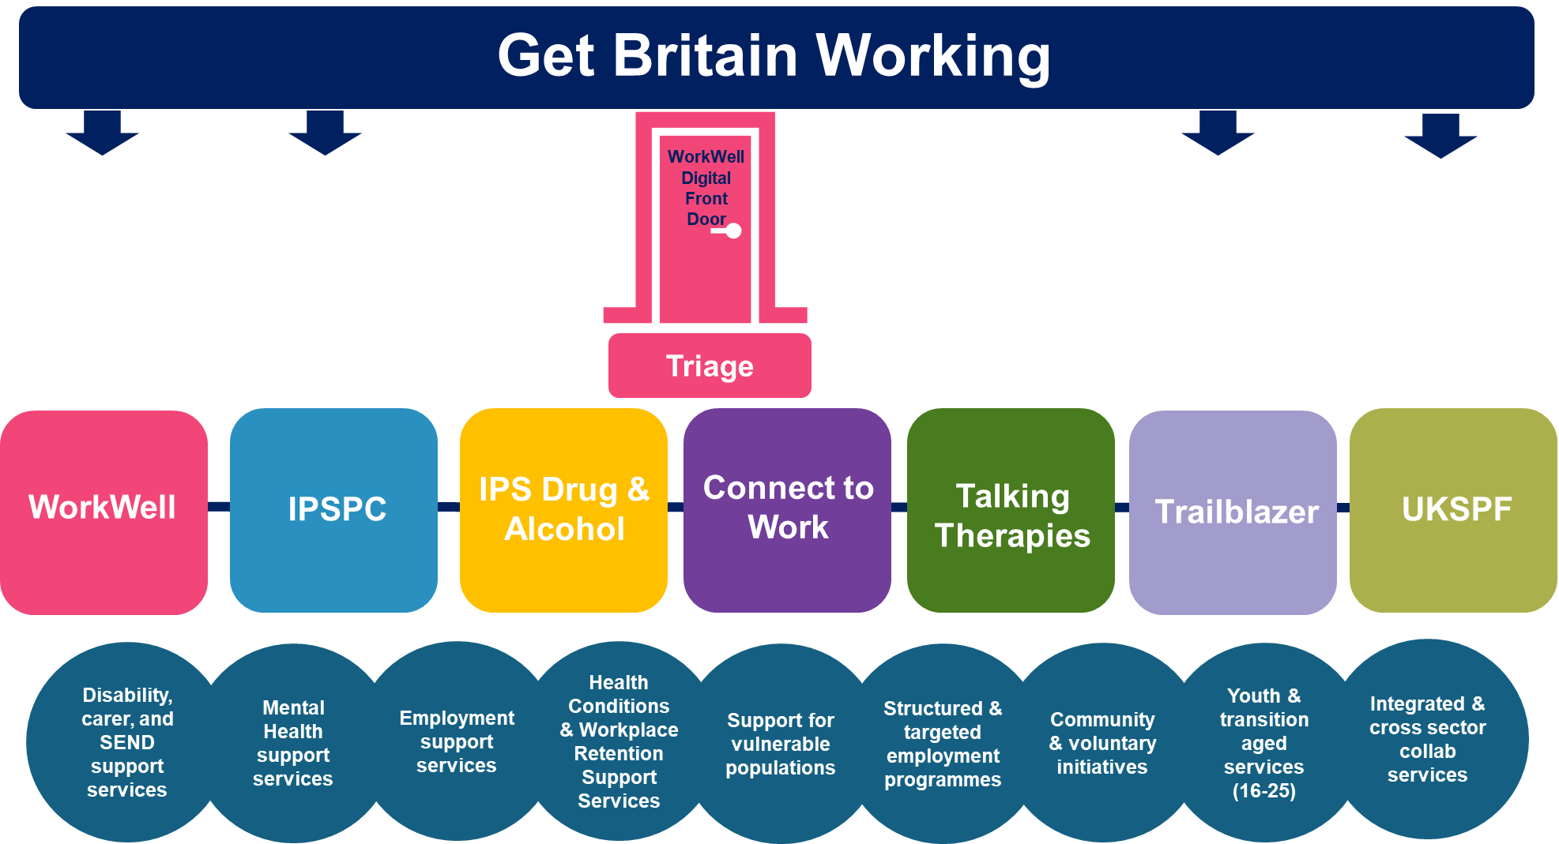
Work and Health Services
WorkWell is at the heart of the health and work infrastructure in North-West London, functioning as a digital front door and triage point for people in need of employment support.
Key Local Initiatives
WorkWell is also a voluntary health and work programme providing early intervention work and health assessments and low-intensity holistic employment support
Connect to Work is a new DWP-funded programme providing voluntary, targeted support to people who are out of work, or at risk of falling out of work, due to disability or long-term health conditions.
Individual Placement and Support in Primary Care was launched in May 2023 to provide employment support to people with mild to moderate physical and mental health conditions and takes referrals from primary care.
Individual Placement and Support – Drugs & Alcohol provides specialist support for people affected by substance misuse.
Talking Therapies provides employment advice for people seeking mental health support through dedicated Employment Advisers.
Inactivity trailblazers will bring together and streamline health, employment and skills services to improve the support available for people who are economically inactive​.
Individual Placement and Support – Serious Mental Illness evidence-based model of supported employment that helps people with Severe Mental Illness find and maintain jobs in the open labour market.
IPS-SMI

Slide 5
WorkWell – typical journey
1. Wide range of referral sources, e.g.
GPs
Employers
JCP
VCS
MSK/LD/Autism services
Self-Referral
5. MDT consideration of managing health advice and support, list includes as minimum:
Diabetes
Hypertension
Obesity
MSK
Mild to moderate mental health
Also sign posting to debt advice
Smoking cessation etc
6. Work and Health coach organises agreed Health provision from that available or sources and works with participant on back to work plan
2. Referral criteria:
Unemployed for due to sickness or at risk of unemployment due to sickness
You must also
want to find/return to work quickly
Be 16 yrs plus
Right to live and work in UK Resident
Registered with a GP in NW London NHS boroughs or lives in NWL
7. Return to Work / Thrive into Work Plan:
at least 1 meeting per week – health and work interventions can run in parallel
8. Exit at the end of 8 weeks with:
Return to work within 4 months, or
Moves to alternative provision, or
Exits the programme
4. WorkWell
Work and Health Coach:
Dialog Plus assessment (exploring at present) and Vocational Profile
3. Triage & Allocation a WorkWell coach or alternative provision (IPS PC, Universal Support, Borough Job Brokerage)
Notes:
Taylor
12.06pm – 12.11 (5-6mins)
Please track the EDI data. 28% of what data and granular detail for Ealing so that we can bring additional support.

Slide 6
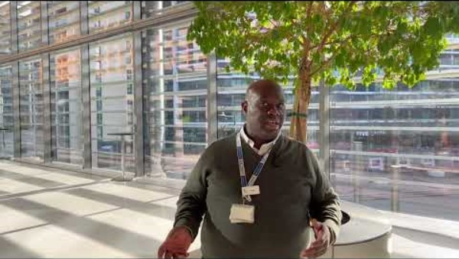
Video
Notes:
https://youtu.be/lbiG1e1ErCk
2 mins

Slide 7
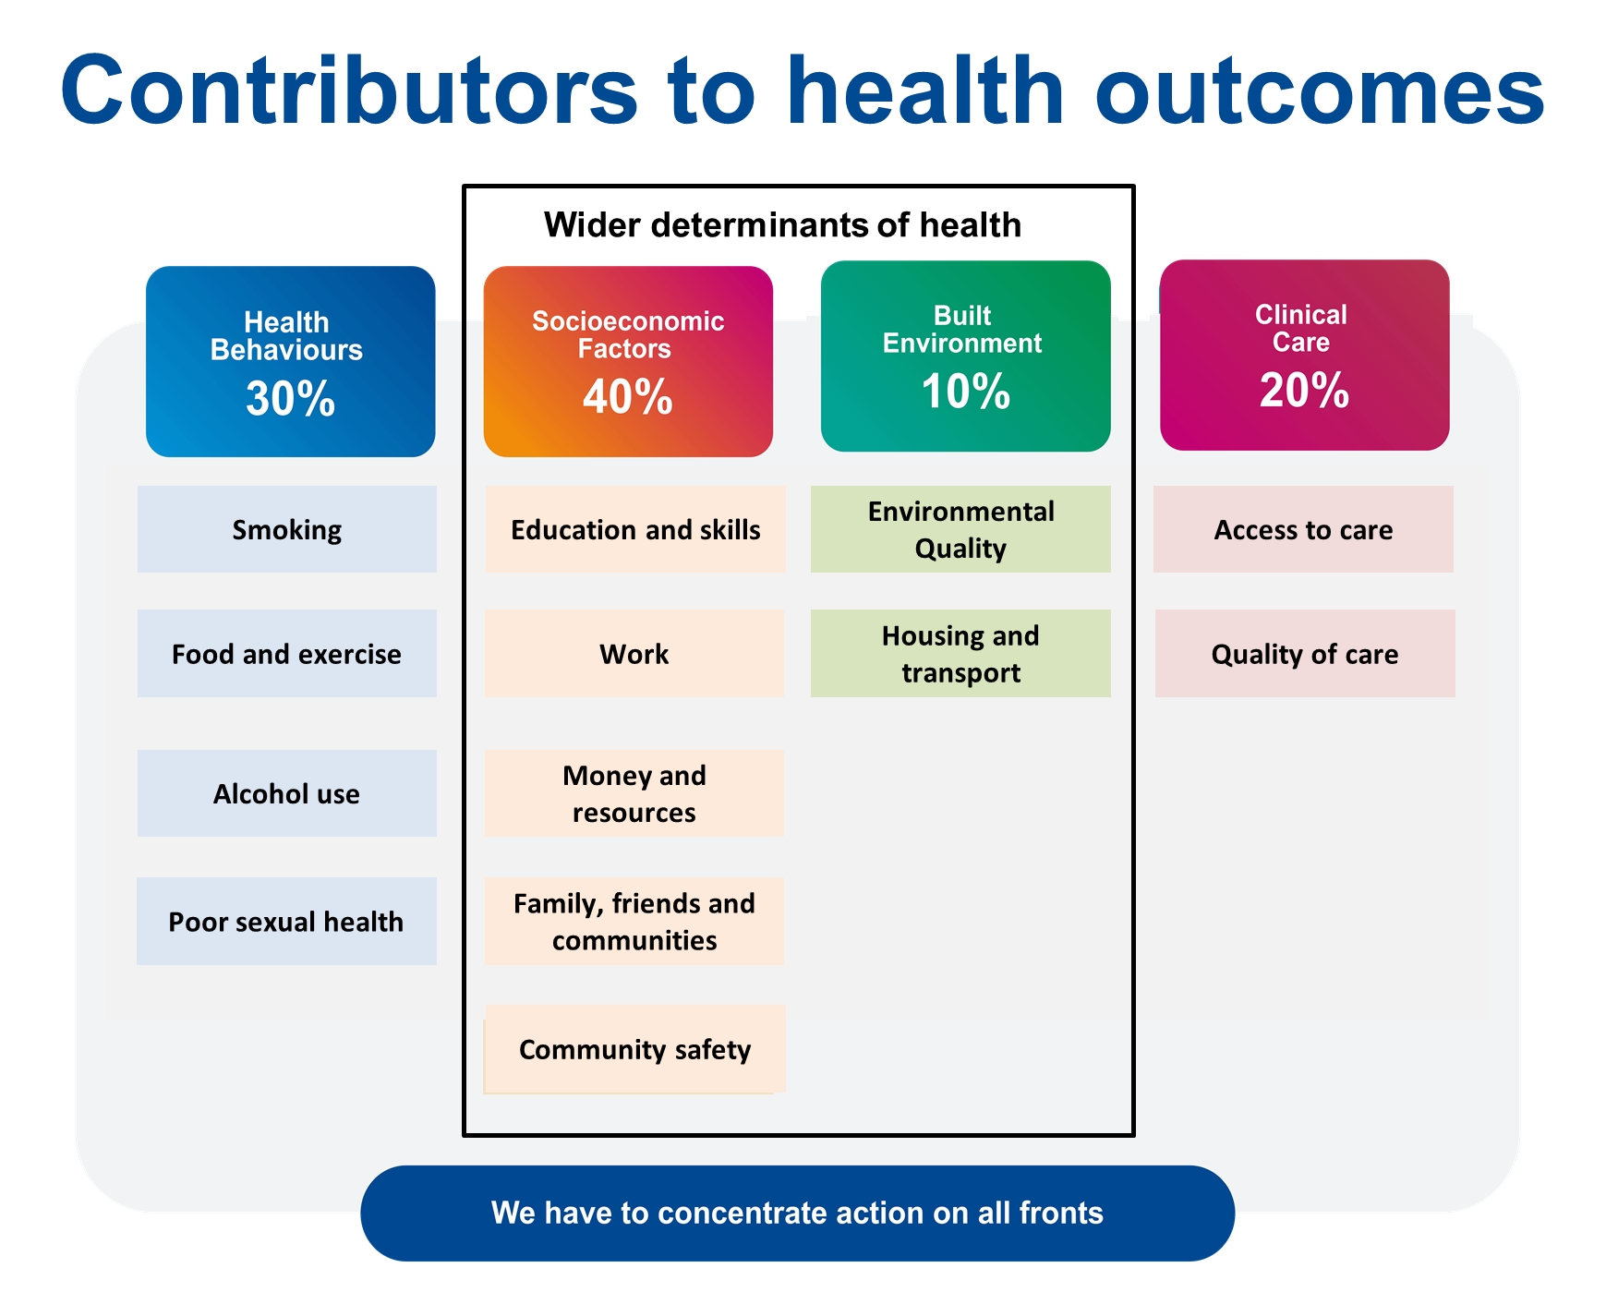
How can we work together to address wider determinants through employment support
In-Reach/Community Appointment days/ Pop-Up
Med3 search – GP practices/PCNs
Consistent Engagement: INTs/PCN leads/Clinical Directors with evidence of impact
MSK Trailblazer Community Appointment Days
Healthcare Referral pathways
Targeting priority groups: VCSE, Community Champions, Care Navigators, local authority teams
Employee Assistance Programme/Health and Wellbeing
Resident Newsletters / Social Media influencers

Slide 8
From struggle to success:
WorkWell in Hillingdon
Hillingdon resident Garry shared his journey with Work Well. Facing the challenges of ADHD, autism and past substance use, Garry struggled to maintain stable employment.
Hillingdon resident Garry shared his journey with Work Well. Facing the challenges of ADHD, autism and past substance use, Garry struggled to maintain stable employment. When he walked into WorkWell on 10th December 2024, he was just 35 days sober and determined to turn his life around but needed guidance.
Garry was provided a coach and a significant portion of his WorkWell sessions focused on identifying triggers and improving his physical health. They were able to develop strategies to help Garry manage his triggers and create the structure he needed to thrive. They also discussed positive lifestyle changes to support him, which included a gym membership to improve his physical health.
With the encouragement and commitment of the service he was able to overcome his problems. In talking about his coach Garry said: "She made me feel comfortable to explain my situation and not be judged. She made me feel like I could be better."
Today, Garry has secured a job as a valeter and quality controller at a car company.
Notes:
If you are a resident in Hillingdon and would like more information about WorkWell –services in Hillingdon, visit
Website: WorkWell - North West London
call 0808 196 2386
email: workwellwest@shaw-trust.org.uk

Slide 10
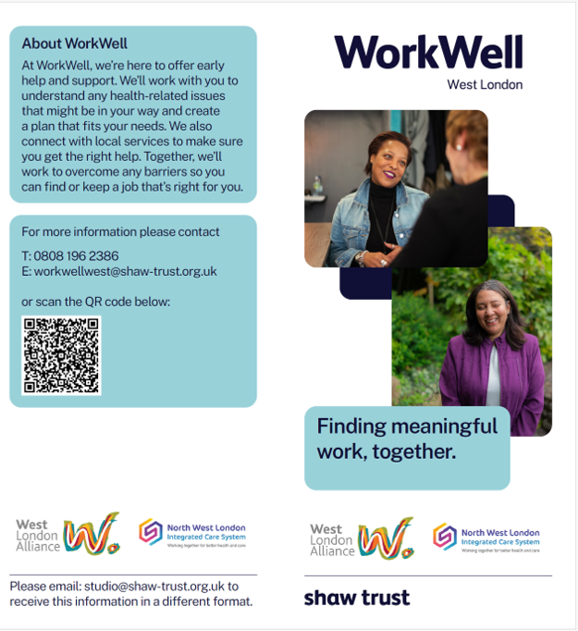




How to make a referral
To self-refer, people can choose from:
0808 196 2386
workwellwest@shaw-trust.org.uk
shawtrust.org.uk/workwell-west-london/
QR code: on the flier attached
For professionals only email:
Nclicb.workwell@nhs.net

