Slide 1

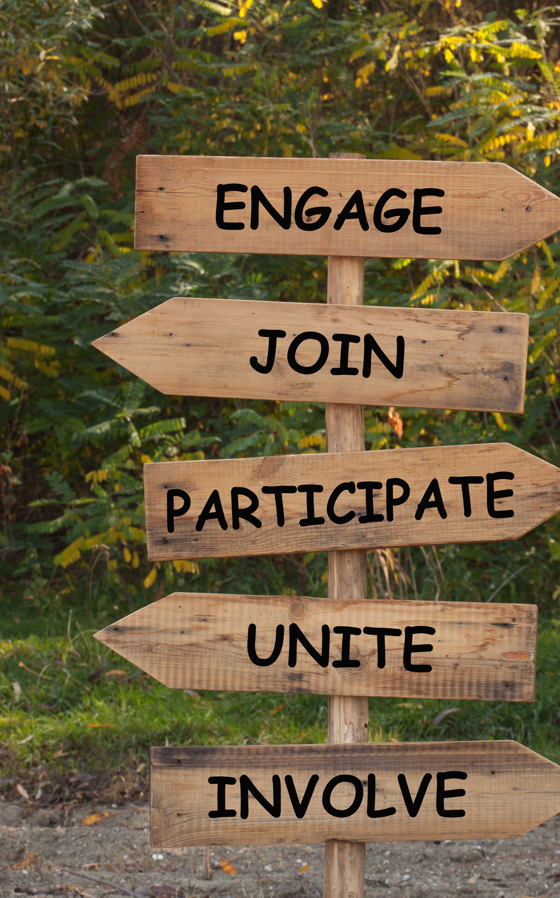

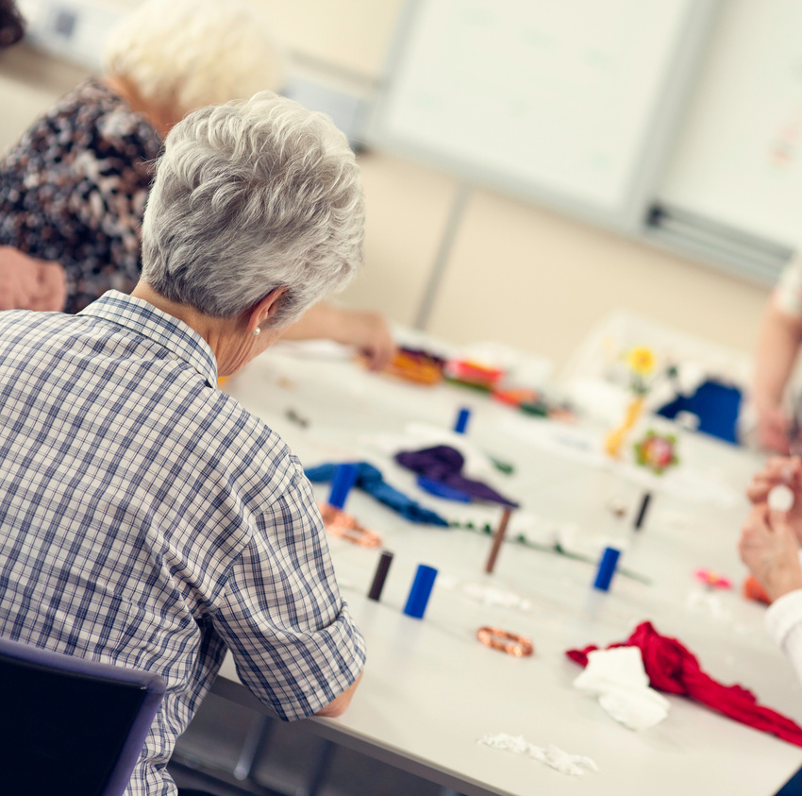

Community Priorities
Programme:2024-26
Local Area Panels

Slide 2
Programme Overview
Purpose:
The CPP was initially set up to support local initiatives set up by local people and community organisations during the Covid 19 Pandemic.
Now expanded to contribute towards the Council’s #2035 goals, aimed at reducing the 18 years gap in life expectancy by 2035.
Overarching Goals 2024 -26:
#2035 Campaign - support the Council’s #2035 priorities to halve the 18 years gap in life expectancy for people living in Westminster by 2035 by putting residents at the centre and working together on the challenges they prioritise.
Fairer Westminster - poverty and inequality are reduced, making WCC (Westminster City Council) a healthier and more equitable place.
Marmot Goals: address health inequalities in UK by creating an enabling society that maximises individual and community potential .
Aims:
To amplify the voices of local communities in defining the priorities of the programme based on what matters most to them in their areas and being part of deciding what activities got funded locally.
To provide seed-funding for community-led initiatives whose priorities and criteria are set by the outcomes of meaningful resident research and engagement.

Slide 3
Phases
Phases | Actions
Phase 1 | Set up six Local Area Panels across 11 wards
Phase 2 | Consultation – Local priorities
Phase 3 | Celebration / launch event
Phase 4 | Grant Applications & scoring
Phase 5 | Award Contracts
Phase 6 | Delivery & monitoring
Phase 7 | Report

Slide 4
Local Area Panels
Panel members will include council officers, a ward councillor, residents, representatives from VCS, community champions and health champions, TRA reps,
Co-designing the local priorities survey (not all panels) – testing
Consulted on focus group sessions
Support delivery of community event – launch event
Shortlisting applications and making the final decision on which projects will be delivered in their local area.
Project Visits (delivery)
10-15 panel members
Further opportunities : employment, education, future provider, actively engaged.

Slide 5
Local Area Panels
Panel 1: Vincent Square, St James & Pimlico South
Panel 2: Westbourne, Bayswater
Panel 3: Harrow Road
Panel 4: Queens Park
Panel 5: Maida Vale, Little Venice, Abbey Road
Panel 6: Church Street

Slide 6
Next Steps
Event: Information Session on local area panels
Date: 10th January 2024
Venue: Westminster City Council
Time: 11am-1pm, 3-5pm
Scan QR Code on leaflets to register on Eventbrite

Slide 7

Questions

