Slide 1



Talking Faith in Suicide Prevention:
New FaithAction Resource
Safia Khokhar, Head of Team Culture and Development & Senior Public Health Strategist
Mariana Covalenco, Public Health Officer
Notes:
Intro Safia and Mariana

Slide 2
The Journey so far …..
2020
Suicide Safer Communities Training Offer was put out to tender and reviewed after feedback highlighted that diversity was not reflective in training. Modification was required.
2021
Action plan developed to review the offer to reflect RBKC and WCC diverse seldom heard communities.
Sept 2022
Suicide Awareness Training delivered to gather feedback from community groups, frontline services and voluntary sector.
Nov 2022
Engaged with Seldom Heard communities, charities and frontline services to explore how the suicide awareness training could be enhanced to consider the diverse communities in RBKC and WCC.
Jan 2023
Jan 2023 Reviewed training offer in result of feedback and reviewed the enhanced training offer back to the market.
April 2023
Faith Communities Engagement on Suicide Prevention
May 2023
March 2023
Engaged with FaithAction, Thrive LDN and Good Thinking and Chairs of Faith Groups
Review of the engagement feedback
FaithAction workshop with representatives of 6 faiths and VSOs.
August 2023
27 March 2024
Resource Launch
November 2023 – February 2024
Draft resource feedback
Notes:
Slide 2 Safia: The Journey engaging with communities around the suicide prevention training to be inclusive (slide 2)

Slide 3
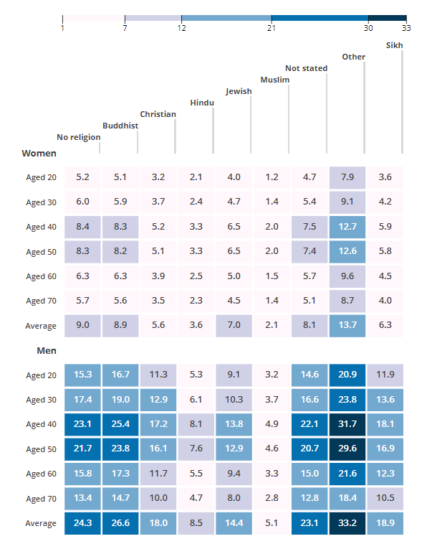

What do we know…
Suicide rates were generally lower for people who reported belonging to a religious group.
Lowest rates of suicide were those who identified as Muslim.
Rates of suicide were highest those who identified as Buddhist.
For men and women, the rates of suicide were lower across the Muslim, Hindu, Jewish, Christian and Sikh groups compared with the group who reported no religion.
Males and females aged between 30 and 50 years had the highest age-specific suicide rate of 26.58 (male) and 8.88 (female) per 100,000 people where region was affiliated.
Rates of suicide per 100,000 people by religious affiliation in England and Wales, 2011 to 2021 (ONS, 2021)
Notes:
Mariana – 4 mins
Suicide rates were generally lower for people who reported belonging to a religious group.
There are 2 limitations to this data:
1. Coroner's judgements are affected by faith. Therefore, not all information will be disclosed.
2. Families might wish to not disclose the faith.
The religions which were included in the "Other" religious group included Pagan, Spiritualist, Mixed religion, Jain and Ravidassia

Slide 4
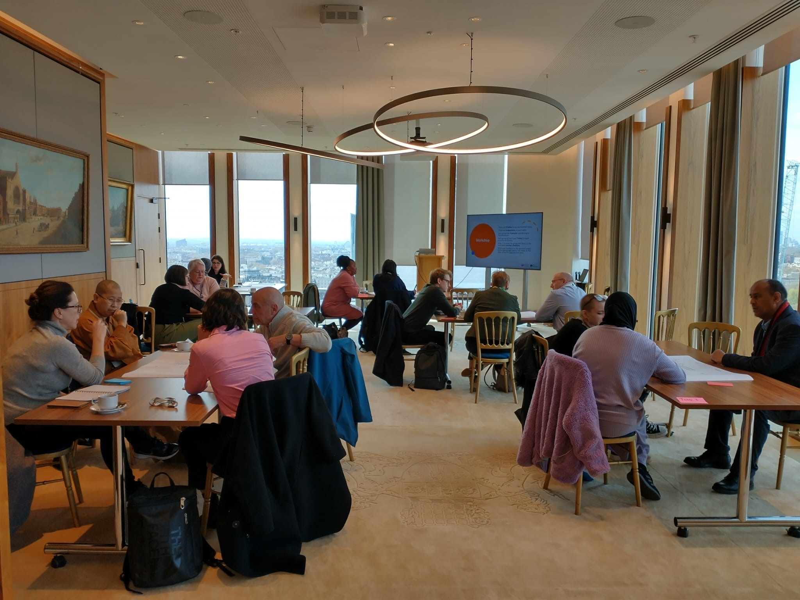
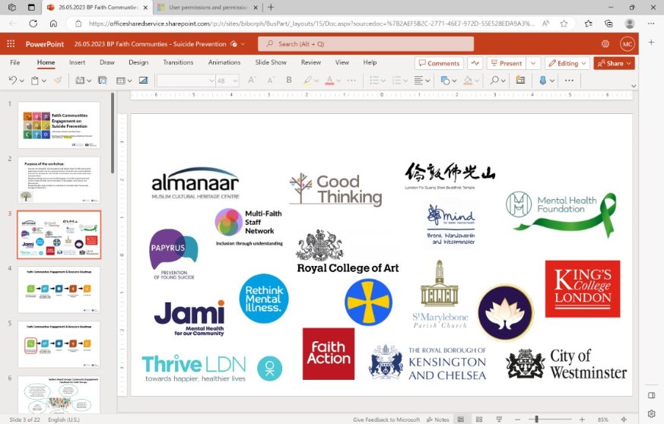
Faith Communities Engagement on Suicide Prevention Outcomes
With all faiths there is a level of misconceptions and myths around suicide, and it is established that a resource to help break this down with scriptures.
Within each faith there is a protective factor of suicide and how we should see the important relationship between our physical and spiritual being.
Recognition from the LGBTQI+ communities and faith as there is stigma of how communities see this community.
Clear narrative and language used to avoid stigma and discrimination around suicide and self-harm.
Notes:
Slide 4: Safia engagement outcomes - focus on stigma and missconceptions

Slide 5
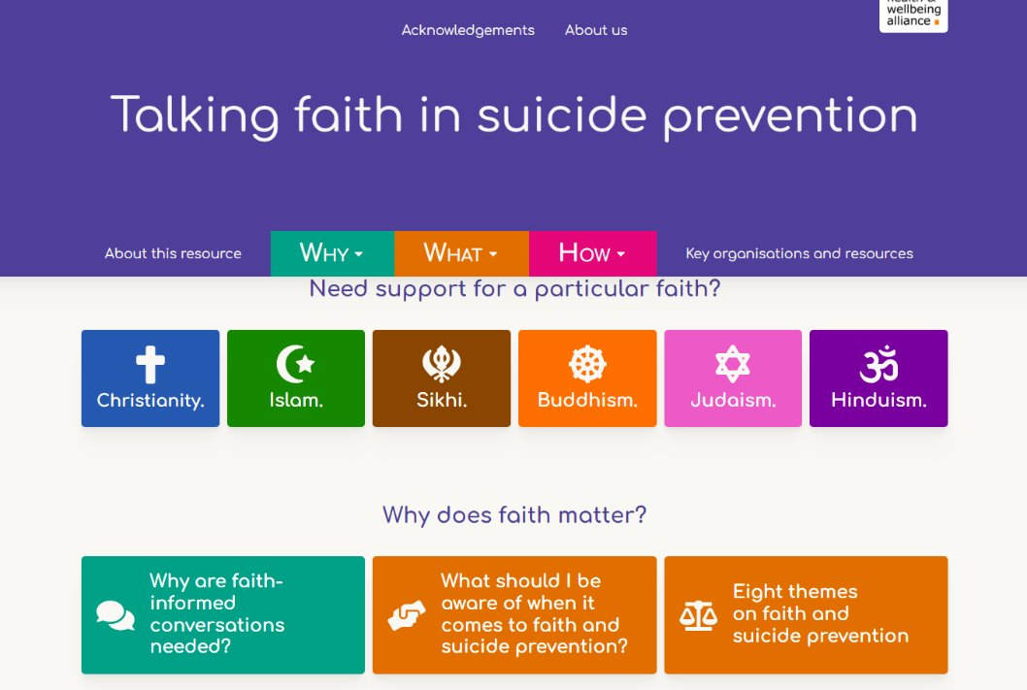
Talking Faith in Suicide Prevention Resource
Click here to acces Faith Resource
Notes:
Slide 5: Mariana - Faith resource– 1 min

Slide 6
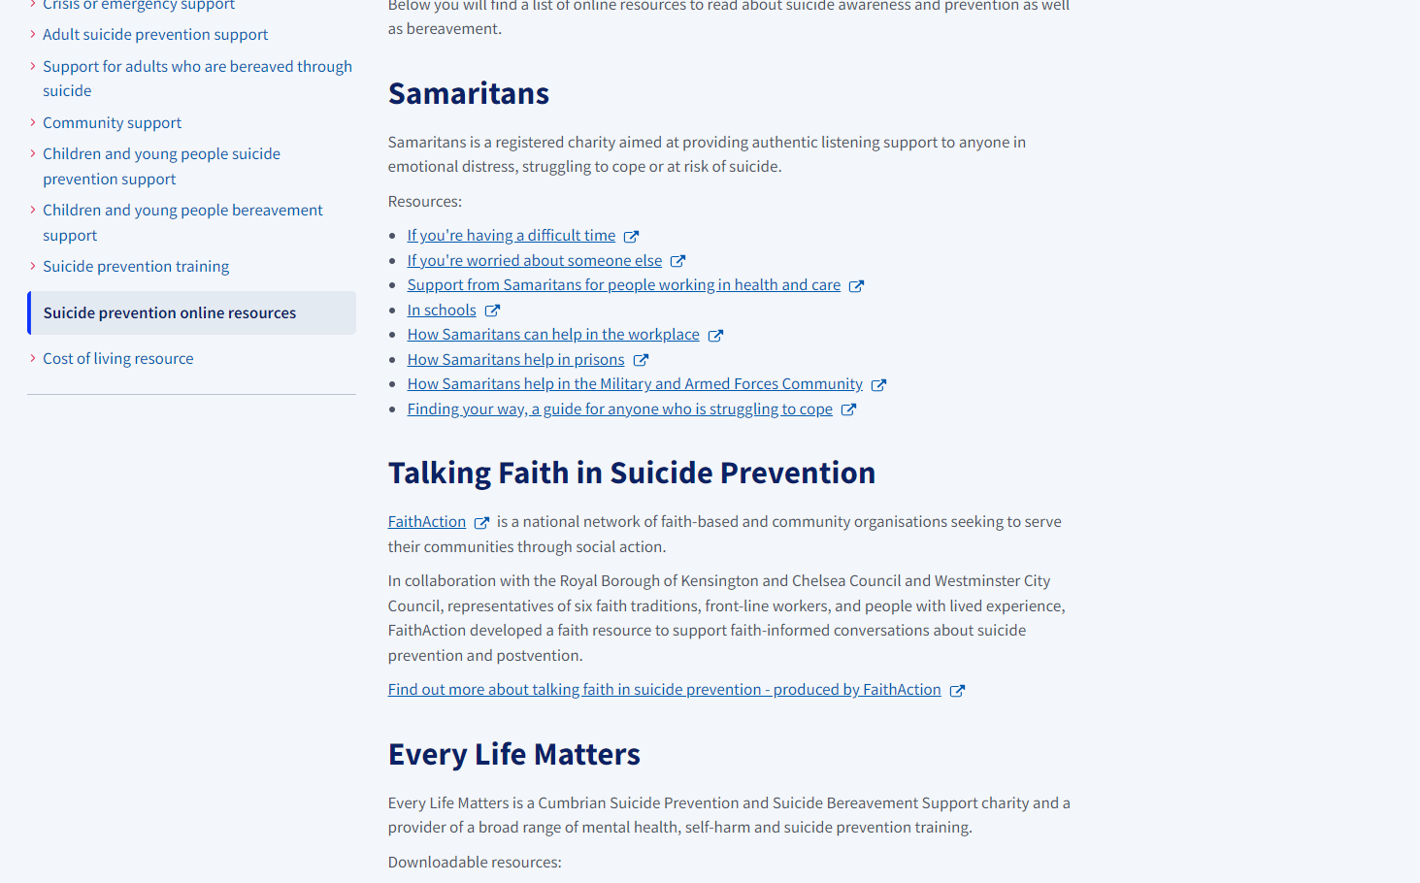
Faith resource on the dedicated suicide prevention resource
Click here to acces page
Notes:
Slide 6: Mariana Faith Resource sits on the SP web resource

Slide 7
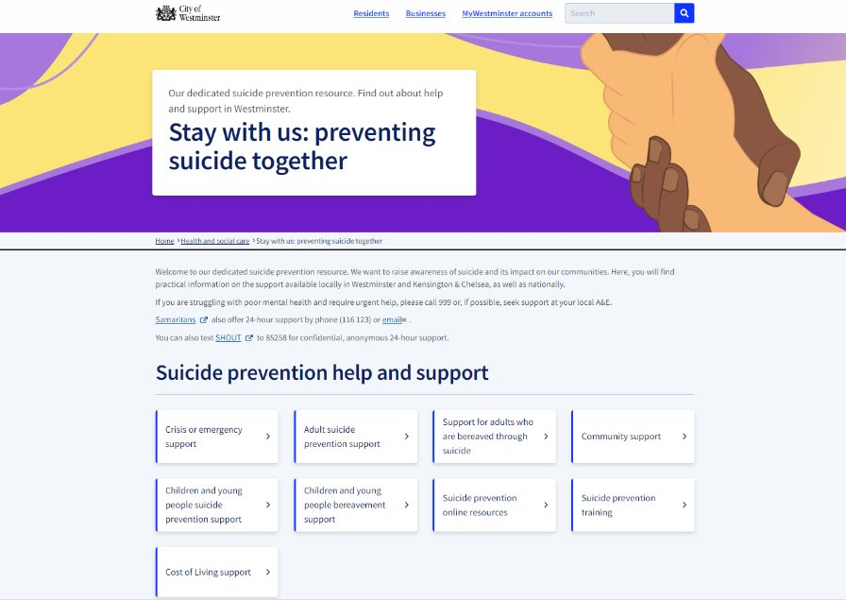
Stay with Us Campaign and Web Resource
Stay with us: preventing suicide together | Westminster City Council
Notes:
Slide 7: Safia - we have s SP web resources on WCC and RBKC website

Slide 8
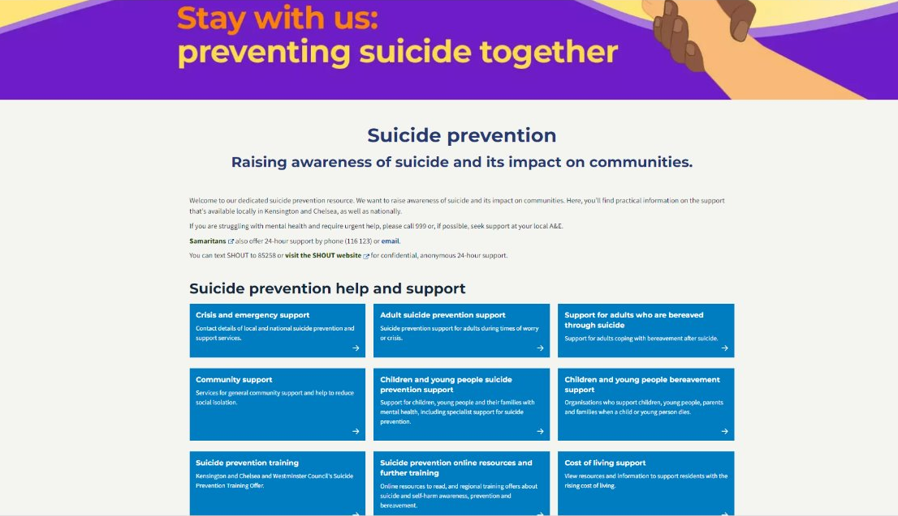
Stay with Us Campaign and Web Resource
Suicide prevention | Royal Borough of Kensington and Chelsea (rbkc.gov.uk)
Notes:
Slide 7: Safia - we have s SP web resources on WCC and RBKC website

