Slide 1




Understanding Dementia for Black, Asian and Minority ethnic community groups
Prepared by David Truswell
for The BME Health Forum
August 2020

Slide 2
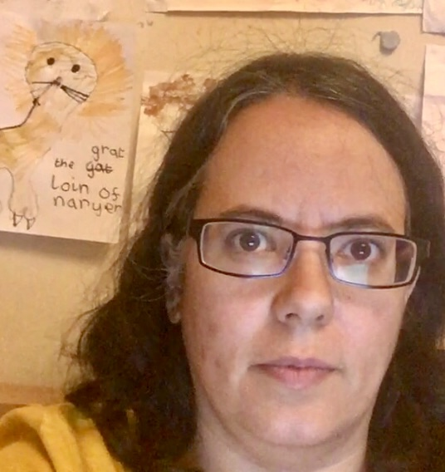
A Message from the Bme
Health Forum
“We have noticed that many clients of BME organisations are carers for people with dementia but the understanding in the community about what dementia is and how to care for people with dementia is not great. We hope that this presentation will help increase awareness and understanding and help improve the lives of BME people with dementia and their carers.”
Nafsika Thalassis
Director, BME Health Forum

Slide 3
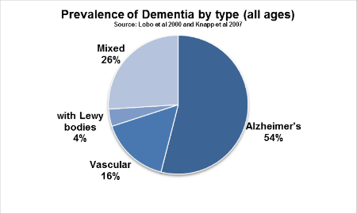
Dementia is the broad term used to describe a number of different conditions affecting the brain, including Alzheimer's disease.
Dementia affects people from all ethnic backgrounds
Notes:
Dementia is a term that describes a set of symptoms such as impaired thinking or memory that are an indication of damage to the brain. Damage to the brain may be caused by disease or brain injury.

Slide 4
A
DEMENTIA Quiz
How many different types of dementia are there?
What proportion of people over 65 are living with dementia?
Is developing dementia a natural part of ageing?
Does dementia only affect memory?
Can you predict if someone will get dementia?

Slide 5
Quiz answers
There are estimated to be 100 different types of dementia
1 in 14 people over 65 are likely to be living with dementia, but this varies from 1 in 100 of those aged between 65 and 70 to 1 in 6 of those aged over 80
No. Dementia is a disease of the brain. People under the age of 60 can develop dementia
No. Dementia can affect perception, mood, personality and behaviour
No. Some life factors increase the risk of dementia but even those with none of the risk factors may still develop dementia

Slide 6
Risk factors
Age
Family history & genetic factors
Cardiovascular disease
High blood pressure
Type 2 Diabetes
Alcohol consumption in excess
Smoking
Ethnicity (African- Caribbean & South Asian) – UK Research
Head Injury
Notes:
All these risks increase the possibility of developing dementia and many people have more than one risk factor. African-Caribbean and South Asian people, especially those from India, have an increase risk of dementia which may be due to these populations also having high rates for some of the other health issues on this list like diabetes and cardiovascular disease.

Slide 7
Some early signs of dementia
Memory loss affecting day-to-day abilities
Difficulty performing familiar tasks
Problems with language
Disorientation in time and space
Impaired judgment
Problems with abstract thinking
Misplacing things
Changes in mood and behaviour
Changes in personality
Loss of initiative
Notes:
Memory loss may not be the first noticeable symptom. Persistent memory loss may be caused by other health problems.

Slide 8
More challenging issues in dementia care
Suspicion/paranoia
Agitated behavior and restlessness
Incontinence/constipation
Disinhibited behavior including sexual and aggressive behavior
Forgetting identity of family members
In later stages, eating and swallowing problems
Delirium
Other severe long-term health conditions needing regular treatment and/or medication
Notes:
Carers often need help and advice to know how to respond to the more challenging issues

Slide 9
Common health issues that often accompany dementia
Depression
Cardiovascular disease
Diabetes
Visual and/or hearing impairment
Frailty
High blood pressure
Notes:
Most people living with dementia will have at least one other long-term health problem that they are being treated for.

Slide 10
Why should I get a diagnosis?
Memory problems and psychological problems in later life can be due not only to dementia but other more easily treated illnesses
Some of the treatments that can delay the affects of dementia need to be started in the early stage of the illness
To be eligible for assessment for possible services and other benefits you may be required to confirm you have a diagnosis of dementia
Life planning for the impact of dementia should begin as soon as possible after diagnosis as it will involve major decisions affecting partners and close family of the person living with dementia
It can make it easier to emotionally adjust to the illness and be able to talk about the illness and its affects on daily life with family and friends
Notes:
Depression, anxiety, forgetfulness behaviour changes in later life can be a result of severe life events, such as loss of a partner, or illnesses that are not dementia. Many of these can be treated more easily than dementia especially if caught in the early stages. Beliefs such as ‘it’s just old age’ or ‘nothing can be done about’ it must be challnganged

Slide 11
HOW TO GET HELP
DON’T ignore the problems and put them down to ‘old age’
TELL your GP
GET a referral to a memory assessment service

Slide 12
WHAT WILL HAPPEN WHEN I TALK TO THE GP?
When you initially call the GP make sure you emphasise your concern about the symptoms you are experiencing
When you get a physical appointment the GP will ask about your general health, ask you to do a short memory test and may ask for a blood sample
Your GP may make appointment for you to repeat the memory test or take further blood samples
Your GP will refer you to a Memory Assessment Service if she/he feels you need a more specialist assessment
If you have language support needs tell the GP to let the Memory Assessment Service know about this
Notes:
The GP may see you two or three times before referring to a Memory Service as they may want to see if the problems are getting worse over time

Slide 13
WHAT WILL HAPPEN AT the MEMORY SERVICE?
Clinical staff and social workers who specialise in dementia at the Memory Service will ask you to do more detailed memory tests and further blood tests. And may ask for a brain scan They may ask to talk to partners or close family members about your recent health.
These tests can take several weeks as they try to establish what type of dementia it is.
The Memory Service will explain what impact dementia will have on everyday life, help to plan and organise any adjustments required and provide any social work support contacts that may be required. They may also provide counselling support and other support contacts for a short time after the diagnosis.
Eventually the Memory Service will discharge you back to the care of your GP for the future monitoring of your dementia care needs. The GP should meet with you regularly to check on this and you should tell the GP if you are concerned about any health or psychological changes.

Slide 14
REDUCING Risk 1
Be physically active
Avoid smoking and excessive alcohol consumption
Stay healthy: keep your blood pressure, cholesterol, blood sugar and weight within recommended ranges
Notes:
Actions that are taken on this need to be done in a way that is culturally appropriate and feel personally validating

Slide 15
REDUCING Risk 2
Stay connected socially
Make healthy food choices, eat a well-balanced and healthy diet rich in seeds, fish, fruit and vegetables
Reduce stress
Challenge your brain by trying something new, playing games or learning a new language
Notes:
Actions that are taken on this need to be done in a way that is culturally appropriate and feel personally validating

Slide 16
WHAT CAN CARERS DO?
PART ONE
Lasting Power of Attorney
Be patient and support people continuing to do as much as possible for themselves when they can
‘Living in the moment’ with people living with dementia
Don’t get into arguments
Don’t take things personally
Notes:
Cultural beliefs have a major impact on what carers believe is expected of them. Usually people expect too much of themselves and underestimate how challenging and complex it can be to support someone living with dementia. ‘Living in the moment’ means accepting that sometimes people living with dementia will believe they are living at an earlier point in their life. Unless they are at immediate physical risk, carers and family should not assume they need to challenge this or ‘bring them back to reality’. Try to appreciate that their mind has slipped back to an earlier moment in their life and has got stuck there for now. Arguing is unlikely to help.

Slide 17
WHAT CAN CARERS DO?
PART TWO
Balance truth telling with compassion - correcting people that someone they were close to is no longer around just forces them to reexperience the loss anew until they forget again
Use technological aids to support caring where you can – alarms, GP trackers. etc.
Organise the care you give as much as you can
Recognise your own limitations - don’t try to be SuperCarer, get help and support
Fun is motivating and is permitted!
Notes:
Continuing reminding people that partners and friends are dead or that they no longer live were they used to simply pushes them to re-experiencing loss and grief as if it were being experienced anew and for the first time. Remember to make time to look after yourself if you are a carer. Ensure that here are times when you and the person you are caring for can get involved in fun activities. Time for enjoyment is part of good mental and physical health for the person living with dementia and their carers

Slide 18
LASTING POWER OF ATTORNEY
HEALTH AND WELFARE
There are 2 types of Lasting Power of Attorney
(1) Health and Welfare
To make decisions about things like:
your daily routine, for example washing, dressing, eating
medical care
moving into a care home
life-sustaining treatment
Notes:
You can take out Lasting Power of Attorney by yourself using forms on the UK government website or you can pay a solicitor to do it for you. You can only do this if you have capacity, otherwise the Court of Public Protection decides who will act as the person with Power of Attorney. People living with dementia should decide who they want to act in this capacity on their behalf as soon as possible.

Slide 19
LASTING POWER OF ATTORNEY
PROPERTY AND FINANCE
(2) Property and Financial Affairs
managing a bank or building society account
paying bills
collecting benefits or a pension
selling your home
You must be 18 or over and have mental capacity (the ability to make your own decisions) when you give Lasting Power of Attorney.
You do not need to live in the UK or be a British citizen.

Slide 20
Looking after carers
Training for carers
Information on dementia
Physical and mental wellbeing of carers
Sharing the burden
Have time for personal interests
Fun is permitted
Notes:
Dementia is a complex illness that people may live with for many years. Family carers should seek dementia carers training and ensure they have support for their caring role and help to understand what to do when they feel they are overwhelmed by the role. Cultural beliefs influence carers expectorations and can lead to carers feeling very isolated and overwhelmed but afraid of asking for help

Slide 21
5 key messages about dementia
1
Dementia is not a natural part of ageing
2
A healthy lifestyle can help reduce the risk
3
Getting a diagnosis can improve your quality of your life in the future
4
Learn to ‘live in the moment’ when caring for someone living with dementia
5
You can live well with dementia
Notes:
People who see the presentation should be encourages to remember these 5 messages if they remember nothing else!

Slide 22
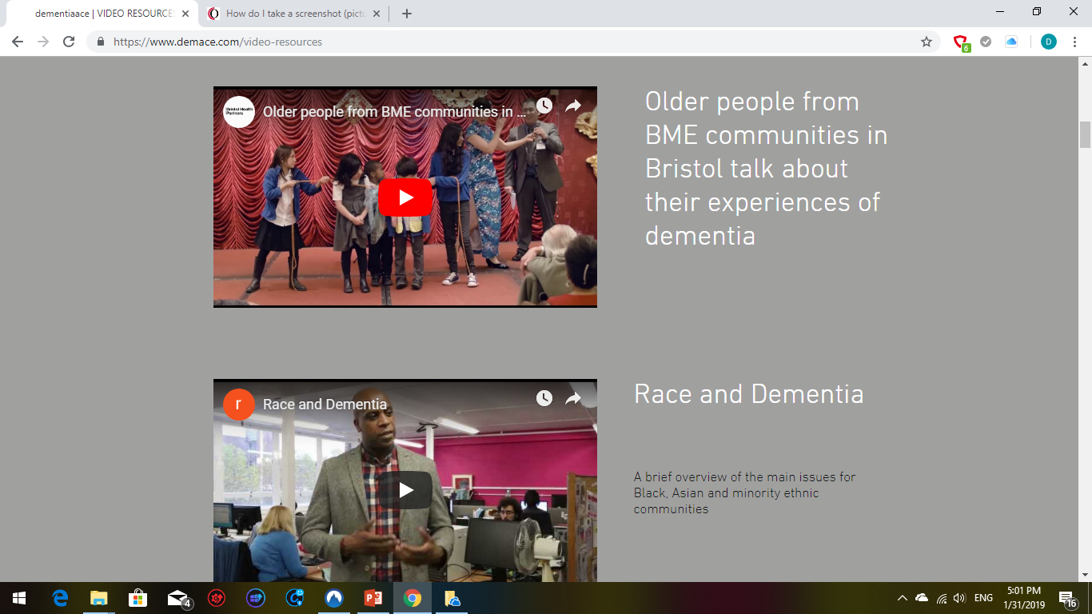
ADDITIONAL VIDEO Resources
DEMENTIA ALLIANCE FOR CULTURE AND ETHNICITY
www.demace.com
Notes:
Many of these videos are made by community groups in the UK and are in a variety of languages

Slide 23
Contact details
David Truswell
BME Health Forum
david@somefreshthinking.com
0796 969 2315

Slide 24
Any Questions?

