Slide 1


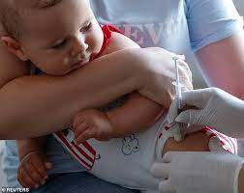


Immunisations
BME Forum 27 09 23
Anna Cox
WCC & RBKC Public Health
acox1@westminster.gov.uk

Slide 2
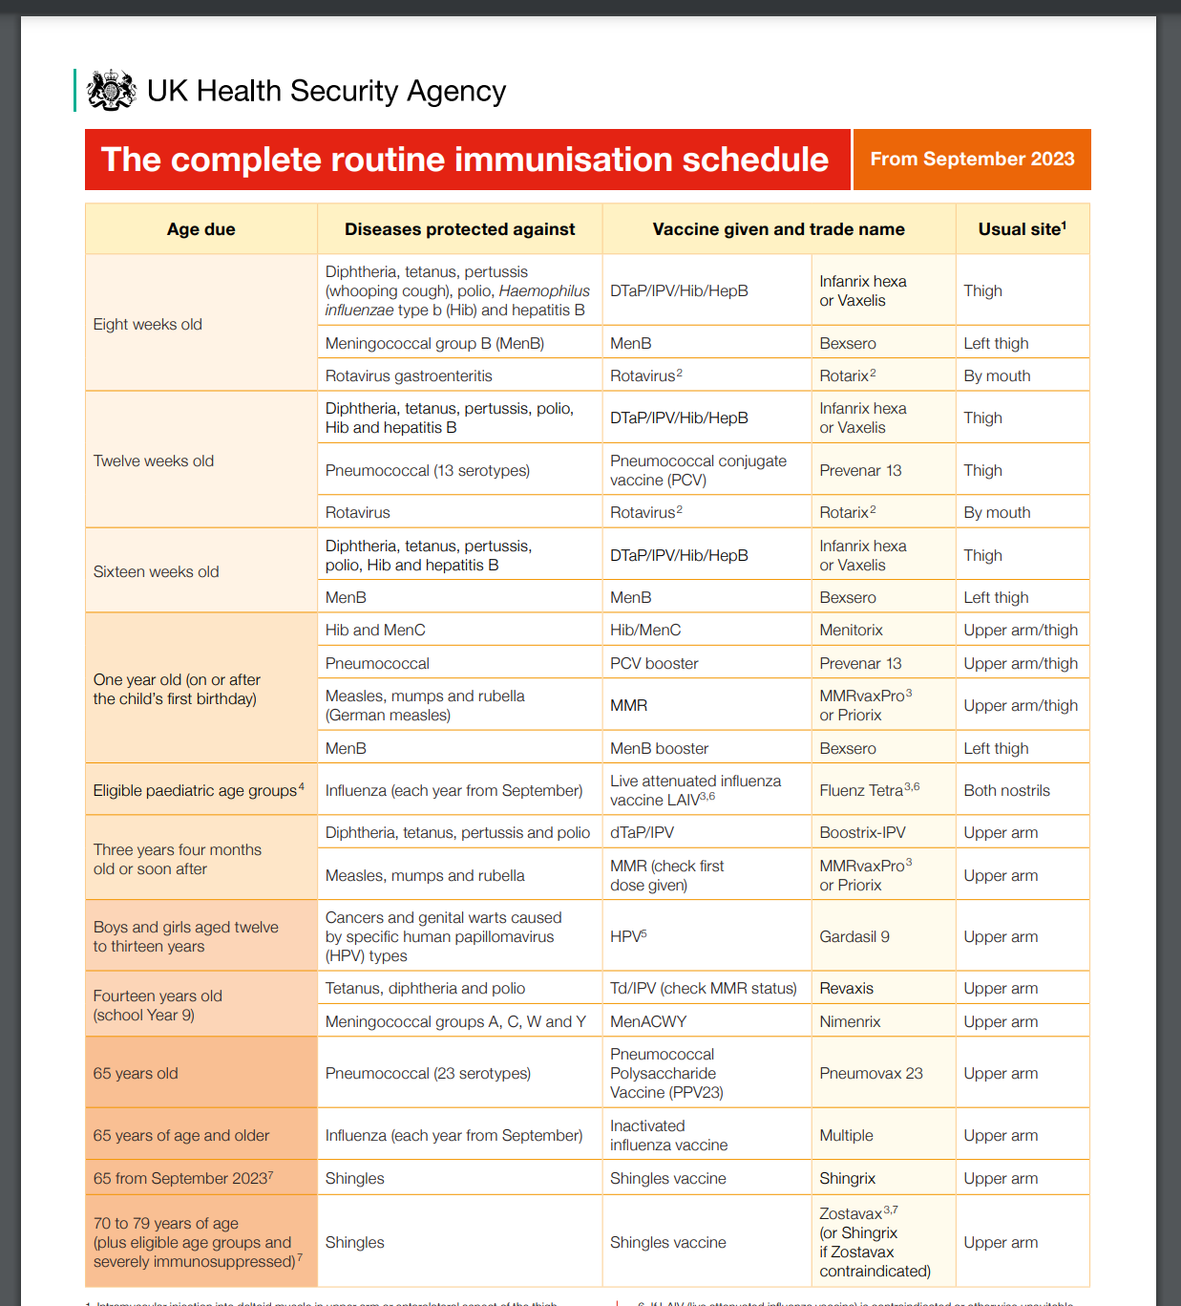
Vaccinations
Diphtheria, tetanus, polio, whooping cough, meningitis, pneumonia, rotavirus, Hep B, mumps, measles, rubella
HPV ( cancers), Meningitis ACWY
Shingles
Flu
Covid
Whooping cough
TB

Slide 3



Slide 4



Slide 5
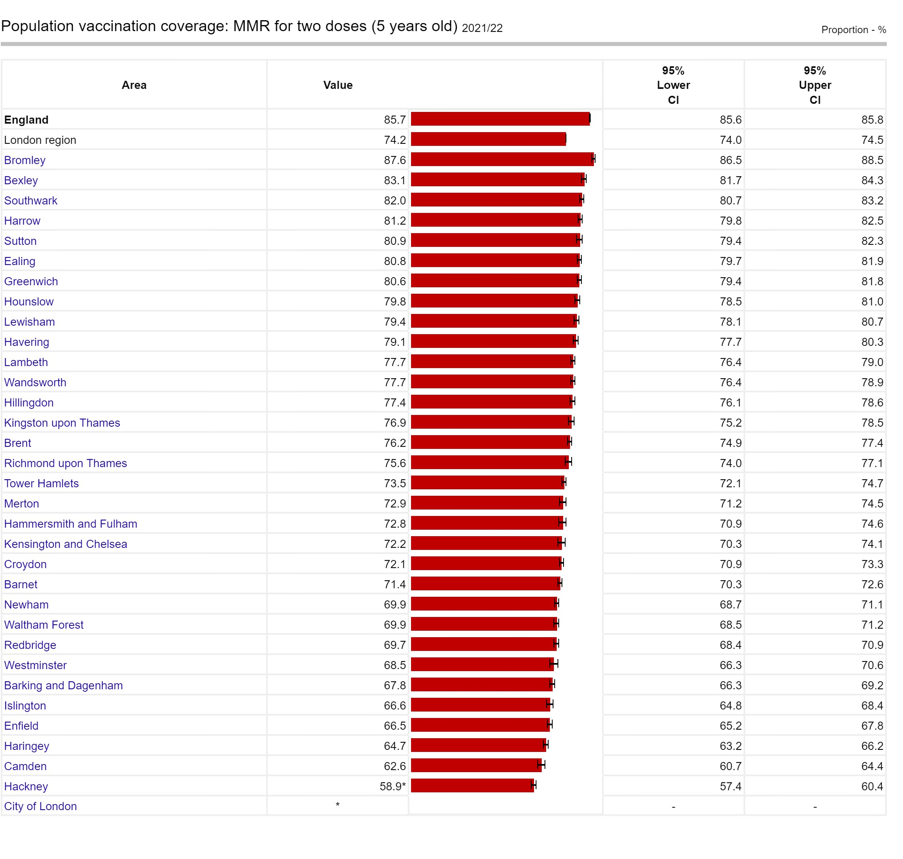
https://fingertips.phe.org.uk/profile/child-health-profiles/supporting-information/vaccs-imms

Slide 6

Resources
https://www.nhs.uk/conditions/vaccinations/nhs-vaccinations-and-when-to-have-them/
https://vaccineknowledge.ox.ac.uk/home
https://www.what0-18.nhs.uk/
https://www.gov.uk/government/publications/flu-vaccination-leaflets-and-posters
https://campaignresources.dhsc.gov.uk/
5 reasons to vaccinate your child against flu poster for primary schools and pre-schools
This poster is available free to order in the following languages:
English, Albanian, Arabic, Bengali, Brazilian Portuguese, Bulgarian, Chinese, Estonian, Farsi, Greek, Gujarati, Hindi, Latvian, Lithuanian, Panjabi, Polish, Romanian, Romany, Russian, Somali, Spanish, Turkish, Twi, Ukrainian, Urdu and Yiddish.

Slide 7
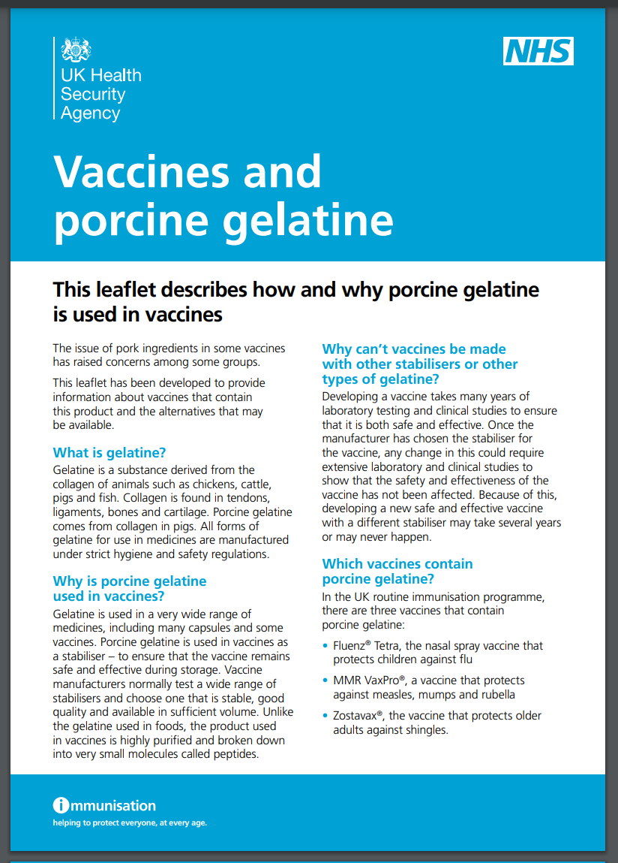
Vaccine Ingredients
Porcine Gelatine
Contains Gelatine |  | Alternative
LAIV Nasal Spray | Flu ( 2yrs-16yrs) | QIVc Injection
Vaxpro | MMR (Measles/Mumps/Rubella) | Priorix
Zostavax | Shingles | Shingrix
Ask Healthcare provider
Children 2-3yrs – GP
Secondary School – School Imms Team (CNWL)
Primary – School Imms Team (CNWL) at community clinic
020 3317 5076
https://assets.publishing.service.gov.uk/government/uploads/system/uploads/attachment_data/file/1107767/UKHSA-12462-vaccines-porcine-gelatine-English.pdf

Slide 8



Welcome
your
Comments
Ideas
&
Suggestions
Looking forward
to
working with you....

