Slide 1




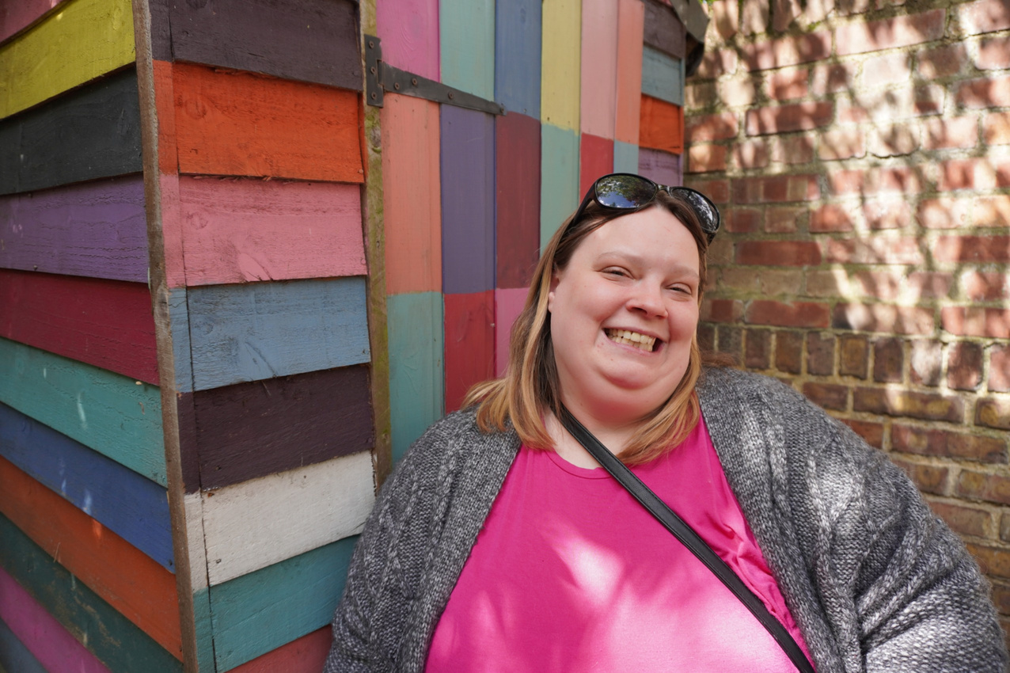
Women's Service What's On Guide
January 2024
Upcoming events
  Self Defense workshops
  SASH workshops
  Inspirational talk
Tuesday
@ Redcliffe gardens
Every other Thursday
@ 209a
Monthly on a Friday
@ 32a Wardour

Slide 2
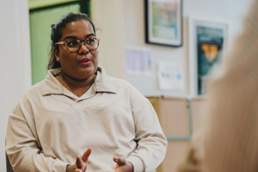


Women's Group @ Redcliffe
94 Redcliffe Gardens SW10 9HH
Tuesday 9th January 2024
11am-HepC Trust
Group discussion-topic to be confirmed
16th January
Art workshop with Liz
23rd January 2024
2nd Self Defence workshop

Slide 3
Women's Group @ Harrow Road
209a Harrow Road W2 5EH
4th January 2024
Group discussion Healthy Relationships
18th January 2024
HepC Trust
+ 5 Ways to Wellbeing discussion

Slide 4
Women's Group @ 32a Wardour
32a Wardour Street W1D 6QT
26th January 2024
SASH workshop
Physical health advice with Maggie (Nurse from Great Chapel Street).
Sexual Health support with Becky (Nurse from Dean street)
ETE support with Nikita
Medical reviews/Restarts will also be available with Katie Saywell
Pam (Nurse) will provide Titrations, Hep B vaccinations, buividal/ECG’s etc.
Kerri Douglas will deliver an inspirational talk about her lived experience and recovery journey. Some of you may already be familiar with her book ‘Gutter to Glory’
Pizza
Arts and Crafts – women to design inspirational & positive affirmation cards.
First Aid certificated course to be confirmed.

Slide 5



Slide 6

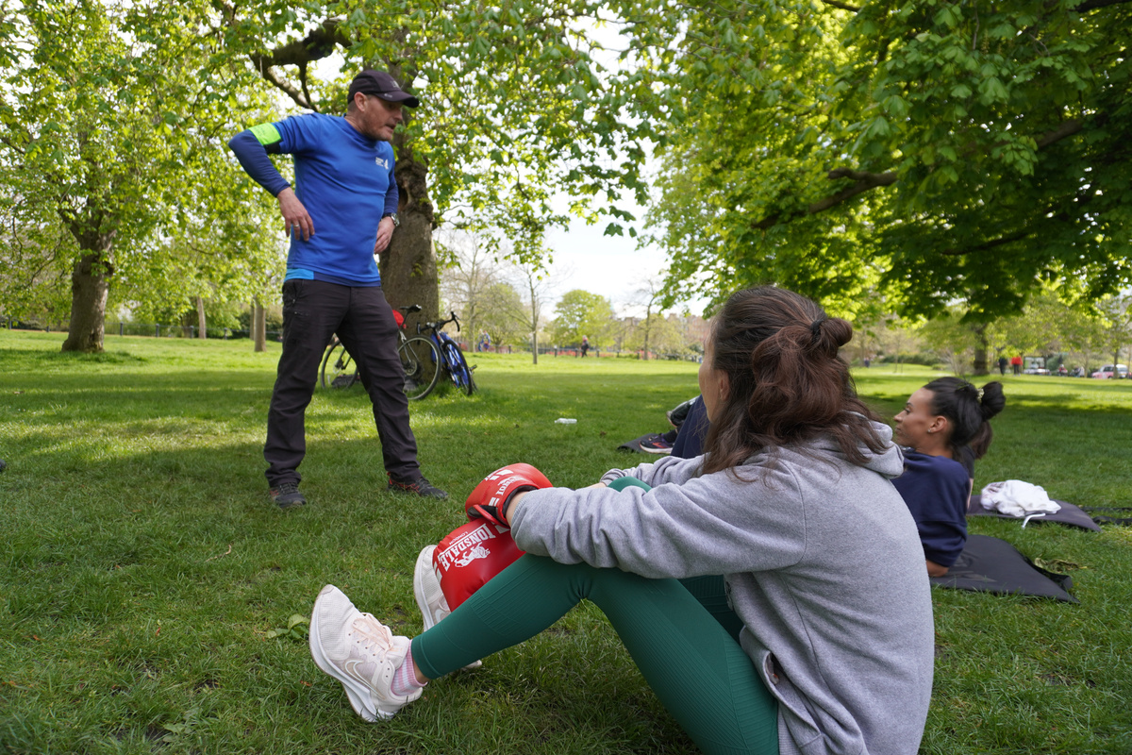
Women's Park Fit @ Hyde Park
Every Wednesday 1.30 - 2.30pm with Danny
All levels of fitness welcome and all equipment provided. Clients must be abstinent on day of attendance
Clients unsure of the location should contact Danny beforehand on 07866154356
Call Danny to refer clients
07866154536

Slide 7

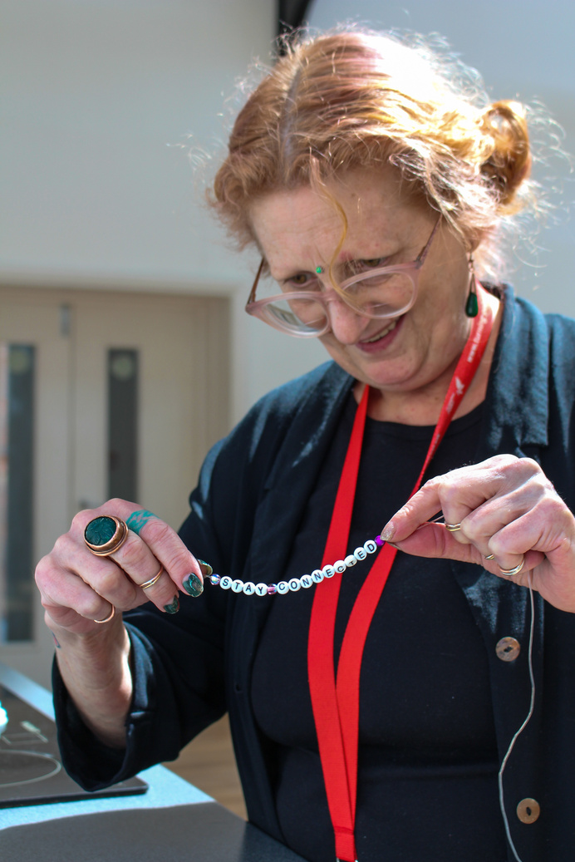


Why is a women specific service important?
  Women often ask for women specific spaces and have better treatment outcomes when offered tailored support
  Offers a safe space that is trauma informed and provides the opportunity to express themselves
  Connect with other women who have similar life experiences
  Provide specific support around concerns women may have such as maternal, reproductive and sexual health, safety, childcare needs
  Make wider support available such as organisations who offer services to victims and survivors of domestic and sexual abuse
What are the benefits for women?
  Reconnect with others and reduce isolation
  Improve their physical health and wellbeing by exercising and being in the outdoors
  Build on their self-esteem and self-confidence through workshops and trying new courses or training
  Improve on their communication skills and have the opportunity to volunteer
  Build on strategies to manage any stress and anxiety levels
For any questions about the women's activties
Call Nyalah Asantewa - 07813395506

