Slide 1

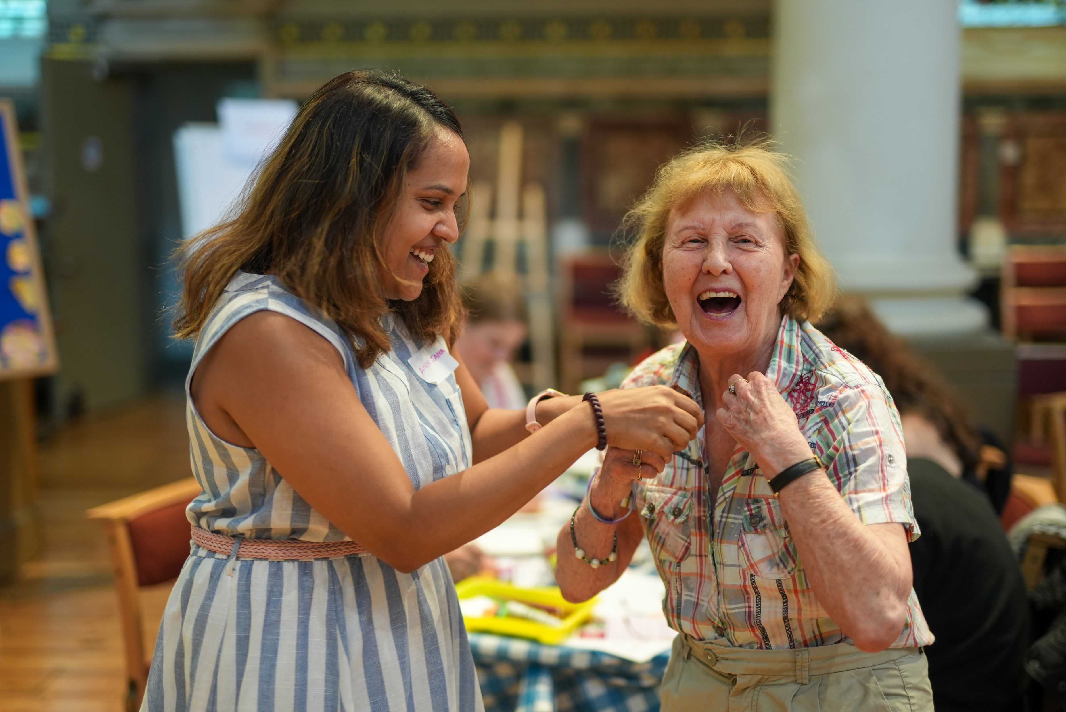
We produce a programme
of creative activities and experiences for and with people living with dementia, their families and carers.

Slide 2
Who we work with
People with a diagnosis of dementia, their family, carers and supporters
People who live in the bi-borough (Westminster and Kensington & Chelsea)

Slide 3
How we work
Relationships are key
Person centered
Offer choice to the individual
Involving people through co-production

Slide 4
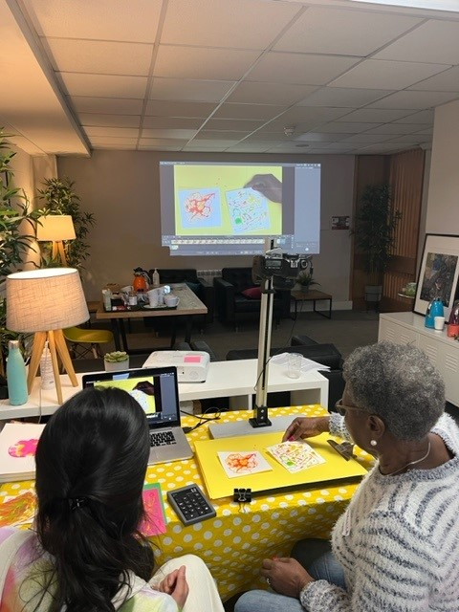
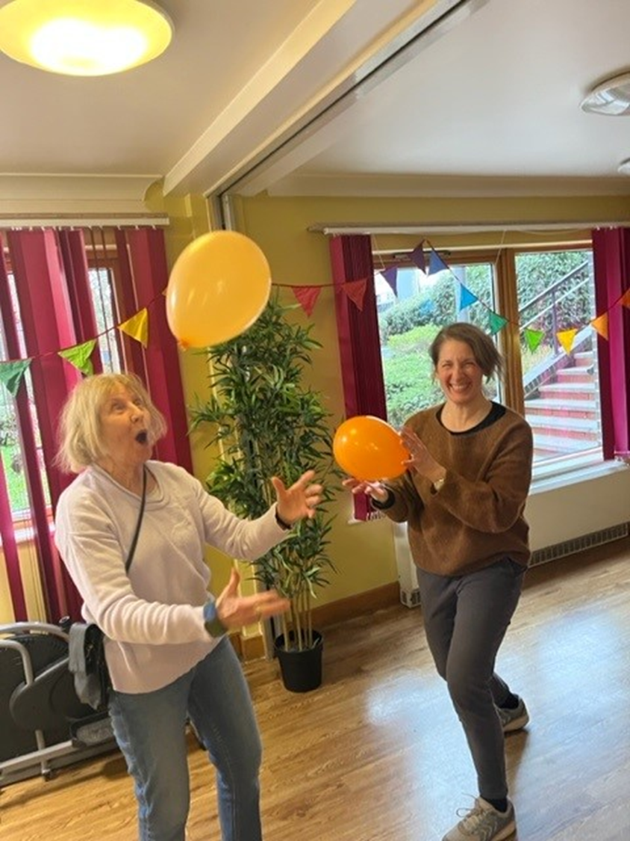
Creative
Space: Art & Movement
-Regent Hall
& Penfold Community Hub
-Monthly
-Mondays

Slide 5
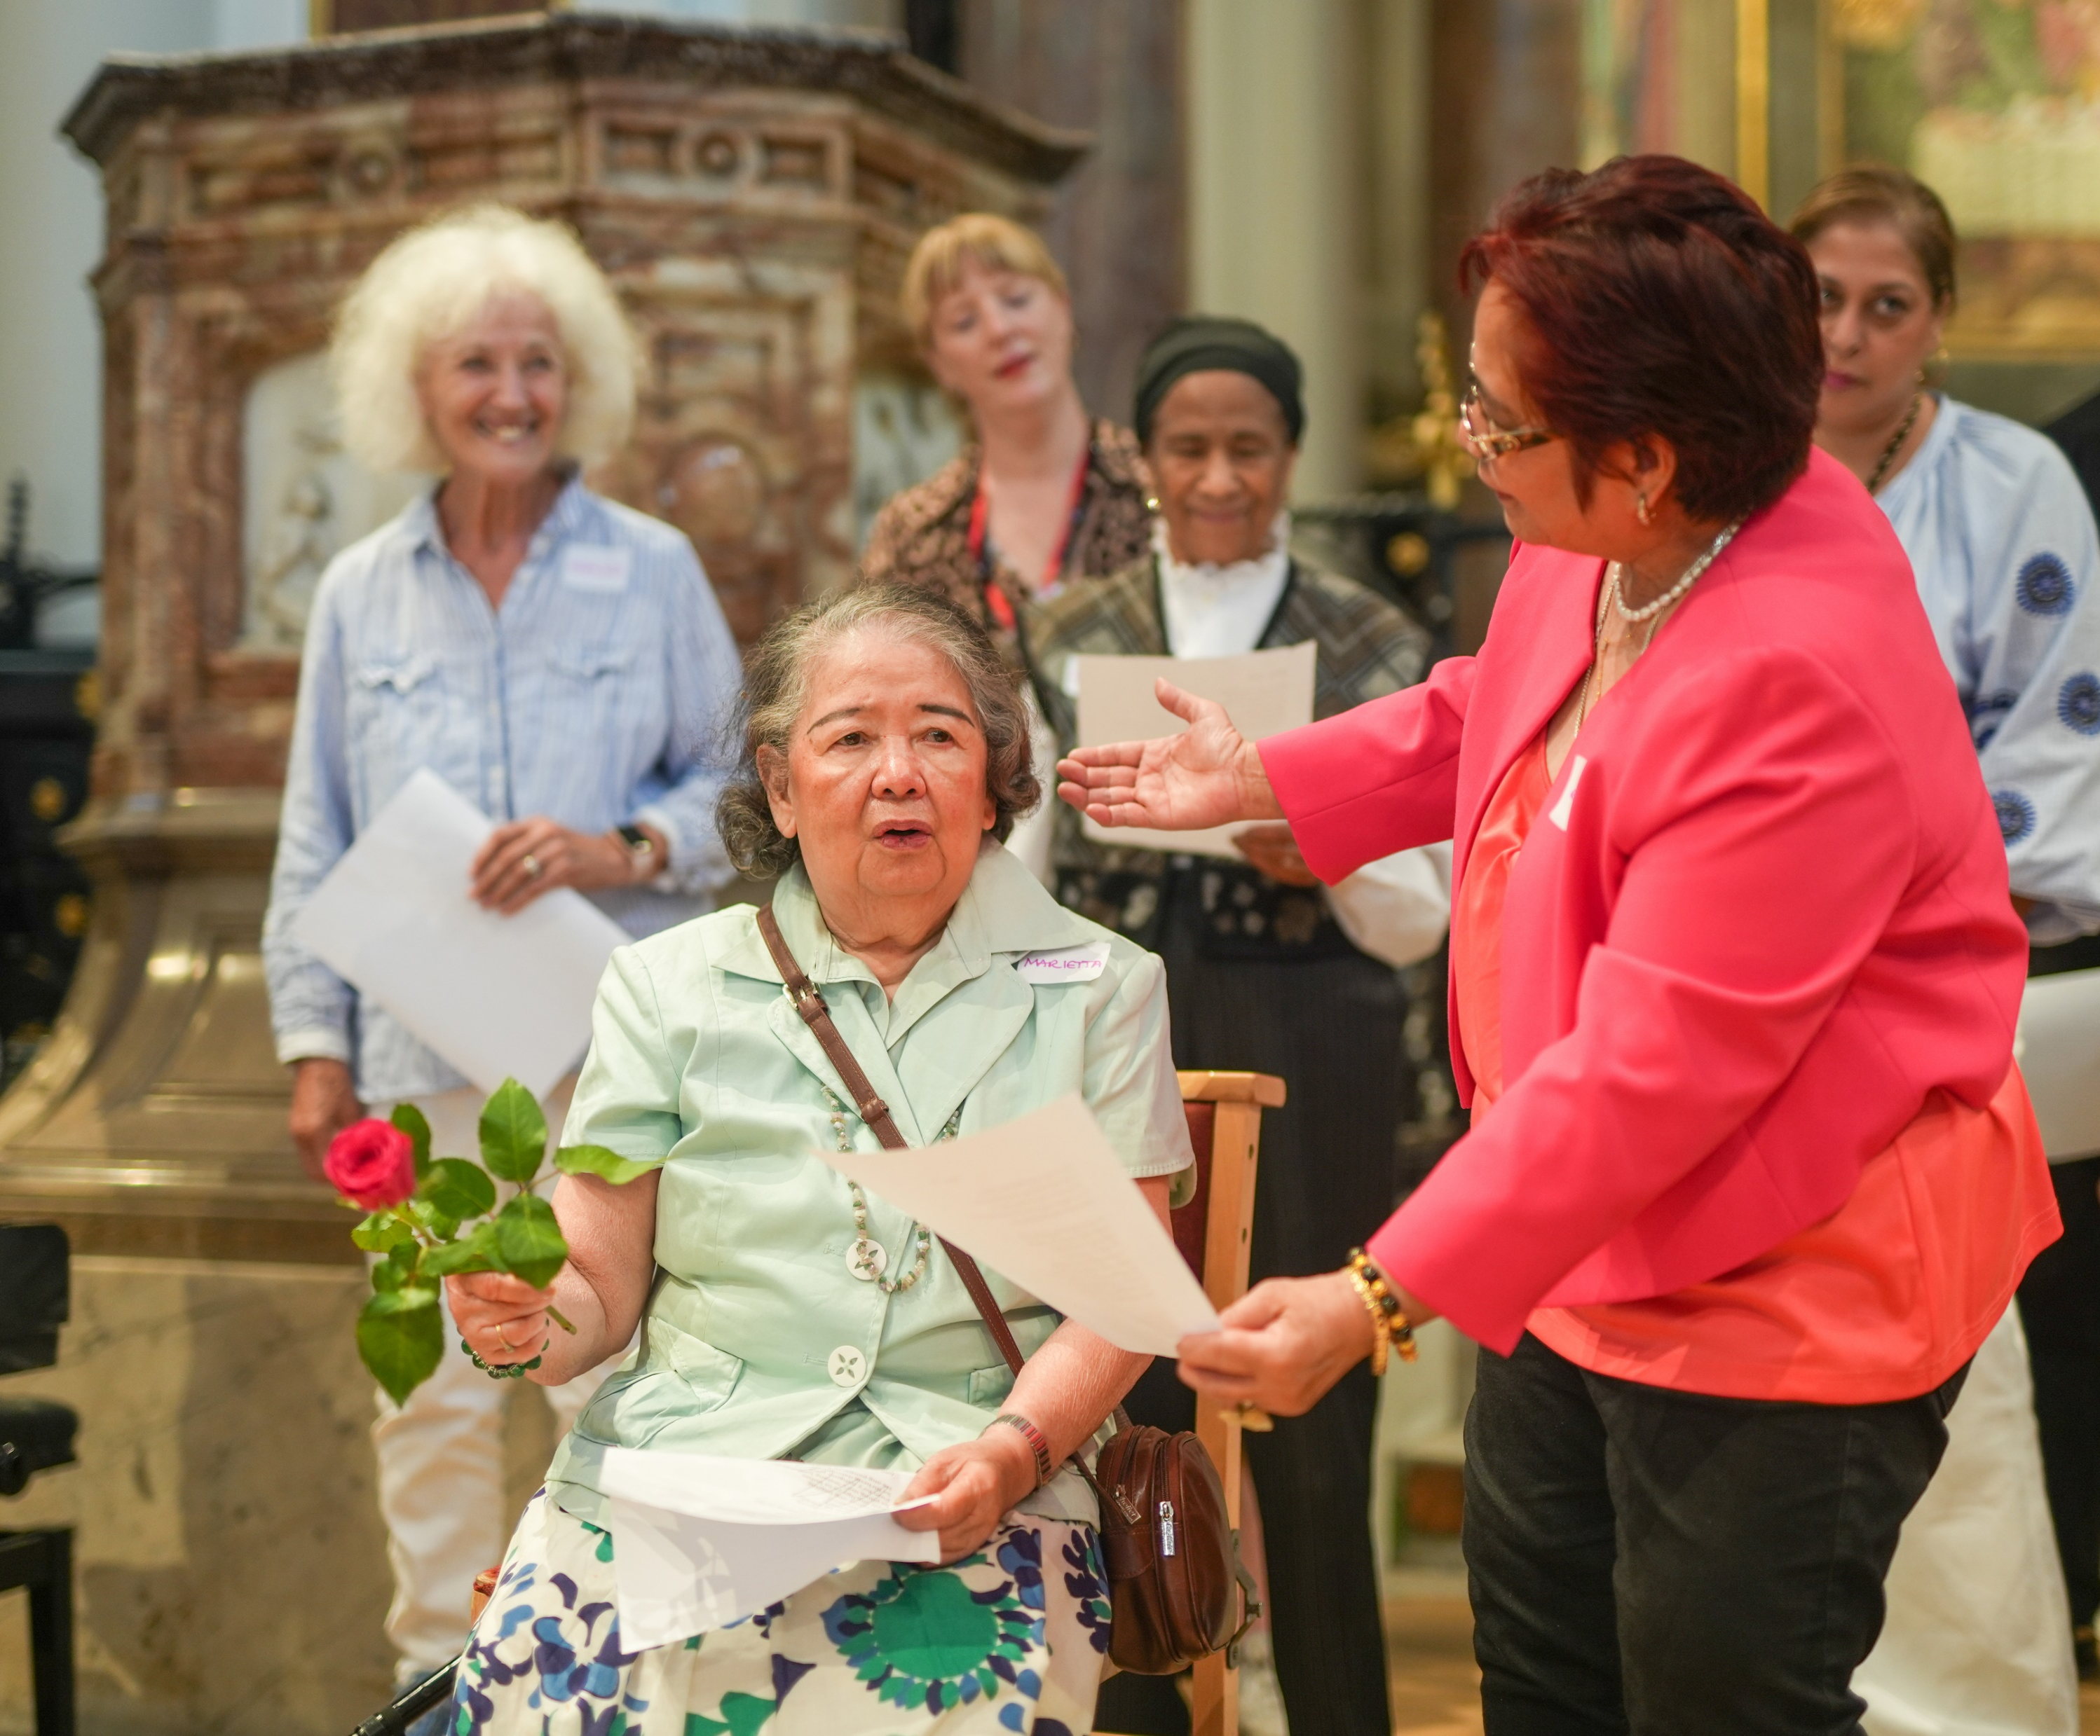
Singing with Friends: choir
-Wigmore Hall
& Zoom
-Weekly
-Tuesdays

Slide 6
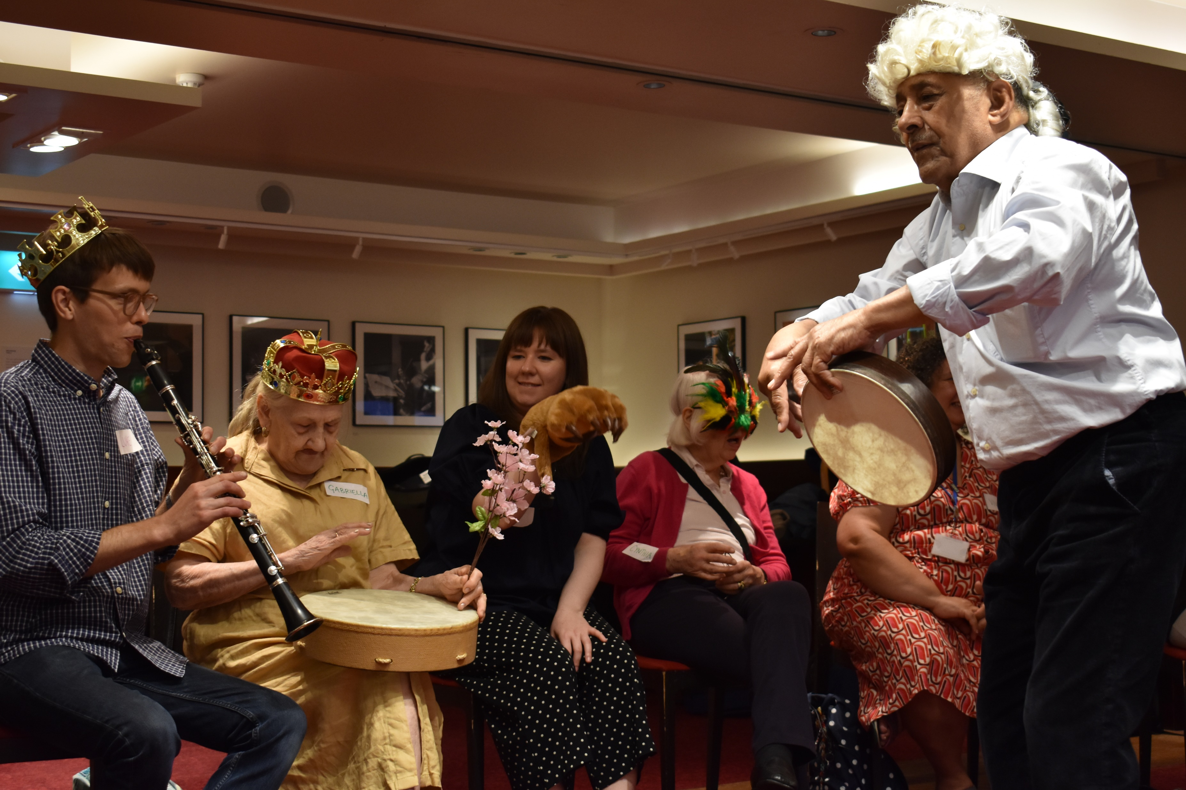
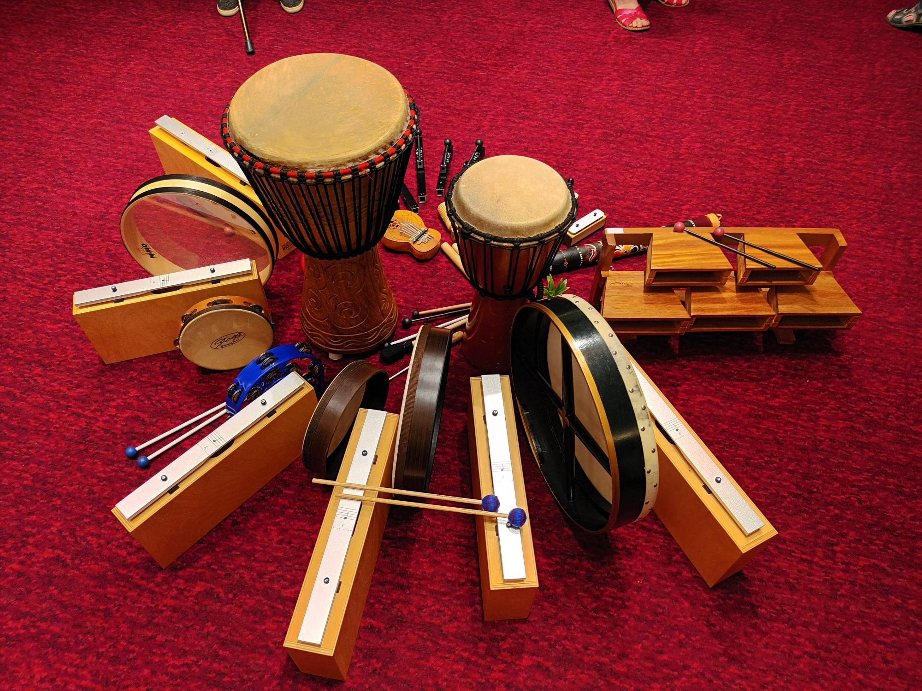
Music for Thought
-Wigmore Hall
-4 sessions
-3 times per year

Slide 7
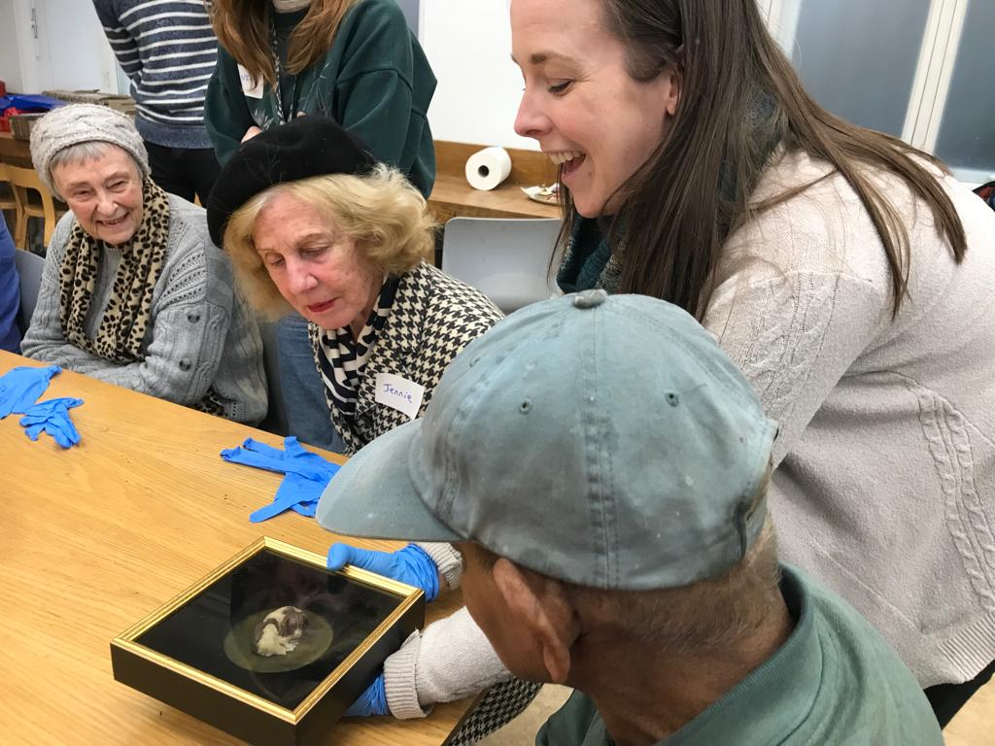
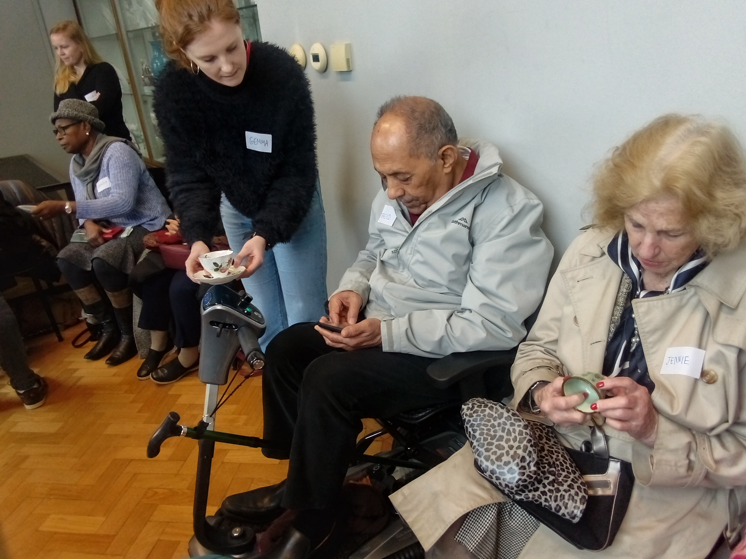
Cognitive Stimulation Therapy
-V&A Museum
-14 sessions
-Annually

Slide 8
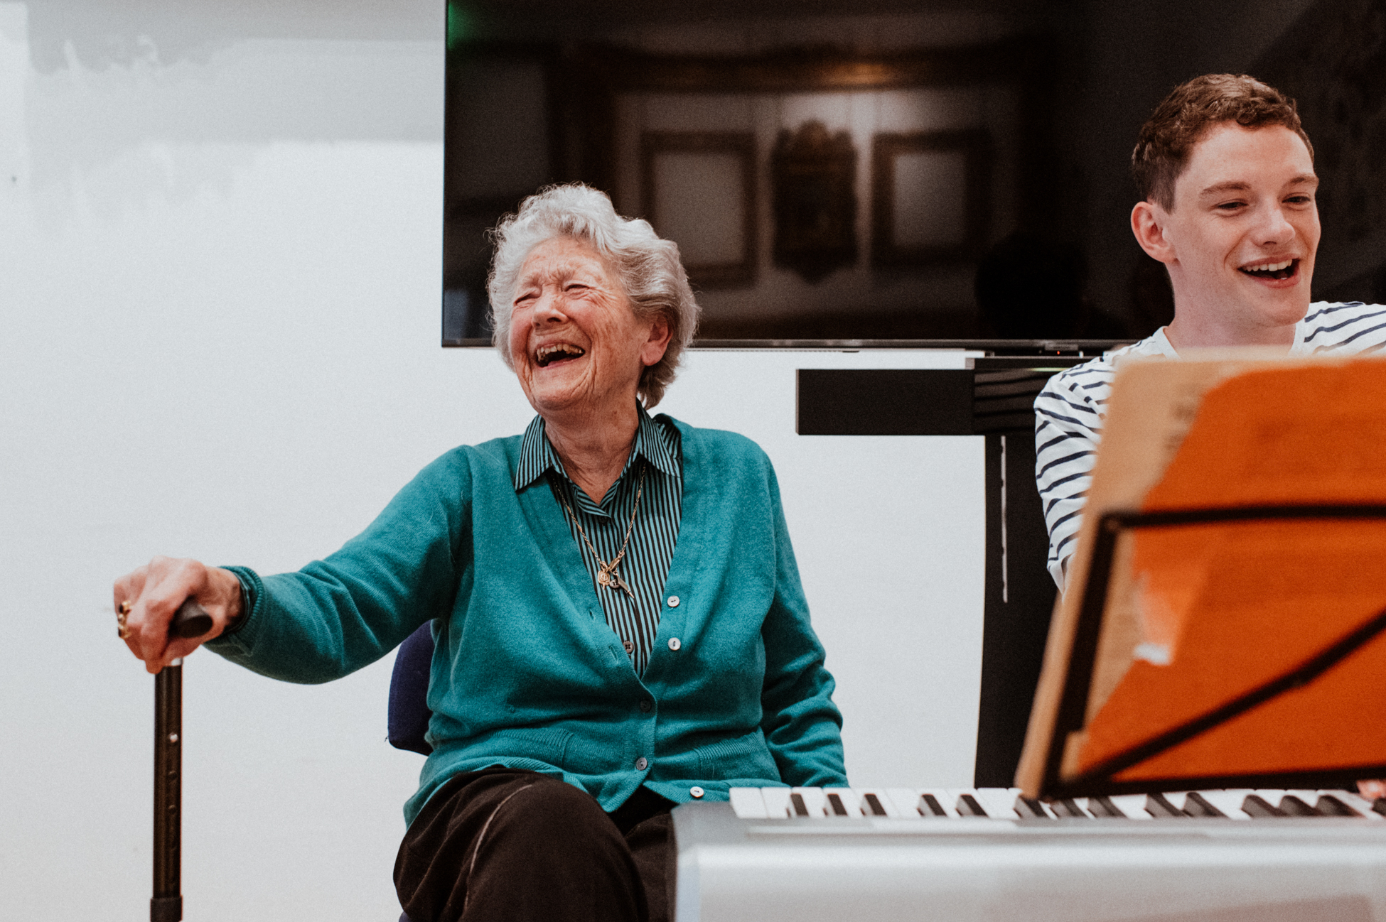
Creative
Befrienders
1-to-1 volunteer befrienders visiting people in their homes

Slide 9
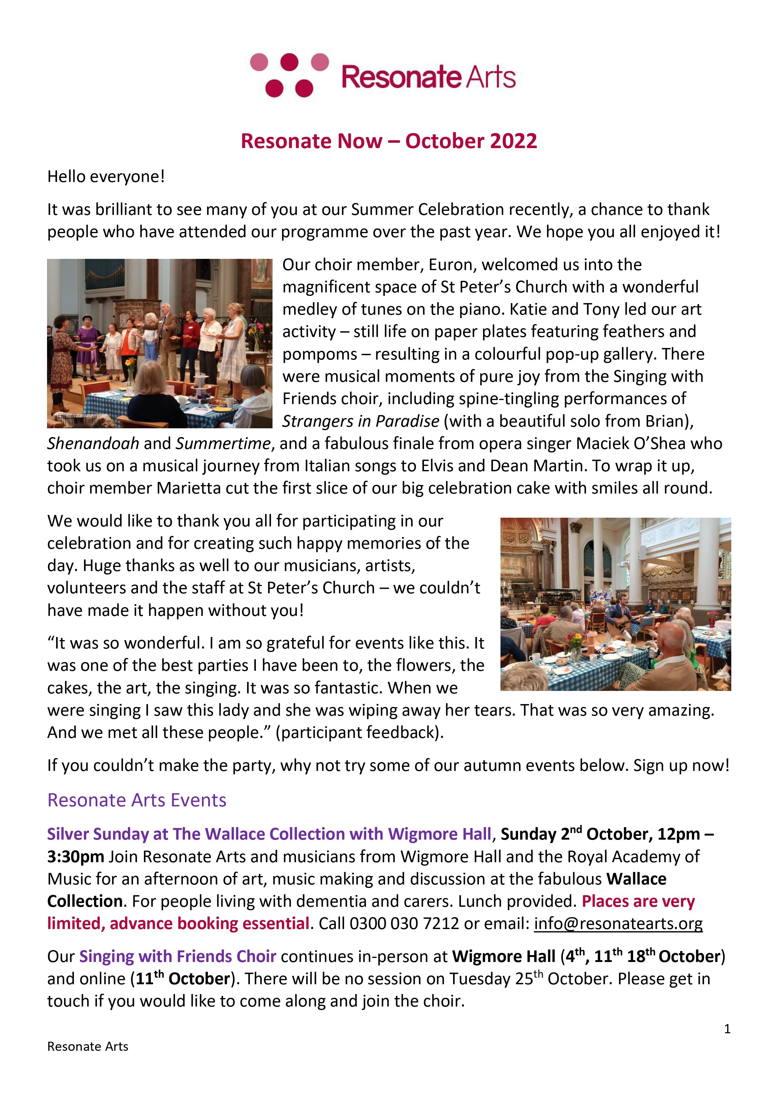
Resonate Now
Monthly newsletter and dementia friendly events listings
Westminster
Kensington and Chelsea

Slide 10
Quotes from our participants
'I love these sessions they make me think differently, please ask me to the next one.’
'We want to come because we know you will be there and that means we will have fun and be okay!’

Slide 11
Quotes from our participants
‘Resonate have never before organised a party like that. It was so wonderful. I am so grateful for events like this. It was one of the best parties I have been to, the flowers, the cakes, the art, the singing. It was so fantastic. When we were singing I saw this lady and she was wiping away her tears. That was so very amazing. And we met all these people.’

Slide 12
Quote from a carer
‘As a carer I took away the laughter and joy I could hear coming from the room. The camaraderie, the happiness that isn’t over-flowing for us at home. It brought a sense of community, and these are invisible people ,but everybody that took part was made to feel very special. It was like they were opening a Christmas present every week.’

Slide 13
www.resonatearts.org
Tel: ​0300 030 7212
E:info@resonatearts.org

