Slide 1
Compassionate care for all
Improving adult community specialist palliative care services for all residents in north west London
NHS North West London Residents Forum
11 December 2024

Slide 2
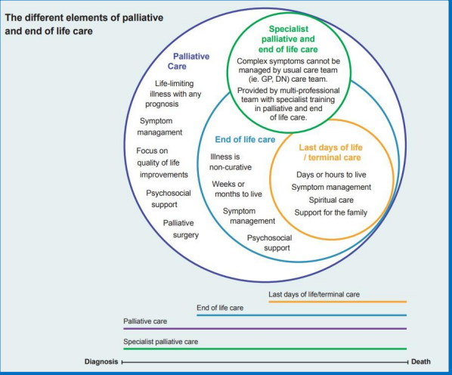
What is community specialist palliative care?
Community Care
- Care outside of hospital
- Usual place of residence
- Home
- Care home
- Hospice

Slide 3
Why are we consulting on specialist palliative care?
National and local priority: Palliative and end-of-life care is a key focus for the NHS and the North West London ICS. Current fragility: Community-based specialist palliative care for adults (18+) is the most fragile part of the pathway. Review objectives (since late 2021): Improve access, quality, and consistency of specialist palliative care services. Address health inequalities, population changes, and workforce challenges. Tackle financial pressures and align services with national policies. Pembridge Unit beds: Consultation includes determining the future of inpatient beds suspended since 2018 due to staffing challenges. Ongoing Pembridge services: Specialist day services, outpatient services, rehabilitation, and 24/7 advice line remain operational. Why focus on specialist palliative care? Concentrating on this area ensures sustainability and improvement of services currently under the greatest strain. This approach also lays the groundwork for broader enhancements to end-of-life care pathways in the future.
Notes:
This slide still does not explain WHY specialist palliative care and not the whole pathway? We have had this question consistently since starting especially from our acute providers, community providers, and residents. Issue papers says its because it’s the most fragile

Slide 4
What we are consulting on: proposed key improvements
The highlights:
A specialist palliative care nursing team available 12 hours a day (8am to 8pm), 7 days a week, across all 8 boroughs.
24/7 specialist palliative care telephone support for all north west London residents whether known or not to the services.
Hospice at Home services available for all 8 boroughs 24/7
Specialist palliative care outpatient clinics in all 8 boroughs.
Improved access to psychological and bereavement support for families for all 8 boroughs
Expanded lymphoedema services for conditions related to both cancer and non-cancer causes for all 8 boroughs.
46 new enhanced end-of-life care beds across north west London, providing additional care options for those whose needs can not be met at home but do not require hospice inpatient care.
Maintaining the 57 consultant-led hospice inpatient beds currently available, which our analysis shows will meet community needs over the next five years.
Notes:
A community specialist palliative care nursing team, supported by a specialist palliative care consultant, who are available 12 hours per day (8am to 8pm), 7 days per week in all boroughs.
24/7 specialist palliative care telephone advice line available to anyone in north west London
Hospice at Home care services available 24/7 in all boroughs
Specialist palliative care consultant and specialist palliative care nurse-led hospice outpatient clinics available in all boroughs
Lymphoedema services for both cancer and non-cancer causes in all boroughs. Lymphoedema is a long-term condition where a build-up of lymph fluid in your body's soft tissues causes swelling.
Improved access to psychological and bereavement services at local hospices for all boroughs
Opening 46 new enhanced end-of-life care beds which will be available to residents of all boroughs (building on the 8 beds currently available in Hillingdon). These beds seek to prevent hospitalisation of people whose needs mean they cannot be cared for at home but they do not require the intensive specialist palliative care provided in a hospice inpatient bed. The enhanced end-of-life care beds are supported by health and care professionals with enhanced end-of-life care knowledge and skills and the community specialist palliative care team on a weekly basis.
Keeping open the current 57 consultant-led specialist hospice inpatient beds. This is the same number of beds that are open now (this does not include the inpatient specialist palliative care beds at the Pembridge Hospice, which have remained suspended since 2018). We have undertaken north west London wide analysis which supports that 57 beds will meet the needs of our population for the next 5 years.

Slide 5
Enhanced end of life care beds
Proposed expansion of NHS-funded enhanced end-of-life care beds across all eight boroughs in North West London to support patients with moderate end-of-life needs.
These beds fill a gap for patients whose needs cannot be met at home but do not require highly specialist inpatient hospice care.
Beds will be closer to residents, making it easier for family and friends to visit. Location to be determined but likely to be in a care home, nursing home or NHS community site.
Reduces hospital admissions at the end-of-life for those who do not wish for this and preserves specialist hospice beds for the most complex cases.
Supports people’s preferred place of death while enhancing comfort and wellbeing at the end-of-life.
Increase from only eight beds currently available in Hillingdon to 54 beds across the boroughs, based on population.
Notes:
Enhanced EoLC beds
Case for having them:
approximately 36,000 people on the end-of-life cohort and that 10,800 people on this cohort were admitted to hospital in the last 12 months with an equivalent of 210 hospital beds occupied by this group each year.
48% of deaths occurred in hospital and national survey findings tell us this is not the preferred place of death for most. This suggests further opportunity to prevent hospitalisation at the end-of-life in north west London.
Our analysis suggests that the reasons for this includes that patients are admitted to hospital because there is not the right type of bed, in the right place, to meet their needs in a community setting:
The percentage of deaths with three or more admissions in the last 90 days of life for all ages and those aged 75+ years is significantly worse in north west London than England .
Deaths in hospital across north west London are significantly higher than England levels, but falling .
The case for enhanced EoLC beds also responds to an acute hospital discharge peer review of delayed discharges in 2023. The review showed there was a group of people who had no viable alternative to where they could be discharged from hospital to as hospice inpatient units and the patient’s own home were considered inappropriate.

Slide 6
The two options we are consulting on
Following a long-listing, short-listing, appraisal and assurance process, we are consulting on the two options below:
Option A (North West London Integrated Care Boards preferred option): Full implementation of the new model of care with Pembridge Palliative Care Inpatient beds not reopening
Fully implement the new model of care, including the 46 new enhanced end-of-life care beds, while maintaining the existing hospice beds without reopening the Pembridge Hospice inpatient beds. This option would be easier and quicker to implement and benefit more north west London residents as a whole.
Option B: Full implementation of the new model of care with Pembridge Palliative Care Inpatient beds reopening
Fully implement the new model, including 46 new enhanced end-of-life care beds and the reopening of Pembridge Hospice inpatient beds. This would require a reduction in other north west london specialist palliative care in-patient hospice beds and result in a loss of income for charitable hospices. It would also have a longer implementation timeline due to the need to recruit specialist palliative care consultant and 35 additional staff.
In addition, we are focused on delivering care that is equitable, personalised, and integrated care that is compassionate, culturally sensitive, and easy to navigate, while providing clear information, better support for patients and families, and improving access to bereavement services.

Slide 7
Progressing the agreed enablers to support the implementation of the new model of care
Whatever the outcome of the consultation we are committed to improving our specialist palliative care services.
The model of care working group ( which included 12 patients) agreed five enablers which are essential to support the implementation of the new model of care.
We are establishing a working group for each enabler, with representatives from across north west London including patients to coordinate work, reduce duplication and improve standardisation and access to resources.
Reducing inequalities workstream
Workforce development workstream
Digital, data and technology workstream
Organisational development workstream
Leadership, governance and integration workstream
Notes:
Establishment of the task and finish groups will be staggered to manage resources and to allow for continuous learning and refinement. It is proposed that the reducing inequalities group be established first. The next steps for the ICB will be to gather expressions of interest from those who would like to be part of this task and finish group.

Slide 8

Further information
For further information and link to the questionnaire visit www.nwlondonicb.nhs.uk/cspc

