Slide 1

Making stroke research work for everyone
Dr Jennifer Crow (Research Occupational Therapist)
06/08/2026

Slide 2

Background
In many cases stroke can be prevented.
Stroke in people under 55 is increasing.
No decrease in second stroke since 2005.
World Stroke Organisation, 2025
Notes:
Why is improving stroke care and services important?

Slide 3

BUT …… Stroke does not affect everyone equally
      More common in Black and South Asian communities
      Regional factors – shape risk, medical access, and recovery
      Lowest socio-economic groups
      Low levels of literacy and English second language
Notes:
People from the lowest socioeconomic groups have strokes 7 yrs earlier than people from more affluent communities. Low levels of literacy are a risk factor for stroke and lack of English proficiency leads to poorer quality of care and health outcomes.

Slide 4
Changes in who is affected by stroke
 | 1995 | 2024
Age | 73 | 67
Ethnicity:
White | 75% | 49%
Black Caribbean | 12% | 18%
Black African | 6% | 22%
Other | 6% | 12%

Slide 5

What is healthcare research?
It is about learning how to make healthcare better for all.
Preventing strokes.
Early diagnoses and better treatment.
Improving recovery and quality of life.
Making access to healthcare services fairer, safer and more effective.

Slide 6
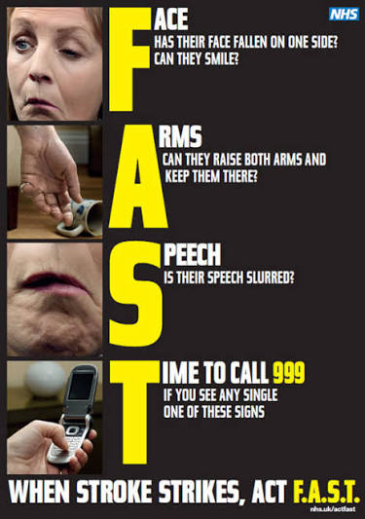
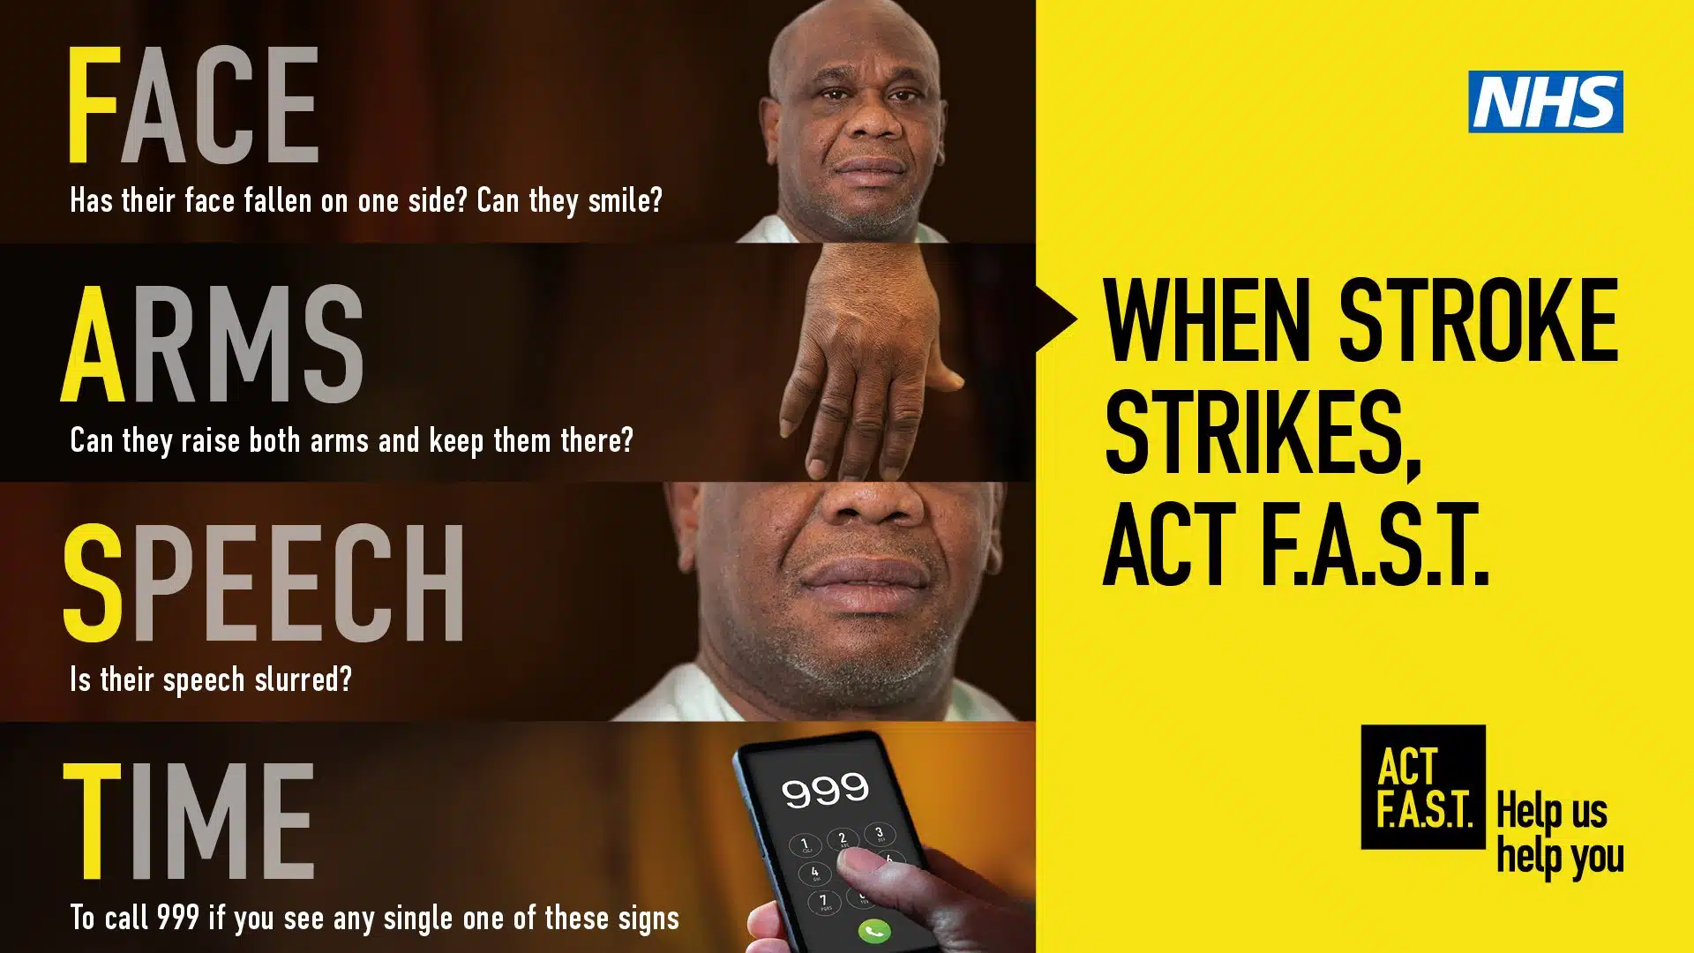
FAST campaign
Notes:
Launched in 2009 in England

Slide 7

Greater Manchester
Notes:
Greater Manchester has a large Pakistani and Bangladeshi population and the National F.A.S.T. campaign for stroke failed to increase awareness among these communities. Just translating the National F.A.S.T campaign into languages was not enough.
Firstly, the word stroke didn’t make sense, and it was often confused with heart attack so the communities said it needs to be called a brain stroke.

Slide 8

The advert needed to resonate with the target audience
Notes:
Who were older Bangladeshi and Pakistani’s. Guided by people from these communities they developed a culturally appropriate and relatable education campaign based on street plays which were popular in rural Bangladesh and Pakistan before TV and the internet. The advert used the same patterns, colours, music and style along with visually demonstrating the signs of stroke on the body.
They created a TV advert in this uniquely South Asian style and used a characteristic rhyme and rhythm to help remember the message. The advert was aired on ethnic TV channels, in local languages.

Slide 9

Why does it matter who takes part in research?
To make sure the treatments, services and care work for people from all backgrounds.
Women and people from different ethnic communities have different experiences of health, illness and recovery.
If some groups are missing from research, we cannot be confident that the findings will benefit everyone.
Better representation means better, fairer healthcare for all.
Notes:
The FAST example shows the importance of involving the right people in research

Slide 10
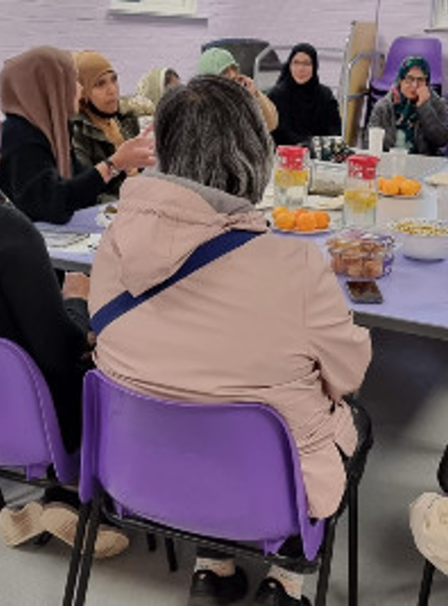
Our goal:
To make taking part in research easier, more welcoming and more inclusive …. so that improvements in healthcare can benefit everyone
Notes:
We are looking for people to partner with us.
What makes it difficult for people to take part in research?
What could researchers do differently?
How can we make research more welcoming and inclusive?
How can we make sure everyone's voice is heard?

Slide 11

Your experiences and ideas can help make research better for everyone
We'd love to hear from you.
You don’t need to have taken part in research before.
Contact: Jenny Crow
Mobile: 07795826663
Email: j.crow@imperial.ac.uk

Slide 12
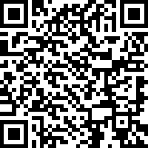
Interested in getting involved or finding out more?
Please find the expression of interest form link here: https://imperial.eu.qualtrics.com/jfe/form/SV_24v6wwsuoZfPCT4
AND the QR code.

Slide 13

Some of the ways you could get involved:
1 to 1 chat – in person, online, over the phone
Meeting locally with you and your family
Taking part in a community group – online or face to face
Working with us to create solutions
One off or ongoing involvement
Your time and travel expenses will be reimbursed
Notes:
We are looking for people to partner with us

Slide 14
