Slide 1
Acute mental health services in Westminster and Kensington & Chelsea
BAME Health forum
13th December 2023

Slide 2

Purpose of today’s session
To share information about proposed changes to acute mental health services and why we think these changes are necessary
To understand your views about these proposals and how these changes could impact the people you support
To hear any alternative proposals that could be considered to improve services for people with serious mental health needs

Slide 3
Consultation process
Preparation for consultation
Public consultation
Decision
March to October 2023
October 2023 to 30 January 2024
By April 2024
Considered local needs
Worked up options with clinicians
Tested options with local stakeholders
Engaged with service users and carers
Tested options with clinical experts
Selected preferred option
Run public engagement events to hear views
Conduct focus groups with specific populations who may be disproportionately impacted
Gather responses to the consultation questionnaire
Further engagement with local stakeholders
Read all responses to consultation
Develop decision making business case considering consultation responses
Formal decision on future made by the Integrated Care Board

Slide 4

Ways to feedback to consultation
The public consultation will run for 14 weeks from
24 October 2023 and 30 January 2024.
To give your views, you can:
Complete the public consultation questionnaire available at:
www.nwlondonicb.nhs.uk/acuteMHconsultation
You can also download and print a paper copy of the questionnaire, complete it, and send it to us:
FREEPOST, HEALTHIER NORTH WEST LONDON (no stamp needed)
Write to us or send us an email
You can share your views without completing the questionnaire. If you are feeding back on behalf of an organisation, please state the name of the organisation in your letter or email.
Invite the programme team to speak to your group or organisation or to request leaflets
Please contact the consultation team 07535 697364.
Come and talk to us
We are holding public meetings both face to face and online. Full details of all events and engagement activities are available on the North West London Integrated Care Board (ICB) website:
www.nwlondonicb.nhs.uk/acuteMHconsultation
)

Slide 5
Scene setting
Why change is necessary

Slide 6
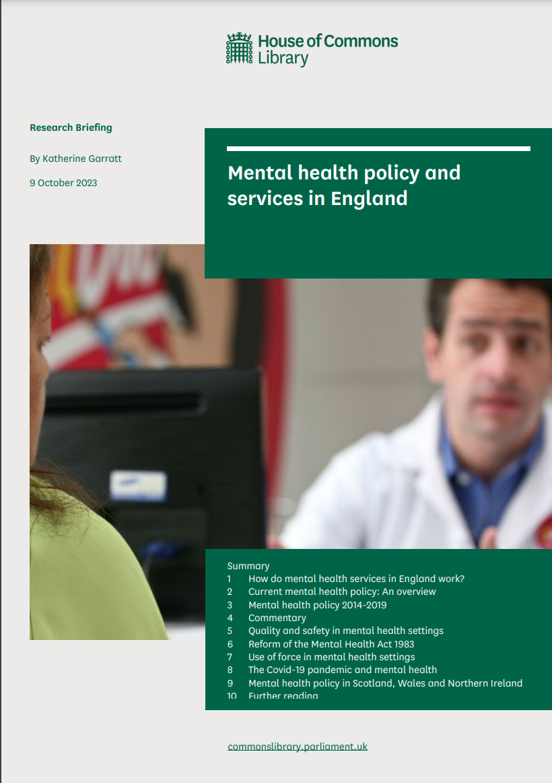


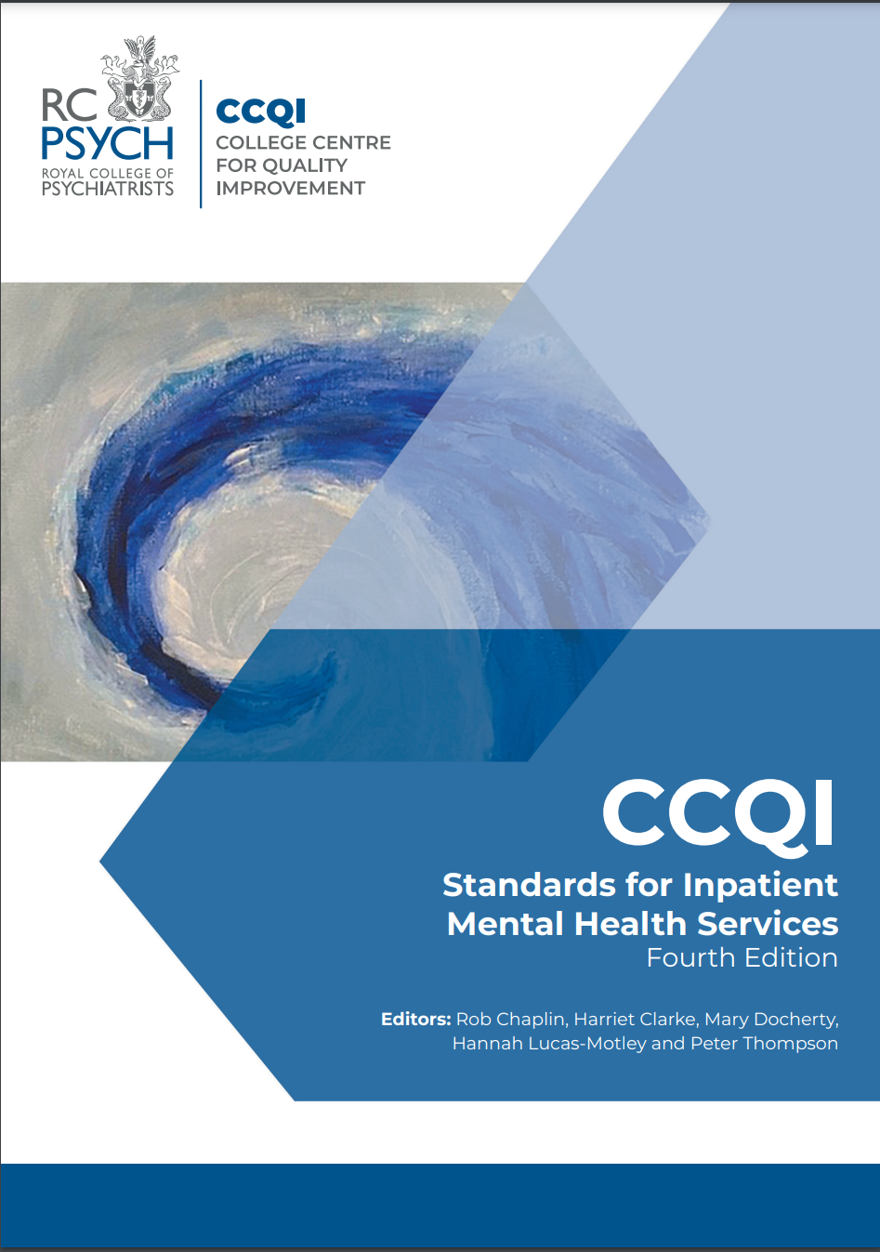

Change is necessary because …
National reviews and reports agree that inpatient care should be reserved for people whose needs cannot be met in a less restrictive setting. This results in better outcomes for patients
National policy aims to shift from inpatient care towards community-based services – both to provide an alternative to admission, and to enable swifter and better supported discharge from inpatient care.
The Royal College of Psychiatrists have developed core standards for inpatient care, including for the ward environment. Key principles include -
Effective community-based alternatives to inpatient care should be prioritised over institutionalised hospital care where there is a choice and it safe to do so.
It is unacceptable for anyone with a need for inpatient provision to experience their care in an environment which is not fit for purpose or is in any way “an obstacle to the delivery of therapeutic care”.
OR
3 Inpatient Wards 51 inpatient beds
2,193 people in the community
Doubling caseloads across hubs
52 Local VCSE Partnerships

Slide 7
Change is necessary because …
The evidence is that people with mental health illness recover more quickly when they are closer to home and near their friends and family. This the feedback we have also heard from service users
Some patients have told us that they find restrictive admissions to hospital upsetting and traumatising
We want to keep the mental health community services we have developed and strengthened since 2020
NHS has finite resources, so we need to spend it as effectively as possible

Slide 8
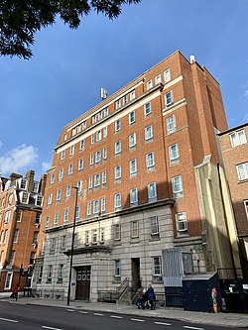
Change is necessary because
The Gordon Hospital
The temporary closure of the adult inpatient wards at the Gordon in 2020 required us to rapidly advance our closer to home plans
The 51 inpatient beds at Gordon Hospital were closed during the pandemic due to
  Increased risk of infection in confined spaces on inpatient wards. The outdated Gordon environment was a particular high risk setting for infection with its shared bathrooms and limited outdoor space
  Greater risk of COVID for Mental health patients resulting in poorer outcomes due to co-morbidities

Slide 9
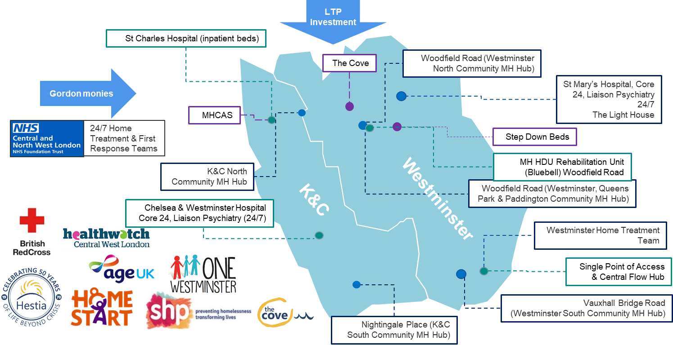
We have significantly strengthened and expanded community and crisis alternative services, enabling us to support 300% more patients across both boroughs
We are now treating 700 patients/ month rather than 200 patients/ month

Slide 10
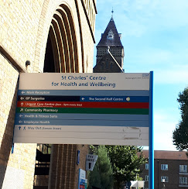
We have modern, high quality inpatient facilities at St Charles
St Charles
The St Charles Centre for Health and Wellbeing is in RBKC offers a better high quality, modern environment for patients. It provides four wards with a total of 67 beds.
It meets the standards recommended by the Royal College of Psychiatrists including
Ensuites in all the rooms
Direct access to outside space from all wards

Slide 11
Developing options for consultation

Slide 12
How we developed options
We developed different options through working with clinicians, partners from across health and social care – including local authorities, the police, and representatives from voluntary organisations and residents with lived experience of mental health issues.
We considered different combinations of inpatient and community-based models of care with the aim to meet the needs of as many people as possible.

Slide 13


The Options …
 | The Gordon Hospital | St Charles | Wider services | Brent
Option 1 – 2019 Model | 51 inpatient beds Meet “safe” standards, but not “desired” standards, due to the constraints of the building | 67 inpatient beds | Community and crisis services developed since March 2020 would be reduced or stopped entirely Mental Health Crisis Assessment Service Community Access service Voluntary sector partnerships Step down beds Health Based Place of Safety at St Charles | Less additional capacity created in Brent than in our preferred Option 3, so some of the beds at St Charles would still be used by Brent residents
Option 2 – Partially transformed model | 13 inpatient beds in single ward | 67 inpatient beds | Community and crisis services would be reduced, including closure of the Mental Health Crisis Assessment Service, with its staff moving to support inpatient care | Less additional capacity created in Brent than in our preferred Option 3, so some of the beds at St Charles would still be used by Brent residents
Option 3 – fully transformed model, with enhanced Crisis assessment service – This is our preferred option | No inpatient beds MHCAS service expanded and relocated to the Gordon Hospital with capacity for 12 patients, including the capability for 4 patients to be admitted overnight | 67 inpatient beds | Retain the community and crisis services developed since the Gordon Hospital wards were closed, voluntary sector partnerships would remain in place and the Community Access Service (CAS) would continue | Additional capacity in Brent would free up seven beds at St Charles for residents of Kensington, Chelsea and Westminster

Slide 14
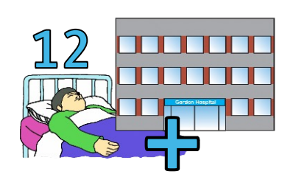
The Mental Health Crisis Assessment Centre
What is MHCAS?
Mental Health Crisis Assessment Service (MHCAS) is based on a model developed in Camden and Islington, and was launched as a local pilot at the St Charles Hospital during the winter of 2022-23.
The MHCAS provides a therapeutic location for people in a crisis to be assessed by a multi-disciplinary team. It seeks to provide an alternative to A&E departments.
The MHCAS will operate 24/7, 365 days a year and have capacity to support 12 patients at any one time and the ability to admit 4 patients overnight.
The proposal is to extend and relocate the MHCAS to the Gordon Hospital.

Slide 15
Preferred Option
Continue with full range of community-based services
No inpatient beds at the Gordon Hospital
Keep 67 inpatient beds at St Charles (as now)
Move the Mental Health Crisis Assessment Service (MHCAS), piloted at St Charles, to the Gordon Hospital, and expand the service to assess and support 12 patients at any one time including 4 beds for patients to be stay overnight

Slide 16
Any Questions or Comments

Slide 17
Help spread the word
The public consultation will run for 14 weeks from
24 October 2023 and 30 January 2024.
To give your views, you can:
Complete the public consultation questionnaire available at:
www.nwlondonicb.nhs.uk/acuteMHconsultation
You can also download and print a paper copy of the questionnaire, complete it, and send it to us:
FREEPOST, HEALTHIER NORTH WEST LONDON (no stamp needed)
Write to us or send us an email
You can share your views without completing the questionnaire. If you are feeding back on behalf of an organisation, please state the name of the organisation in your letter or email.
Invite the programme team to speak to your group or organisation or to request leaflets
Please contact the consultation team 07535 697364.
Come and talk to us
We are holding public meetings both face to face and online. Full details of all events and engagement activities are available on the North West London Integrated Care Board (ICB) website:
www.nwlondonicb.nhs.uk/acuteMHconsultation
)

Slide 18
Thank you

