Slide 1
NHS Community Health Services in Westminster
Richard McKinlay
Jo Davis
Gina Casserly
March 2026

Slide 2

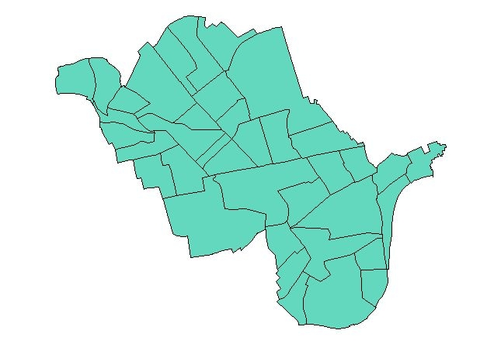
District Nursing
Neuro-rehabilitation
Service
Stroke Services
Falls Prevention
Bedded Rehabilitation
Night Nursing
Post Covid Service
Specialist Palliative Care
Nutrition & Dietetics
CLCH Services in Westminster
Continence
Podiatry
Tissue Viability
Diabetes
Community Matrons
Learning Disabilities & Autism
Childrens Speech and language Therapy
Complex Children’s Service
Health Visiting
Walk In Centre Soho
Dental

Slide 3
CNWL Community Independence Service
- 0–2-hour response time, available seven days a week from 8am to 10pm (including public holidays).
-Fast access to a full assessment, aim to provide safe clinical care at home which helps people to avoid unplanned hospital admission
-Nurses, Paramedics and Health Technicians
- 2-48 hour and 3-14 day response times
- Up to 6 weeks of rehabilitation in the patients home (housebound patients only)
- Physiotherapists, Occupational Therapists and Rehab Assistants
- Referrals from hospital to help with smoother discharge home
- Patients seen same day as they are discharged at home
- Ensure safety in their home environment
- Provide bridging packages of care#
- Physiotherapists, Occupational Therapists, Healthcare Assistants
Urgent Community Response
Community Rehabilitation
Home First

Slide 4

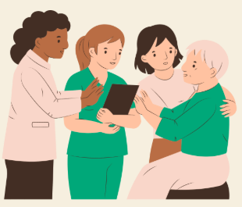
CNWL Mental Health Services
Providing health services in London Boroughs, Milton Keynes and Surrey
Child and adolescent, adult, older adult Mental Health Services
Commitment to involving patients and carers in service development, PCREF, Open Dialogue
Other services: addictions, sexual health, community services
Work closely with third sector partners and other services
Gina Casserly, Westminster Neighbourhood & Innovation Lead CNWL
gina.casserly@nhs.net
Notes:
Mental health services including primary care, community mental health and inpatient wards, e.g., St Charles Hospital
PCREF: embedding cultural competency in practice, collaborating with community partners, carers and patients to improve access to care for global majority.

Slide 5
I would like to… access support
I have not been feeling myself
Assessment
Are you in crisis?
Is it anxiety or depression?
Self-refer to Talking Therapies
2 weeks
No
Yes
Suitable
Yes
Treatment
(6 - 12 weeks CBT or Counselling)
Not sure
Not suitable
Contact crisis services
Speak to your GP
After 3 months
Signposting
Contact local SPA or 111 (select option 2) for advice and support over the phone with professionals.
Contact Samaritans for listening support. Nationwide number: 116 123
Completed treatment
Discharge
Onward Referral
Referral
Specialist teams, e.g.,
CMHH
Eating Disorders
Trauma service
Present at your nearest MHCAS at K&C W10 6DZ
or Highgate N19 5JG
Consultation and referral
Notes:
MHCAS – Mental Health Crisis Assessment Service

Slide 6
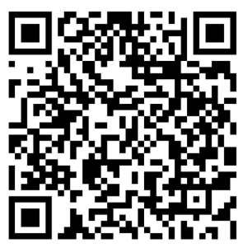
I would like to… learn and understand more about health and wellbeing
Recovery & Wellbeing College
Discovery College
You do not need to be currently accessing CNWL support to attend Recovery or Discovery College courses.
Learn more about mental health and wellbeing
Courses delivered by a professional and Expert by Experience
Courses include: Understanding Anxiety, Diabetes & Wellbeing, Talking about Pain
Online & face-to-face courses
Workshops for young adults (16 – 25)
Co-created with professionals and young adults with lived experience
Courses include: Exploring Identity, Moving on from CAMHS, Understanding Self-harm
Online & face-to-face courses

Slide 7
CLCH Community Neuro Rehab Service
3 Borough based teams delivering goal-lead therapy, including:
Physiotherapy
Occupational Therapy,
Speech and Language Therapy,
Psychology
Rehab Assistant
Primary service users by diagnosis:
Acquired Neurology: Stroke, Brain Injury, Spinal Cord Injury
Progressive Neurology: Parkinsons, Multiple Sclerosis, MND
Rehabilitation pathways:
Early Supported Discharge for Stroke
Specialist Neuro Rehab Outreach – Complex Neuro rehab
Community Neuro Rehab Service Pathways
Evidence of worse outcomes for our service users linked to
Deprivation
Ethnicity
Need for work with communities to address these inequities

Slide 8
Our Contacts for non-patient specific queries
Jo Davis jodavis4@nhs.net
Richard Mckinlay Richard.mckinlay@nhs.net
Gina Casserly gina.casserly@nhs.net

