Slide 1










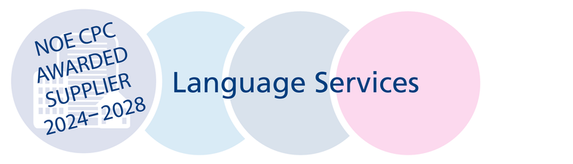
INCLUSIVE INTERPRETING SERVICES FOR ALL COMMUNITIES
PRESENTATION
27th June 2025
Presented by
Michelle Martin & Sarah Hobbs
Notes:
[Smile as you begin to create a welcoming tone]
Good morning, everyone! Thank you for joining us today. I'm Michelle Martin, and alongside me is Sarah Hobbs. Together, we're thrilled to present on behalf of Silent Sounds Communications Ltd.
[Pause briefly, make eye contact with the audience]
We’ll take you through our services, highlighting what makes us unique and we'll have the opportunity to learn some basic BSL signing with Sarah, our Deaf Services Manager

Slide 2

INCLUSIVE INTERPRETING FOR ALL
  Established 20+ years
  British Sign Language (BSL) interpreting
  250+ languages
  Face-to-face, video, telephone interpreting, document translations
  Breaking language barriers and embracing effective communication with a personable and caring approach
Notes:
We began offering British Sign Language interpreting. As we evolved, we expanded our reach, offering interpreting and translations services in over 250 languages, 1000's of dialects. face-to-face, video, telephone, written translations, we offer comprehensive services to meet diverse communication needs.
Our attentive approach and personable demeanour have established us as the UK's trusted provider for interpreting and translation services in the UK.
Our Vision
"To create a world without language barriers by delivering quality interpreting and translation services through effective, streamlined processes with a personal touch, and responsiveness that’s always just a phone call away. We empower individuals and organisations to communicate, collaborate, and succeed in a diverse, global society."

Slide 3



ENSURING QUALITY & TRUST
  All interpreters are qualified, DBS-checked, and assessed
  Random audits and client feedback ensure consistent standards
  Continuous improvement through monthly reporting
  Transparency with communities and partners

Slide 4

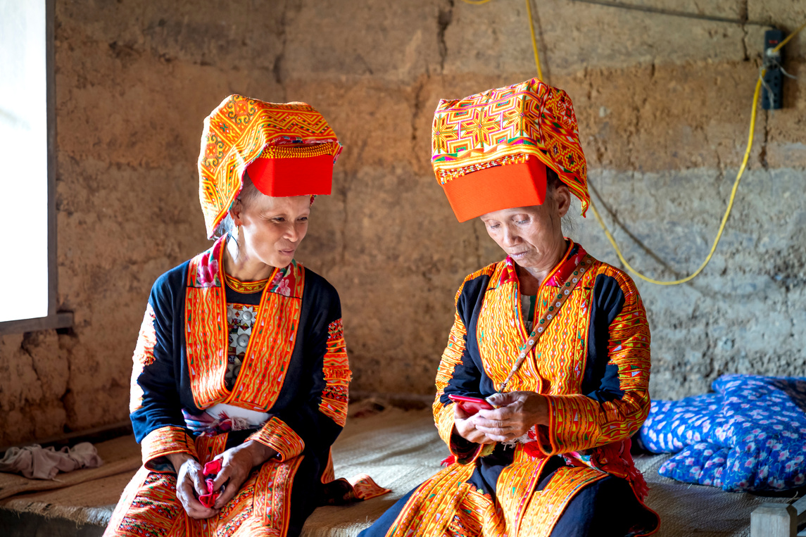
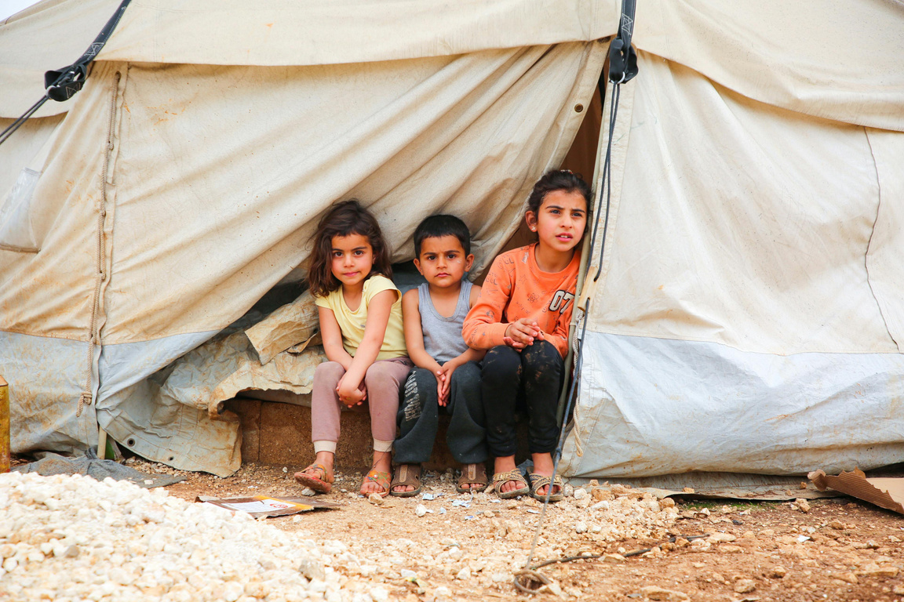
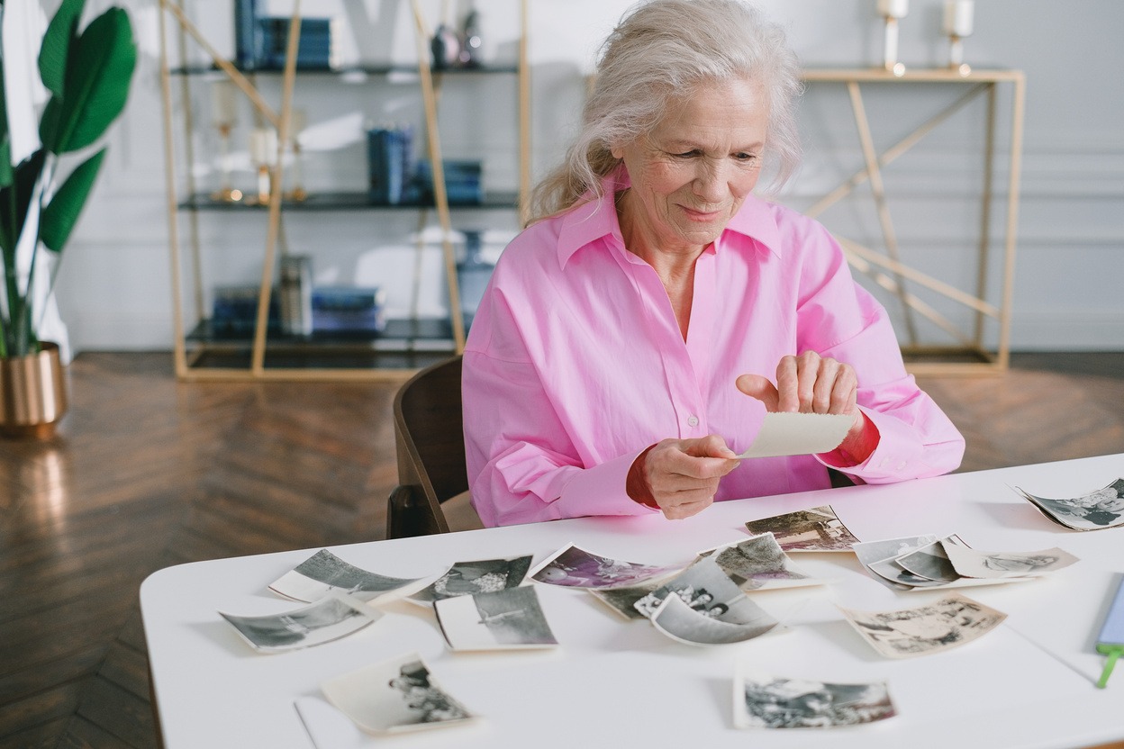
WHO FACES LANGUAGE BARRIERS?
  Ethnic minorities with limited English
  People with literacy or cognitive challenges
Deaf and Deafblind individuals
  Refugees and newly arrived communities

Slide 5


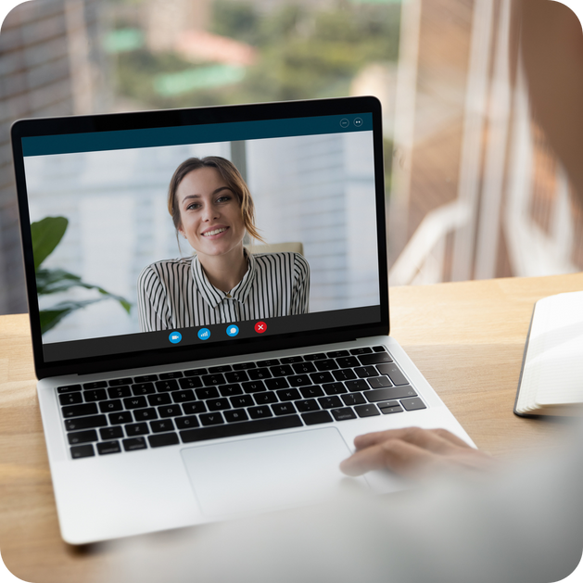
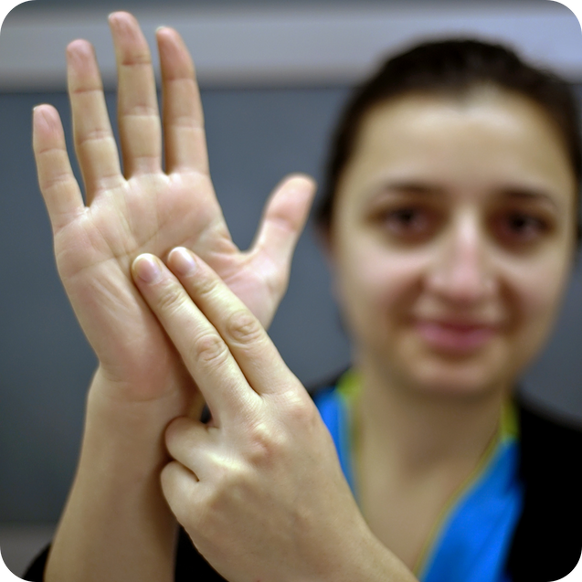

COMMUNICATION EQUITY MATTERS
Professional interpreting is requested tens of thousands of times monthly across the NHS and charity sectors. Demand is growing as awareness and accessibility increase.
Face to Face
400 per day
Telephone Interpreting
1200 per day
Video interpreting
50 per day
BSL
35 bookings daily
Translation service
of docs 20 per day
Notes:
Language shouldn’t block access to healthcare or public services which is why we are on call 24/7 365 days a year
Regular use of interpreting saves lives and improves trust

Slide 6




SUPPORTING OUR INTERPRETERS
  We recruit from the communities we serve
  We invest in ongoing training and professional development
  Competitive rates, respect, and flexible booking
  Providing free CPD hours and trauma-informed support
  Encouraging diverse and multilingual applicants

Slide 7

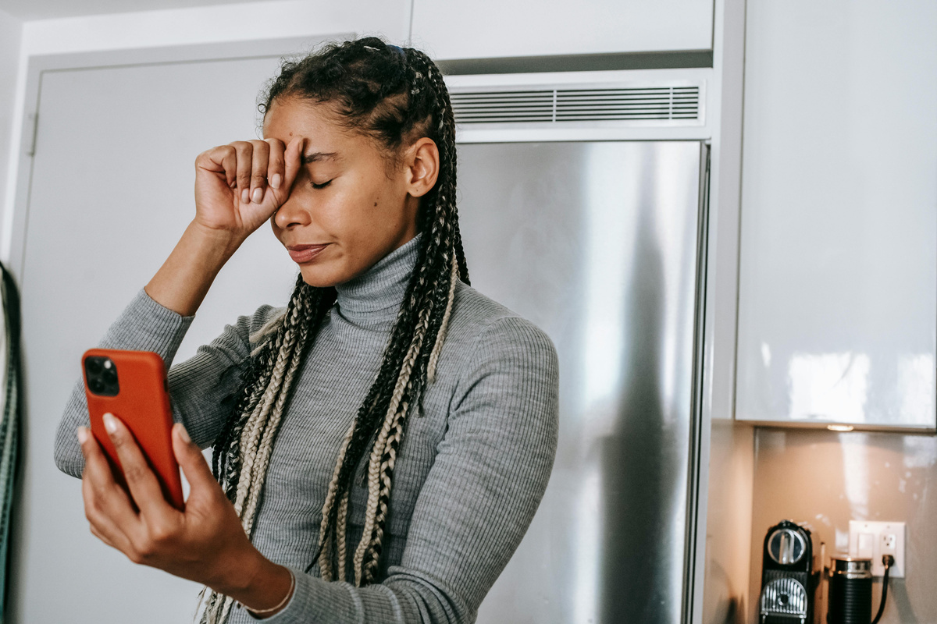


COMMUNITY ENGAGEMENT PROGRAMMES
Deaf Culture Workshops
  Free community events on Deaf identity
Deaf Awareness Training
  Basic BSL for NHS and charity frontline staff
Emergency BSL Interpreting
  15-minute video response service
Sustainability Focus
  Remote interpreting = lower carbon footprint

Slide 8
BSL SIGNS TO TAKE AWAY WITH YOU

Slide 9

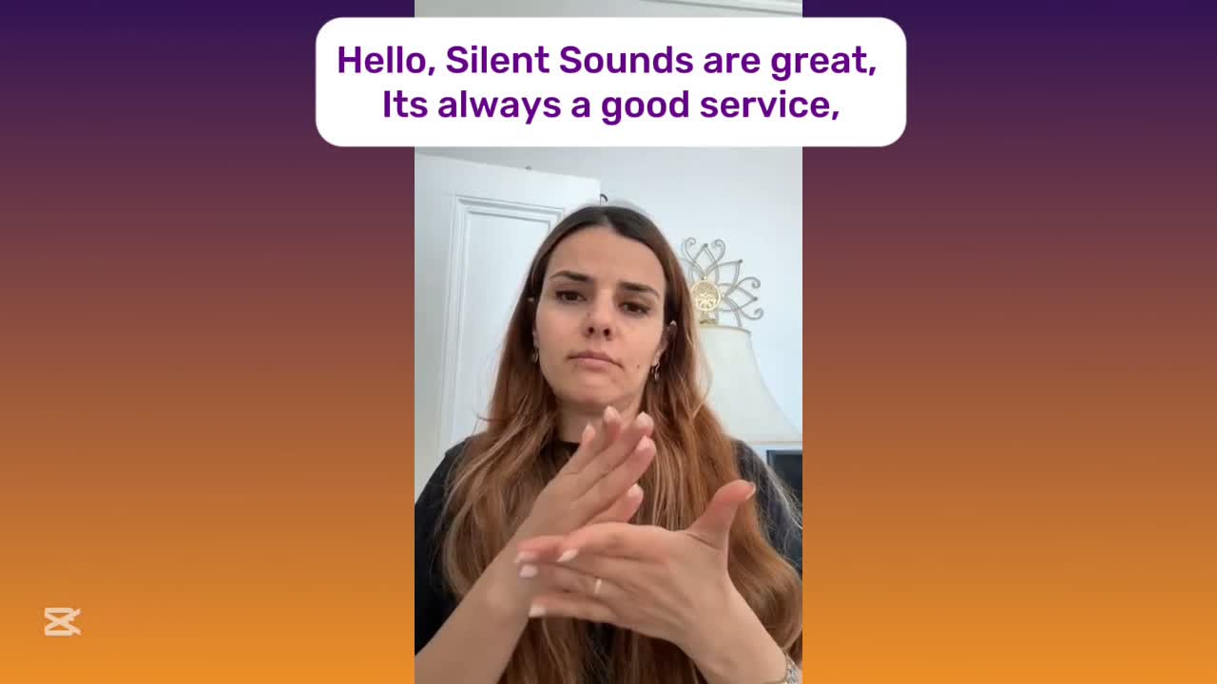
BSL TEAM TESTIMONIALS

Slide 10

THANK YOU FOR YOUR ATTENTION

